Slide 1
RACRA Fall 2017
Oct 24

Slide 2
HB 801 Section 2 Effective Fall Term 2017
STEM postsecondary coursework identified by the BOR of the University System of Georgia in consultation with the TCSG, the Department of Economic Development and private Eligible Postsecondary Institutions
Academically rigorous and required for or leading to employment in high demand fields in Georgia in science, technology, engineering and mathematics
Grades of B, C or D given an additional 0.5 point
The approved course list will be posted on the GSFC website
Link to Directory
Notes:
This will require all transfer work to be articulated so to know if the transfer grade is to receive the additional weighting.

Slide 3
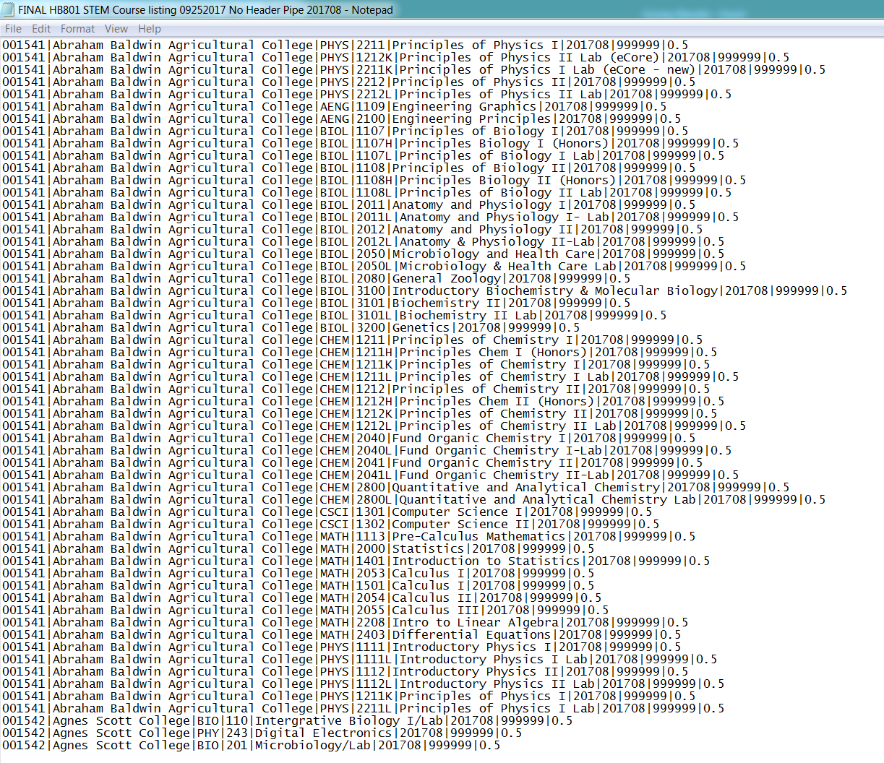

Slide 4
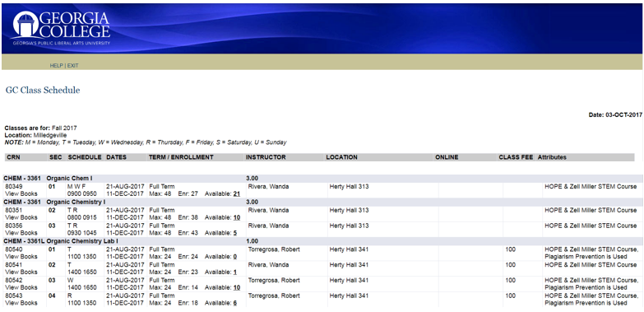
STEM Attribute
Notes:
Recommend best practice to add attributes to the schools course section search

Slide 5
HB801 User Acceptance Testing
UAT held September 18, 19 and 20
Completed test plans
No major issues found
Institutions signed-off on the testing

Slide 6
HB801 STEM GaMod Concepts
Add .5 to ZORTGPA and ZORHGPA
Use STEM listing in a banner table
Transfer Articulate all coursework
Best Practice updated in July 2017
Be prepared for changes in STEM course listing

Slide 7
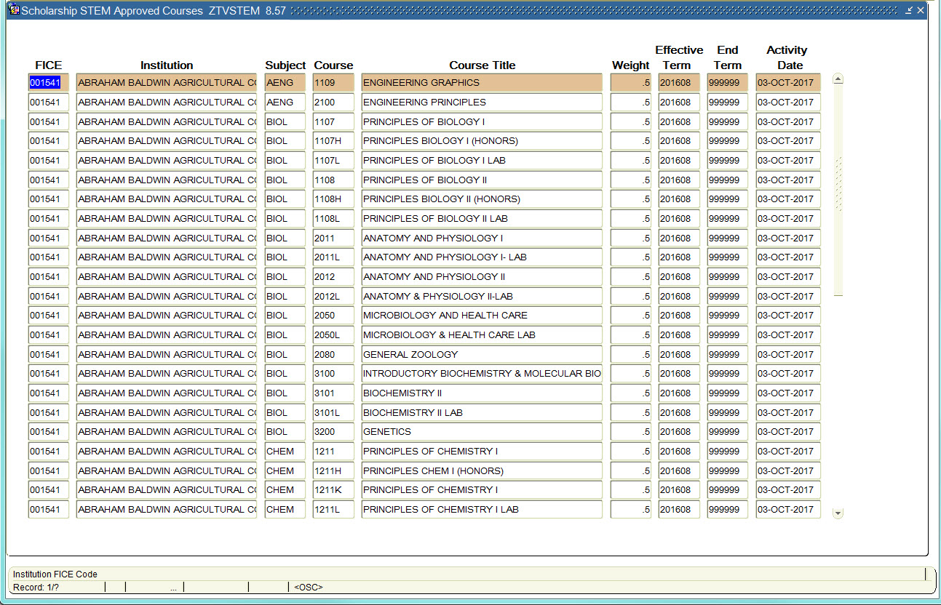
HOPE and ZELL STEM Approved Course List

Slide 8
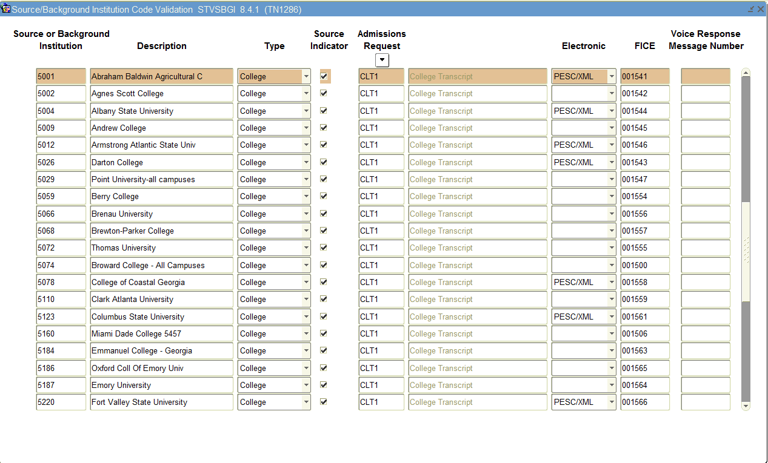

Slide 9
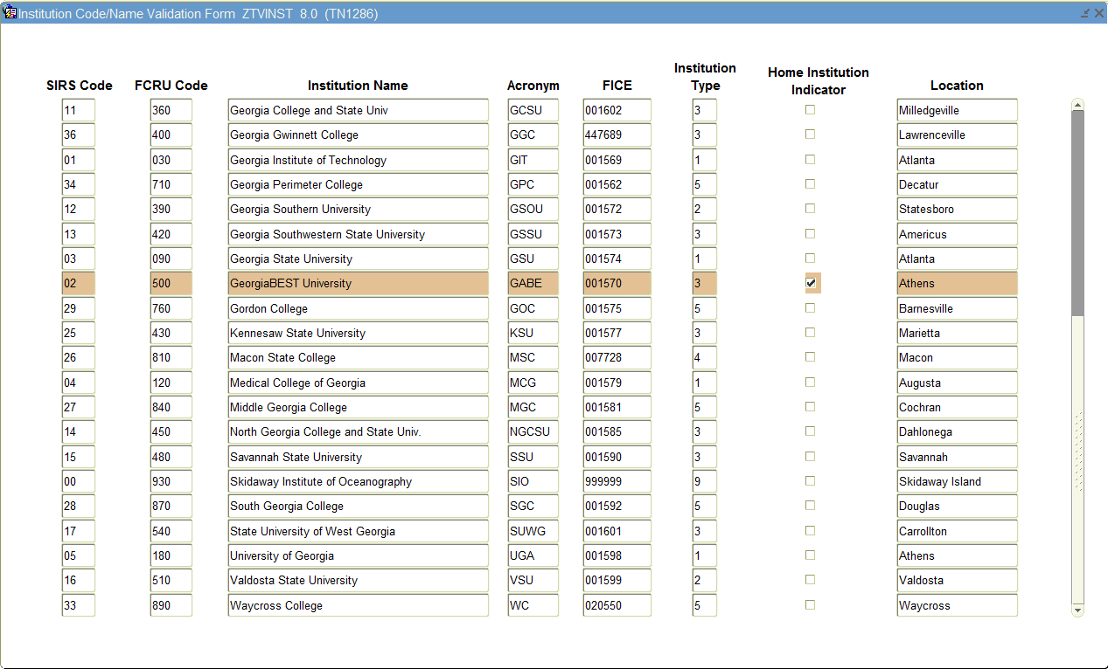

Slide 10
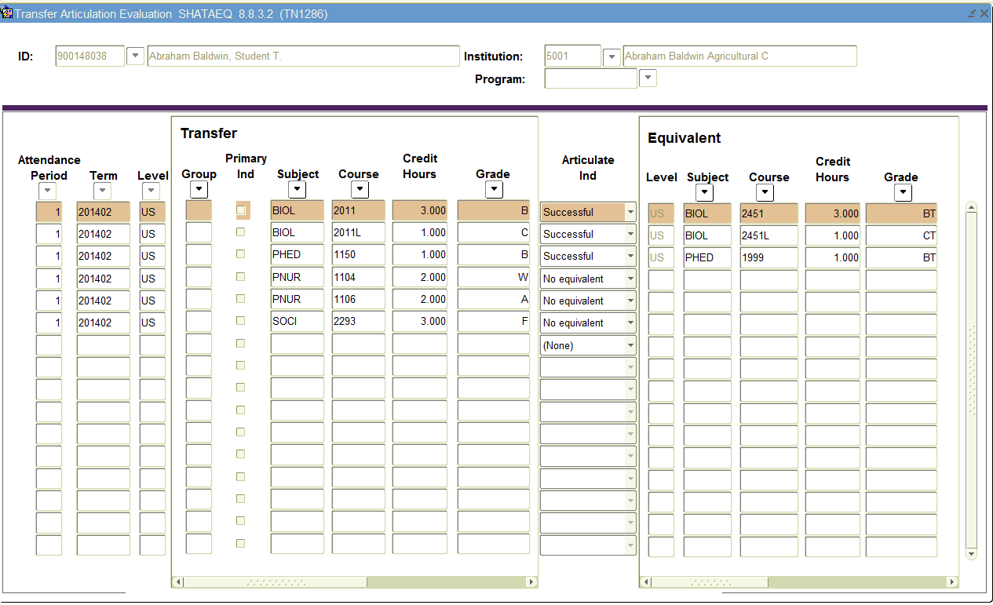
Notes:
Business Practice Reworked and Set to Schools in July 2017

Slide 11
HB801 STEM Boost Institutional Numbering
Code | Institution | Code | Institution
001541 | Abraham Baldwin Agricultural College | 001574 | Georgia State University
001542 | Agnes Scott College | 001575 | Gordon State College
001544 | Albany State University | 022884 | Gwinnett Technical College
005601 | Albany Technical College | 001577 | Kennesaw State University
021136 | American Intercontinental University | 001578 | Lagrange College
001545 | Andrew College | 005254 | Lanier Technical College
001546 | Armstrong State University | 020748 | Life University
005600 | Athens Technical College | 001580 | Mercer University
012165 | Atlanta Metropolitan State College | 001581 | Middle Georgia State University
008543 | Atlanta Technical College | 001582 | Morehouse College
005599 | Augusta Technical College | 005619 | North Georgia Technical College
001579 | Augusta University | 031555 | Oconee Fall Line Technical College
011074 | Bainbridge State College | 030300 | Ogeechee Technical College
001554 | Berry College | 001586 | Oglethorpe University
001556 | Brenau University | 001587 | Paine College
001557 | Brewton-Parker College | 001588 | Piedmont College
005763 | Central Georgia Technical College | 001547 | Point University
005620 | Chattahoochee Technical College | 001589 | Reinhardt University
001559 | Clark Atlanta University | 029258 | Savannah College Of Art & Design
008976 | Clayton State University | 001590 | Savannah State University
005511 | Coastal Pines Technical College | 005618 | Savannah Technical College
001558 | College Of Coastal Georgia | 001591 | Shorter University
001561 | Columbus State University | 001592 | South Georgia State College
005624 | Columbus Technical College | 005617 | South Georgia Technical College
003484 | Covenant College | 013039 | South University
003956 | Dalton State College | 030665 | Southeastern Technical College
010727 | Devry University | 005621 | Southern Crescent Technical College
010997 | East Georgia State College | 005615 | Southern Regional Technical College
001563 | Emmanuel College | 001594 | Spelman College
001564 | Emory University | 005616 | Swainsboro Technical College
001566 | Fort Valley State University | 001555 | Thomas University
001602 | Georgia College & State University | 001596 | Toccoa Falls College
447689 | Georgia Gwinnett College | 001597 | Truett Mcconnell University
009507 | Georgia Highlands College | 001598 | University Of Georgia
001569 | Georgia Institute Of Technology | 001585 | University Of North Georgia
001571 | Georgia Military College | 001601 | University Of West Georgia
004024 | Georgia Northwestern Technical College | 001599 | Valdosta State University
005622 | Georgia Piedmont Technical College | 001600 | Wesleyan College
001572 | Georgia Southern University | 010487 | West Georgia Technical College
001573 | Georgia Southwestern State University | 005256 | Wiregrass Technical College
 |  | 001604 | Young Harris College
Note: | This code must be in the FICE field on STVSBGI in order for the HOPE processing to pick up the STEM boost for eligible coursework.
Notes:
Mention challenges with Devry and maybe Mercer. Also, SCAD and GGC FICE numbers do not match GSFC’s OPEDID

Slide 12
Annual STEM Weighted Course Listing
Annual Updates to list
Effective Aid Year (i.e. term)
Academic Affairs involved
USG process

Slide 13
HB801 Course List Submission Form

Slide 14
CHECS Workflow
Colleges
TCSG: 22
USG: 26
GICA: 25
Other Private
Colleges: 9
Total: 82
College Academic History Data
1. College Extracts Transcript Data from SIS*
Sch # | SSN | Term | Subj Code | Crse # | Hrs | Grade
820 | XXXX | Fall 18 | ENGL | 1101 | 3 | A
820 | XXXX | Fall 18 | MATH | 1102 | 3 | C
2. Data are Edit-Checked & Run through GSFC Rules Engine
*Student Information System
GSFC
Business Rules Engine
Calculates:
GPA
Checkpoints
HOPE GPA Status
Primarily PSI/System Responsibility
Primarily GSFC Responsibility
4. College Loads Results Data into SIS to make HOPE Awards
GPA/Checkpoint Results
3. GPA & Checkpoint Results Data are Created
Sch# | SSN | TERM | GPA
820 | XXXX | Fall 18 | 3.5
820 | XXXX | Fall 18 | 2.7

Slide 15
CHECS
Profile Grade Scale File - supports batch loading of PSI grades into the CHECS data system
Profile Terms File - supports the batch loading of PSI terms into the CHECS data system
Historical Snapshot File - documents the HOPE/Zell Miller Scholarship and Grant status of students as of Summer term 2018
Transcript Data File - facilitates the batch loading of academic data, by term and student, for GPA and Checkpoint calculations
Request Data File - allows the PSI to request GPA and Checkpoint data for particular students
GPA/Checkpoint File - documents the passing of HOPE/Zell Miller Scholarship and Grant GPA and Checkpoint data from CHECS to the PSI

Slide 16
CPOS
Pursuant to the 17-18 Federal Student Aid Handbook, Volume 1, Chapter 1, Page 1.20
”If a student is enrolled in courses that do not count toward his degree, certificate, or other recognized credential, they cannot be used to determine enrollment status unless they are eligible remedial courses. This means you cannot award the student aid for classes that do not count toward his degree, certificate, or other recognized credential.”

Slide 17

Consolidated Institutions
* Announce consolidation to be approved in future by USG BOR

Slide 18

Questions?
tracy.ireland@usg.edu rich.loftus@usg.edu

