Slide 1

RACRA Meeting March 27, 2018
Lucy Harrison
Assistant Vice Chancellor for Academic Library Services, Executive Director of GALILEO
Jeff Gallant
Program Manager, Affordable Learning Georgia

Slide 2
New in 2018: Cost Designators for Required Materials
USG institutions must prominently designate courses with no cost (free) or low-cost ($40 or less) materials at the point of registration
Optional this summer; roll out statewide in Fall 2018

Slide 3
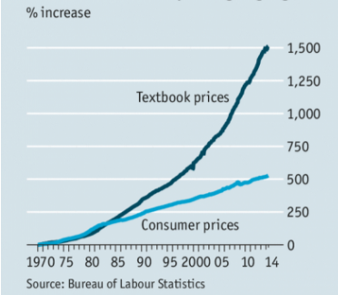
The Problem We're Addressing
In the United States:
Textbooks and course materials average $1,250 per student per year
This is a four-year cost of $5,000+
Source: The Economist, 8/16/2014
https://www.economist.com/news/united-states/21612200-its-economics-101-why-textbooks-cost-so-much
Source: The College Board:
https://trends.collegeboard.org/college-pricing/figures-tables/average-estimated-undergraduate-budgets-2017-18

Slide 4
Impact of High Textbook Costs
A survey of 22,000 students in 2016 showed:
66% had chosen not to purchase a required textbook
48% took fewer courses
26% dropped a course
Source: 2016 Student Textbook and Course Materials Survey, Florida Virtual Campus
https://florida.theorangegrove.org/og/file/3a65c507-2510-42d7-814c-ffdefd394b6c/1/2016%20Student%20Textbook%20Survey%20Draft%205.pdf

Slide 5
Core ALG Strategies
Redesign courses to use free and low-cost materials
Build an engaged community of educators
Partner with other leaders
Reduce the cost of textbooks to students

Slide 6
Results
To date, all ALG programs have saved students over $31 million on textbook costs
219,343 students have benefited
$18 million annual projected savings from current grants

Slide 7
New in 2018: Cost Designators for Required Materials
USG institutions now required to prominently designate sections of courses with no cost (open or free textbooks) or low cost course materials at the point of registration.
The course attributes will be collected by the Academic Data Collection as optional in Summer 2018 and required in Fall 2018.

Slide 8
Banner Codes
Use Banner codes to display course attributes
ZNCM (No-cost: $0 required costs)
ZLCM (Low-cost: $40 or under required cost)

Slide 9
GeorgiaBEST Activities
Training webinar on Banner 8, November 2017
http://www.usg.edu/georgia_best/application_development_and_support/training/georgiabest_training#specialized_training
Banner 9 now displays attributes in search results automatically. Feature release webinar on Banner 9, January 2018
https://www.usg.edu/georgia_best/application_development_and_support/training/georgiabest_training

Slide 10
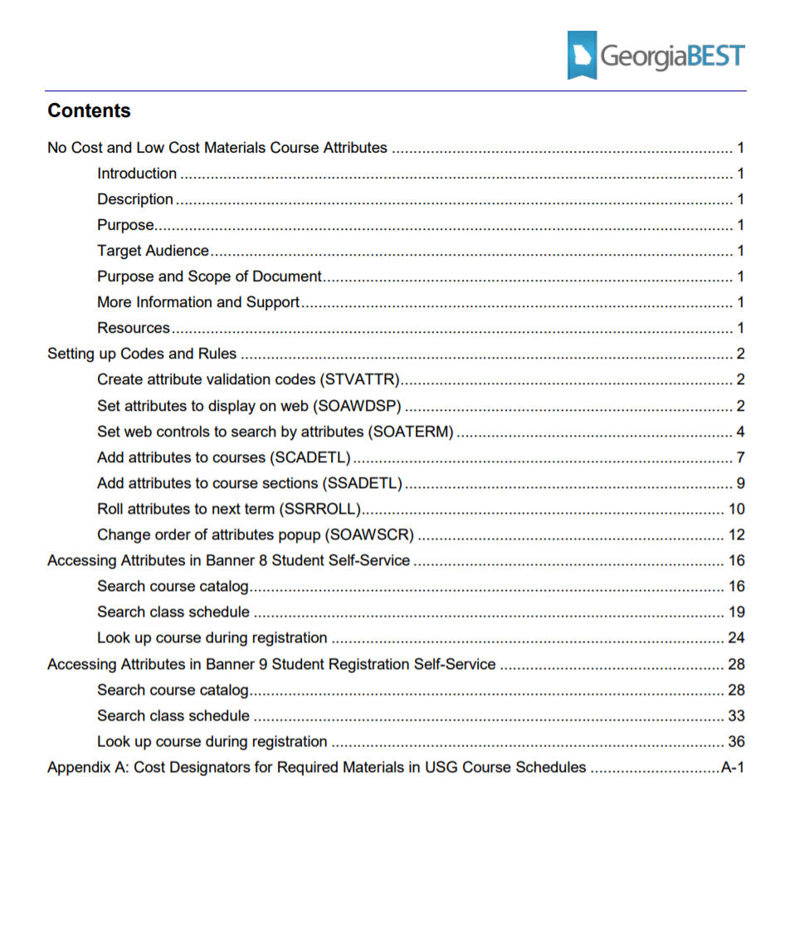
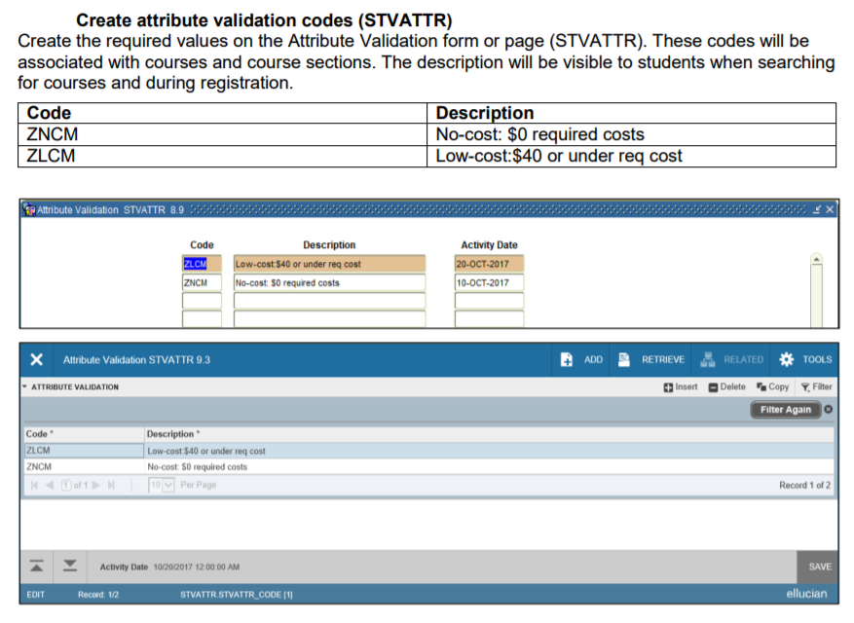
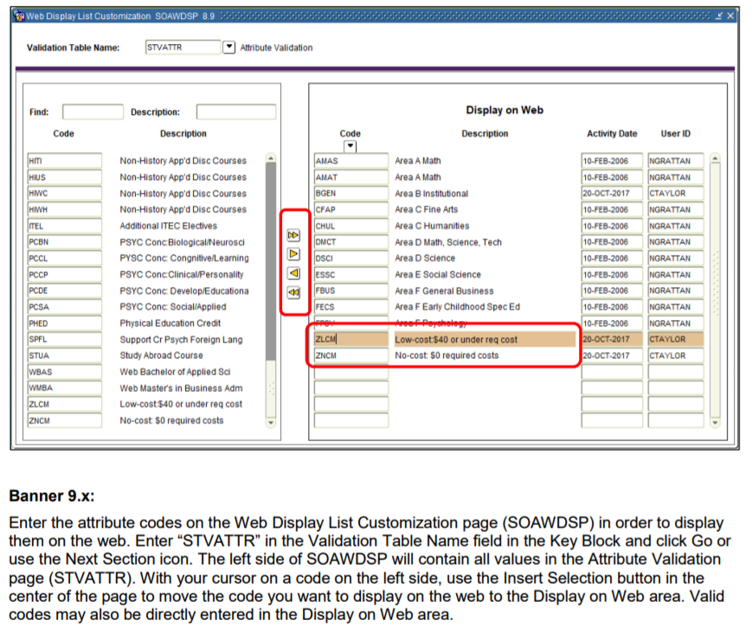
Documentation Available

Slide 11
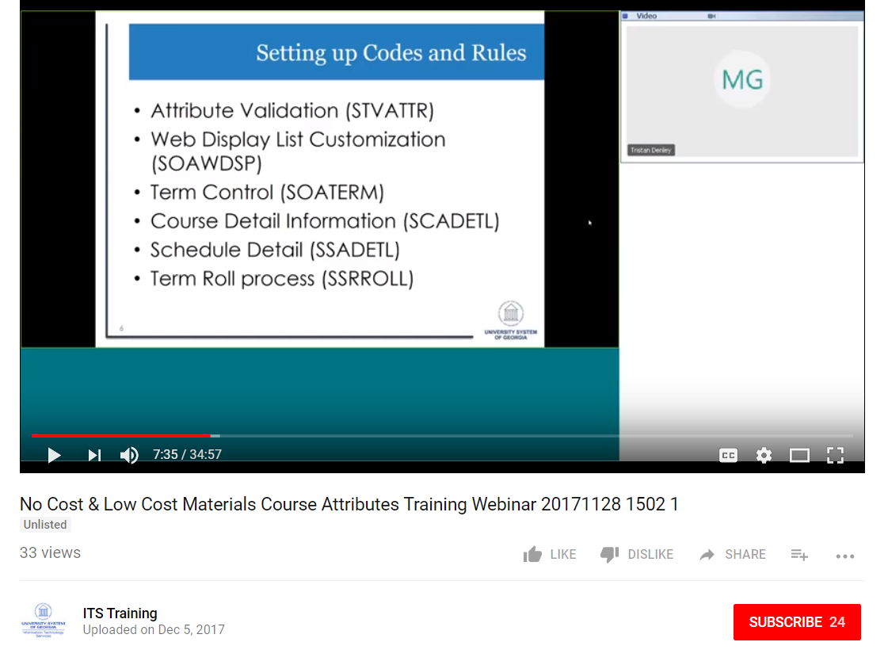
Documentation Available
GeorgiaBEST > Application Development
Business Practice
http://www.usg.edu/georgia_best/application_development_and_support/business_processes
Training

Slide 12
Who Collects Textbook Info?

Slide 13
Who Provides Textbook Info?

Slide 14
Enable Students to Find Courses by Attribute
Institutions will vary on enabling Banner searches
Basic instructions provided in training/documentation
Custom approaches may require additional work

Slide 15
Implementation on Campuses
How’s it going?
Ready to implement fall 2018?
Questions or concerns?

Slide 16
Questions?
For Banner:
Critical / Business Interruption situations:
Call ITS Helpdesk at 706-583-2001
Non-critical questions:
Email the ITS Helpdesk at helpdesk@usg.edu
For Affordable Learning Georgia:
http://affordablelearninggeorgia.org/
Lucy Harrison
GALILEO Executive Director
Lucy.Harrison@usg.edu
ALG Staff:
Jeff Gallant Marie Lasseter
Program Manager Director, Academic Technologies
Jeff.Gallant@usg.edu Marie.Lasseter@usg.edu

