Slide 1

Transforming Remediation
Charting a Course for the 2014 – 2015 Academic Year
Barbara Brown
Assistant Vice Chancellor for
Transitional and General Education
Office of Educational Access & Success
Barbara.Brown@usg.edu

Slide 2
What We’ve Done So Far
Task Forces – Spring and Summer 2013
Ad Hoc Committees – Fall 2013 and Spring 2014
Regional workshops, statewide meeting – Spring 2014
Policy and Procedure Committee – Summer 2014
http://www.usg.edu/educational_access/complete_college_georgia/transforming_remediation

Slide 3
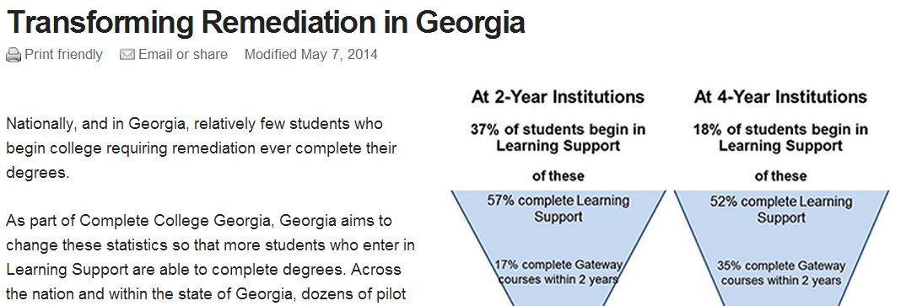
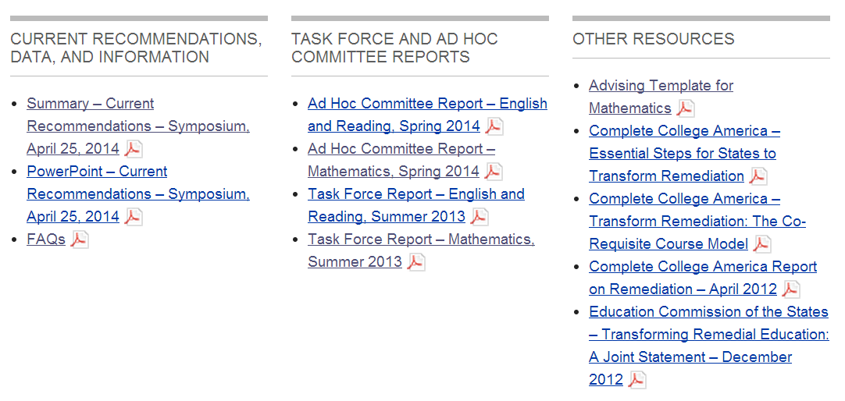

Slide 4
Where We’re Going:
The Time Frame
Target is implementation “at scale” by Fall 2015
Some institutions will be “at scale” in transforming remediation (voluntary basis) in English/Reading and Mathematics in Fall 2014
Albany State University
Bainbridge State College
College of Coastal Georgia
Gordon State College

Slide 5
Corequisite Remediation
Corequisite Remediation means that:
Students enroll in a corequisite Learning Support course that provides “just-in-time” support while they are also enrolled in a collegiate (gateway) course.
Corequisite Learning Support Course + Gateway (collegiate) course = Success!!!
Gateway (collegiate) courses will be ENGL 1101, MATH 1001, MATH 1101, MATH 1111
Some less prepared students will still be required to begin in “stand-alone” Learning Support courses.

Slide 6
Corequisite Remediation
Recommendations for corequisite support courses:
1 - 2 credits, 2 – 4 contact hours (institutional credit)
Format is up to institutions
Paired collegiate course sections may have only Learning Support (LS) students or a mix of LS and non-LS students
Whenever possible, institutions are encouraged to have the same instructors teach the gateway course sections and the corequisite support sections
Efforts should be made to avoid identifying LS students in mixed collegiate course sections to their fellow students.

Slide 7

Corequisite Remediation
Recommendations for corequisite support courses:
The content of corequisite support courses must be geared to supporting students in mastering the content of the gateway courses.
Recommendation that there be separate corequisite courses for each of the gateway mathematics courses.

Slide 8

Corequisite Remediation
Recommended corequisite course numbers and titles:
ENGL 0999 – Support for English Composition (ENGL 1101)
MATH 0997 – Support for Quantitative Reasoning (MATH 1001)
MATH 0998 – Support for Mathematical Modeling (MATH 1101)
MATH 0999 – Support for College Algebra (MATH 1111)

Slide 9

Corequisite Remediation
Students may not drop or withdraw from the corequisite course without dropping or withdrawing from the collegiate course and vice versa.
Students who withdraw from the corequisite and collegiate courses will NOT, however, be required to withdraw from other collegiate courses not directly related to the Learning Support requirement.

Slide 10
Corequisite Remediation
Students will exit Learning Support upon successful completion of the gateway (college) course.
No limit on “attempts” in corequisite courses.

Slide 11
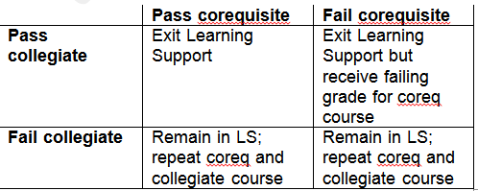
Corequisite Remediation

Slide 12
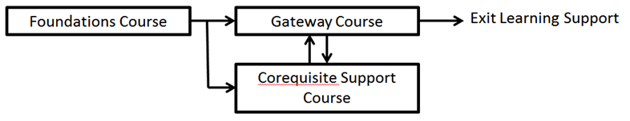
Year-Long Pathways
Intended for students with significant gaps in preparation
One semester “Foundations” courses

Slide 13
Year-Long Pathways
Recommendations for “Foundations” Learning Support courses:
3 – 4 credit hours (institutional credit).
Content must be geared to preparing students for mastery of the content of the gateway (collegiate) course in that subject.
The mathematics committee recommended separate Foundation courses for each of the three possible gateway mathematics courses.

Slide 14
Year-Long Pathways
Recommended Foundations course numbers and titles:
ENGL 0989 – Foundations for English Composition (ENGL 1101)
MATH 0987 – Foundations for Quantitative Reasoning (MATH 1001)
MATH 0988 – Foundations for Mathematical Modeling (MATH 1101)
MATH 0989 – Foundations for College Algebra (MATH 1111)

Slide 15
Year-Long Pathways
Students who withdraw from Foundations courses will not be required to withdraw from collegiate courses.
Students must successfully complete Foundations courses in no more than two attempts or be subject to Learning Support exclusion for one year.

Slide 16

Year-Long Pathways
Students placed on Learning Support exclusion would have the option to take Learning Support courses and collegiate transfer courses at a Technical College System of Georgia institution during that year.

Slide 17
MATH Pathways
MATH 1111 (College Algebra) prepares students for calculus. Should not be the default math pathway.
MATH 1001 (Quantitative Reasoning) or MATH 1101 (Mathematical Modeling) should become the default math pathway.

Slide 18
Changing MATH Pathways
Foundations for MATH 1111 >>> MATH 1001 or 1101 – go straight into MATH 1001 or 1101 with corequisite support
Foundations for MATH 1001 or 1101 >>> MATH 1111
Enroll in MATH 1111 with corequisite support IF
Students pass MATH 1111 pretest OR
Students earned A or B in non-Algebra Foundations course
Enroll in Foundations course for MATH 1111

Slide 19
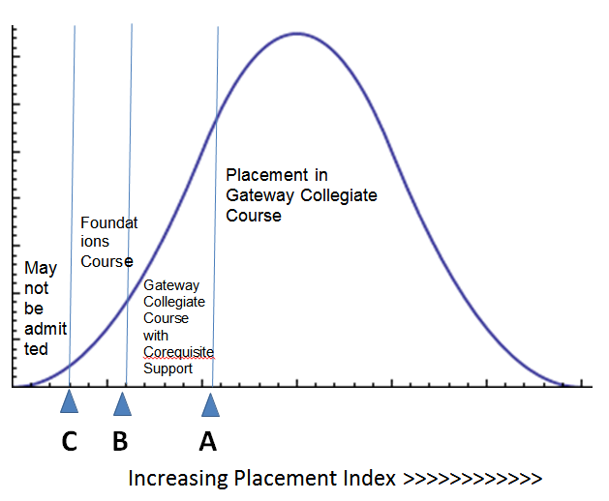
Placement

Slide 20
Placement
An English Placement Index (EPI) and a Mathematics Placement Index (MPI), reflecting a student’s probability of success (POS) in passing the related initial core course, will be used to place students into levels of Learning Support.
The indices will be calculated using:
HSGPA and SAT/ACT - when both are available
HSGPA and Compass - when SAT/ACT are not available
Compass and SAT/ACT - when GPA is not available
Compass - when neither HSGPA nor SAT/ACT are available
HSGPA, SAT/ACT and Compass when Compass would be helpful

Slide 21
Placement
For each of the “gateway” courses, a system-level “cutoff” score has been calculated. These cutoffs are based on the POS associated each index score
English 1101: English Placement Index score yielding a POS of 60%. If needed, placement will be based on the Compass Reading score plus Compass eWrite.
Math 1001, 1101, and 1111: Math Placement Index score POS of 55% or higher.
The MPI cutoff score will be higher for MATH 1111 than for MATH 1001 and 1101 to achieve equal probabilities of success.

Slide 22
Changes to Admissions Policy
Students who place into both (Math and English/Reading) LS areas will not be denied admission unless
They score below the “floor score (C)” in both areas or they score below the “floor score” in one area and at the below the offsetting index score in the other.

Slide 23
Advising
Train all advisors on new rules.
Consider math pathways.
Use DegreeWorks.
Develop advising guides to ensure that students are placed in the correct pathways with the appropriate level of support.
Advising template developed by the Ad Hoc Steering Committee to Transform College Mathematics.

Slide 24
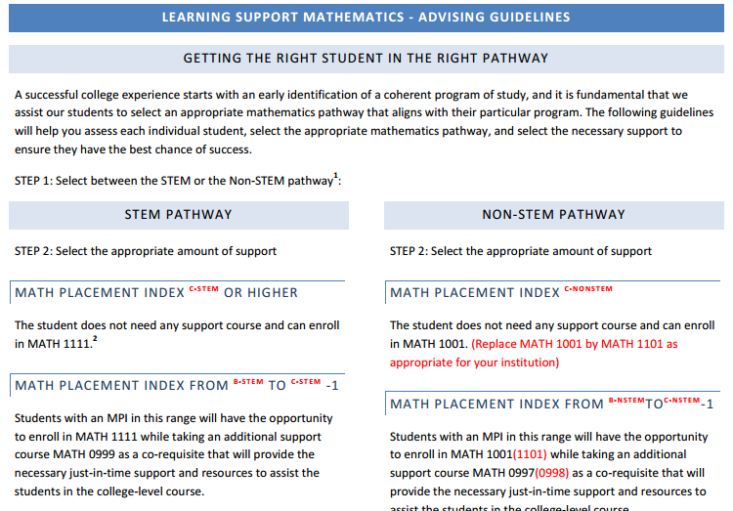

Slide 25


