Slide 1
College Completion
Transforming Remediation
15 to Finish
Guided Pathways to Success
Reverse Transfer
Barbara Brown
Assistant Vice Chancellor for
Transitional and General Education
Office of Educational Access & Success
Barbara.Brown@usg.edu

Slide 2
College Completion:
Transforming Remediation
Fall 2013 System requirement for Compass Exit Testing eliminated
Fall 2013 Corequisite remediation became default strategy
Spring 2014 Regional workshops to discuss institutional ideas and concerns. System-wide symposium on remediation
Fall 2014 – Some USG institutions (voluntary) will be “at scale” using corequisite remediation
Fall 2015 – Most USG institutions will be using corequisite remediation

Slide 3
College Completion:
15 to Finish
Creating a culture of 15 credits = full-time
Georgia Perimeter College is lead institution on this effort.
www.15tofinishgeorgia.com
GPC leading 15 to Finish events this spring: 4 regional workshops, 1 statewide symposium (April 18)

Slide 4
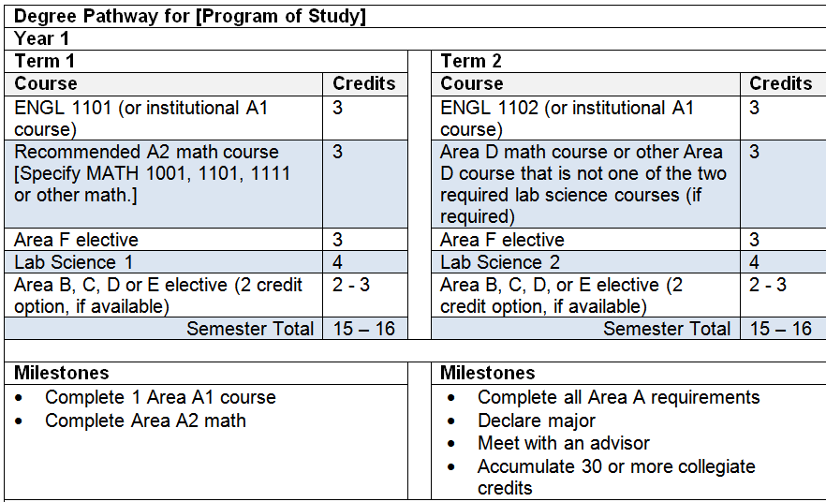
College Completion:
Guided Pathways to Success
Program maps and meta-majors

Slide 5
College Completion:
Reverse Transfer (Lumina Grant)
Centralized USG process for reverse transfer.
Clear models, guidelines, practices, and how-tos.
Efficient ways to share student data between receiving and sending institutions.
Assurance that both sending and receiving institutions will receive appropriate credit.
Clear explanations of the benefits of associate degree completion.

