Slide 1
Summary of Changes Recommended by the Council on General Education
Change to ASAH 2.4.5 Rules Regarding Inclusion in Areas A – F
Change to ASAH 2.4.6 Approval Procedures
Change to ASAH 2.4.7 Prerequisites and Exceptions
Changes to Area F Course Guidelines
  General Studies/Interdisciplinary Studies
Changes to Area F Learning Objectives
  Music
  Physics
  Teacher Education (includes small change to Course Guidelines)
  Theatre
  Visual Arts

Slide 2
Change to ASAH 2.4.5 Rules Regarding Inclusion in Areas A - F
Courses in Areas A–F may not carry a fraction of a semester hour of credit.
Except as required by accrediting agencies, core curriculum credits do not have an expiration date.
Institutions may not permit the completion of any course to fulfill requirements in more than one Area A–F. Where the same course is authorized in more than one Area A–F, the student completing the course to meet the requirements of one area must take another course in the second area to meet the requirements of the second area.

Slide 3
Change to ASAH 2.4.6 Approval Procedures
Each institution will first submit the courses proposed for Areas A–E to the relevant Academic Advisory Committee and then to the Council on General Education. US/GL/CT courses and plans must be approved by the Council on General Education.
The courses in Area F must be approved by the relevant Academic Advisory Committee. [To be replaced.]
Courses previously approved for use in Area A–F at an institution do not require re-approval for use at that institution.

Slide 4
Change to ASAH 2.4.6 Approval Procedures
Learning outcomes and courses that are authorized for Area F must be established by the relevant Academic Advisory Committees. Institutions must follow these guidelines when making changes to Area F requirements for their degree programs. Therefore, no approval is needed for institutions to add individual courses to Area F. The respective Academic Advisory Committees must review their Area F guidelines and institutional offerings regularly to ensure institutional compliance with the Advisory Committee-approved guidelines. Advisory Committees will discuss perceived non-compliant Area Fs with the Chief Academic Officer of the impacted institution. If necessary, the matter will be referred to the USG Chief Academic Officer or another Academic Affairs Officer.
Academic Advisory Committees must follow the process described below when making changes to the learning outcomes and course guidelines for their respective Area Fs.
The proposed changes to Area F guidelines must be approved by the respective Academic Advisory Committee and submitted for consideration by the General Education Council.
Changes to Area F guidelines must be approved by the Council on General Education and submitted to the Regents Advisory Committee on Academic Affairs (RACAA).
If approved by RACAA, the Area F changes will be submitted to the Assistant Vice Chancellor for Academic Programs for revision of the academic programs website and implementation in the review of new program proposals.

Slide 5
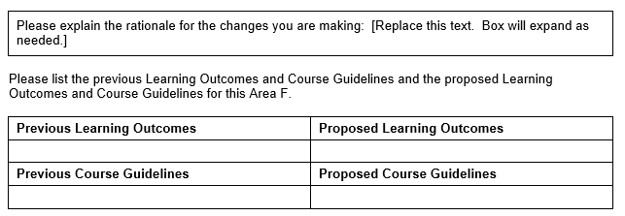
Form: The form to be used for making changes to Area F Learning Outcomes or Course Guidelines is presented below.
Requires review and approval by:
The appropriate Area F committee.
The Council on General Education
RACAA
After approval, changes to be posted on the Academic Programs website.

Slide 6
Change to ASAH 2.4.7 Prerequisites and Exceptions
Exception 2
Degree programs may add courses in Areas A–E to their Area Fs. Students in such degree programs will receive credit for the course in Area F, and this course may be a prerequisite for courses in Area F or the major. Unless required of all students in Area B or C, any foreign language courses approved for inclusion in Areas A – E must also be included in Area F for majors requiring foreign languages, so that foreign language courses included in Areas A – E do not become required prerequisites for Area F courses.

Slide 7
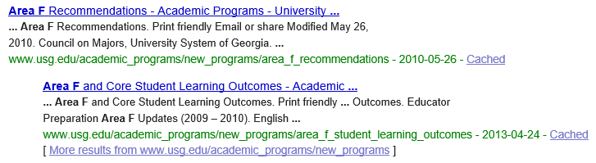
Changes to Area F Course Guidelines and Learning Objectives

Slide 8
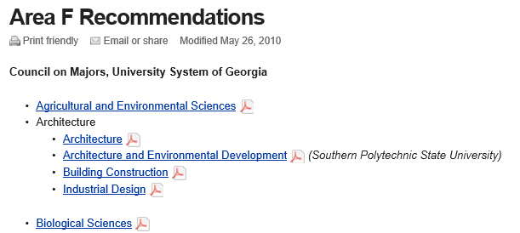
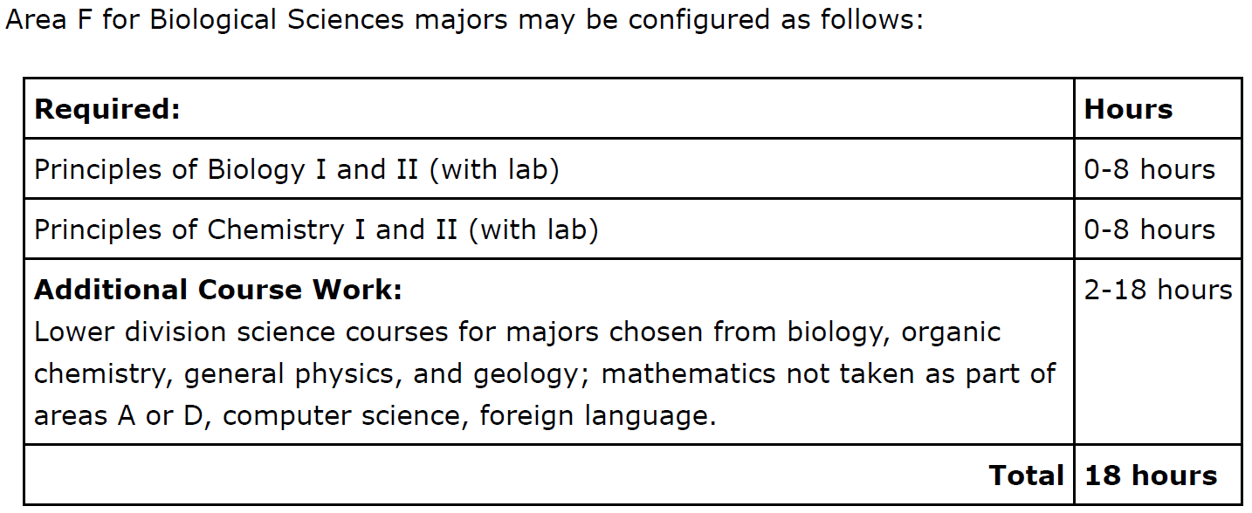

Slide 9
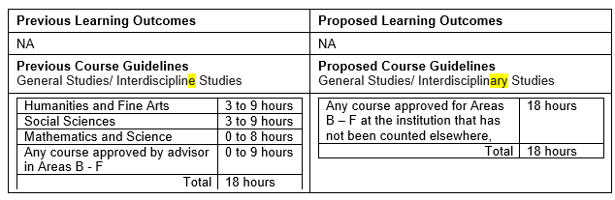
Changes to Area F Course Guidelines
General Studies/Interdisciplinary Studies
  Originated and approved by the Council on General Education.

Slide 10


Slide 11
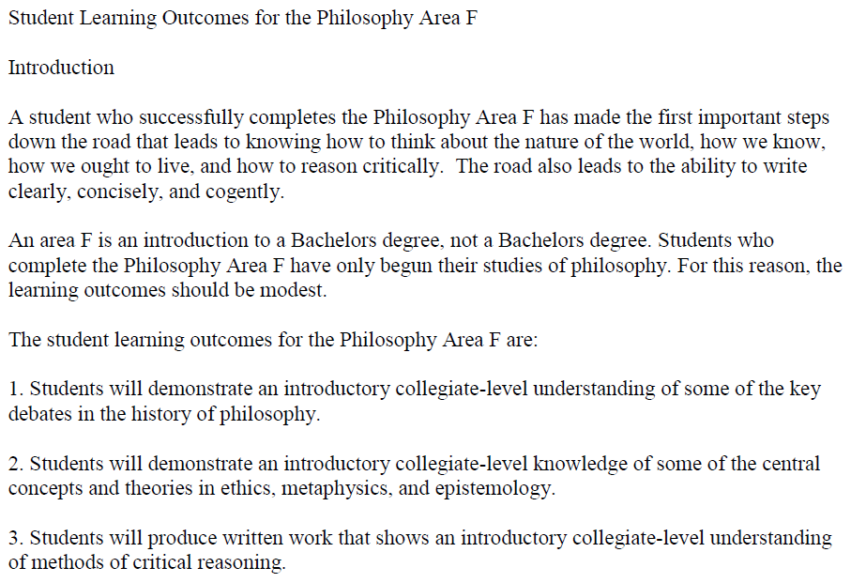

Slide 12
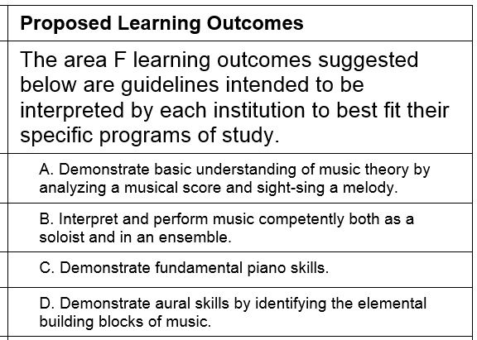
Changes to Area F Learning Objectives
Music
  Approved by the Fine and Applied Arts Academic Advisory Committee
  Approved by the Council on General Education

Slide 13
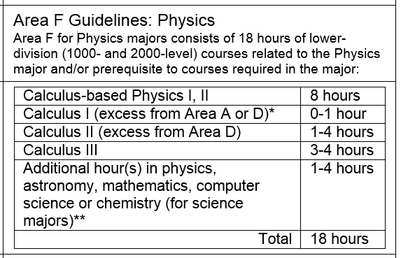
Changes to Area F Learning Objectives
Physics

Slide 14
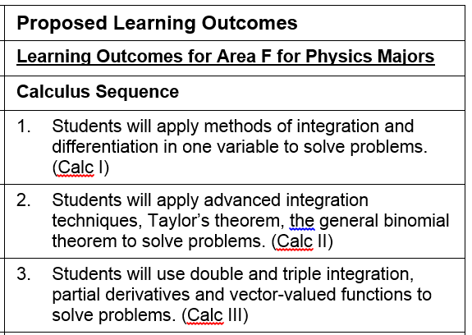

Slide 15
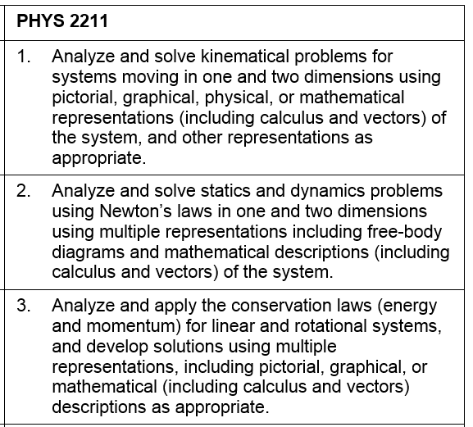

Slide 16
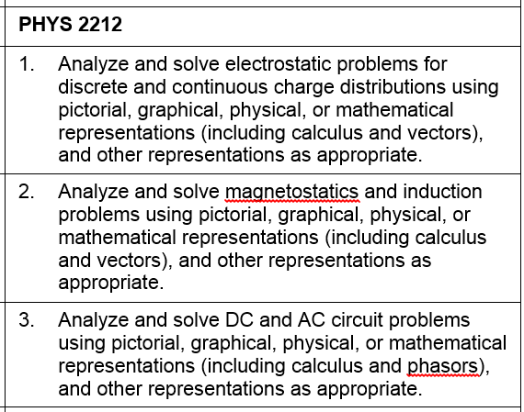

Slide 17
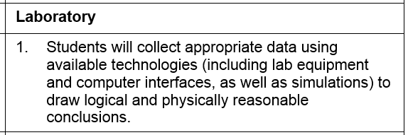
  Approved by the Physics Academic Advisory Committee
  Approved by the Council on General Education

Slide 18
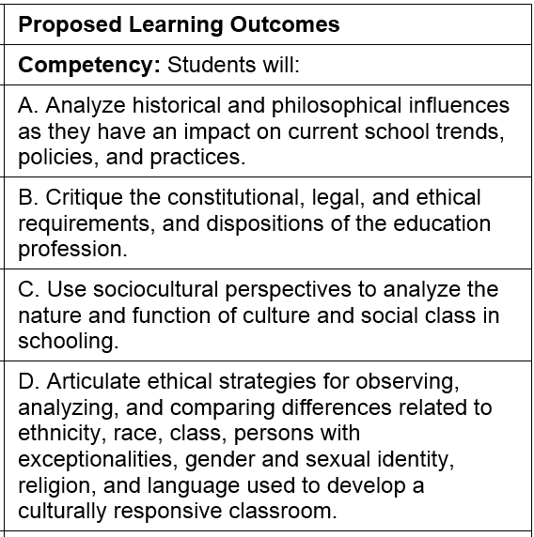
Changes to Area F Learning Objectives
Teacher Education (includes small change to Course Guidelines)

Slide 19
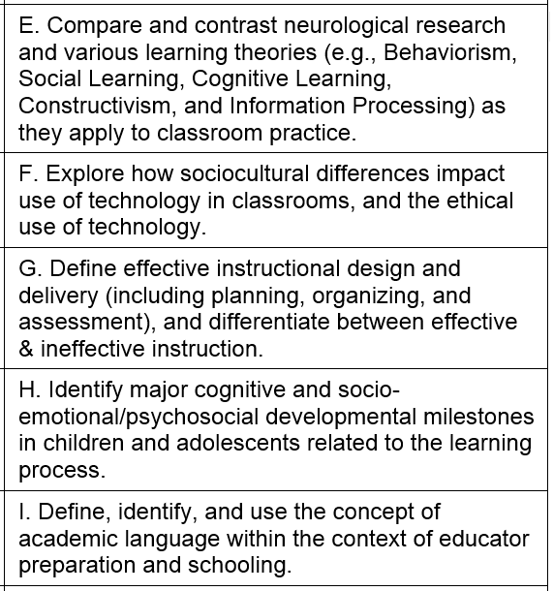

Slide 20
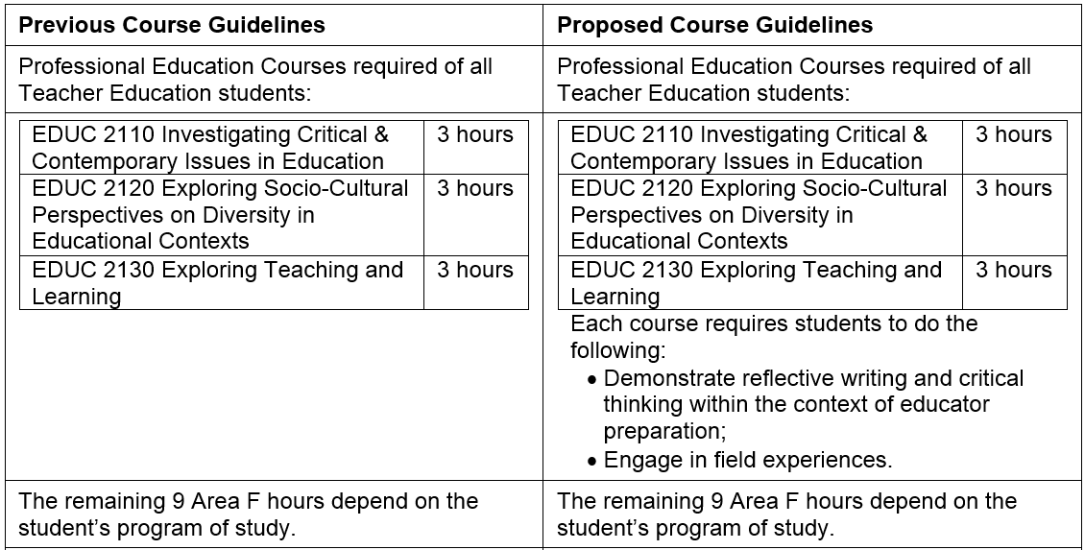
Course Guidelines
  Approved by the Educator Preparation Academic Advisory Committee
  Approved by the Council on General Education

Slide 21
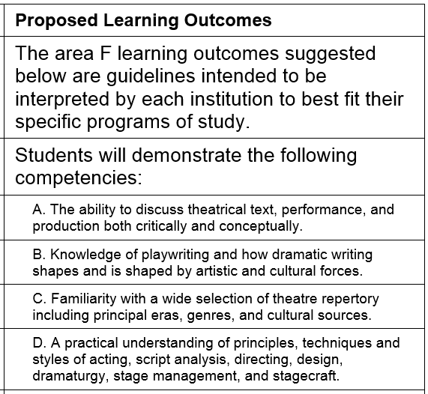
Changes to Area F Learning Objectives
Theatre
  Approved by the Fine and Applied Arts Academic Advisory Committee
  Approved by the Council on General Education

Slide 22
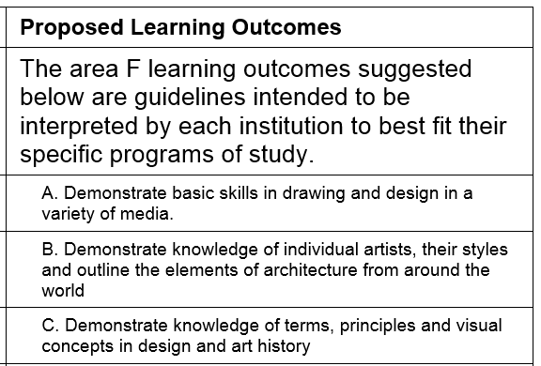
Changes to Area F Learning Objectives
Visual Arts
  Approved by the Fine and Applied Arts Academic Advisory Committee
  Approved by the Council on General Education

