Slide 1

New Learning Models
2030 Taskforce
Update: RACAA – February 18, 2015
New Learning Models Occur in the Opportunity Spaces Where Teaching and Learning are Catalyzed by Technology

Slide 2
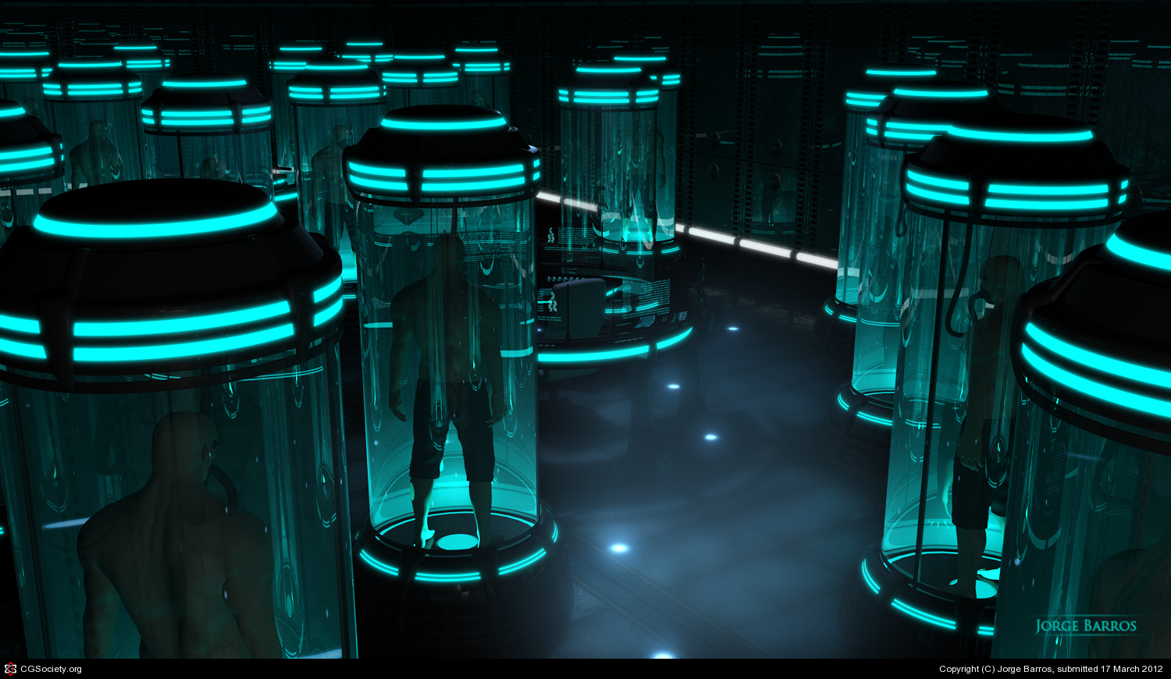
New Learning Models Occur in the Opportunity Spaces Where Teaching and Learning are Catalyzed by Technology

Slide 3
NLM 2030 Task Force
What factors will be critical to the success of the University System and its stakeholders over the next 15 years?
What practices and business models will best guide and support learners, faculty and institutions in and to 2030?

Slide 4

“It’s difficult to make predictions…
especially about the future.”
Lawrence Peter Berra

Slide 5
V
U
C
A
UNCERTAINTY
VOLITILITY
COMPLEXITY
AMBIGUITY

Slide 6

Scenario-based Futures
“Scenarios generate a series of plausible outcomes that challenge preconception – uncover blind spots – and align organizations for action.”

Slide 7


Crowdsourcing the Future
Multi-Stakeholder Open Online Collaboration

Slide 8
Who’s Your Crowd?
5% Students
3% Budget
8% Faculty
33% USO Staff
NLM 2030 Taskforce
51% Institutional Administration
65 Members

Slide 9
Who’s Your Crowd?
5% Students
3% Budget
8% Faculty
12% Other
33% USO Staff
23% Students
42% Faculty
Invent/Explore
the Beyond
NLM 2030 Taskforce
51% Institutional Administration
23% HEd Administration
65 Members
500+ Participants

Slide 10

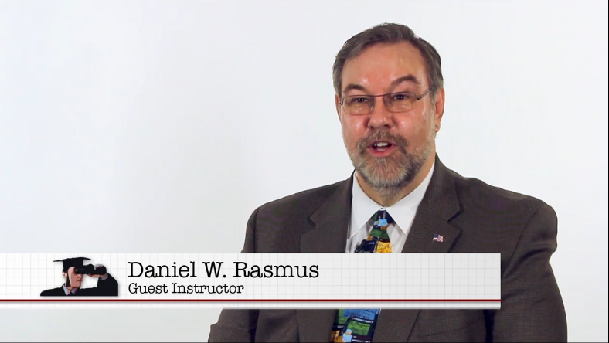
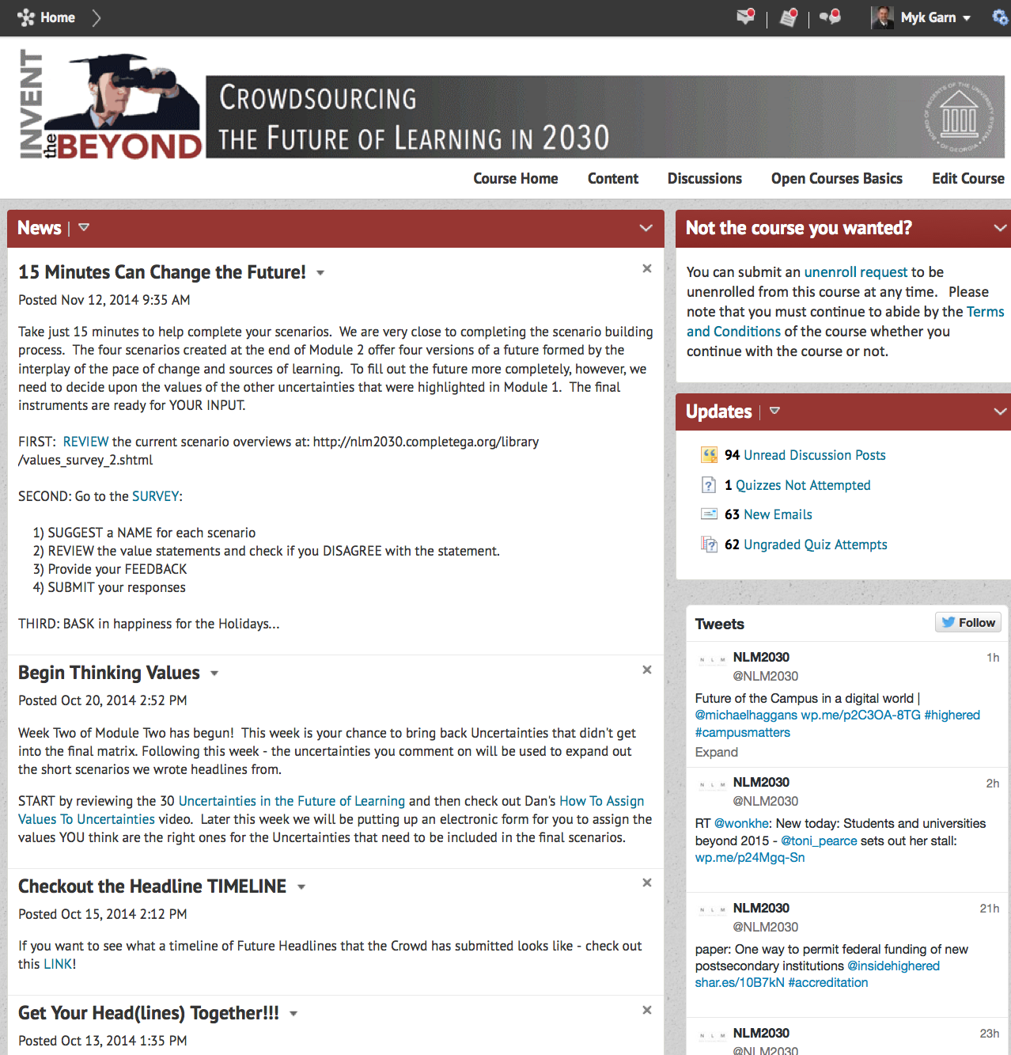
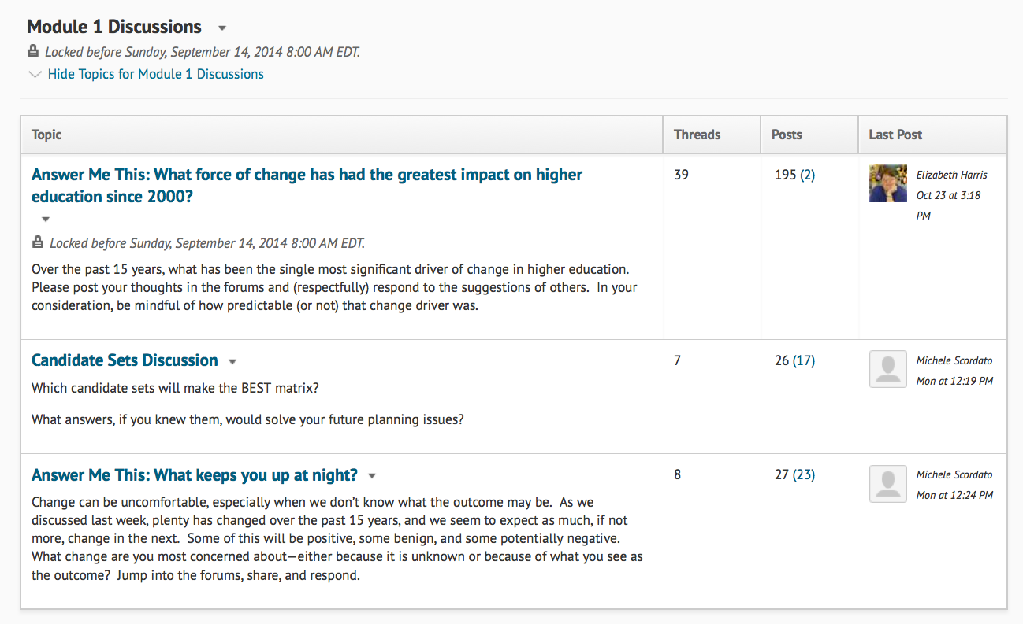
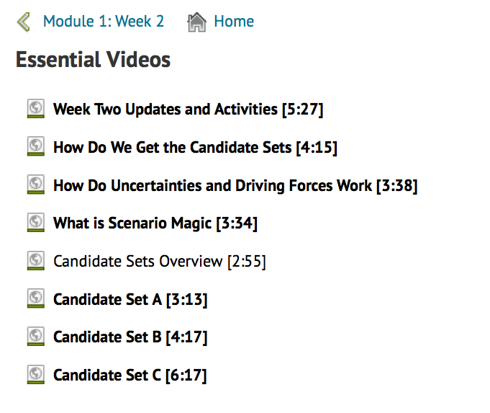
Inventing the Beyond

Slide 11


Change Drivers
Economic
Workforce
Technology & Instruction
Social & Cultural
Policy & Politics

Slide 12
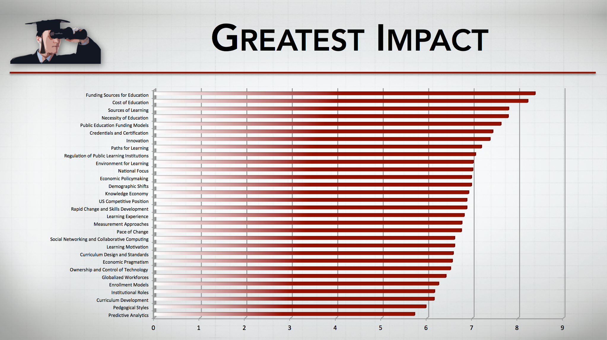
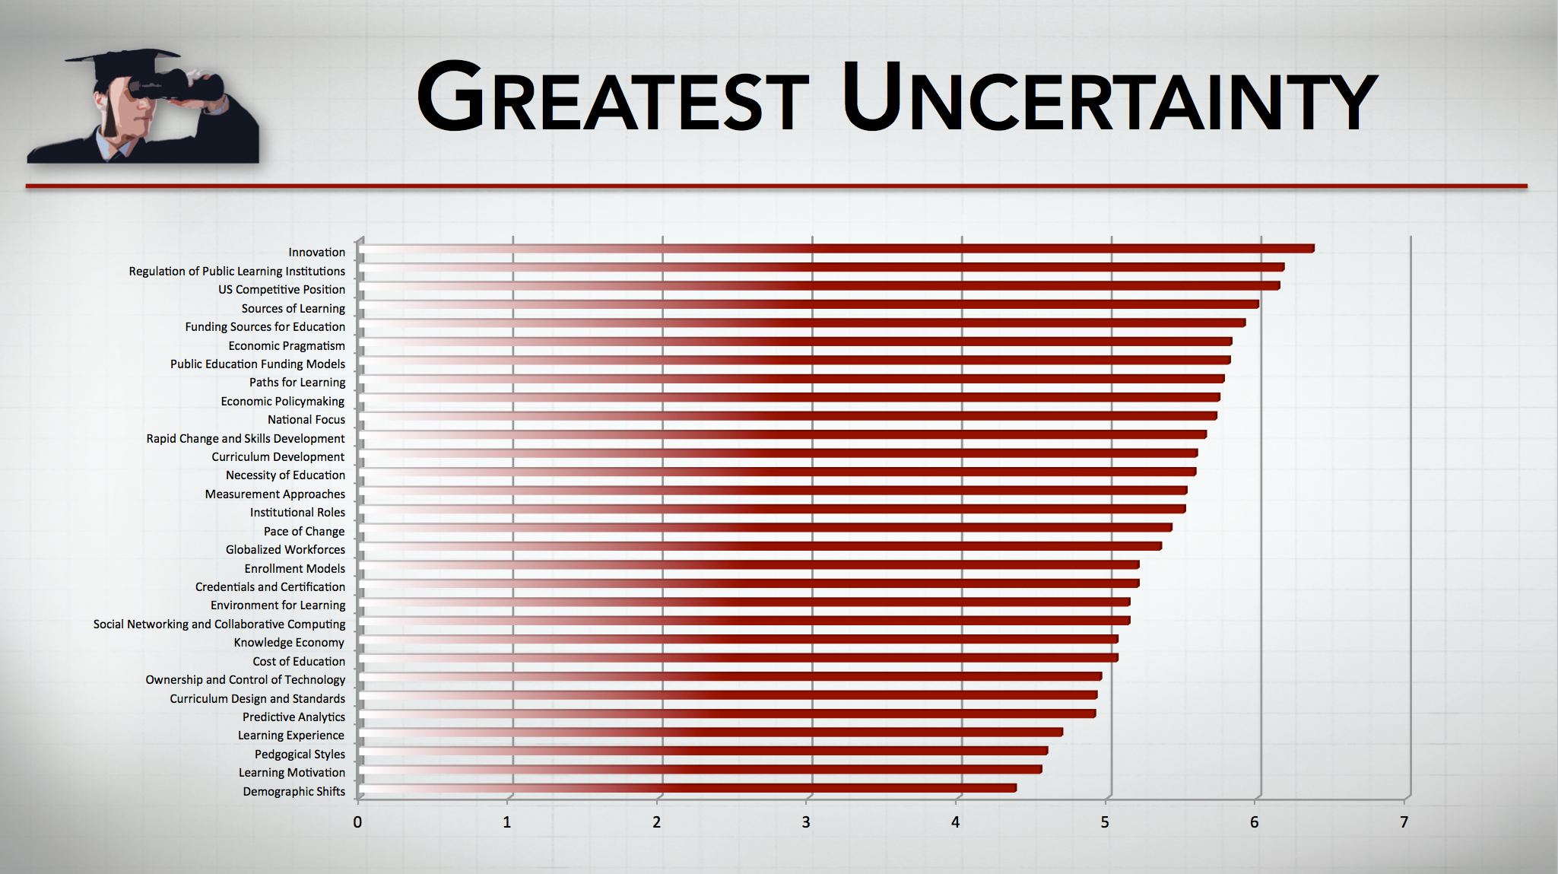
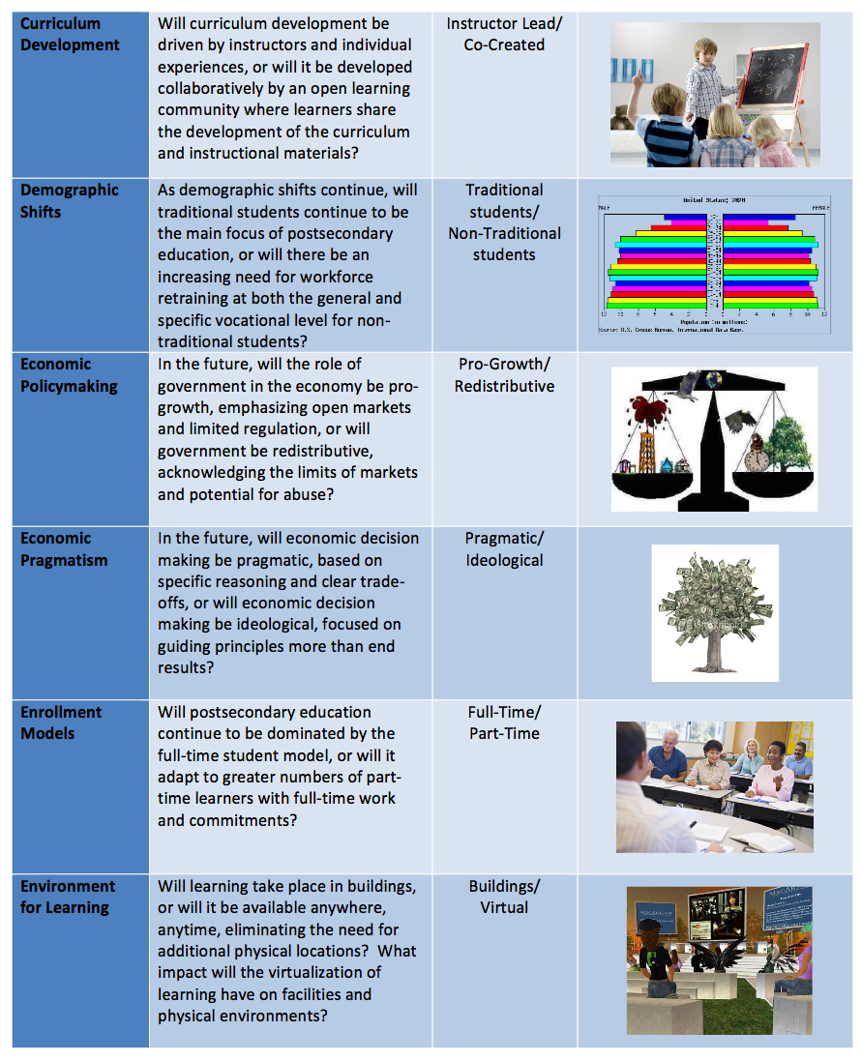
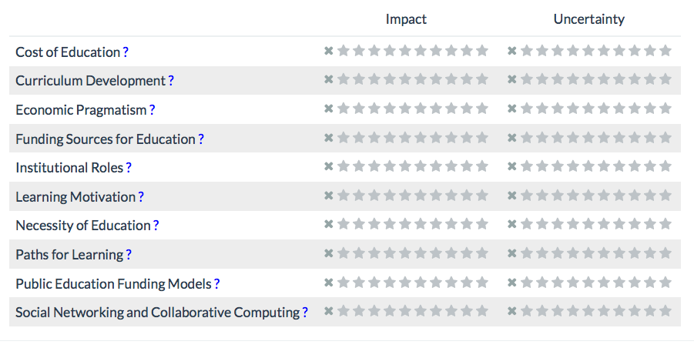
Rating the Uncertainties

Slide 13

Rapid Change
A
B
Find Your
Own Path
To Each
Their Own
Open
Open Source
Co-Created
Closed/
Academy
Pace of Change
C
Sources of Learning
D
Drowning
in Riches
Walled
City
Managed/Slow Change
2014 Daniel W. Rasmus and Serious Insights LLC
Notes:
Describe the drivers

Slide 14
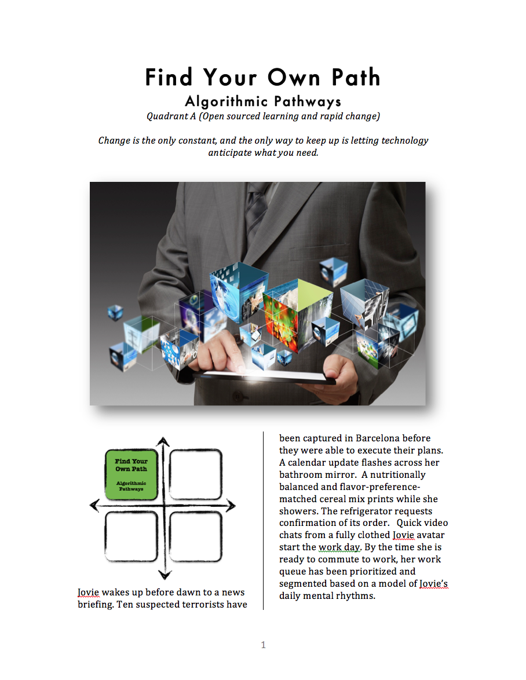
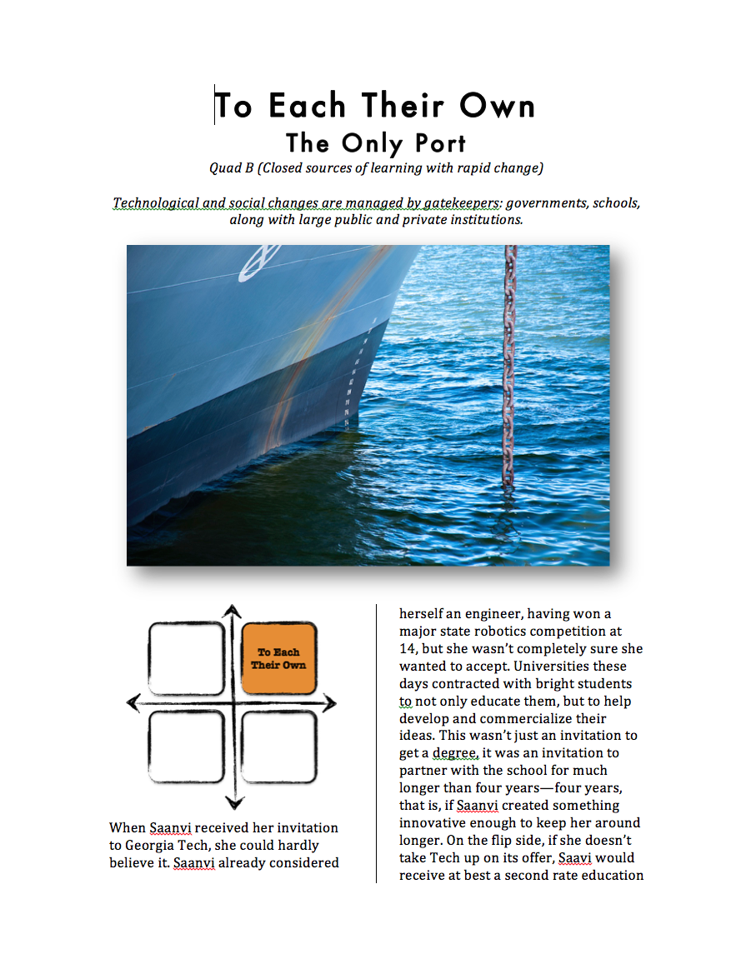
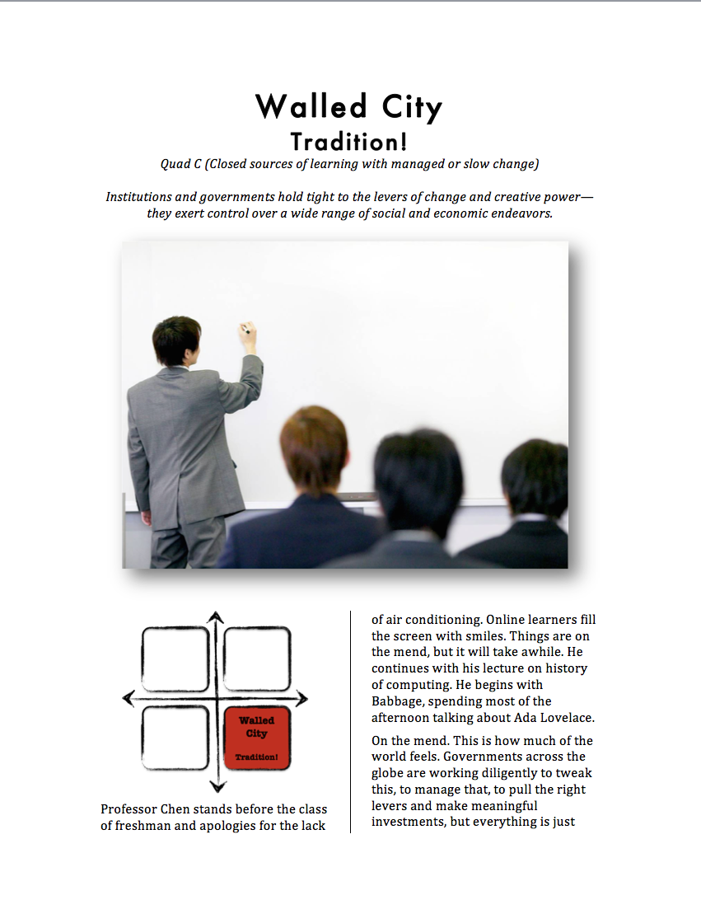
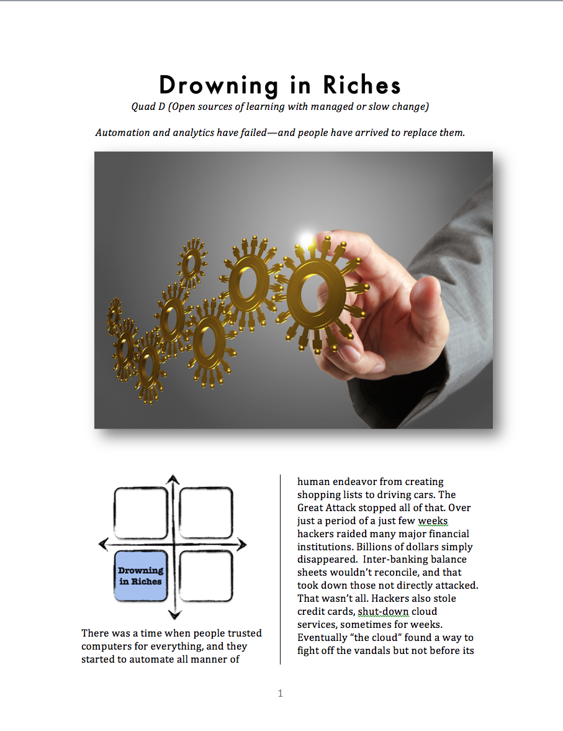
The USG Scenarios The Futures of Learning in 2030

Slide 15

Find Your Own Path
Open Source – Rapid Change
EVERYONE IS AN EXPERT – BUT NO ONE IS A GATEKEEPER
INVENTION AND REINVENTION ARE RAMPANT.
WORKPLACES PREFER ‘MICRO-DEGREES’ TIED TO SKILLS
PUBLIC INSTITUTIONS ARE BARELY FUNDED BY THEIR STATES.
PRIVATE ENTITIES ARE MORE NIMPLE AND LESS BURDENED THAN PUBLIC INSTITUTIONS
EARLY WEALTH IS THE GOAL
MARK ZUCKERBERG IS THE GOD

Slide 16
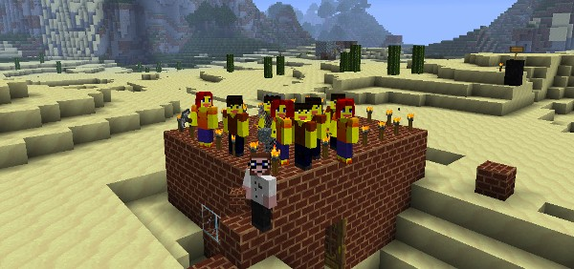
To Each Their Own
Rapid Change – Closed Academy
UNIVERSITIES ABSORB THEIR FEEDER COLLEGES AND RUN CHARTER SCHOOLS - CONTROLLING THE EDUCATIONAL PIPELINE.
TECHNOLOGICAL, EDUCATIONAL AND SOCIAL CHANGES ARE MANAGED BY GATEKEEPERS.
RULES AND ROADS TO SUCCESS ARE CLEAR…BUT USUALLY PRIVATE
INSTITUTIONS AND CORPORATIONS ENFORCE THEIR OWN PROPRIETARY SOLUTIONS…STANDARDIZATION IS RARE.
REPUTATION IS KING.
REINVENTION COMES FROM WITHIN THE ACADEMY WHICH HAS USED IT’S POLITICAL MUSCLE TO BLOCK EXTERNAL TRESPASSERS TO THE CAMPUS.

Slide 17
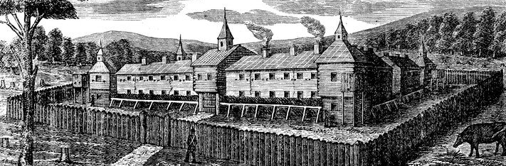
Walled City
Closed Academy – Slow Change
CHANGE IS CONTROLLED
DRIVEN BY – BUSINESS AND THE GOVERNMENT – BUT ITS PACE IS GLACIAL.
INNOVATION FOCUSES NOT ON ‘THE NEXT BIG THING’ BUT ON OPTIMIZATION THROUGH STANDARDIZED APPROACHES.
PUBLIC FUNDING INCREASES
A STABLE ECONOMY AND INCREASES IN NEW MAJORITY STUDENTS INCREASES TAX REVENUES & PUBLIC FUNDING TO COLLEGES.
A JOB AND SCHOOL FOR LIFE
GOWN TO COMPANY COOPERATION LETS FACULTY AND STUDENTS MOVE BACK AND FORTH AT SEVERAL CAREER POINTS

Slide 18
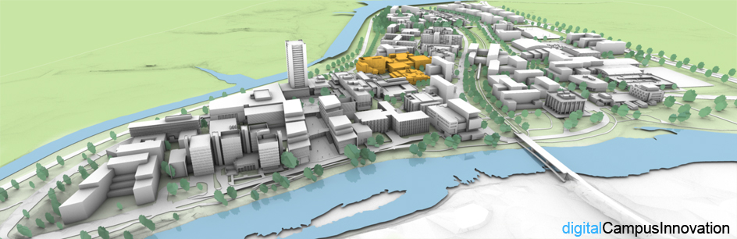
Drowning in Riches
Slow Change – Open Source
MUCH EXPERIMENTATION
BUT FEW EXPERIMENTS GO BEYOND TESTING TO ADOPTION.
OPEN COMPETITION FROM FOR-PROFITS HAS GUTTED PUBLIC COLLEGE REVENUES
SHIFTS ARE SMALL AND INCREMENTAL
THE RISE OF THE PUBLIC LIBRARY AS THEY MOVE FROM CURATOR TO CULTIVATOR.
FACULTY ARE FREE AGENTS SELLING SERVICES AS INFORMATION NAVIGATORS, VALIDATORS AND CAREER PATHFINDERS.

Slide 19

Join the Crowd
https://opencourses.desire2learn.com/
Notes:
“Our future is not about our past success.” (Nadella, 2013)

Slide 20
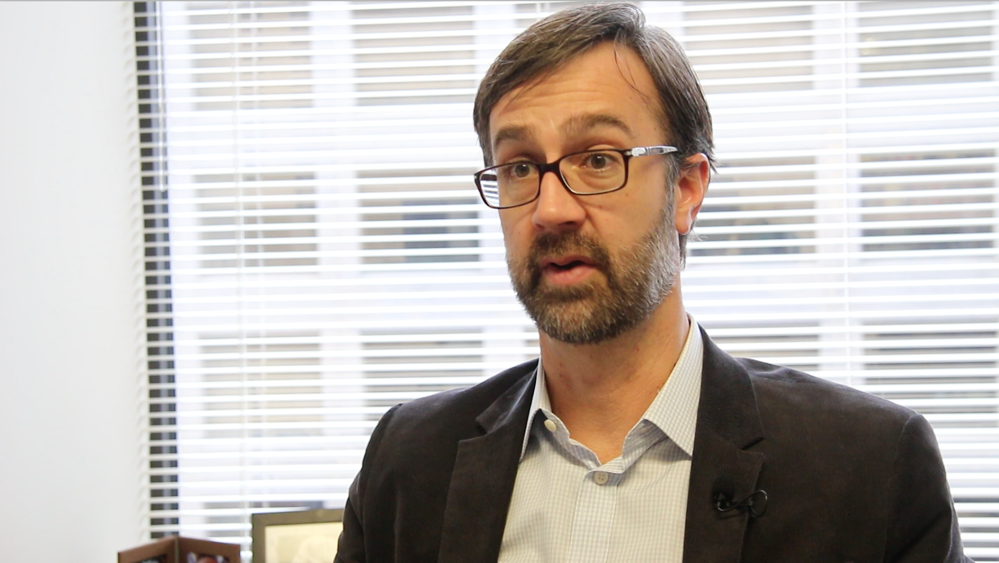
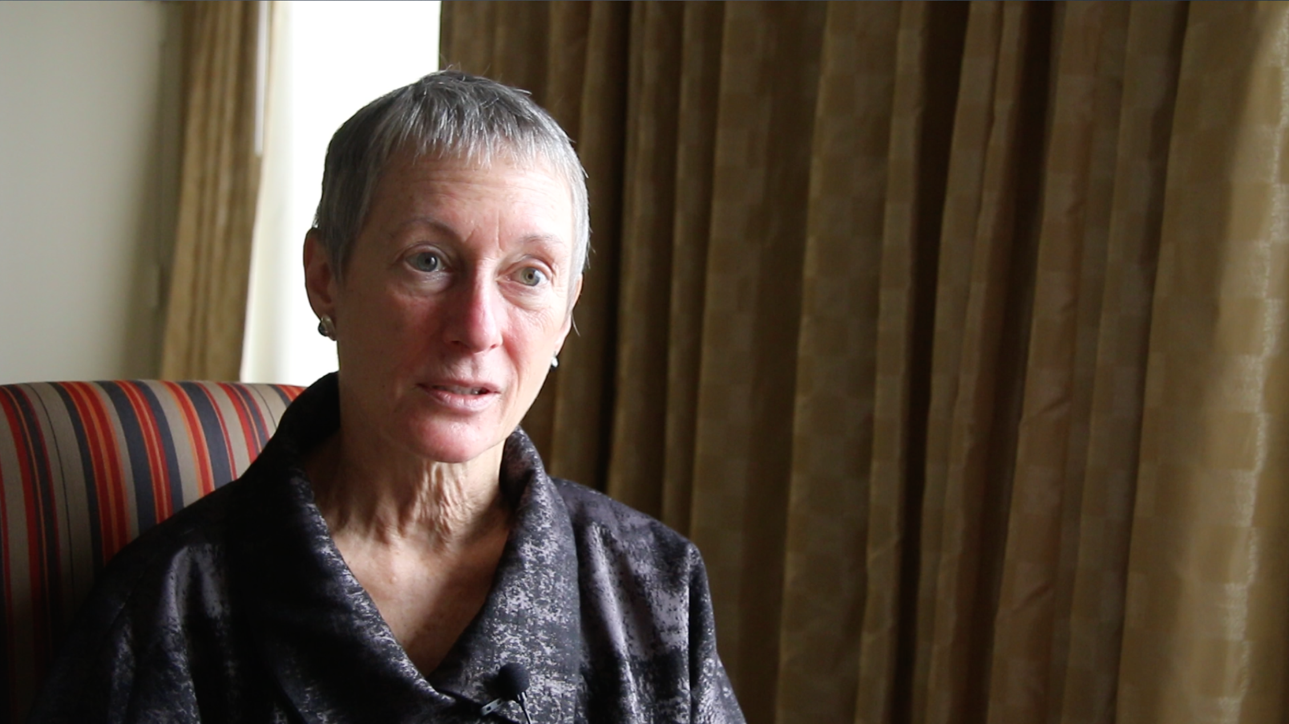
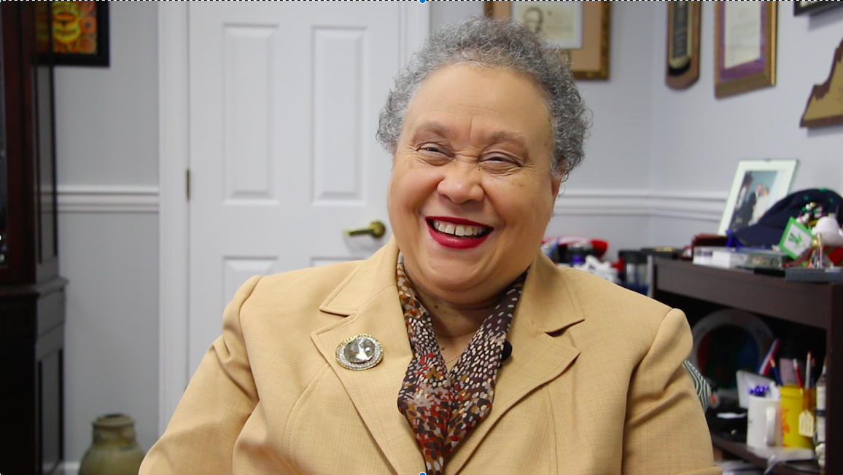
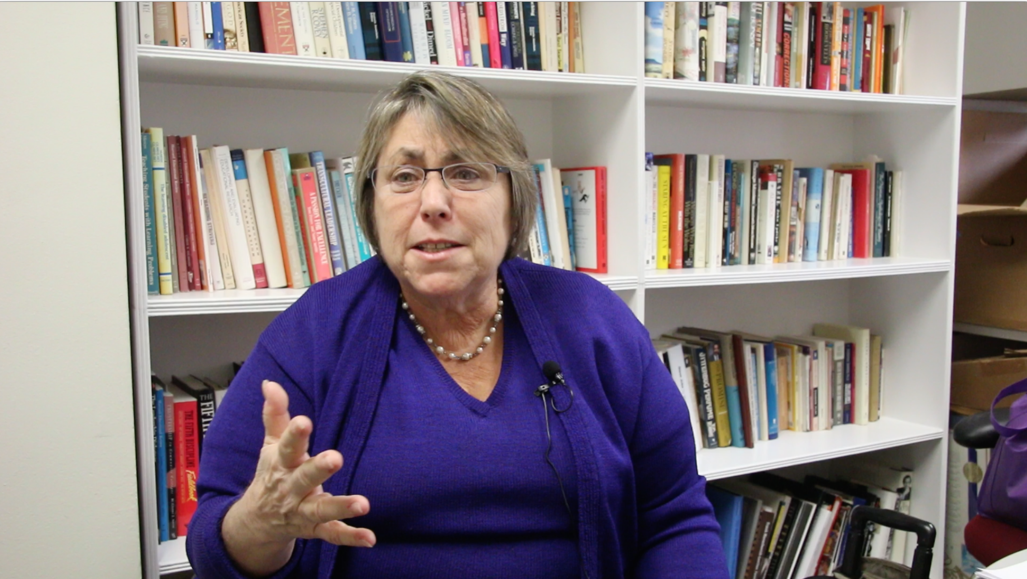
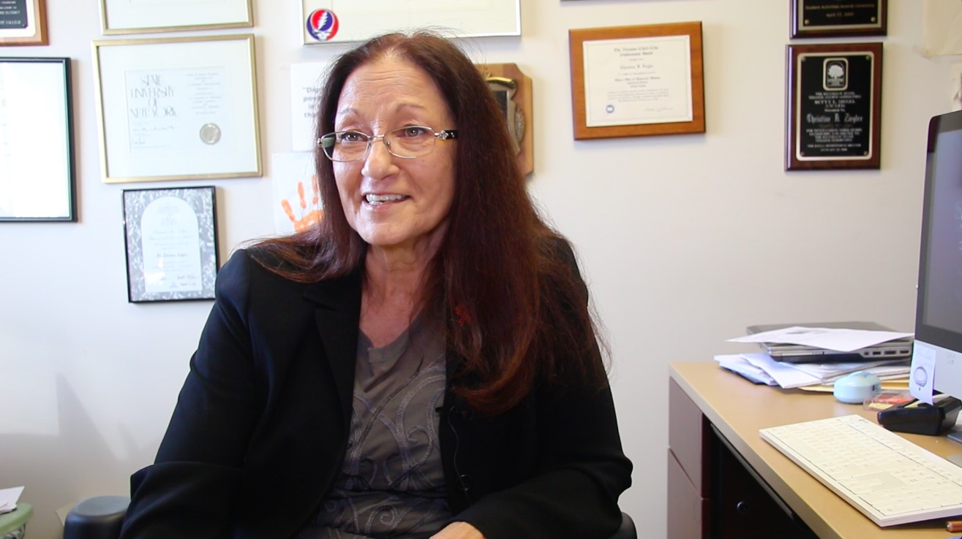
Explore with Experts
Kevin Carey, New America
Susan Albertine, AAC&U
Belle Wheelan, SACS
Martha Kanter, NYU
Christine Ziegler, KSU

Slide 21
“The Future is scary, but you can’t just run back to the past because it’s familiar”
Robin Sherbatsky

Slide 22
Pressure to Change
Services for Students
Faculty Activities
Instruction (Undergraduate – Lower Division)
1
2
3
4
5
6
7
8
9
10
Instruction (Undergraduate – Lower Division)
Financial Aid
Instruction (Undergraduate – Upper Division)
Instruction (Undergraduate – Upper Division)
Tenure and Advancement
Advising
Textbook & Instructional Materials
Information Services & Technology
Instruction (Graduate)
Instruction (Graduate)
Research
Admissions, Registration, Transcripts
Advising
Library Services
Employment
Bookstore
Grants
Career Services
Service
Notes:
“Our future is not about our past success.” (Nadella, 2013)

Slide 23
Critical Success Factors
Students
Must be willing to be generalists to accumulate credentials in a variety of ways, formats and locations
Faculty
Will need to be highly specialized free agents , focused on being a brand and a superstar in their field, adept at recruiting the best students and creating stars
Institutions
Will create partnerships to resource, repackage, share and syndicate knowledge; able to articulate & demonstrate value while sustaining a solid pricing model
Notes:
“Our future is not about our past success.” (Nadella, 2013)

Slide 24
IMPLICATIONS for New Learning Models
Plenty of Content
Content will be easily available and very cost efficient
Smaller Learning
Course development will take a ‘micro’ approach to content delivery focusing on smaller units/skills that are clearly defined, sequenced and linked
Agile Development & Deployment
Faculty experts direct change quickly and nimbly using innovative assembly and delivery modes such as: directed learning, competency-based learning, micro-credentialing, badges
and service/experiential learning
Notes:
“Our future is not about our past success.” (Nadella, 2013)

Slide 25
What’s Next
Explore the Beyond
LIVE Webcast – March 24
NLM 2030 Taskforce
Recommendations for Strategic Action
Summer 2015
New Learning Models Symposium
Notes:
“Our future is not about our past success.” (Nadella, 2013)

Slide 26
