Slide 1

Overlay Requirements
Cindy Taylor
RACRA
April 4, 2012

Slide 2
Overlay Requirements
Revision to Core Curriculum
Created new form and process to allow institutions to specify the courses or tests that can be used to fulfill an overlay requirement and update the requirements on Georgia Requirements Form (ZOAGARP).
Added overlay requirement status to USG Academic Transcript (ZHRTRTC).
Georgia Enhancements 8.12 released on December 16, 2011

Slide 3
Documentation
Release Review slides
http://www.usg.edu/georgia_best/training/georgiabest_etraining
Test Plan
http://www.usg.edu/georgia_best/testplans_relnotes/gamods8_12_testplan_FINAL.pdf
Workbook
http://www.usg.edu/georgia_best/user_docs/gamods8_12_CoreOverlayRequirements_workbook_FINAL.pdf

Slide 4
New Functionality
Overlay Requirements Fulfilling Courses/Test Scores Form (ZOAORFC)
Overlay Requirement Update Process (ZORORUP)
Script to insert Overlay Requirement values in Hold Type Code Validation Form (STVHLDD)
Script to insert Overlay Requirement values in Non-Course Requirements Code Validation Form (STVNCRQ)
Script to insert Overlay Requirement values in Georgia Requirements Hold Rules Form (ZOAGARH)
Script to insert Overlay Requirement values in Georgia Requirements Type Validation Form (ZTVGARQ)

Slide 5
Enhancements
Georgia Requirements Type Validation Form (ZTVGARQ)
Transcript Type Rules Form (ZHATPRT)
USG Academic Transcript (ZHRTRTC)

Slide 6
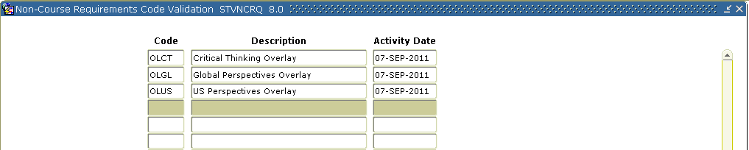
Setup
Confirm non-course requirement codes on Non-Course Requirements Code Validation form (STVNCRQ).
ITS provided script to insert required values.

Slide 7
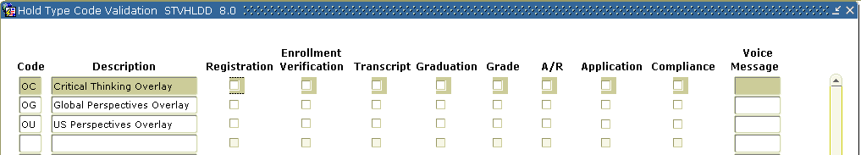
Setup
Confirm hold type codes and establish hold rule on Hold Type Code Validation form (STVHLDD).
ITS provided script to insert required values.
No indicators checked by the validation code delivery script.
Check the hold indicators based on institutional requirements.

Slide 8
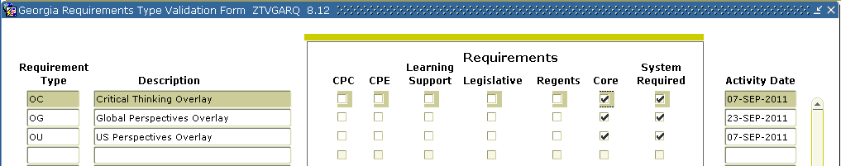
Setup
Confirm requirement type codes on Georgia Requirement Type Validation form (ZTVGARQ).
ITS provided script to insert required values.
New Core checkbox column added and checked for overlay requirements.

Slide 9
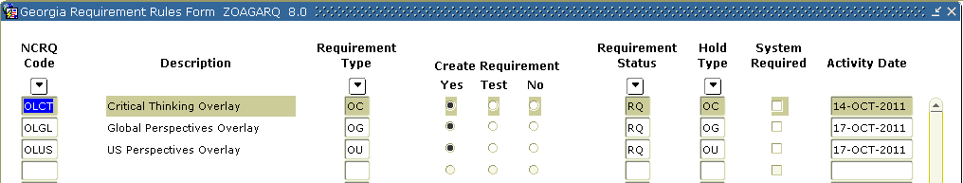
Setup
Create rules on Georgia Requirement Rules form (ZOAGARQ) using new STVNCRQ, ZTVGARQ and STVHLDD codes.
Select Yes for Create Requirement indicator to add NCRQ codes to ZOAGARP as a default requirement.

Slide 10
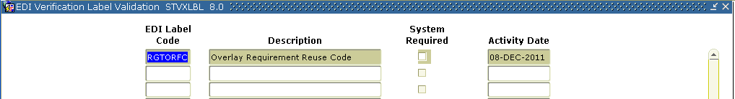
Setup
Create overlay requirement reuse label on EDI Verification Label Validation form (STVXLBL).

Slide 11
Setup
Create overlay requirement reuse translation on EDI Cross-Reference Rules form (SOAXREF) for Cross-Reference Label RGTORFC.
Based on the current policy, courses previously used to satisfy a Legislative requirement can be used to satisfy the OLUS (US Perspectives) overlay requirement. The RGTORFC translation will be used by the ZORORUP process to identify the NCRQ codes associated with the Legislative requirements.

Slide 12
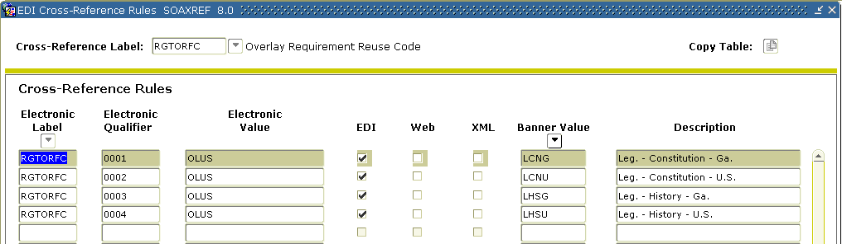
Setup

Slide 13
Setup
Create rules on Overlay Requirements Fulfilling Courses/Test Scores form (ZOAORFC).
If both course and test score rules are built on ZOAORFC for a requirement, the Overlay Requirement Update Process (ZORORUP) will satisfy the overlay requirement if the student fulfills either the course rules or the test score rules. The process does not require both course and test score rules to be met in order for a student to satisfy the requirement.

Slide 14
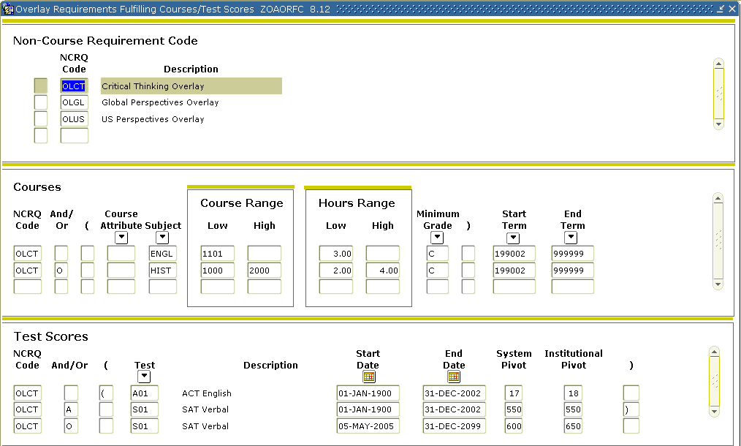
Setup
Screenshot only depicts form functionality, not actual requirement rules. Build rules that are appropriate for your institution.

Slide 15
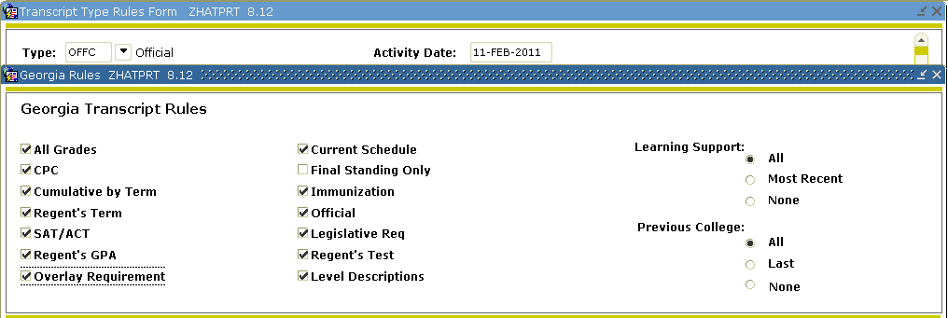
Setup
Check the new Overlay Requirement indicator on Transcript Type Rules form (ZHATRPT) to print requirement status on USG Academic Transcript (ZHRTRTC).

Slide 16
Process Flow
Run Overlay Requirements Update process (ZORORUP) to evaluate overlay requirements based on ZOAORFC rules and SOAXREF > RGTORFC overlay requirement reuse translations and update ZOAGARP as well as end/remove holds.
Run ZORORUP during end-of-term processing after CPC Requirement Update process (ZORCPCR) and Legislative Requirements Update process (ZORLHCR).

Slide 17
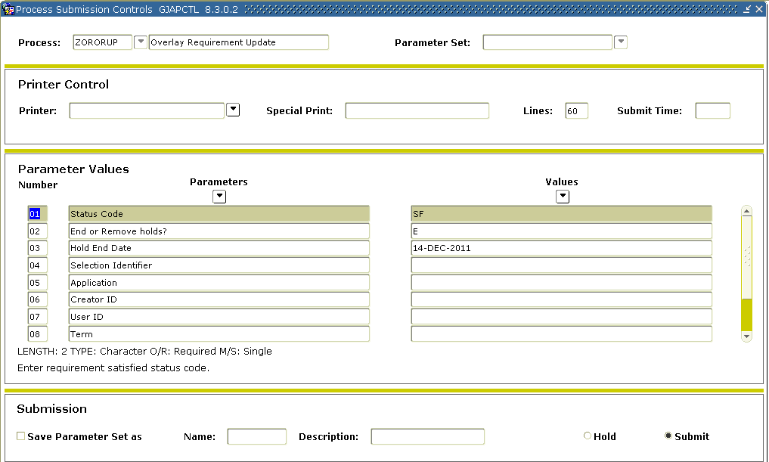
Overlay Requirements Update Process (ZORORUP)

Slide 18
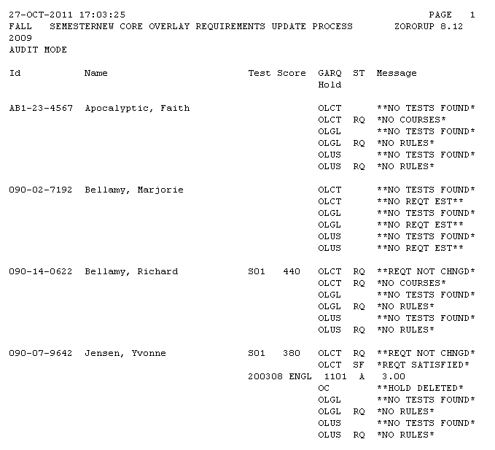
Overlay Requirements Update Process (ZORORUP)

Slide 19
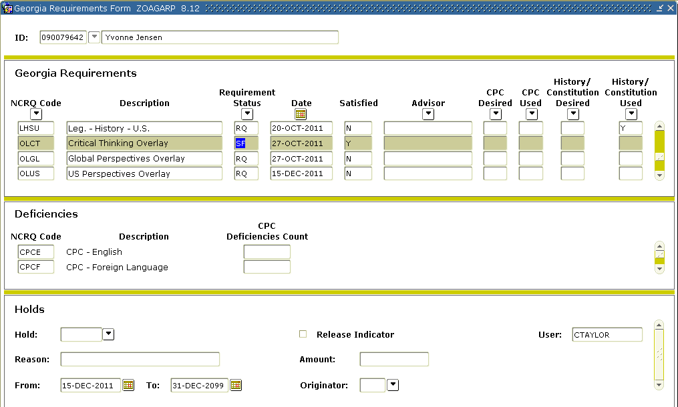
Georgia Requirements Form (ZOAGARP)

Slide 20
Process Flow
Generate ZHRTRTC transcript with overlay requirement status.
Use transcript type with Overlay Requirement indicator checked on ZHATPRT.
The Overlay Requirement status will indicate blank for unsatisfied and S for satisfied.

Slide 21
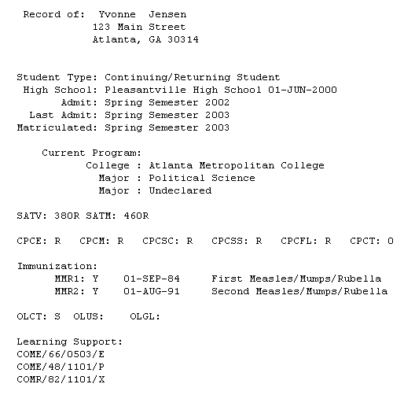
USG Academic Transcript (ZHRTRTC)

Slide 22

Questions

Slide 23
Additional ITS Resources and Support
To create a new or update an existing production down, business interrupting (emergency) support request, call the ITS Helpdesk immediately
706-583-2001
1-888-875-3697 (toll free in Georgia)
For anything else, contact the ITS Helpdesk at
http://www.usg.edu/customer_services (self-support request) or
E-mail helpdesk@usg.edu
Note: Self-Service requires login using a user ID and access code. Contact the ITS Helpdesk at helpdesk@usg.edu to obtain self-service login credentials.

