Slide 1

USG Housing P³ Initiative
RACAA Meeting
February 18, 2015
Jonathan.Lucia@usg.edu

Slide 2
Guiding Principle
Quality, safe, affordable housing for students
Objectives
Provide additional housing for USG students without incurring additional BOR capital lease obligations;
Reduce the amount of BOR capital lease obligations associated with the portfolio of existing housing assets;
Leverage private sector efficiencies in the design, construction, operations and maintenance of student housing; and
Develop a long-term relationship between the USG, its member institutions and a private housing provider (Concessionaire) to attract students to live on-campus and to enhance the college experience for these students.

Slide 3
Key Milestones
Board of Regents assembled a team of Advisors/Consultants – June/July 2013
Phase I Campuses Selected – July/August 2013
Board of Regents establishes Guiding Principles for P3 – October 2013
Prepared Due Diligence on Phase I Campuses – July 2013 – October 2014
Marketed P3 Program to Potential Developers – November 2013 – April 2014 (Presented Proposed USG P3 Program at 3 National Conferences)
Issued Request for Qualification – May 2014
Three Firms Short listed – July 2014
Final Concessionaire RFP proposals submitted – October 2014
Referendum Approved by Voters for P3 Property Tax Abatement – November 4, 2014
Corvias Campus Living selected as Concessionaire – November 2014
Master Concession Agreement Executed – November 2014
Kickoff Meetings on campuses-December/January 2014-2015
April 2015 Financial Close-(anticipated)
Leaseback Period-May/June 2015
Project Turnover Date-July 1, 2015
Completion of new construction-July 2016

Slide 4
BOR USG – Corvias Partnership Every Objective Met
$300 million in debt retired
New Housing financing non-recourse to BOR
Reinvestment plan ensures a funding source for major building overhaul or replacement of housing
Rent Caps with BOR final approval
Campuses compensated for residence life, security and rent collection expenses
Management fees are performance-based
Default for failure to perform, failure to pay rent to BOR, bankruptcy

Slide 5









Phase I – Existing and New Beds
 | Existing Beds | New Beds | Total
ABAC | 1,324 | - | 1,324
ASU | 1,239 | - | 1,239
CCG | 352 | 220 | 572
CSU | 444 | 520 | 964
DSC | - | 364 | 364
EGSC | 200 | 214 | 414
GSU | 2,322 | 1,152 | 3,474
GRU | - | 727 | 727
UNG | 314 | 536 | 850
TOTAL | 6,195 | 3,733 | 9,928
400
75
85
20
20
75
185
16
75
95

Slide 6
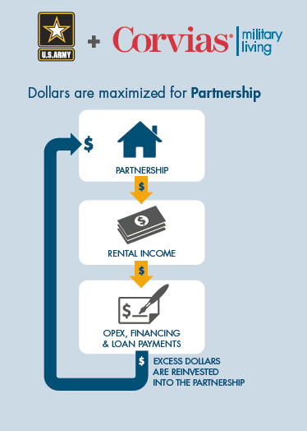
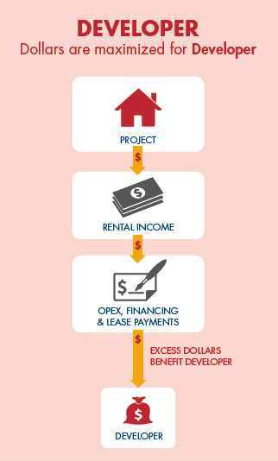


The Traditional P3 Model: A Comparison
Notes:
Jennifer

Slide 7


Student Centered Partnership

Slide 8
Student Centered Partnership
New Residence Hall Design process that……
is collaborative
is catered to campus culture and needs i.e. living learning programs, faculty in residence
is focused on providing intentional spaces for community development, educational programming, & interaction
requires minimum design standards
results in secure, comfortable, attractive, & state of the art living environment

Slide 9


Slide 10
Student Centered Partnership
Quality Assurance
Fees paid to Corvias are based on key performance indicators
Student satisfaction
Condition of facilities
Work order completion
Occupancy
Campuses Maintain Control
Housing assignments
Program elements i.e. living-learning, faculty in residence
Code of conduct
Live-on requirement
Meal plan requirement
Collaborative governance structure

Slide 11
Student Centered Partnership
Seamless Approach
Campus representatives drafted the operating agreement with a seamless student experience as the primary goal
All residence life, security, rent collection, and grounds keeping functions retained by campuses
Students will continue to pay their housing fees as they previously have and financial aid will apply as usual
Rental rate increases capped at 3%
All marketing subject to approval by campus

Slide 12
Student Centered Partnership
Operating Efficiencies
Purchasing power leveraged across projects
Focus on energy efficiency and sustainable practices and materials-will include educational component for students
Identification & alignment of best practices across institutions
Allows institutions to focus on core mission while providing well maintained facilities that are conducive to student success
Residual income from the cost savings and efficiencies stays with the campuses, the projects, and the BOR-not the private partner
Operating efficiencies create improved stewardship of student fees

Slide 13
Student Centered Partnership
Immediate capital improvements
Corvias funding $5.6M for up-front capital repairs and renovations to existing buildings
Foundation Disbursements
$500,000 per year for needs-based aid-escalates 3% annually
Part of contractual agreement with Corvias
Funds distributed from USG Foundation to individual Foundations
MOU will be provided
Similar to other USG Foundation arrangements, Presidents will determine award process

Slide 14
Governance Structure
Operating Team
Concessionaire Operations Director
Residence Life
Security
Finance, Financial Aid, Controller, Bursar
Execution of partnership, issue identification and day-to-day problem solving
Management Committee
Concessionaire Operations Director
Campus P3 Coordinator
Finance, Student Affairs, Facilities, Housing
BOR P3 portfolio manager
Oversee and monitor, evaluate performance, coordinate, resolve issues
Portfolio Management Committee
Concessionaire Portfolio Manager
Campus P3 Coordinator
BOR P3 portfolio manager
BOR leadership
Establish standards and procedures, ensure accountability, portfolio decisions

Slide 15
Flow of Funds
Revenues:
1. Gross Revenues
Student Housing Rents, Application/Reservation Fees, Summer Revenue
Other income; campus rental of space etc.
Operating Expenses:
2. Ground Rent (Guaranteed)
3. Retained Services (15% GR)-Residence Life, Rent Collection, Security, Grounds keeping, Marketing
4. Operating Expenses
5. Repair and Replacement Reserve ($175.00 per bed)
Debt Service
Net Operating Income
6. Base Management Fee-2%
7. Performance Management Fee-2.25% (based on Key Performance indicators)
Net Cash Flow
8. 50% Residual Cash Flow to USG (Contingent Rent)
9. 50% Reinvestment Reserve Fund

Slide 16
FY 2016 Campus Disbursements
 | Retained Services | Base Rent |  | Total Payment
Total Revenue | $43,891,325
ABAC | 974,000 | 1,300,000 |  | 2,274,000
ASU | 1,015,000 | 1,050,000 |  | 2,065,000
CCG | 275,000 | 140,000 |  | 415,000
CSU | 470,000 | 670,000 |  | 1,140,000
DSC | 0 | 140,000 |  | 140,000
EGSC | 175,000 | 140,000 |  | 315,000
GSU | 3,430,000 | 1,300,000 |  | 4,730,000
UNG | 245,000 | 335,000 |  | 580,000
GRU | 0 | 175,000 |  | 175,000
Total Campus Distributions | $6,584,000 | $5,250,000 |  | $11,834,000
 | 15.00%

Slide 17
FY 2017 Campus Disbursements
 | Retained Services | Base Rent |  | Total Payment
Total Revenue | $69,438,194
ABAC | 1,052,000 | 1,020,000 |  | 2,072,000
ASU | 1,047,720 | 1,060,000 |  | 2,107,720
CCG | 488,000 | 200,000 |  | 688,000
CSU | 1,160,000 | 670,000 |  | 1,830,000
DSC | 345,000 | 185,000 |  | 530,000
EGSC | 393,009 | 200,000 |  | 593,009
GSU | 4,630,000 | 1,300,000 |  | 5,930,000
UNG | 700,000 | 430,000 |  | 1,130,000
GRU | 600,000 | 325,000 |  | 925,000
Total Campus Distributions | $10,415,729 | $5,390,000 |  | $15,805,729
 | 15.00%

Slide 18
Phase II
Review of campus requests underway
Analysis of debt and performance of entire housing portfolio
Discussions with potential participants & due diligence-February-May 2015

