Slide 1

Affordable Learning Georgia:
Raising Awareness About How Textbooks Affect Student Success
Information for Stakeholders
2014

Slide 2
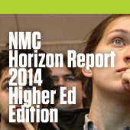
Technologies
Consumer Technologies
Digital Technologies
Internet Technologies
Social Media Technologies
Learning Technologies
Visualization Technologies
Enabling Technologies
Challenges
New Models
Digital Literacy of Faculty
Rewards

Slide 3
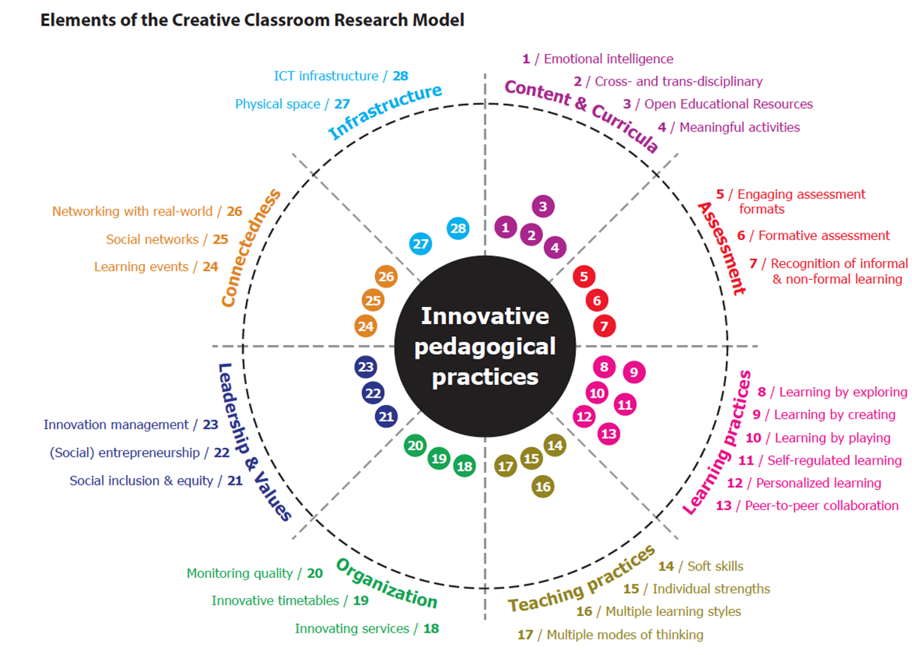

Slide 4
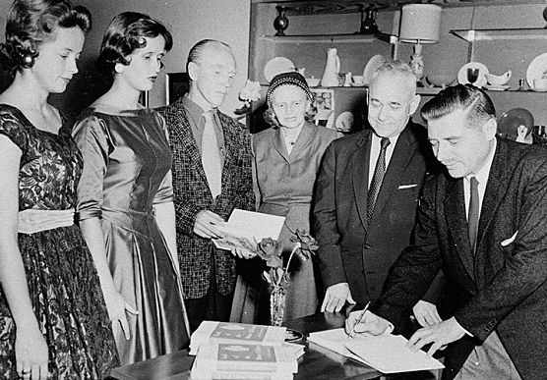
Textbooks
Photograph of signing of the first book published by a faculty member at Georgia College, Milledgeville, Baldwin County, Georgia, 1956. Vanishing Georgia, Georgia Division of Archives and History, Office of Secretary of State. Digital Library of Georgia.
Trends and Issues

Slide 5
Background: Textbooks and Student Success Barriers
According to a study of the U.S. Government Accountability Office, the annual average amount spent by college students on textbooks is 26% of the cost of tuition at a public, four-year university.*
Columbus State University undergraduate students spend a minimum over 4 years of $4500 on textbooks ** and graduate with an average debt of $25,687*** and an average annual student loan payment of $3,715****
SOURCES
* College Textbooks, GAO-05-806, July 2005. U.S. Government Accountability Office.
** Mark Flynn, CSU: Total list price for core courses textbooks = $2,300 - $2,500. For course texts in the major, depending on discipline = $2,300-$4,500 more. The total four years = $4,500-$7,000 depending on the discipline.
*** US News College Report. Columbus State University. ****College Measures. Columbus State University.

Slide 6
Background: Textbooks and Student Success Barriers
Students spend an average of $1200 a year on textbooks. *
65% of students surveyed reported that they had decided against buying a textbook because it was too expensive.***
94% of students surveyed who had decided not to purchase the textbook feared that doing so would hurt their grade. More than 50% of these students felt significant concern for their grade.***
Almost 50% of students surveyed reported that the cost of textbooks impacted how many/which classes they took each semester.***
According to “Turning the Page” a June 2013 report on the textbook market from the Lumina Foundation, “approximately 30 percent of college students do not purchase textbooks required for specific classes.”**
SOURCES:
* Trends in College Pricing. p. 11, 2013-14. The College Board.
** Turning the Page. June 2013. Lumina Foundation
*** Fixing the Broken Textbook Market. January 2014. U.S. PIRG Education Fund and the Student PIRGs

Slide 7
How Students Get Texts
SOURCE: College Textbooks, GAO-13-368, June 2013. U.S. Government Accountability Office.

Slide 8
How Students Get Texts
SOURCE: Chronicle of Higher Education, Technology, Graphic, January 27, 2013

Slide 9
Recent USG OER Adoptions: Student Savings and Impacts
Summer 2013: The first USG-developed electronic Open Textbook, US History I, was published. Partnership with University of North Georgia and faculty from UNG, FVSU, and GPC. Saves students nearly $100 while providing rich and fully sourced content.
SAVINGS:
Adopted for use in USG's eCore History I classes over the Summer and Fall 2013 semesters, saving students more than $44,000.
Summer and Fall 2013 student savings from the use of Open Textbooks in e-Core Calculus I, Intro to Statistics, and U.S. History 1 totaled over $84,000.
IMPACTS:
In Spring 2013, prior to open text implementation: 88% of the students in HIST2111 competed the course.
In Summer 2013, the first semester with the Open Textbook, retention increased to 94%. Completion rose from 56% in the spring to 84% in the summer with the open textbook.

Slide 10

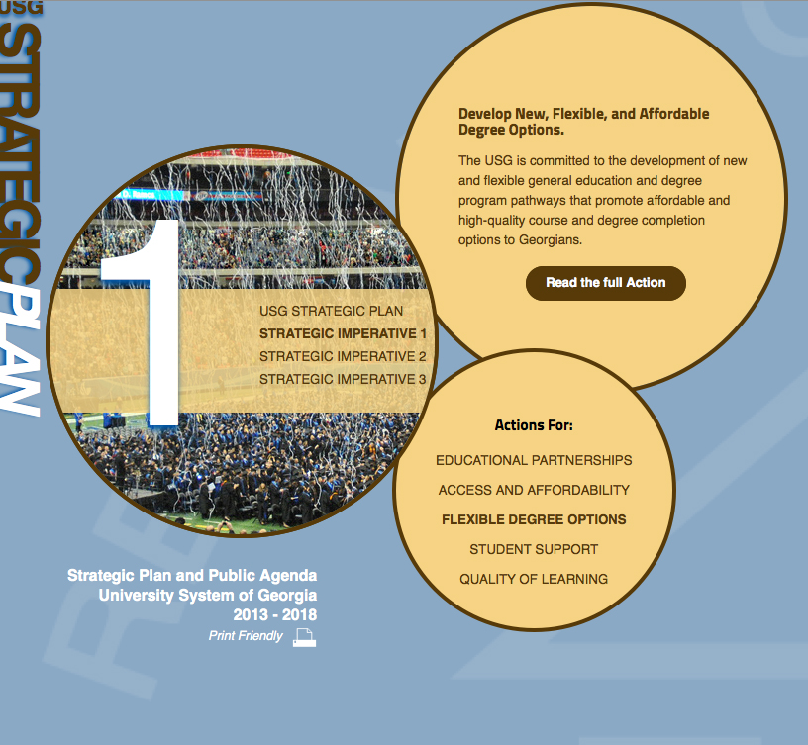
Affordability Accessibility Choice
USG Vision: Reduce the cost of instructional resources as a strategy for ensuring student success
New
Models
USG Strategic Imperative 1: Academic Excellence and Degree Completion
We will maximize our resources and strengthen educational partnerships to ensure that Georgians have a seamless educational system that is both affordable and of the highest quality.
Actions for Flexible Degree Options: Develop New, Flexible, and Affordable Degree Options
The USG is committed to the development of new and flexible general education and degree program pathways that promote affordable and high-quality course and degree completion options to Georgians. Next generation academic program structures and innovations in distance learning, prior learning assessment, and open courses and learning resources provide opportunities for great expansion of the academic enterprise

Slide 11
Complete College Georgia: Retention
SOURCE:
Complete College America, College Completion Data. State Data. Georgia 2011. p. 4. Complete College America. 2011.

Slide 12
Affordable Learning Georgia
A Brief Overview

Slide 13
Background: Affordable Learning Georgia Project
A University System of Georgia (USG) initiative to promote student success by providing affordable textbook alternatives, part of the overall plan to expand affordable access to USG education through multiple pathways including both traditional residential, “traditional” online, and new online modalities such as MOOCs
A one-stop service to help USG faculty and staff identify lower-cost, electronic, free, and Open Educational Resources, building on the cost-effective subscription resources provided by GALILEO and the USG libraries
A California State University partnership

Slide 14

Affordability Accessibility Choice
California State University Partnership
---
USG Focus
June 2013-June 2014:
Established working relationship and acquired framework for launching USG Affordable Learning initiative, including MERLOT and website
Campus Champions and Library Coordinators
Stakeholder Focus Groups
Newsletter, Videos

Slide 15
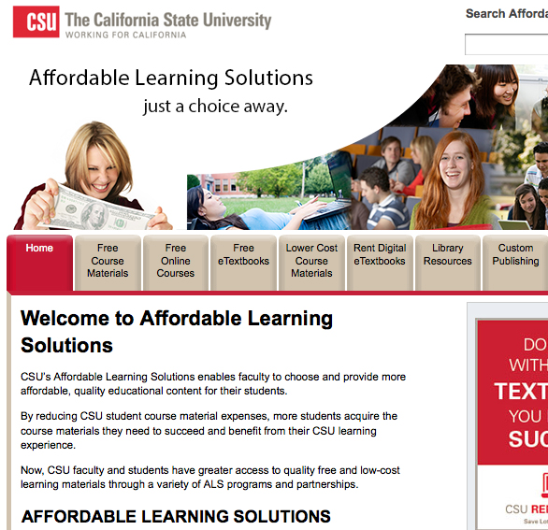
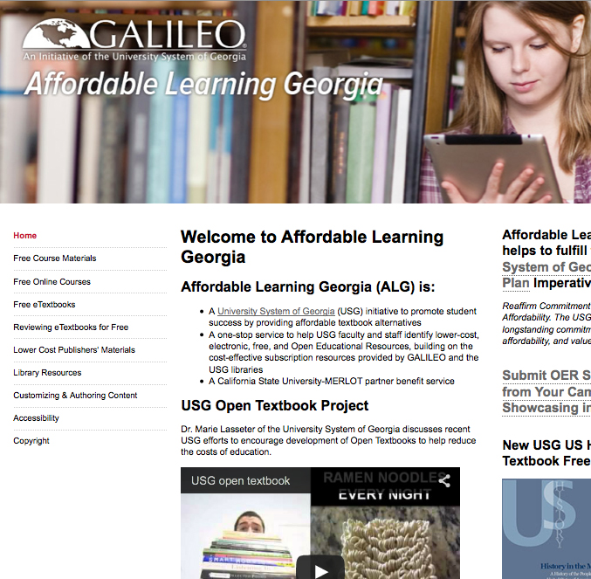
ALG Website
$ Based on structure provided by Affordable Learning Solutions, providing quick access to thousands of OER resources, including textbooks. Continues to evolve and change
$ Linkages to GALILEO, USG Libraries, USG Bookstores, AMAC (Alternative Media Access Center for accessibility support), USG Copyright, andmore
$ LibGuides framework and implementation for course reading list support
$ Third-generation site in development for enhanced content management, success story showcase, newsfeed, and more
www.affordable learninggeorgia. org
libguides.galileo.usg.edu

Slide 16


Affordability Accessibility Choice
MERLOT, OER, GALILEO, and Library alternatives to textbooks

Slide 17
Videos
Georgia College and State University
2014 Affordable Learning Georgia
Watch the Video
The Impact of A Free Book
2013 OpenStax College
Watch the Video

Slide 18




Affordability Accessibility Choice
Beyond ADA— financial barriers to timely access to textbooks have negative impact on student success

Slide 19

Affordability Accessibility Choice
No Mandate….
Traditional
Faculty authored
E-textbooks
Rental programs
Library resources

Slide 20

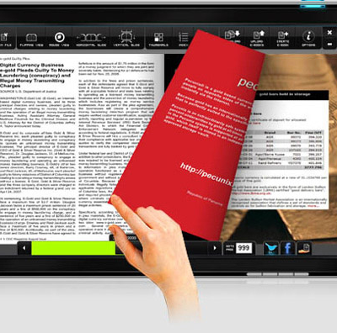

Funding for FY15
Affordable Learning Georgia / GALILEO
Support from Governor and General Assembly
Need to show significant current and anticipated savings by October 2014
Planning underway for specific strategies
Dialogue with stakeholders, including this presenttion

Slide 21
Next Steps
May 2014-June 2015

Slide 22

GOING FORWARD: ACTIVITIES AND STRATEGIES
Possible Goals/Programs:
OER for eCore
OER for Top Fifty Courses
OER Adoption Program: working with campuses
Bookstore program
Symposium on the Future of the Textbook

Slide 23
ONGOING Conversations
USG Community
Faculty/Staff
Administrators
Students
Libraries
University Presses
Bookstores
AMAC
IT
Others
CAL State
SUNY
Florida
Oklahoma
Lumina Foundation
And more…
Vendors
SIPX
Verba
D2L
OpenStax
Lumen Learning
And more…
And learning…..

Slide 24


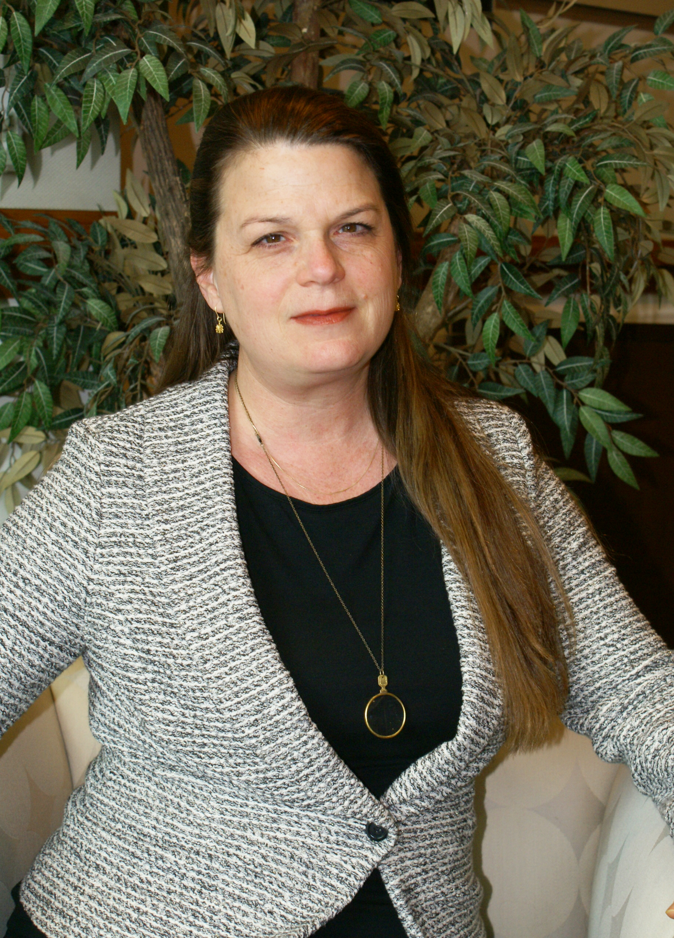
Lauren Fancher
Jeff Gallant
Marie Lassiter

Slide 25
How can you help?
DISCUSSION

Slide 26
Readings
Baraniuk, R. G., & Burrus, C. (2008). Global Warming Toward Open Educational Resources. Communications Of The ACM, 51(9), 30-32.
Center for American Progress (2012) Dramatically Bringing Down the Cost of Education with OER.
EDUCAUSE Library (2013). Open Educational Resources (OER)
Lumina Foundation (2013) Turning the Page. An economic analysis of the market for textbooks: Current conditions, new developments and policy options
ITHAKA (2014) Opening the Textbook: New Opportunities for Libraries and Publishers
U.S. Government Accountability Office (2005). College Textbooks: Enhanced Offerings Appear to Drive Recent Price Increases
U.S. Government Accountability Office (2013). College Textbooks: Students Have Greater Access to Textbook Information

Slide 27
www.affordablelearninggeorgia.org
Subscribe to This Week in Affordable Learning Georgia email news

Slide 28
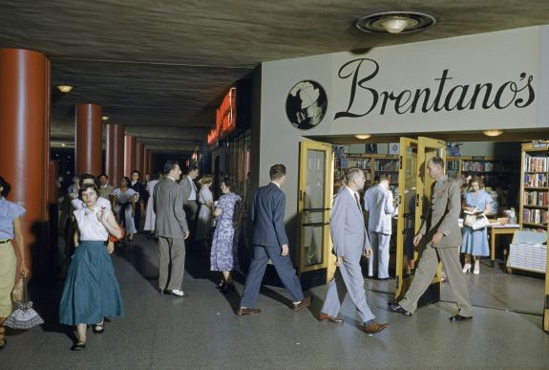
Bookstore discussion: July 17, Macon
VERBA
Compare
Compete
Collect
Audience
Bookstore Managers
Auxillary Services
CBOs
Pentagon employees walk past bookstore on the Concourse. Arlington, Virginia (Date: 1/1/1953), World History Image Collection

