Slide 1
Learning Support Changes/ Placement Options/ Associate Degrees by Reverse Transfer April 2, 2015 for RACRA
Barbara Brown
Office of Educational Access & Success
Barbara.Brown@usg.edu

Slide 2
Learning Support Changes: Where Are We Now?
Fall 2015
Two areas of Learning Support: English and Mathematics
Two levels of remediation in each area:
Foundations (3 – 4 credit stand-alone courses for least prepared students)
Corequisite (1 – 2 credit courses providing just-in-time support for students also enrolled in collegiate courses)

Slide 3
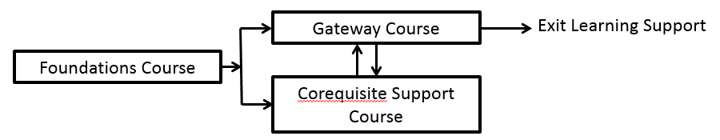
Fall 2015
The majority of students needing remediation should be placed into corequisite remediation.

Slide 4
Students may have up to two attempts to complete Foundations level courses. (Recommend allowing an additional attempt for students enrolled in remediation under the current system who have not exited Learning Support by Fall 2015.)
Institutions are NOT required to offer Foundations courses.

Slide 5
Students will exit Learning Support by completing the gateway (collegiate course) in their area of remediation.
Students will no longer be required to withdraw from unrelated collegiate courses when they withdraw from Learning Support courses.

Slide 6
Placement
A Mathematics Placement Index (MPI) and an English Placement Index (EPI) will be calculated based on:
High School Grade Point Average (HSGPA)
SAT or ACT
COMPASS (when indicated)
Required Fall 2016; earlier implementation is voluntary

Slide 7
Placement
When Compass testing is required,
the COMPASS Math test will be used for math placement.
the COMPASS Reading and COMPASS e-Write (2 -12) tests will be used for English placement (by Fall 2016).

Slide 8
Formulas
For institutions that require SAT or ACT for admission
Student applies with: | EPI | MPI
SAT and HSGPA (sh) | EPI_{sh} = (1603*HSGPA )+ SATV | MPI_{sh} = (291*HSGPA )+ SATM
SAT and HSGPA with Compass added (shc)** | EPI_{shc =} EPI_{sh} + (.08 * (EPI_{c} - EPI_{sh} )) | MPI_{shc =} MPI_{sh} + (.25 * (MPI_{c} - MPI_{sh} ))
SAT only (must take Compass)
SAT with Compass added (sc) | EPI_{sc} = (4.6*SATV) + (27.5*(COMPASSR+eWrite)) | MPI_{sc} = (1.7*SATM) + (13.3*COMPASSM)
ACT and HSGPA (ah) | EPI_{ah} = (1553*HSGPA) +(34*ACTE) | MPI_{ah} = (298*HSGPA) + (25*ACTM)
ACT and HSGPA with Compass added (ahc)** | EPI_{ahc =} EPI_{ah} + (.08 * (EPI_{c} – EPI_{ah} )) | MPI_{ahc =} MPI_{ah} + (.25 * (MPI_{c} – MPI_{ah} ))
ACT only (must take Compass)
ACT with Compass added (ac) | EPI_{ac} = (122*ACTE) + (26.3*(COMPASSR+ eWrite)) | MPI_{ac} = (57*ACTM) + (5.4*COMPASSM)
**Calculating EPI or MPI based on Compass-only for use in formulas marked with ** (c) | EPI_{c} = 51.6*(COMPASSR+eWrite) | MPI_{c} = (10*COMPASSM) + 795

Slide 9
Formulas
For institutions that do NOT require SAT or ACT for admission
 | EPI | MPI
HSGPA with Compass added (hc) | EPI_{hc} = (794*HSGPA )+ (23.6*(COMPASSR+eWrite)) | MPI_{hc} = (323*HSGPA )+ (6*COMPASSM)
No info Must take Compass (c) | EPI_{c} = 51.6*(COMPASSR+eWrite) | MPI_{c} = (10*COMPASSM) + 795

Slide 10
Interim Placement (until Fall 2016, if needed) Recommendations
In cases where placement testing is required, continue using the current Compass tests (Compass Math (algebra), Compass Reading, Compass English (writing))

Slide 11
Interim Placement Recommendations
The current minimum Compass test scores (unless institutions have set higher standards) required to exempt placement in Learning Support courses are:
*It is recommended (but not mandated) that a score of 47 be required for students wanting to enter in MATH 1111 (to ensure a reasonable chance of success.)
Minimum Compass scores for direct placement in collegiate courses.
Reading | English | Mathematics
74 | 60 | 37*

Slide 12
Interim Placement Recommendations
Students who place into Learning Support in either Reading or English should be placed in the new Learning Support English course, as reading will no longer be offered as a separate course.

Slide 13
Interim Placement Recommendations
Currently, students who would be placed in Learning Support in all three areas are not admitted to USG institutions. In the interim period, students who place into Learning Support in all three areas may be admitted to USG institutions as long as their scores do not fall below the minimum scores for admission to USG institutions (see below).
Minimum Compass scores for admission to USG institutions.
Reading | English | Mathematics
62 | 32 | 20

Slide 14
Interim Placement Recommendations
Currently, students scoring below the minimum score in one or more areas are not admissible to USG institutions. In the interim period, students who score below the minimum Compass score in only one area or in both English and reading (but not mathematics) may be admitted to a USG institution. Students who score below the minimum Compass score in mathematics AND English or reading will continue to be denied admission to USG institutions.

Slide 15
Interim Placement Recommendations
Institutions may decide where to set the cutoff between placement in corequisite remediation and in Foundations-level remediation (if both are offered). For institutions seeking guidance on this, the following cutoffs are suggested (but not mandated).
Suggested scores for placement into corequisite remediation (if both Foundations-level and corequisite Learning Support are offered)
Reading | English | Mathematics
66 | 40 | 25

Slide 16
Interim Placement Recommendations
It is recommended that students whose placement would be at the Foundations-level in either English or reading be placed into the new Foundations-level English course.

Slide 17
Associate Degrees by Reverse Transfer
Project: Credit When It’s Due
Funded by: Lumina Foundation
Goal: Facilitate exchange of information needed to award associate degrees via reverse transfer. (Increase degree completion in Georgia.)

Slide 18
Current (bachelor’s) institutions determine which students may be eligible for award of associate degrees via reverse transfer.
SQL script run against Banner
All students > Currently Enrolled> Working on Bachelor’s degree> Transferred in> No Associate Degree> Transferred from an Associate Degree Granting Institution in the USG> More than 15 credits transferred in> Cumulative credits greater than or equal to 60> Grade point average at least 2.0> Emails of students fitting all criteria.

Slide 19
Current (bachelor’s) institutions send emails to eligible students with link to Parchment landing page.
Sample email to student
Hello [Student name],
We’re glad that you chose to come to [Receiving Institution Name] from an associate-degree granting institution. We see that although you earned credits at your associate-degree institution, you did not receive an associate degree. Now that you have accumulated more than 60 credits between your associate degree institution and [Current Institution Name], you may be eligible for award of an associate degree.

Slide 20
We recognize that your current goal is a bachelor’s degree. However, having an associate degree can increase your earning power and make you eligible for more jobs while you work on your bachelor’s degree. And, in the event that your bachelor’s degree is delayed, you will have a degree in hand.
If you are interested in award of your associate degree, here’s what you need to know.
You will not have to take additional coursework at your associate degree institution.
You will not lose any of the credits you have earned at [Current Institution Name].

Slide 21
What will you have to do?
You will have to consent to have your transcript from [Receiving Institution Name] sent to your associate degree institution so that they can evaluate whether you have met their requirements for an associate degree.
You will have to indicate that you wish to be awarded the associate degree if you have met the requirements
You will have to agree that your associate degree institution can notify [Current Institution Name] if you receive an associate degree so that we can update our records.
You can do all of this and get the process started AT NO COST TO YOU, by clicking on this link and filling out the required information: www.parchment.com/USGrevtrans.
Your associate degree institution will contact you after evaluating your eligibility for award of an associate degree.

Slide 22
We hope you will take advantage of this opportunity. It is a win-win for you. If you meet the requirements for an associate degree, you will receive the degree, increasing your employability and earning potential. If you do not yet meet requirements for a degree, your associate degree institution can tell you what you need to do at [Receiving Institution Name] to meet requirements for the associate degree. Since all USG institutions share a core curriculum, courses that meet requirements at [Receiving Institution name] should also satisfy degree requirements at your associate degree institution, so you will not lose time or credit in seeking your associate degree.
If you have questions, you can contact me (Jane Doe) at [Receiving Institution Name] at Jane.Doe@usg.edu or 404-XXX-XXXX.
Best,
Jane Doe

Slide 23
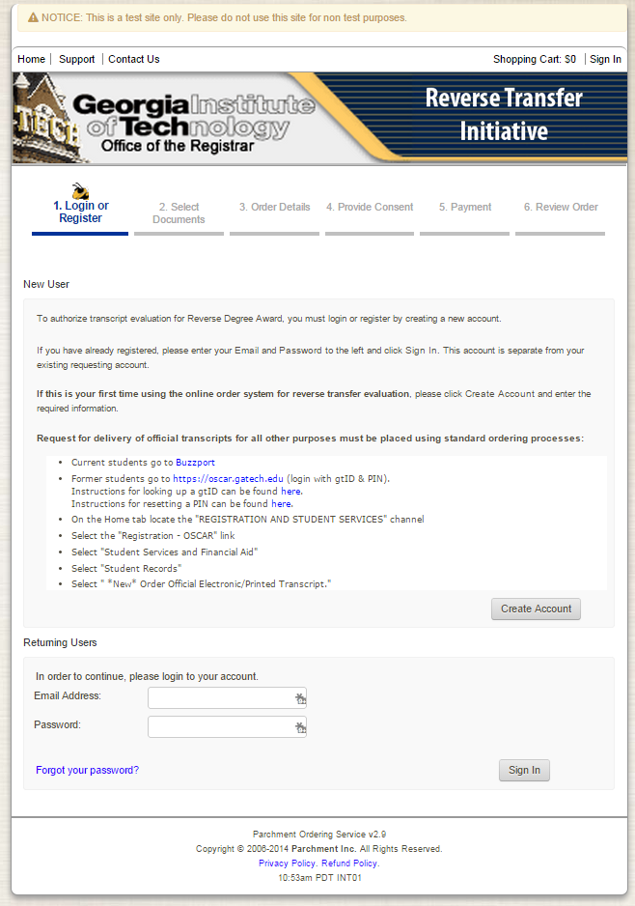
Parchment Landing Page
Not for requesting official transcripts for other purposes or destinations.

Slide 24
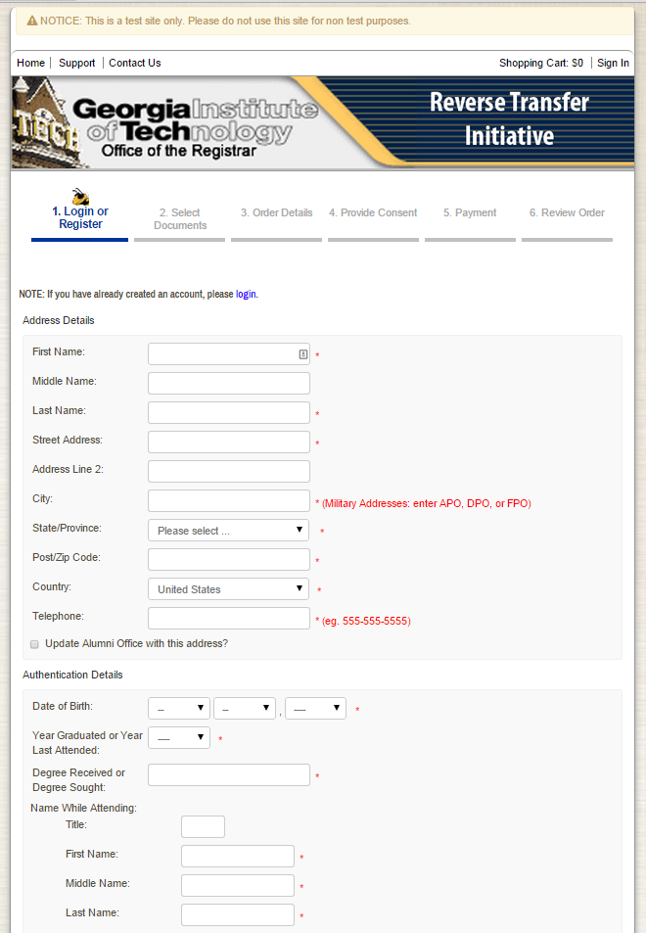
Student provides Address and Authentication Details to create account

Slide 25
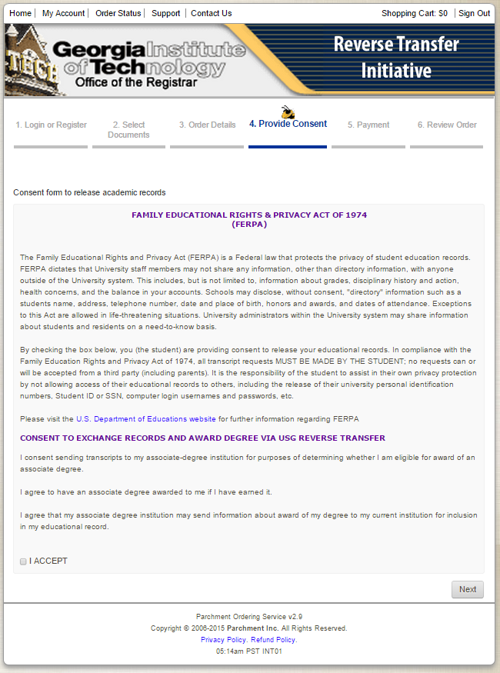
Student provides consent under FERPA to release record for this purpose.

Slide 26
I consent to sending a transcript to my associate-degree institution for purposes of determining whether I am eligible for award of an associate degree.
I agree to have an associate degree awarded to me if I have earned it.
I agree that my associate degree institution may send information about award of my degree to my current institution for inclusion in my educational record.

Slide 27
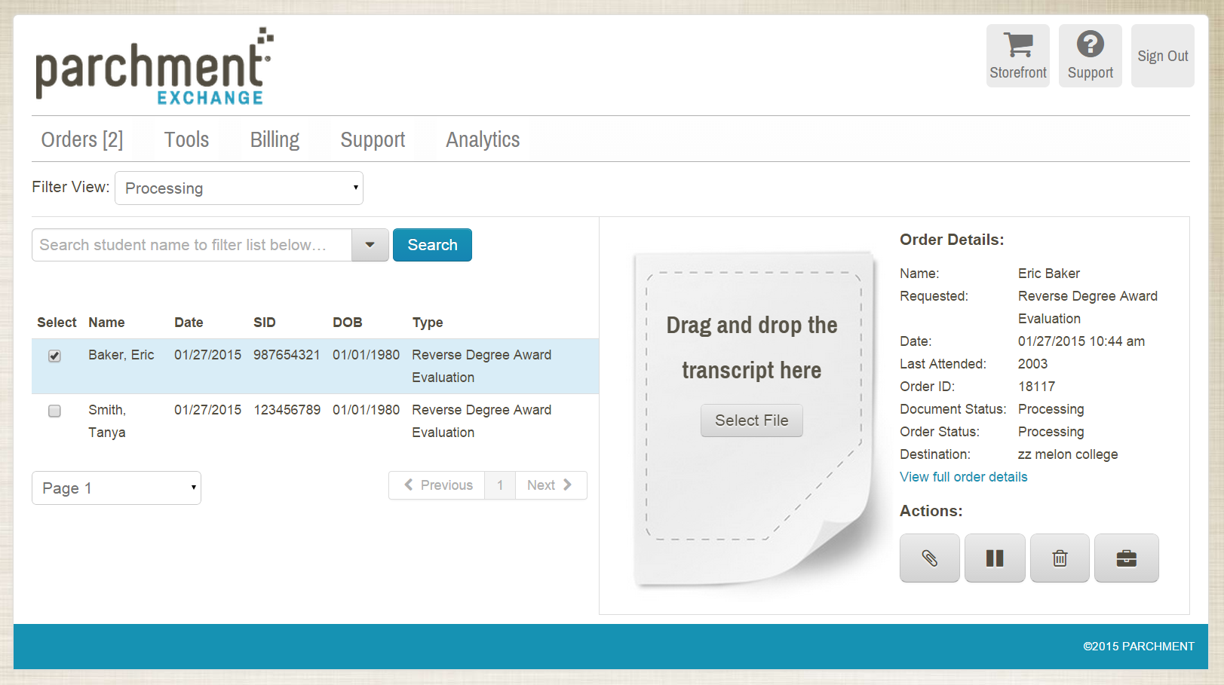
Processing of Request by Current Institution

Slide 28
What gets sent to associate degree institution?
Transcript
Contact and authentication information
Consents Cover Page
Associate degree institution evaluates student eligibility for awarding of an associate degree.
If student meets institutional requirements, and associate degree will be awarded.
Associate degree institution sends notice of award (transcript) of associate degree back to the student’s current institution.

Slide 30
16 USG institutions use the Parchment Platform in some form
1 Premium subscriber (send, receive, and analytics)
University of Georgia
2 Send and receive (Basic)
Georgia Institute of Technology
Georgia State University

Slide 31
1 Parchment send only (Basic)
Dalton State College
12 Parchment receive only (Basic)
Albany State University
Atlanta Metropolitan State College
Clayton State University
College of Coastal Georgia

Slide 32
Parchment receive only (Basic) (cont’d)
Columbus State University
Fort Valley State University
Georgia Perimeter College
Georgia Southern University
Kennesaw State University
University of North Georgia
University of West Georgia
Valdosta State University

Slide 33
14 institutions NOT using the Parchment Platform
Abraham Baldwin Agricultural College
Armstrong State University
Bainbridge State College
Darton State College
East Georgia State College
Georgia College and State University
Georgia Gwinnett College
Georgia Highlands College
Georgia Regents University
Georgia Southwestern State University
Gordon State College
Middle Georgia State College
Savannah State University
South Georgia State College

