Slide 1
RACRA Spring 2015
Top 10 USG Updates
You Need to Know

Slide 2
Mandatory Fee Waiver for Military Using Tuition Assistance
10
November 2014 – BoR approved revision to 7.3.4.2, Waiver of Mandatory Fees:
An institution may waive mandatory fees for:
7. Member of the armed services utilizing the military’s tuition assistance programs to attend the institution.
This was a targeted policy revision specifically to address out-of-pocket costs for military service members utilizing the DoD Tuition Assistance (TA) Program:
Must be currently serving;
Must be utilizing the DOD’s Tuition Assistance program;
Veterans and those using the GI Bill are not eligible; and,
Spouses and dependent children are not eligible.
New fee classification code – WFMT
As a reminder, per the April 2012 Special Institutional Fee Resolution, all active duty military students may also be exempt from SIF.

Slide 3
Computer Science & RHSC – Science and Math
9
August 2014, Governor Deal issued a press release encouraging more computer science course offerings for high school students.
Deal recommended that students be allowed to use the courses to satisfy science and math requirements for high school graduation.
GADOE rule change to allow students to use specific computer science courses to satisfy their 4th science or 4th math unit.
Deal also asked the USG to accept the courses for college admission.
The courses were sent to the appropriate USG academic advisory committees for review.
The results…

Slide 4
Computer Science & RHSC – Science and Math
9
USG math committee did not approve the courses; however, they have offered to work with GaDOE on course revisions to allow possible future approval.
The following courses were approved to count as a 4th science for admission:
11.017 – International Baccalaureate Computer Science, Year One
11.0171 – International Baccalaureate Computer Science, Year Two
11.471 – Computer Science Principles
11.472 – Programming, Games, Apps and Society
11.016 - AP Computer Science (already approved and on Staying on Course)

Slide 5
Computer Science & RHSC – Science and Math
9
ONLY the above are approved by the USG to satisfy the 4th science unit.
Updates will be made to the Staying on Course document once we have confirmation that the SBOE approved the courses.
We may be asked to review additional computer science courses in the future.

Slide 6
Computer Science & RHSC – Foreign Language
9
Governor Deal also requested that the USG allow students to use 2 units of computer science to satisfy the RHSC foreign language requirement for admission.
The USG agreed; however, only those computer science courses on the science list on Staying on Course may satisfy the foreign language requirement.
Students opting to take computer science instead of foreign language must take 2 units of computer science to satisfy the requirement. Students cannot combine 1 unit of computer science with 1 unit of a foreign language or American sign language.
Students may ONLY use a computer science course to satisfy one requirement.

Slide 7
Dual Enrollment Legislation SB2
8
SB 2 would permit a student who completes certain high school courses in 9th and 10th grade, meets college dual enrollment admission requirements, and then completes the following to be awarded a high school diploma:
(i) an associate degree program;
(ii) a technical college diploma program and all postsecondary academic education and technical education and training prerequisites for any state, national, or industry occupational certifications or licenses required to work in the field; or
(iii) at least two technical college certificate of credit programs in one specific career pathway and all postsecondary academic education and technical education and training prerequisites for any state, national, or industry occupational certifications or licenses required to work in the field as determined by the Technical College System of Georgia

Slide 8
Dual Enrollment Legislation SB132
7
SB 132 (“Move on When Ready Act”) seeks to streamline the current dual enrollment options (MOWR, Accel, HOPE Grant) under this title.
Similar to current Accel program:
Full-time or part-time enrollment would be allowed;
Funding would be provided through State appropriations;
The program administered by GSFC and regulations would be provided;
Similar to the current MOWR program, students would not be limited to core academic courses:
“A participating eligible high school shall grant secondary credit to an eligible high school student enrolled in a dual credit course in an eligible postsecondary institution if such student successfully completes that course. The secondary credit granted shall be for a comparable required course; career, technical, and agricultural education course; or elective course.”

Slide 9
Dual Enrollment Legislation SB132
7
High schools and colleges must enter into agreements with GSFC to participate. Colleges must agree to:
(1) Waive all mandatory and non-course related fees for participating students;
(2) Provide course books to students participating in the program at no charge;
(3) Accept the amount paid by GSFC as full payment for tuition, mandatory and non-course related fees, and course books.
Under no circumstances shall the eligible postsecondary institutions require an eligible high school student participating in the program to pay for tuition, mandatory and noncourse related fees, or course books.

Slide 10
Border State Residents Out-of-State Tuition Waiver
6
March 2015, the BoR approved a new out-of-state waiver provision for residents of eligible border states attending eligible institutions.
Each year, the Chancellor shall review the enrollment levels to determine whether any USG institutions have sufficient excess capacity to increase recruitment of students from neighboring states.
If an institution is given permission to award the waiver, it will be allowed to do so for the next 3 academic years.
Institutions eligible to award the waiver Fall 2015 have received a working guidance document providing additional information, including FAQs.
A new fee classification code will be provided shortly.
Questions should be directed to the Office of Academic Affairs.

Slide 11
Border State Residents Out-of-State Tuition Waiver
6
Border Residents
Students domiciled in an out-of-state county bordering Georgia, enrolling in a program offered at a location approved by the Board of Regents, and for which the offering institution has been granted permission to award Border County waivers; or
Students domiciled in another state bordering Georgia subject to the following conditions. Each year, the Chancellor shall review the enrollment levels at each USG institution to determine whether any USG institutions have sufficient excess capacity to increase recruitment of students from neighboring states. Should the Chancellor determine that cause exists to activate the Border Residents waiver, the Chancellor or the Chancellor’s designee will present the list of institutions to the Committee on Academic Affairs of Regents for approval. If an institution is given permission to award the Border Residents waiver, it will be allowed to do so for the next three academic years.
Any students receiving the Border Residents waiver will remain qualified for the waiver, so long as they are continuously enrolled at the institution that awarded the waiver.
Border County Residents
Border State Residents

Slide 12
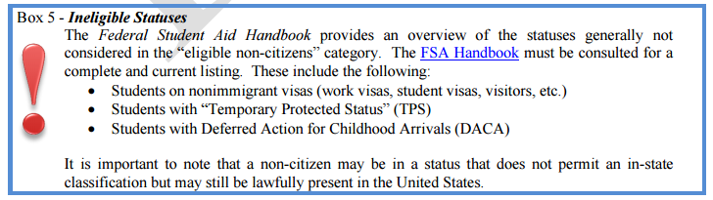
Tuition Classification Manual Updates
5
General
Verbiage changes and reorganization for additional clarity.
Formatting changes to make it easier to find information.
Additional hyperlinks provided and all hyperlinks checked.
Information boxes added to highlight key pieces of information. Example:
Part II – Conducting Self-Audits
Guidance for monitoring the Presidential Waiver cap and the Athletic cap added.
Part III – Verification of Lawful Presence (VLP)
VLP information expanded and housed in new Part III, Verification of Lawful Presence.

Slide 13
Tuition Classification Manual Updates
5
Part IV – Classifying Students as In-State or Out-of-State
Expanded military information.
Expanded non-citizen information.
Expanded discussion of criteria to evaluate a student under 24 as an independent student.
Guidance for determining and documenting the domicile of homeless and foster youth added.
More detailed information on the types of documents that can provide evidence of domicile and weighting consideration provided.
Added information on maintaining an in-state when leaving the state and returning.

Slide 14
Tuition Classification Manual Updates
5
Part V – Awarding of Out-of-State Tuition Waivers
Overview
Guide to reading the waiver information added.
Table 2 replaced child/spouse documentation requirements information in each waiver section.
Information regarding the eligibility of same-sex spouses for the Military Personnel and Recently Separated Military Personnel waivers provided.
Additional information provided for each waiver:
Waiver Type
Discretionary Waiver indicator
Fee Classification Code
Family Eligibility indicator
Waiver and waiver provisions grouped and reorganized to align with revised policy.
Revisions added to “Change History” for each impacted waiver.

Slide 15
Tuition Classification Manual Updates
5
Waiver-Specific Changes:
Presidential - added (to replace International and Superior Student).
Border County Residents - indicated that waiver recipients no longer have to be re-verified to maintain the waiver.
Border State Residents – added (under Border Residents Waiver).
Economic Advantage - revised based on Sept 2014 policy revisions.
Career Consular Officials– removed “A” visa as required documentation – official letter/form from employing consulate office is sufficient.
Teachers Employed Full-Time on Military Bases in Georgia – created separate entry to align with policy and clarified that dependent students and spouses do not qualify under this provision.
Military Personnel – clarified that students that enroll immediately following high school graduation are considered “continuously enrolled” for the purpose of awarding the Military Personnel Waiver and can be eligible if their military parent leaves the state before the first day of classes.

Slide 16
Tuition Classification Manual Updates
5
Waiver-Specific Changes:
Recently Separated Military Personnel - changed time period to enroll following separation from 12 to 36 months. Also, added note to indicate that same-sex spouses may be eligible for this waiver provided they fall under the U.S. Department of Veterans Affairs definition of “covered individuals”.
USG Study Abroad Participants - added (under Reciprocal).
Graduate Students Attending a Research or Comprehensive Institution – revised based on Sept 2014 revisions (increased waiver caps for Research and addition of the Comprehensive sector).
Students in ICAPP Advantage Programs - retired

Slide 17
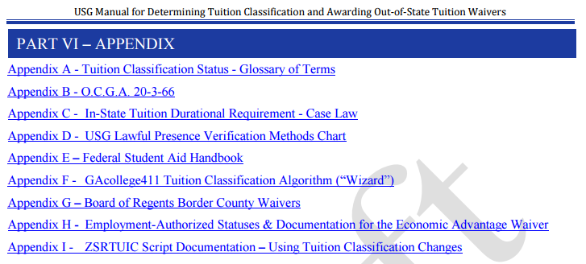
Tuition Classification Manual Updates
5

Slide 18
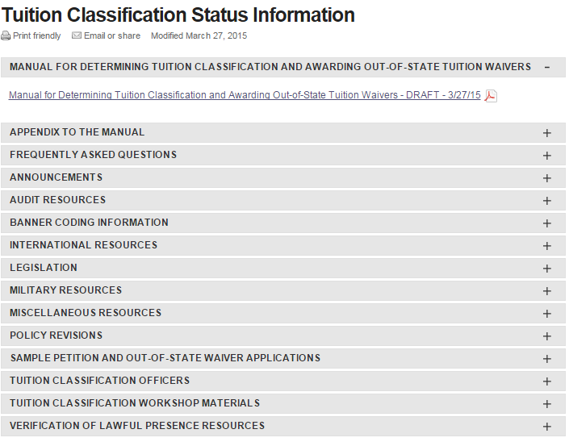
Tuition Classification Resource Page Updates
4

Slide 19
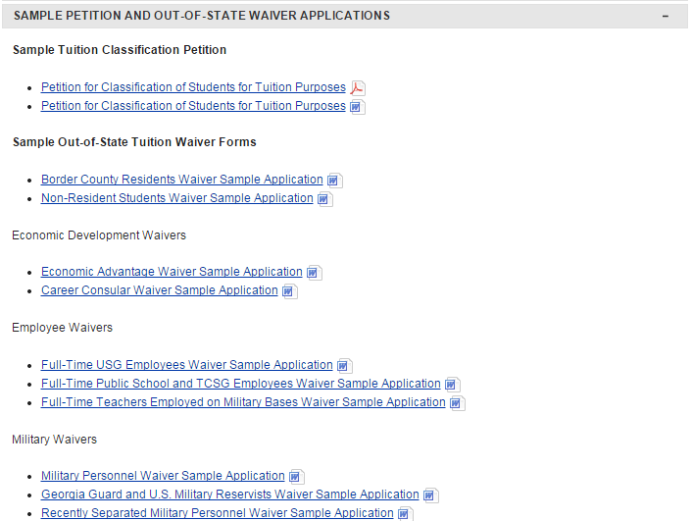
Sample Petition and Waiver Applications
3

Slide 20
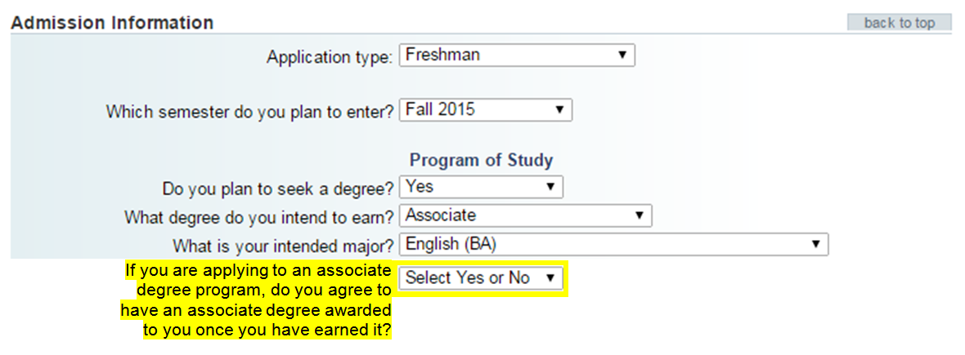
Annual Application Updates
2

Slide 21

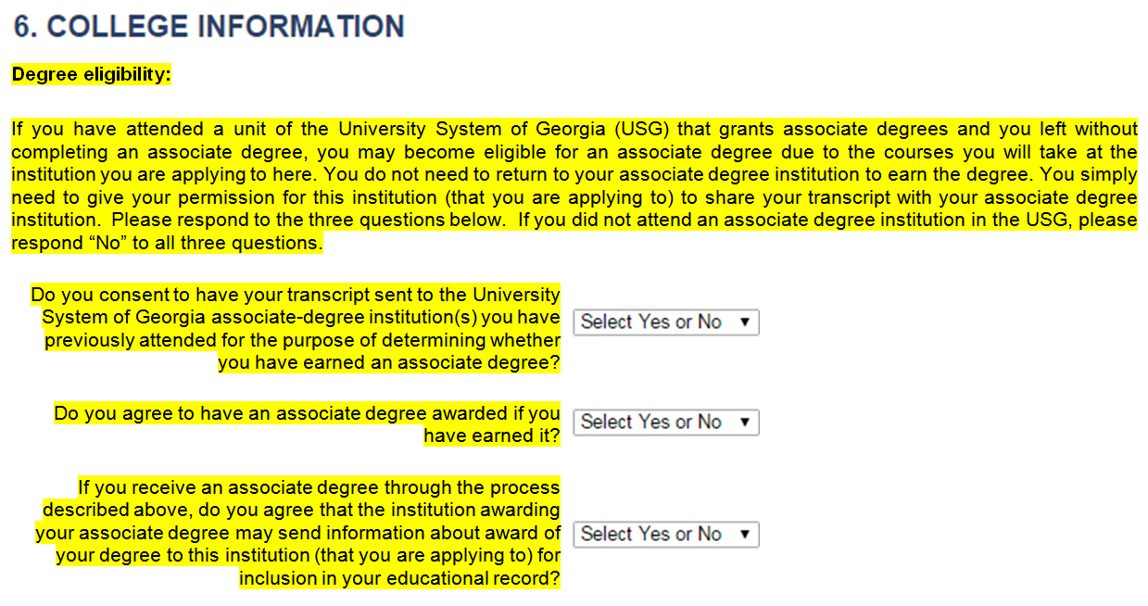
Annual Application Updates
2

Slide 22
Annual Application Updates
2
Current
Select One
Guardian
Parent
Spouse
Revised
Select One
Parent
U.S. court-appointed legal guardian

Slide 23
Policy Working Group Updates
1
Required High School Curriculum
Academic Renewal
Academic Calendar
Transient Policies

