Slide 1
RACRA Fall 2016

Slide 2
Information Items

Slide 3
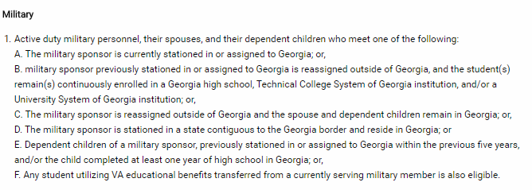
OOS Tuition Waivers – Active Duty
BOR Policy 7.3.4.1 – Out-of-State Tuition Waivers
Changes were approved in the March 2016 BOR meeting
and updated policy is available online.

Slide 4
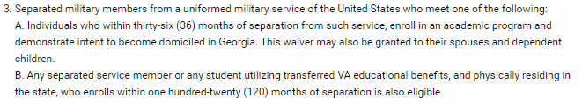
OOS Tuition Waivers – RSM
Changes were approved in the March 2016 BOR meeting
and updated policy is available online.
NOTE: The Active Duty & the Guard/Reservists waivers no longer require annual recertification provided continuous enrollment. The Recently Separated Waiver already does not require recertification.

Slide 5
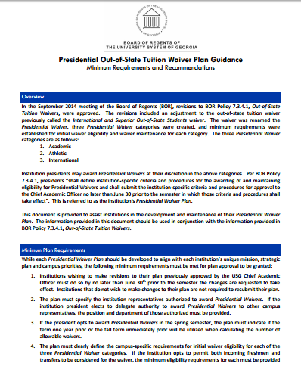
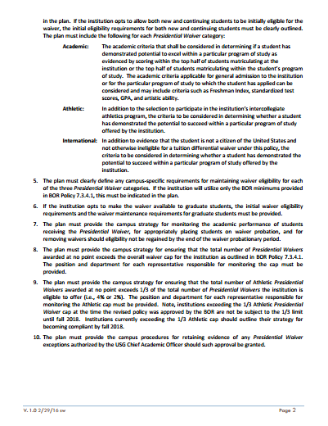
Presidential Waiver Plans & Guidance

Slide 6
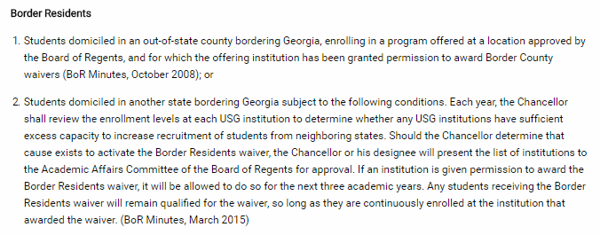
OOS Tuition Waivers – Border Residents
NOTES:
The Border County and Border State Residents waivers do not require annual recertification provided continuous enrollment.
When determining initial eligibility apply the same requirements that would be applied to a GA student requesting and in-state classification in GA but for the border state.

Slide 7
Satisfying RHSC Deficiencies
ASAH 3.2.6 – Special Admissions
Added to the changes approved August 2014.
Changes approved September 2016:
EPI and MPI scores exempting LS placement satisfy a deficiency in the corresponding area.
Exiting LS satisfies a deficiency in the corresponding area.
Changes are available online.

Slide 8
IB Policy Change
BOR Policy 4.2.1.6 – Course Credits for International Baccalaureate
Removed requirement that IB Diploma must be earned for a student to receive IB credit.
Credit for IB no longer limited to 24 semester hours.
Changes approved in the October 2016 BOR meeting
and will be published online shortly.

Slide 9
Academic Calendar Policy Change
BOR Policy 3.4 – Calendar of Academic Activities
Change to allow more flexibility for alternative term lengths.
Changes approved in the October 2016 BOR meeting
and will be published online shortly.

Slide 10
TCSG/USG GE Transfer
List of courses guaranteed transfer between TCSG and USG institutions.
Accessed from ASAH 2.17, Acceptance of Core Coursework and Placement Test Scores from TCSG Colleges.
TCSG Articulation Advisory Group formed Fall 2016:
Sandie Davis – Georgia Highlands College
Jason Edmond – University of Georgia
Suzanne Jabaley – University of North Georgia
Lindsay Lee – Kennesaw State University
(Dr. Felita Williams (lead) and Sarah Wenham – USO)

Slide 11
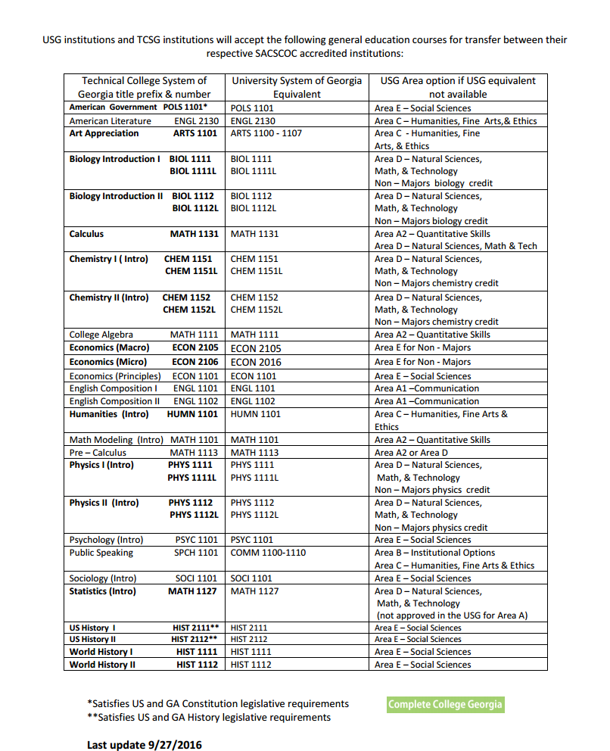
September 2016 Advisory Group agreed to add ECON 2105 and ECON 2106 to the list.
Effective with students taking the course Fall 2016 but we encourage institutions to work with any student who has taken the course and could benefit from the change.

Slide 12
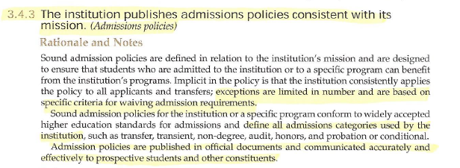
SACSCOC Accreditation Requirement

Slide 13
Unique Dual Enrollment Course Numbers
The unique dual numbers created to:
Give an alignment option when there is not sufficient similarity between the college course and an actual high school course.
Provide another high school credit option when a student has already received credit for the matched/aligned high school course.

Slide 14

Science Courses Aligned to Unique DE #s
A college science course aligned to a unique dual enrollment number may satisfy the 4th science requirement for high school graduation.
Example:
9th grade – HS Physical Science (40.01100)
10th grade – HS Biology I (26.01200)
11th grade – HS Chemistry I (40.05100)
12th grade – College Chemistry I
26.0A864 – Dual Enrollment Life Sciences USG (CHEM 1211 Chemistry I)
4th Science

Slide 15
DE - Fs for Ws
We’ve been in touch with GADOE and they are working on guidance.

Slide 16
Conversation Items

Slide 17
Previous DE 30+ Hours Completed
Admitting former Dual Enrollment students with 30+ transferable hours:
FR or XF admission requirements?
Student Type coding?
Admit Type coding?
RHSC coding?
(The USO still wants test score data even if admitted based on college GPA).

Slide 18
DE/MOWR – Programming/Coding
How do you determine if the college programming/coding courses assigned a unique DE number can satisfy the Foreign Language area of the RHSC or count as the 4th science?

Slide 19
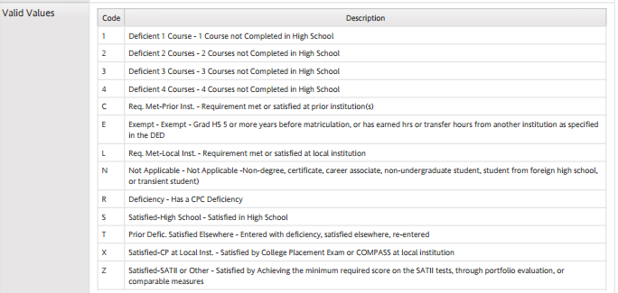
RHSC Status Coding
In light of the changes approved in August 2014 and September 2016, we need to ensure that policy and the coding provided in the DED align.

Slide 20
RHSC Status Coding
Survey results - there are inconsistencies in coding.
Examples:
Some institutions code students with deficiencies as “S”.
Many institutions are using the R code, even though it is outdated.
Z does not seem to be a code used only for home schooled students; many institutions used S, N, R, X for home school scenarios.
Most selected X for the scenarios in which exams satisfied deficiencies, others selected NA and Z.
For EPI/MPI scenario most chose X.
Most coded learning support scenarios as C or L.

Slide 21
RHSC Status Coding
We need to refine the descriptions to clarify appropriate coding in the DED. What do we need to be sure to consider?
Is there a minimum level of detail that you need?
For example, can we lump all test options together under one code?
Do you need the codes to distinguish between deficiencies satisfied prior to enrollment and after enrollment?
Do you need codes 1-4 to represent how many courses a student was missing in high school?

Slide 22
RHSC Status Coding
If a deficiency is satisfied through college coursework, do you need separate codes to indicate where it was satisfied?
Currently we have the following in the DED:
C – Requirement met-Prior institution
L – Requirement met-Local institution
T – Prior Deficiency Satisfied Elsewhere (entered with deficiency, satisfied elsewhere, re-entered).

Slide 23
RHSC Status Coding
Do we need a new code for when a deficiency is satisfied by an exam? Or can those be lumped under the X code?
Current X – Satisfied CP at local institution-Satisfied by College Placement Exam or COMPASS at local institution.
Can EPI/MPI exempting Learning Support placement also fall under the X code?
Can exiting Learning Support be lumped under exemption through coursework completed after enrollment (currently C, L, or T depending on where completed)?

Slide 24
RHSC Status Coding
Is this a data element we need to be cautious updating or can you handle any changes using SOAXREF?
Are there any Banner or other processes built around the codes that we need to be aware of?

Slide 25
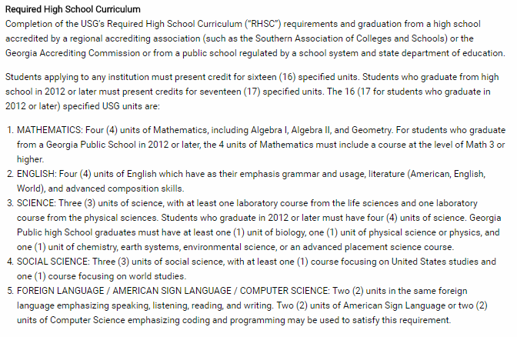
RHSC Proposal

Slide 26
RHSC Exceptions Proposal
RHSC Challenges
Georgia public high school students
Foreign Language
4th Science
Mathematics
Out-of-state students
Mainly science and Foreign Language
We have to preserve the integrity of the RHSC.

Slide 27
RHSC Exceptions Proposal
Goal:
Preserve the integrity of the RHSC while giving institutions additional flexibility to work with students with deficiencies.
Proposed Solution:
Create an RHSC Exception admission category.

Slide 28
RHSC Exceptions Proposal
What would an RHSC Exception look like?
Students may have a maximum of 4 RHSC unit deficiencies with only 1 deficiency in math, English, science and social studies and no more than two in foreign language, and be admissible as an “RHSC Exception”.
Evidence of “special potential to succeed” not required.
Students must meet all other regular admission requirements.
There would be a “RHSC Exception” cap but separate from the Limited Admission cap.
Cap requested by the institutions and approved by USO academic affairs.
New Admit Type code would be established.

Slide 29
Thoughts? Concerns?
1.
2.
3.
4.

Slide 30
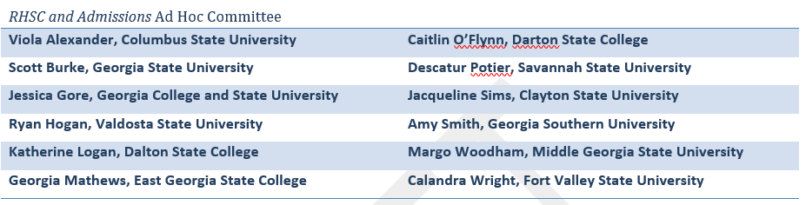
Thank you!!!

Slide 31


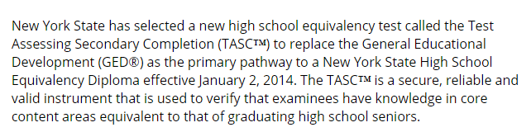
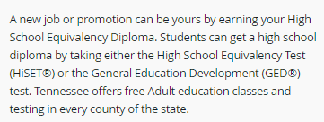
GED Alternatives
Request to revise BOR policy/ASAH to allow HiSET and TASC.
With changes to the GED in 2014, many states have switched to TASC and/or HiSET or added those to GED option.
TASC only
TASC and GED

Slide 32



GED Alternatives
TASC, HiSET, and GED
Indiana’s High School Equivalency (HSE) Exam

Slide 33
GED Alternatives
Current
“…have satisfactorily completed the GED.”
“…students who earn the GED…”
“…the student in possession of the GED…”
“…if they have a high school diploma or GED…”
Possible new wording?
State-issued high school equivalency certificate…
State-issued diploma…
HiSET, TASC, or GED score report?
Or???

Slide 34
Denial Referrals Project
Does your institution refer applicants not meeting your admission requirements to other USG institutions?
What does this referral process look like?

Slide 35
GAfutures Updates

Slide 36
XAP Applications
Application design updates
New features include:
Responsive design for ease of use with phones and tablets
Auto-formatting of fields like email, phone, dates
Embedded help instructions
Section expand/collapse option based on question responses
Initial pilot of updates in mid-November
New template available to all applicants after December
XAP will incorporate design updates as annual updates for 2017 are submitted

Slide 37
XAP Applications
Is XAP your only online undergrad application?
Is XAP your primary application?
Do you have a paper application?
Do you download/upload XAP apps into Banner? What process?
Have you customized your XAP app?
Have you customized your Axiom source file (if used)?

Slide 38
Transcript Download Options
Manually download from the SURFER Inbox
File Types: XML, HTML, PDF, RTF
File Content Types: Single Record (one student per file) or Batch (all students submitted as of 6AM)
Automatic download using secure FTP server
File Types: XML, HTML, PDF, RTF
File Content Types: Single Record (one student per file) or Batch (all students submitted as of 6AM)
Current FTP users: University of Georgia, Georgia Tech, Kennesaw, Georgia College, Columbus State, Albany State
Note: GSFC is aware of page break issue in batch PDF (working toward solution).

Slide 39
More about Option 2: Automatic download using secure FTP server
GSFC has secure FTP file process for institutions to retrieve student transcript records
Institutions
use their own FTP product to automate their transcript file downloads
connect securely to FTP server to retrieve and delete their files
Batch or individual XML, PDF or HTML files placed on server for institution to process
Access to SURFER system Transcript Inbox no longer required
Question: Does any institution use RTF file format? If not, GSFC can remove that option.
Contact Bob Lahl at GSFC to set up your institution for testing and production processing (rcl@gsfc.org).

Slide 40
Other comments or questions about GAfutures.org?

Slide 41
XAP User Conference
XAP is planning user conference similar to the one held in 2009.
Is February 2017 a good time?
Potential agenda items:
Review of recent enhancements/improvements
Upcoming/roadmap
Discussion of needs/desired improvements
Is there interest?
Anyone interested in one-on-one with Xap?

Slide 42
What else is going on?
(Tell me something good!!!)

