Slide 1
New SAT Implementation RACRA – October 20th 2016
Rachana Bhatt –Research and Policy Analysis
Amanda Marshall - ITS
Sarah Wenham – Student Affairs

Slide 2

Overview
March 2016 – 1st administration of the new SAT.
The scoring structure of the new SAT is significantly different from the old SAT. (Yay!!!)
What are the appropriate test score minimums for students taking the new SAT?
Old SAT BOR Minimums
Research, Comprehensive, State University 430CR/400M
State College Requiring SAT/ACT 330CR/310M
Math is EASY!
College Board provided old SAT math section/new math section/new math test concordance.
400 Math section (old) >>> 22 Math test (new) >>> 440 Math section (new)
310 Math section (old) >>> 18 Math test (new) >> 360 Math section (new)
Critical Reading/ERW/Reading… now that is the challenge!

Slide 3
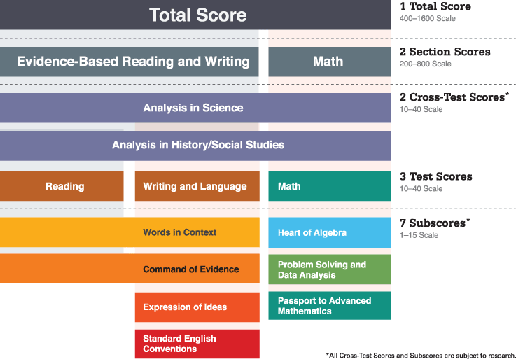
New SAT Score Structure
There is not concordance between the old Critical Reading section and the new Evidence-Based Reading & Writing section.
X
CR ERW
There is concordance between the old CR section and the new Reading test.
There is also concordance between the old Writing section and the new W&L test (but the BOR has not had a Writing requirement).
So what do we do?

Slide 4
Analysis conducted by Research & Policy Analysis staff at USG-BOR in Spring 2016
Goal: Develop research-based guidance for use of New SAT in
Admissions Requirements
Freshman Index
Learning Support Placement Indices
Two Proposed Phases
Phase I (Summer 2016-Spring 2017)
Phase II (Spring 2017 and Beyond)

Slide 5
Phase I (Summer 2016-Spring 2017) **Implemented**
Maintain Old SAT minimum scores/formulas using Old SAT
Convert New SAT scores to Old SAT scores using College Board Concordance
Sector |  | Old SAT (Section Scores) | New SAT (Test Scores)
Research, Comprehensive, State Universities |  | 430 CR 400 M | 24 R 22 M
State Colleges |  | 330 CR 310 M | 19 R 18 M

Slide 6
Phase II (Summer 2017 and Beyond) **Not Implemented**
Challenges with new SAT format
Option 1: Use New Section Scores and develop minimum/formulas accordingly
(e.g. Old SAT M Minimum 400 New SAT M Section Minimum 440)
But, no concordance b/t New ERW and Old CR
Option 2: Use New Test Scores and develop threshold/formulas accordingly
(e.g. Old SAT CR Minimum 430 New SAT R Test Minimum 24)
But:
Students/Counselors/Administrators used to Section scores
Old W never used—continue to ignore?
Considerations
Hold students harmless
New SAT scores can’t be tied to USG student outcomes for another year

Slide 7
Analysis of Old CR & W
Option 2: To utilize New Test scores (M, R, W&L) need to:
Establish Old W minimum to then concord with New W&L minimum
Examine consequences for Admissions, FI, Learning Support Placement
Data
Students that entered USG between Fall 2012-Fall 2014
Old W & CR scores
Grade received in Engl 1101 and/or 1102
Cumulative 1st year GPA

Slide 8
Analysis of Old CR and W/ New R and W&L
Analysis Part 1
Analysis Part 2
At current CR minimum (430) what is success in English and GPA?
Average Pass Rate (receive C or above)
English 1101: 56%
English 1102: 60%
Average GPA of 2.5
Finding
A 430 W matches Engl 1101 (1102) pass rates and average GPA.
What does a 430 CR/430 W minimum look like?
Potential options: And or Or requirement, combine CR and W?
Constructed average Engl pass rates and average GPA for all combinations of CR and W scores

Slide 9
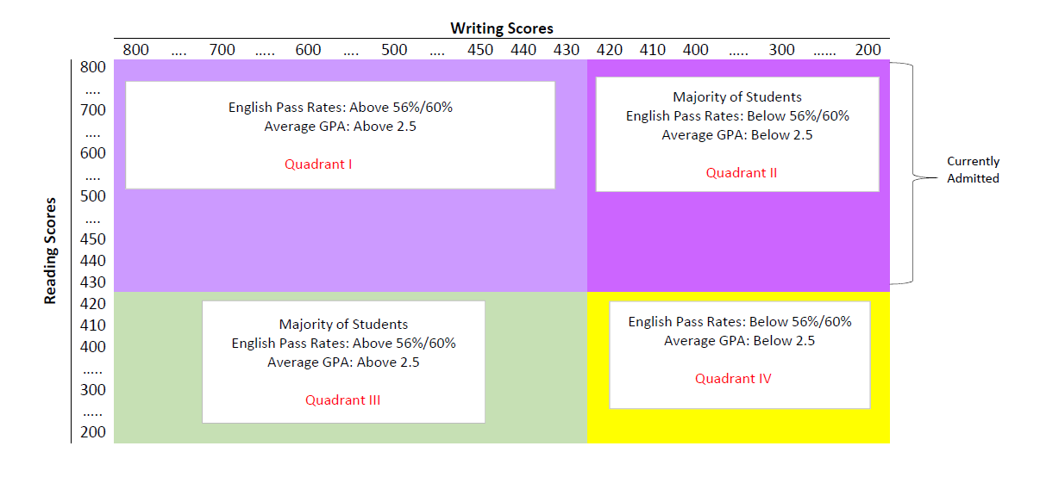
Analysis Part 2
430 CR and 430 W (24 R and 25 W&L)
Admit those in Quadrant I with high predicted English pass rates and GPA
Harms students that previously admitted in Quadrant II
430 CR or 430 W (24 R or 25 W&L)
Admit those in Quadrants I, II, III
No apparent drawbacks
But still need to examine impact on FI/Placement Indices….

Slide 10
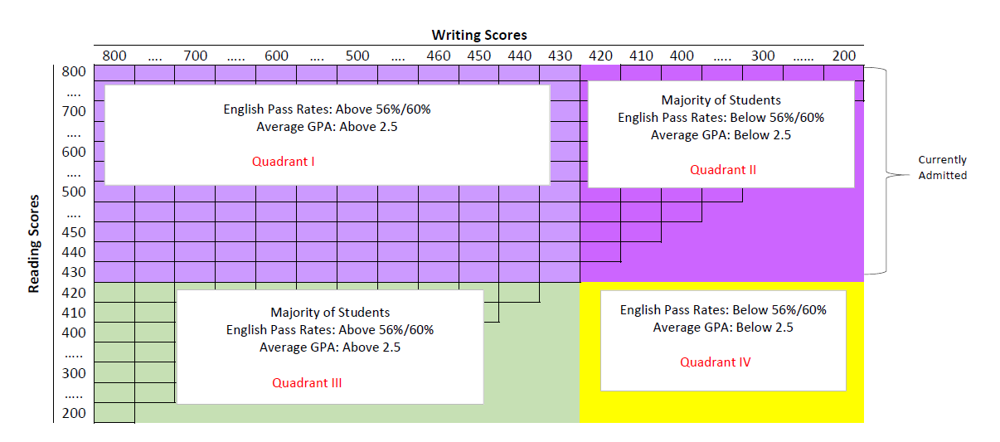
Analysis Part 2
860 CR+W (49 R+W)
Any combination of CR and W achieving 860 or above (grid)
Harms some students that previously admitted in Quadrant II
Combinations of CR + W leading to 860 or above have very different pass rates/GPA

Slide 11
Analysis Part 3
If use New Test Scores (400 M=22 M and (430 CR=24 R or 430 W=25 W&L)) for admissions, what are implications for Freshman Index/placement indices?
FI: 500*HSGPA + CR +M
R(2500), C(2040), SU (1940), SC (1830)
Finding: FI and Placement thresholds would need to be re-calculated to address non-linear relationship between Old Section and New Test.
E.g. 500*HSGPA + (max of(R, W&L)*20) + (M*20)
Old CR | New R |  | Old W | New W |  | Old M | New M
400 | 22 |  | 400 | 23 |  | 400 | 22
420 | 23 |  | 420 | 24 |  | 420 | 23
430 | 24 |  | 430 | 25 |  | 430 | 23.5
450 | 25 |  | 450 | 26 |  | 450 | 24.5
470 | 26 |  | 470 | 27 |  | 470 | 25.5
490 | 27 |  | 490 | 28 |  | 490 | 26
 | HSGPA | CR/R | M | FI
Old SAT | 2.4 | 430 | 400 | 2030--SU
New SAT | 2.4 | 24 | 22 | 2120--C

Slide 12
Recommendations
Amend Phases
Phase I (Summer 2016-Spring 2017) Phase I: (Summer 2016-Summer 2020)
Phase II (Spring 2017 and Beyond) * Use existing cutoffs/formulas for admissions, FI, other placement indices
* Convert New SAT scores to Old using College Board Concordance
* Use M, CR. Optional to include W.
Fall 2020 and Beyond
* System Office will study relationship between New scores and first year student success

Slide 13
Test Score Requirements
Old SAT minimum score requirements will remain in effect through Summer 2020.
Research, Comprehensive, State Universities 430CR/400M
State Colleges Requiring SAT/ACT 330CR/310M
Students taking the new SAT must meet the equivalent of the above.
Research, Comprehensive, State Universities 24 Reading test/22 Math test*
State Colleges Requiring SAT/ACT 19 Reading test/18 Math test*
*or equivalent new SAT Math section score

Slide 14
W/W&L and Presidential Exceptions
The research completed by RPA indicates that the old SAT Writing section score is a similar predictor of student success as the Critical Reading section score.
Institutions may, at their discretion, consider a student’s old SAT W section score or new SAT W&L test score as evidence of potential for success and justification for admitting a student not meeting the CR section/R test minimum under the Presidential Exception provision.

Slide 15
Dual Enrollment
The current BOR DE requirement of 970 Total (CR + M) will remain in effect through SU 2020.
For new SAT test-takers:
The Reading test score must be converted to an old SAT Critical Reading section score.
The Math test score* must be converted to an old SAT Math section score.
The Critical Reading section score and the Math section score are then added together and the resulting score must meet the 970 minimum.
Example: Student scores 29 on the Reading test and 25 on the Math test.
29 Reading test >>> 530 old CR section score
25 Math test >>> 460 old M section score
990 Total score
*or new SAT Math section score
Old SAT Total New SAT Total

Slide 16
Freshman Index and the EPI/MPI Calculator
Old SAT >>> Scores entered directly into the SAT FI formula and EPI/MPI calculator.
New SAT >>> Scores first converted to the equivalent old SAT scores using the College Board concordance. The converted scores can then entered into the FI formula and EPI/MPI calculator.

Slide 17
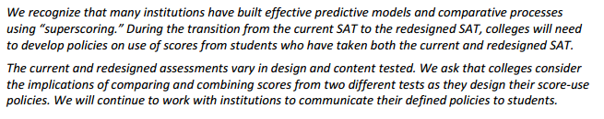
Superscoring Across Old and New SAT
From the College Board:

Slide 18
ADC Considerations
ALL new SAT scores must be loaded into Banner, including those not used in admission decisions.
The codes provided in the DED must be used.
Institutions opting to store converted scores in Banner may do so but must:
Store the original raw scores with the accurate Test Code, Test Date, and Test Score.
Retain the accurate test date with the converted scores.
The ADC will use the following logic to ensure only raw scores are collected:
Old SAT Test Code (i.e. S01, S02, or S07) + Test Date of March 2016 or later = converted score (not collected).
New SAT Test Code (i.e. S10, S11, S12, S13, S14) + Test Date prior to March 2016 = converted score (not collected)
Any SAT score with a positive Equivalency Indicator will be identified as a converted score (not collected).

Slide 19
Communicating Requirements
The College Board recommends providing score requirements in terms of both the old SAT and the new SAT and avoiding directing students, parents, and counselors to the concordance tables.
Example:
Students taking the old SAT (administered prior to March 2016) must have a minimum of 430 on the Critical Reading section and 400 on the Math section.
Students taking the new SAT (administered March 2016 or later) must have a minimum of 24 on the Reading test and 22 on the Math test.
We are in the process of updating BOR policy and the ASAH and other materials:
State College Test Score Requirements
Dual Enrollment Admission Requirements
Other materials?

Slide 20
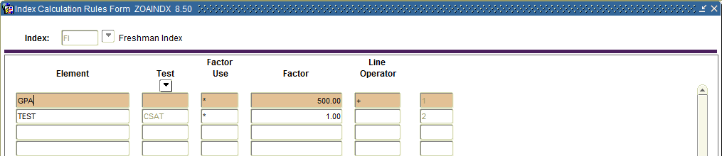
Freshman Index Calculation
SAT Freshman Index formula unchanged and in effect for students through Summer 2020
FI formula review to be completed in Summer 2018
Student submitting old SAT scores
No change in calculation or requirements
Index Calculation Rules Form (ZOAINDX)
Batch – Admissions Index Calculation Process (ZORINDC)
Student – Index Information Form (ZOAINDP)

Slide 21
Freshman Index Calculation - new
Student submitting new SAT scores
Convert Reading Test score (S13) to equivalent old SAT Critical Reading Section score (S01)
Convert Math Test score (S15) to equivalent old Math Section score (S02)
Calculate FI using existing formula

Slide 22
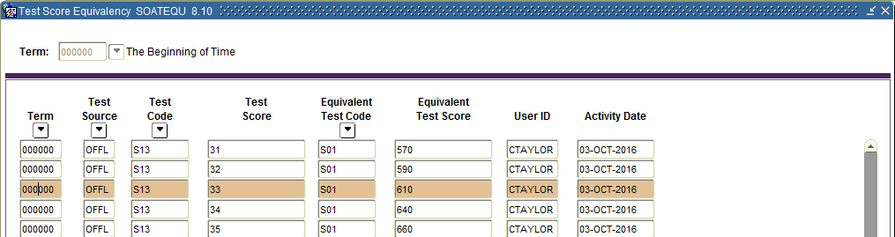
Freshman Index Calculation
SAT Score conversion
SAT Concordance Tables for Higher Education
Test Score Equivalency Form (SOATEQU)
No delivered script to populate the equivalencies

Slide 23
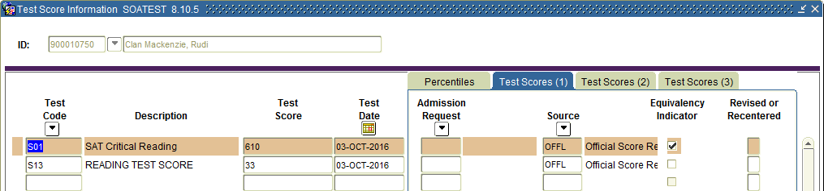
Freshman Index Calculation
SAT Score conversion
Enter new SAT (S13)on Test Score Information Form (SOATEST)
Save and refresh screen to see equivalent test/score (S01) added to SOATEST with Equivalency Indicator

Slide 24
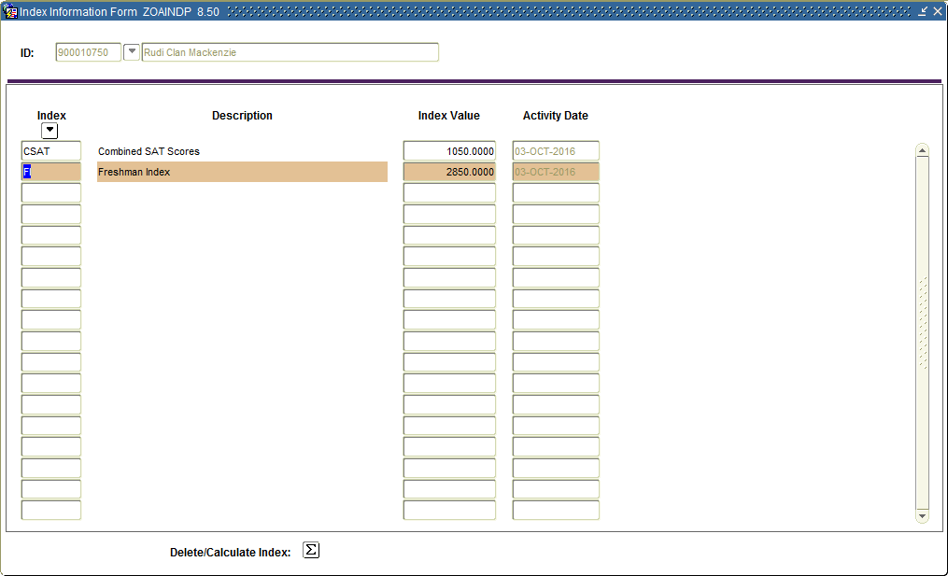
Freshman Index Calculation

Slide 25
Documentation
Admissions Index Process user documentation
http://www.usg.edu/georgia_best/application_development_and_support/banner/userdocs
‘Updated Guidance on New SAT Scores’ posted to RACRA listserv on August 18, 2016
Refer to SAT/ACT Resource Page on Student Affairs web site
http://www.usg.edu/student_affairs/faculty/policies_resources/sat_act

Slide 26
Resources
Information Technology Services (ITS) Helpdesk business hours are 8 a.m. to 5 p.m. Monday through Friday, with the exception of Board of Regents holidays. If assistance is needed after business hours, please contact the ITS Helpdesk via the after-hours support information below. Email is not monitored after hours or during the weekend.
If you need after-hours assistance with ITS product or service related business interruption or production down issues, call the ITS Helpdesk at 706-583-2001, or 1-888-375-3697 (toll-free within Georgia) and listen to the menu prompts for instructions on how to contact ITS on-call support. If you encounter a problem reaching or using the ITS Helpdesk call center telephone menu, Call 404-831-3669 and leave your name, telephone number, and a brief message, and an ITS Helpdesk agent will contact you.
If you need non-emergency after-hours assistance (i.e., evening, weekend, or holiday), we request that you notify us at least two weeks in advance. To request non-emergency after-hours assistance, go to the Self-Service Support Request website and select Submit Support Request, E-mail helpdesk@usg.edu, or Call 706-583-2001, or 1-888-375-3697 (toll-free within Georgia)

Slide 27
Any Questions?

