Slide 1
Campaign Overview
RACRA Spring Meeting
April 2, 2015
Rosalind Barnes Fowler
Public Awareness Director

Slide 2
DISCUSSION TOPICS:
Suggested changes/additions for GBMA website
Looking for various check lists that we can place on website for adults interested in returning to school (this also includes those tips this committee believe we should provide to adults interested in re-enrollment).
Suggested tools campuses can use to “track” students that originate through GBMA efforts to matriculation.
Improving the process in connecting staff from various campus departments (such as the Registrar’s Office, Financial Aid Office, Student Advising, Adult Learner Centers, etc.) to assist potential adult student applicants {are we missing any other areas that should be included on the team}.
Issues related to contacting students (USO staff & USG staff) – suggestions?

Slide 3
CAMPAIGN OVERVIEW

Slide 4
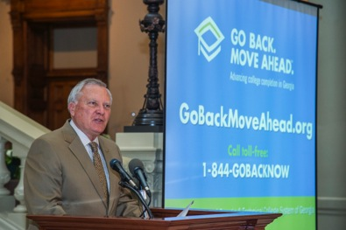
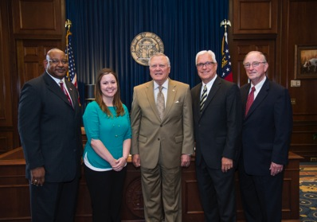
GOVERNOR’S PRESS CONFERENCE
Tuesday, July 29 at the Capitol
Official campaign announcement by:
  Governor Deal
  Chancellor Huckaby
  Commissioner Jackson
  Adult Learner graduates Molly Bickerton (Ogeechee Tech) and Mark Smith (Valdosta State)

Slide 5
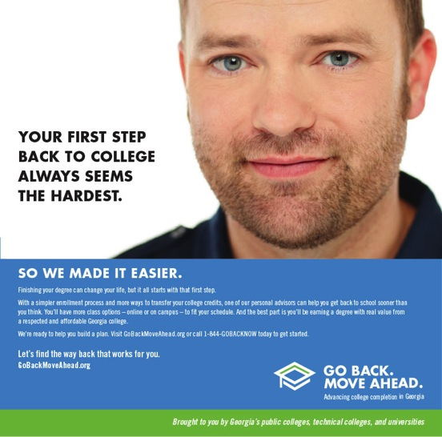
ADVERTISING / PRINT

Slide 6
ADVERTISING / PRINT

Slide 7
ADVERTISING / PRINT w/ space for customization

Slide 8
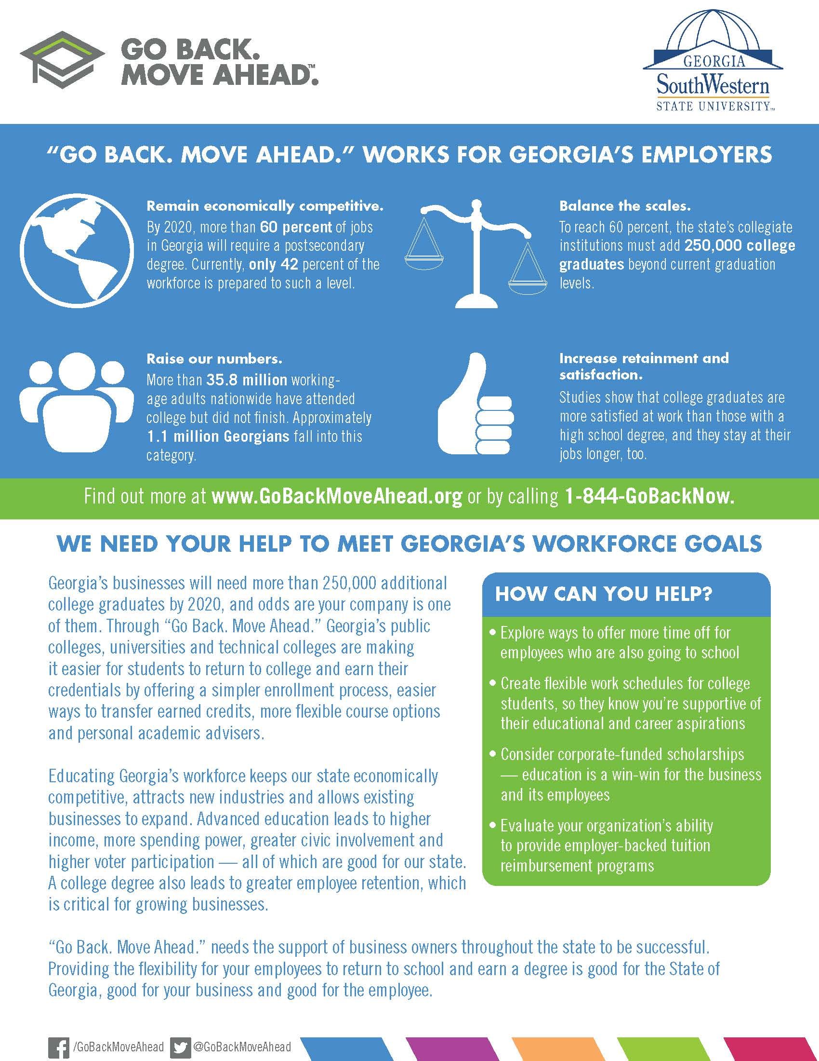
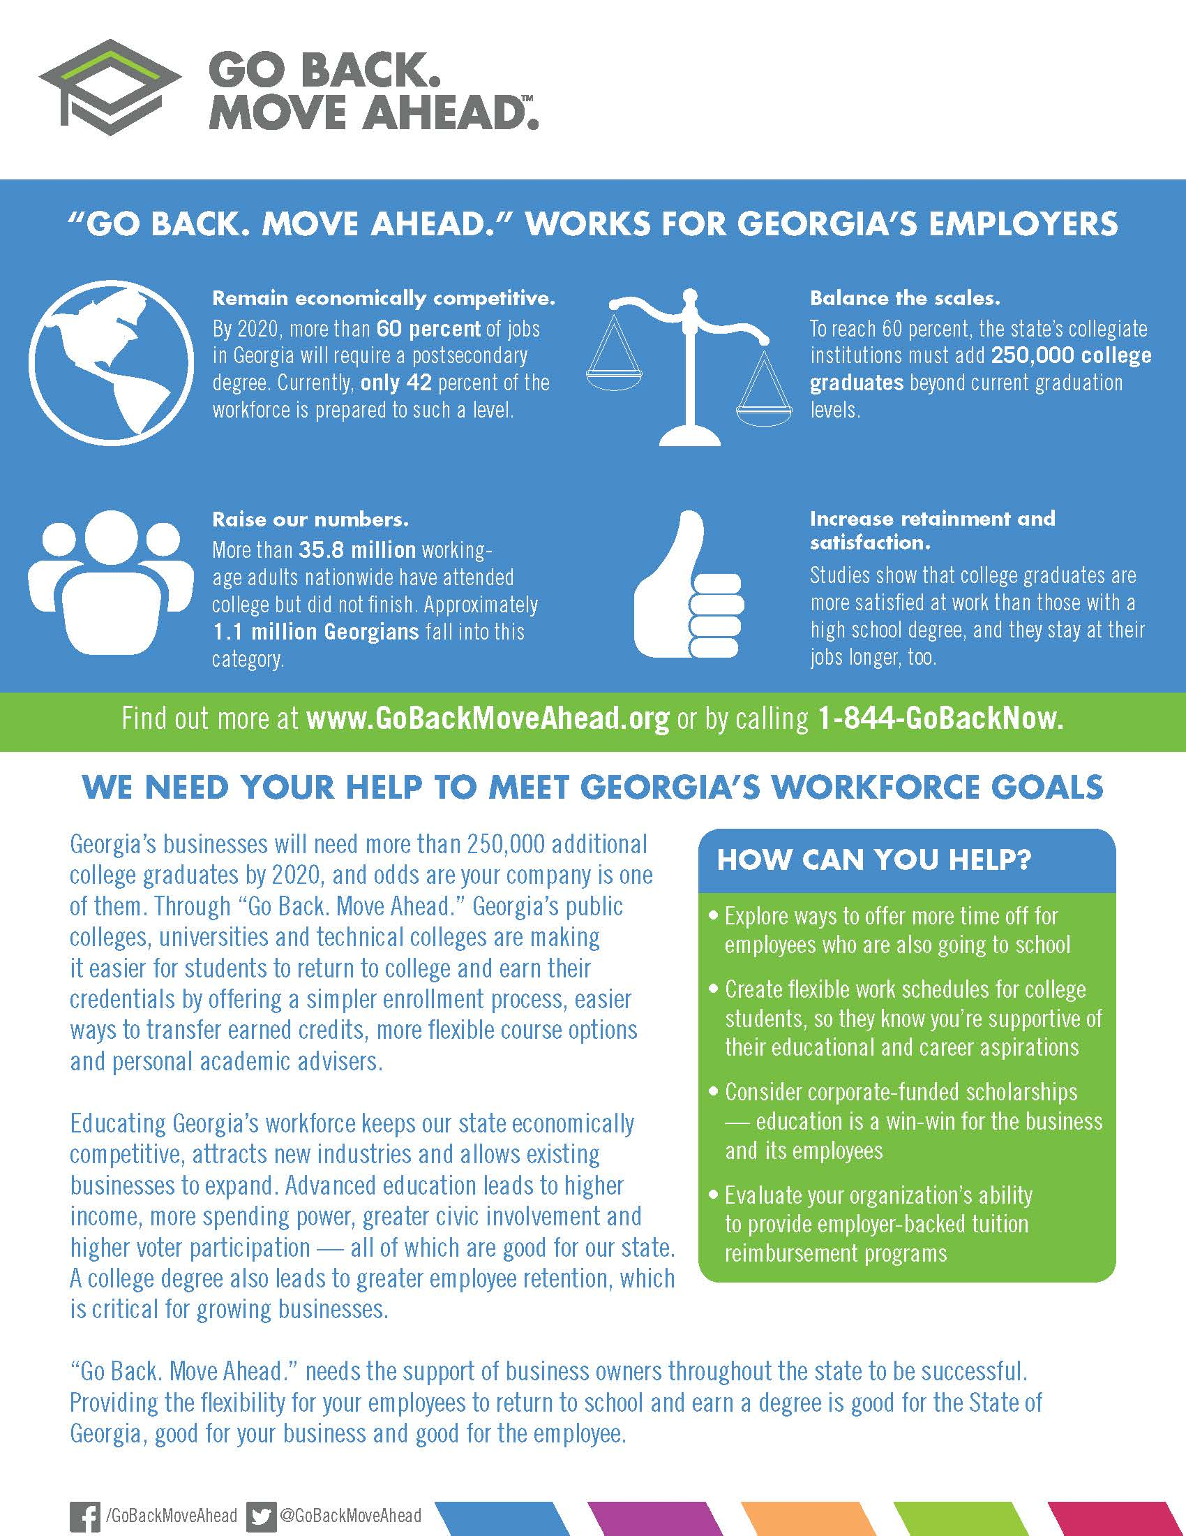
CORPORATE PROMOTIONAL EFFORTS

Slide 9
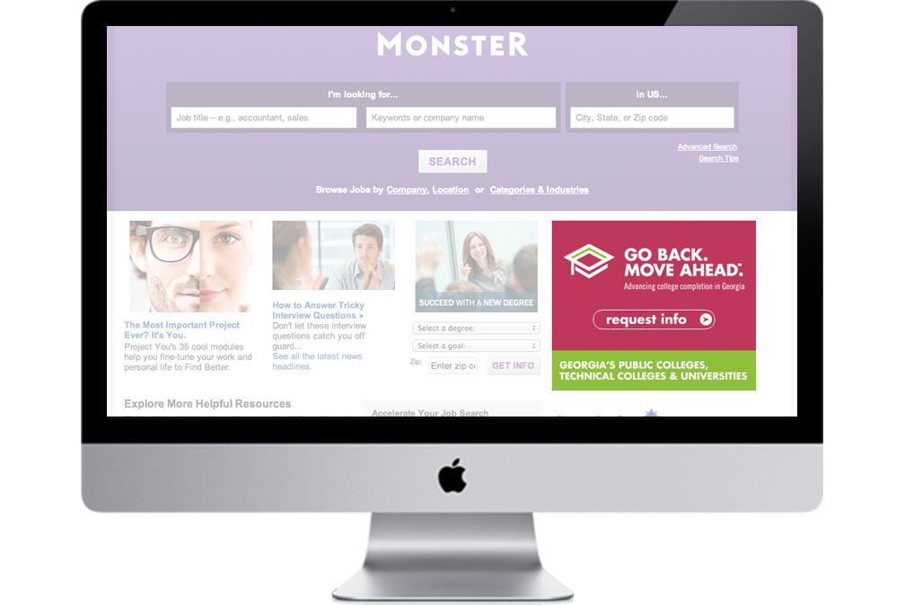


ADVERTISING / BANNER ADS

Slide 10
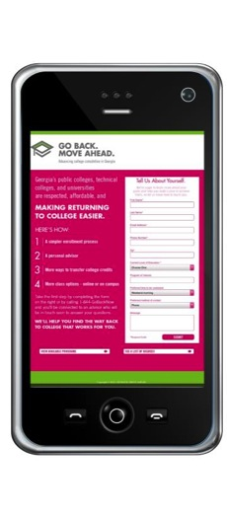
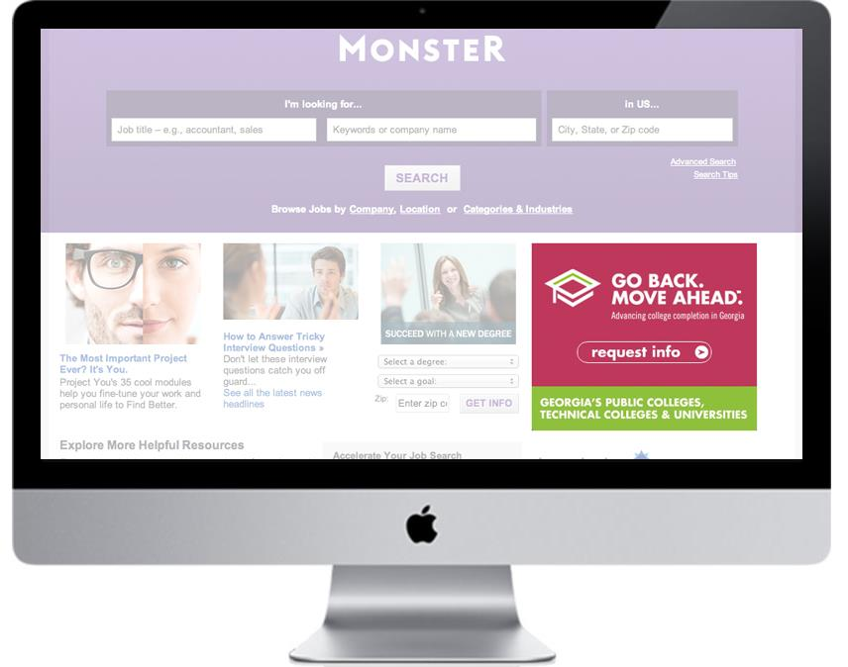
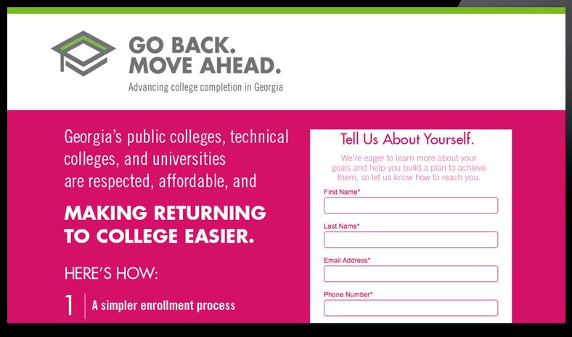
ADVERTISING / LANDING PAGES

Slide 11
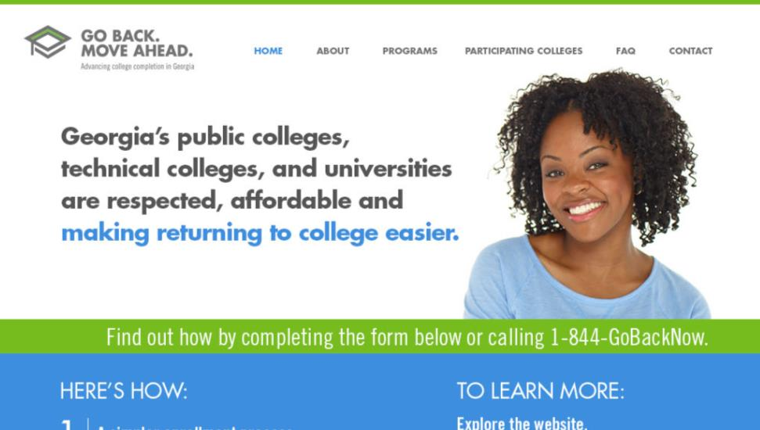
ADVERTISING / WEBSITE

Slide 12
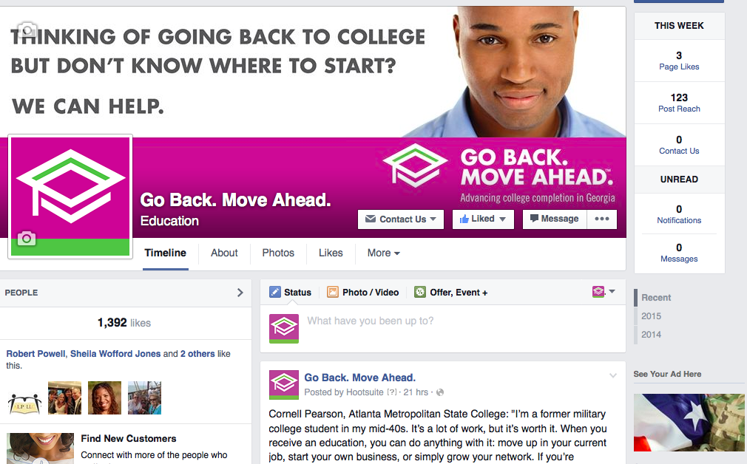

ADVERTISING / FACEBOOK

Slide 13
PAID MEDIA PLAN

Slide 14
PAID MEDIA PLAN
Target Audience
  Adults 25-64 (identified audience, but skewing younger)
  Some college, no degree
  Live in Georgia
  34% of our target is African-American
Geography
  Georgia
    Prioritize markets with large population and multiple institutions
    Secondary focus on smaller markets with single institutions
Timing
  August
  October/November
  January
  March/April
Budget
  $1,272,000

Slide 15
PAID MEDIA PLAN / COMPONENTS
According to MRI, a large percentage of our target audience are heavy users of:
Our target is more likely to be a light user of:
Media | A25-64, No Degree, Some College and Live in Georgia | A25-64, No Degree, Some College, Live in Georgia and African-American
Internet | 69% | 82%
Outdoor | 77% | 62%
Television | 55% | 66%
Radio | 53% | 57%
Media | A25-64, No Degree, Some College and Live in Georgia | A25-64, No Degree, Some College, Live in Georgia and African-American
Newspaper | 62% | 55%

Slide 16
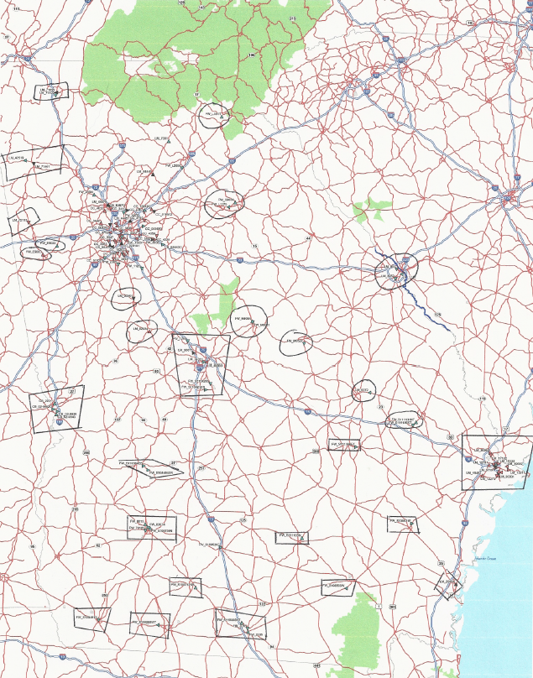
Media: Outdoor
Statewide/Placement Map

Slide 17
OVERALL RESULTS

Slide 18
CONVERSIONS OVERVIEW – TOTAL CONVERSIONS
There are 3,338 total conversions to date:
2,375 form completions
963 inbound calls

Slide 19
CONVERSIONS OVERVIEW – CONVERSIONS OVER TIME
The conversion rate to date was calculated using US-only traffic and is at 3.99%. While the conversion rate has decreased recently, please note that the number of conversions for the month has not dropped below other months without ads running.
The Google Display Ad, which continued running this month, likely accounts for much of the change in conversion rate – it has been driving traffic to the site but has not resulted in any conversions. Recommendations on next steps to follow.
Conversion rate, with US-only traffic.

Slide 20
CONVERSIONS OVERVIEW – BY TYPE
Campaign conversion rate (which does include inbound calls) is 3.99%. Please note that this number is based on US-only traffic to the microsite and landing pages.
The majority of total conversions have come in through the microsite, with inbound calls at 29% (up this reporting period). This has remained relatively stable since the campaign started.
Through ongoing testing, we’ve found that the “I Am Ready” landing page has the best conversion rate of the three. This page differs most from the main website in that it pushes visitors straight to the form. Based on this data, we are now sending 50% of ad traffic to the microsite and 50% to the “I Am Ready” landing page.

Slide 21
AT A GLANCE – CAMPAIGN PERFORMANCE TO DATE
 | Total Conversions | Visits to Site & Landing Pages* | Conversion Rate** | Clicks from Online Ads***
To date | 3,338 | 83,701 | 3.99% | 56,623
Change this reporting period | +181 | +16,794 | ⬇0.73% | +19,491
These changes took place over the time period of a month rather than two weeks as we have switched to monthly reporting.
*The website visits information and conversion rate are based on US-only traffic. Earlier reports have shown international traffic as well in this column.
**The conversion rate includes inbound calls and is calculated by finding the percentage of conversions (calls or form completions) out of all website and landing page visits. This report shows the conversion rate based on US-only traffic.
***Includes SEM, banner and video advertisings

Slide 22
Website & Landing Pages

Slide 23
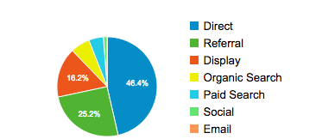
WEBSITE & LANDING PAGES – BY SOURCE
Traffic by source for life of campaign, US traffic
Direct traffic and referrals (note that non-Google display ads in many cases track as referrals) continue to be the primary sources of sessions on the landing pages.
During the past reporting period though, a Google Display ad that was run had a huge impact on site traffic. 72% of all site traffic during this time period came from the Google Display ad. However, as mentioned previously, this resulted in zero conversions.

Slide 24
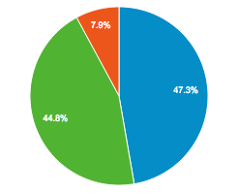

WEBSITE & LANDING PAGES – BY DEVICE
Traffic by device for life of campaign, US traffic
Traffic from mobile devices has historically been around 47% and increased significantly to around 80% this reporting period.
While we have been seeing a steady (though minor) increase in traffic from mobile devices, this month’s change can be mostly attributed to the Google Display Ad. 86% of visits from cost per click came in on a mobile device. Please see the slides featuring additional information on the Google Display Ad performance for recommendations.

Slide 25
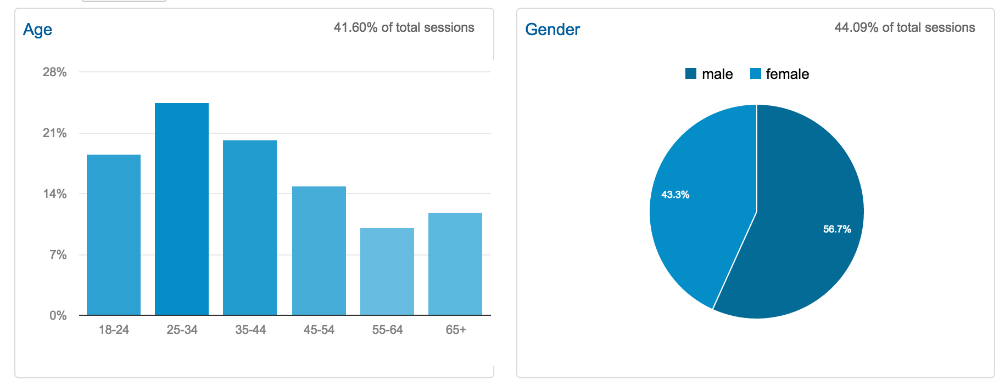
WEBSITE & LANDING PAGES – DEMOGRAPHICS
Access to demographic information was recently enabled in Google Analytics. We are able to see that (based on 44% of total sessions) 56.7% of sessions are male users, and the leading age group is 25-34.
We recommend monitoring this in conjunction with changes in advertising to establish a cause and effect. Additionally, along with the affinity category and in-market segment info, this data can be used to support the creation of a content strategy in FY16.

Slide 26
Online Ads

Slide 27
ONLINE ADS – OVERVIEW
These charts show the impact of ad clicks (banner ads, Pandora and video clicks) on conversions. Until recent reporting periods, the correlation is evident.
The high number of ad clicks in the lower chart can be attributed to the Google Display ad, which acted as more of a branding ad.
Only ads through Google AdWords (paid search, display ad and pre-roll) ran during the month of February.

Slide 28
ONLINE ADS – VIDEO PRE-ROLL
Video Pre-Roll ads have delivered (total as of 2/28/15):
1,711,114 impressions (0.22% CTR)
  909,519 YouTube impressions (0.28% CTR)
3,107 total clicks to landing pages
The performance of the YouTube video pre-roll improved slightly this month with increased percentage viewings at all points.
Note: YouTube pre-roll ads run continuously, with AdWords ads. YuMe video only runs during advertising flights.
Vendor | 25% video viewed | 50% video viewed | 75% video viewed | 100% video viewed
YouTube | 44% | 28% | 23% | 21%

Slide 29
ONLINE ADS – ADWORDS ADS
AdWords ads have delivered (total as of 2/28/15):
1,613,559 impressions
28,838 clicks (1.79% CTR)
Average cost-per-click is $0.39
The branded terms continue to deliver the highest CTR and lowest CPC. The performance (CTR) of these terms, as well as the non-branded terms, improved during the month of February.
Performance by AdGroup | Clicks | CTR | CPC | Conversions
Branded GBMA Terms | 2,477 | 13.39% | $0.33 | 94
Online Degree Terms | 820 | 0.15% | $7.10 | 3
Go Back To College Terms | 657 | 0.22% | $4.56 | 18

Slide 30
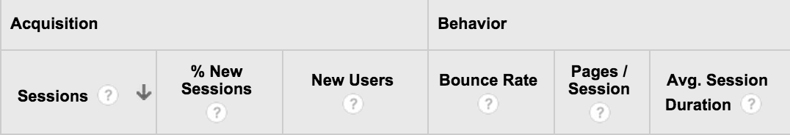
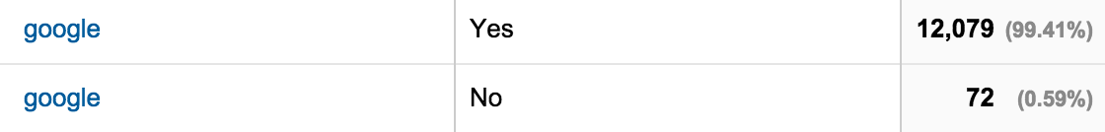
ONLINE ADS – GOOGLE DISPLAY AD
As mentioned, 72% of all site traffic this month came in from the Google Display ad. All visitor stats for this appear legitimate and do not indicate bot traffic. However, particularly for the traffic coming in from mobile (which is the majority of ad traffic, as seen below), the average session duration is very short.
In order to reduce the possibility of this being accidental click traffic, we’re looking to edit this ad only to show on desktop. We will continue monitoring ad performance.
Visitor activity info for those coming in from Google display ad:
Mobile percentage info for display ad:

Slide 31
ONLINE ADS – FACEBOOK
Facebook ads and boosted posts have delivered (total as of 2/28):
1,189,540 impressions
17,650 clicks
12,992 actions
247 Page ‘Likes’
Average cost-per-click is $0.40
Facebook boosted posts have delivered (from 2/1 – 2/28):
60,255 impressions
749 clicks
499 actions
24 Page ‘Likes’
Average cost-per-click is $0.69
Similar to the last reporting period, we spent more of the advertising budget on a Page Like ad, rather than boosting content. However, we did not see the same gain in followers that we saw last period.
As you know, we have now partnered with HYFN to more effectively advertise to the target Facebook audience.
We will continue posting content to the Facebook page (and boosting when appropriate) to keep our existing audience engaged.
Facebook Page Like ads have delivered (from 2/1 – 2/28):
18,409 impressions
82 clicks
53 actions
51 Page ‘Likes’
Average cost-per-click is $2.01

Slide 32
Social Media

Slide 33
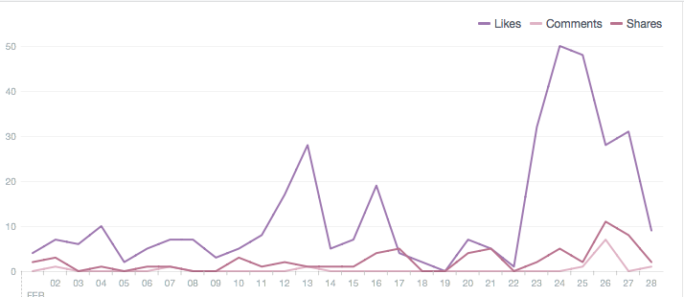
SOCIAL MEDIA – FACEBOOK OVERVIEW
1,376 total Facebook fans (increase of 7.7% this reporting period, or 98 fans)
42,597 total post reach (10.66% decrease from last report)
308 total post likes (72.2% decrease from last report)
While new Likes are up over the past few months, our engagement metrics have been decreasing in recent periods due to a decrease in spend on boosting content.
Post engagement for 2/1 – 2/28

Slide 34
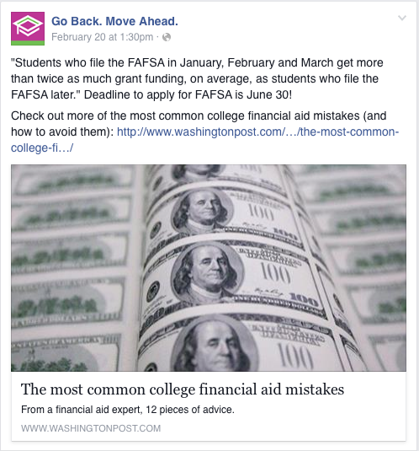
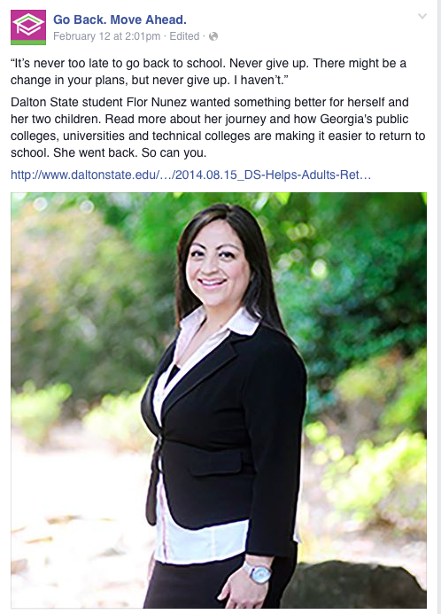
SOCIAL MEDIA – FACEBOOK DETAILS
97 likes, 9 comments, 22 shares
125 likes, 1 comments, 4 shares
Shown are two of the most active posts for the date range. While engagement overall was lower due to less spend on boosting posts, the most popular post was a link to a 3rd party article. This particular article gave tips on financial aid, directly addressing the “Need Support” need state.

Slide 35
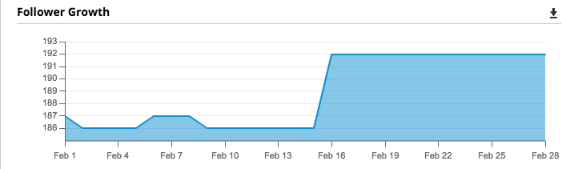
SOCIAL MEDIA – TWITTER OVERVIEW
196 total Twitter followers (increase of <10 fans since last report)
Currently, engagement remains low on Twitter as the majority of efforts are being put into Facebook.
There are a number of minor efforts (mentioning schools, re-tweeting more related content, etc.) that could have a valuable impact. We are beginning to implement some of these efforts this month, as budget allows.
If you have a list of related accounts (those speaking to adult learners, and system colleges – though we are following a number of them already) we could engage with, we may be able to see some increase in reach. Additionally, this could be an easy way to find content for reposting.
Twitter follower growth

Slide 36



INQUIRY STATS
3,211 completed one of 4 Web Forms
868 called the Corporate Call Center
2,562 calls made by Corporate Call Center
Preferred Contact Method:
Email 1,521
Phone 1,511
No preference 179
When contacting us:
Monday – Friday 2,723 (Tues. 541; Wed. 703)
Saturday & Sunday 488
When they would like to be contacted:
Weekend 300
Week Days 2,075 (1,035 indicated Week Day MORNING)
No Preference 836

Slide 37

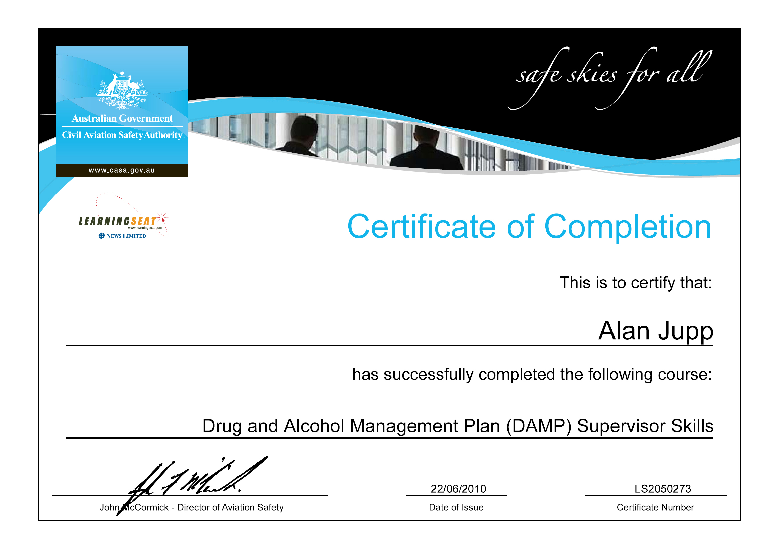
INQUIRY STATS
Degrees Sought:
Associates 192
Bachelors 625
Certificate 39
Diploma 30
Not listed 2,325
Educational Level already reached:
Need a GED 65
No College 331
Some College 2,182
Associates 383
Bachelor’s 238
No data 12

Slide 38
UPCOMING CAMPAIGN ACTIVITY

Slide 39
GO BACK. MOVE AHEAD. WEEK
Campuses are given the option to choose when to conduct these events]
1st time: October 2014
Current:
  April 2015
  Integrate radio remotes
  Pilots (DSC, GPC, GSW, CCGA)
Goal:
  All campuses (USG & TCSG) participate
  Host one week event in October (synergy)

Slide 40
OTHER
Call Center: April 2, 2015 (USG managed now)
Website: Upgrades over the Summer
Budget: USG to fund effort this year (looking to provide money for campus work)
Improved Tracking: Seeking better tracking from the USG side to determine the number of students who matriculate to our campuses (need to be able to keep track of those students that ‘might’ be attracted based on our collective effort).

Slide 41

QUESTIONS?
Rosalind Barnes Fowler
rosalind.barnes@usg.edu
P | 404-962-3126
C | 404-615-3524
@rzbarnesfowler

Slide 42
DISCUSSION / Q&A

Slide 43
DISCUSSION TOPICS:
Suggested changes/additions for GBMA website
Looking for various check lists that we can place on website for adults interested in returning to school (this also includes those tips this committee believe we should provide to adults interested in re-enrollment).
Suggested tools campuses can use to “track” students that originate through GBMA efforts to matriculation.
Improving the process in connecting staff from various campus departments (such as the Registrar’s Office, Financial Aid Office, Student Advising, Adult Learner Centers, etc.) to assist potential adult student applicants {are we missing any other areas that should be included on the team}.
Issues related to contacting students (USO staff & USG staff) – suggestions?

