Slide 1

Required High School Curriculum (RHSC)
4 mathematics
4 English
4 science (effective 2012 grads)
3 social science
2 units of the same foreign language or 2 units of American Sign Language
BOR Policy 4.2.1.1 and ASAH 3.2.3

Slide 2
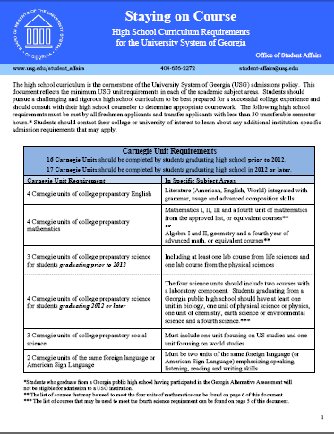
BOR Policy 4.2.1.1
ASAH 3.2.3

Slide 3
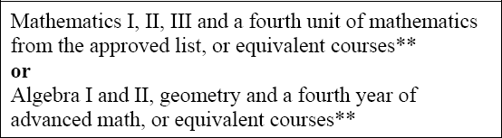
Mathematics Requirements

Slide 4
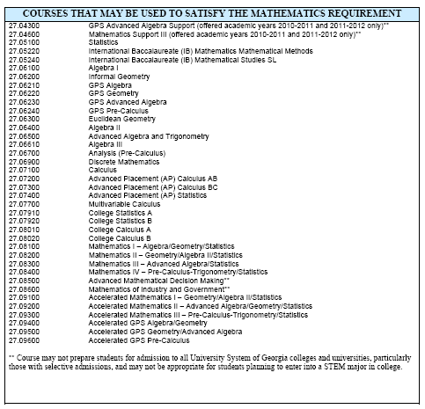

Slide 5
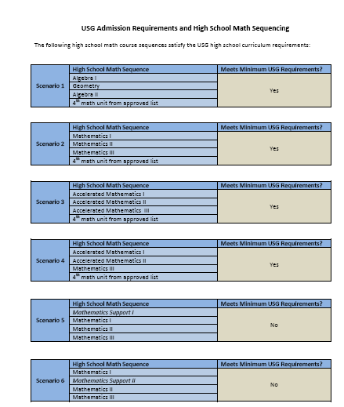

Slide 6
FAQs
Question:
Can a student satisfy high school graduation requirements without satisfying the USG’s Required High School Curriculum?

Slide 7

FAQs
Answer:
Yes, GADOE’s IDA(3) rule (List of State-Funded Courses) includes “Core” courses that do not satisfy a RHSC unit.
Example

Slide 8
Math FAQs
Question:
If a student completes an accelerated integrated mathematics course one year and an on-level integrated mathematics course the following year, will this count towards satisfying the University System of Georgia’s Required High School Curriculum (RHSC) in the area of mathematics?

Slide 9
Math FAQs
Answer:
Students may remain on-track provided they complete four total units of mathematics which includes Mathematics III and one additional unit of mathematics from the approved list found in this document.
For example, a student completing the following will have met the BOR Required High School Curriculum in Math:
Accelerated Mathematics I
Mathematics II
Mathematics III
Mathematics IV

Slide 10
Math FAQs
Question:
Does the following satisfy the USG’s Required High School Curriculum?
Mathematics I
Mathematics II
Mathematics Support III
Mathematics III

Slide 11
Math FAQs
Answer:
Mathematics Support III can count as an acceptable course for 2012 and 2013 graduates ONLY. For 2012 and 2013 graduates, institutions may consider the following as an acceptable math sequence:
Mathematics I
Mathematics II
Mathematics Support III
Mathematics III

Slide 12
Math FAQs
Question:
Can Mathematics III/GHSGT Preparation count as a 4th math?

Slide 13
Math FAQs
Answer:
No, while the course covers some of the content covered in Mathematics III, students completing the course are not exposed to all of the concepts covered in Mathematics III.
The focus of this course is on preparing students to successfully pass the GHSGT.

Slide 14
Math FAQs
Question:
Can History of Mathematics count as a 4th math?

Slide 15
Math FAQs
Answer:
No, high schools only give elective credit for this course and it does not include a sufficient level of math rigor.

Slide 16
Math FAQs
Question:
Does Mathematics of Finance count as a 4th math?

Slide 17
Math FAQs
Answer:
No, Mathematics of Finance was reviewed by the USG faculty review committee and was not approved to count as a RHSC math unit.

Slide 18
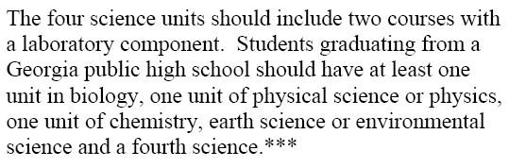
Science Requirements

Slide 19
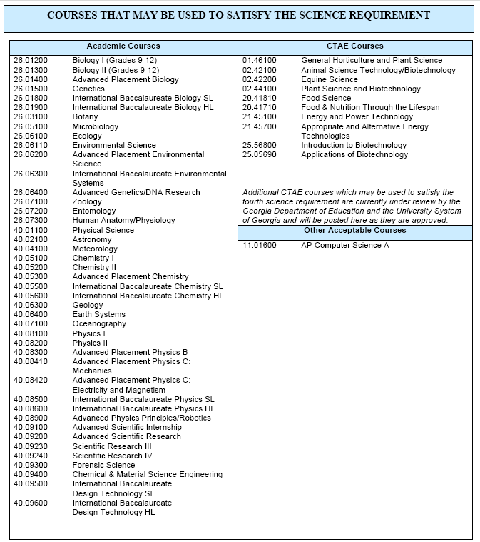

Slide 20
FAQs
Question:
If a school or school system only offers physical science in the 8th grade, can a student use that credit to satisfy the RHSC?

Slide 21
FAQs
Answer:
Students enrolled in Georgia private high schools and high schools in other states often complete physical science while in the 8th grade and then take 3 additional science units in high school. Students from private high schools and public high schools in other states can count physical science courses taken in the 8th grade as one of the 4 required science units.

Slide 22
Approval Process
GADOE requests review
USG Faculty Committee reviews: Course approved, not approved, or approved with recommendations
Approved courses added to Staying on Course
Not approved courses added to tracking document
Detailed course info provided to USG

Slide 23
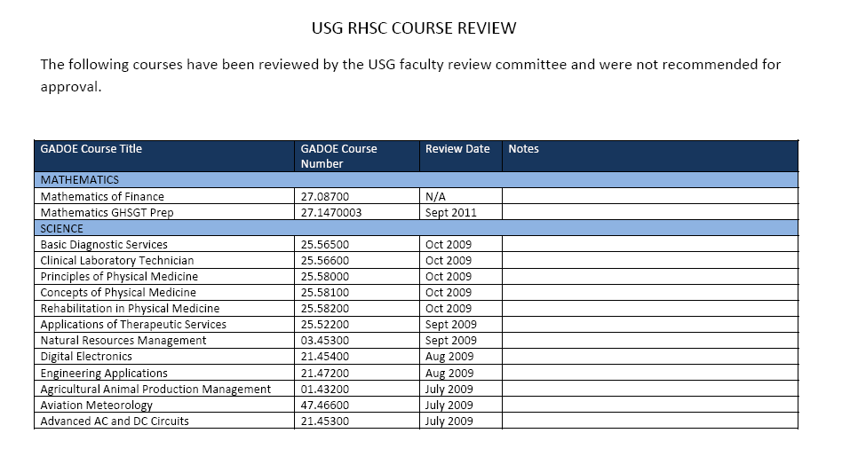
Courses Not Approved
Accessed from the Staying on Course document

Slide 24
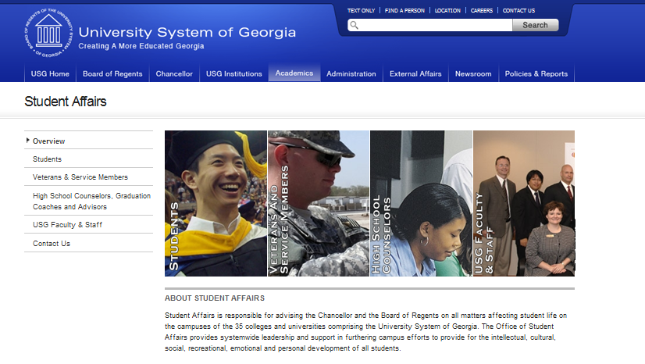
www.usg.edu/student_affairs
Click on “Students or “High School Counselors”

Slide 25
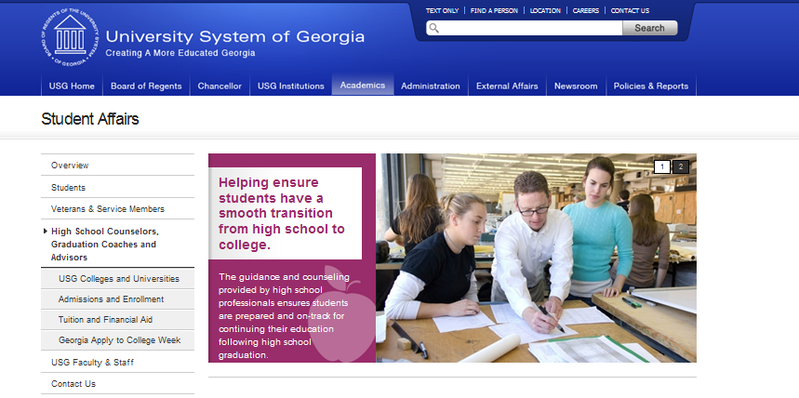
Click on “Admissions and Enrollment”

Slide 26
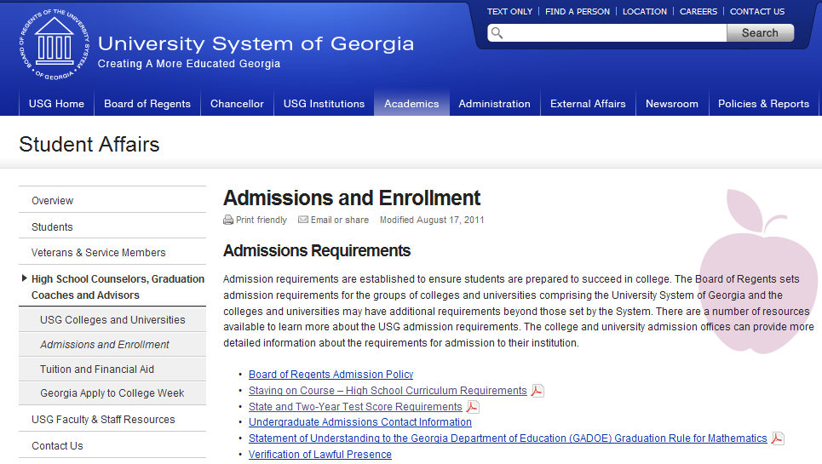
Click on “Staying on Course”

