Slide 1
Research and Policy Analysis Update
RACRA
Tuesday, March 24, 2018
Middle Georgia State University

Slide 2
Team RPA
Angie Bell-AVC of RPA
Rachana Bhatt-data requests, GA AWARDS
Tan Tran-HR data, OneUSG
Lori Hagood-data governance, CCG, GA AWARDS
Patrick Harris-IPEDS, data quality
Michael Pizarek (new!)-general research
Jeniffer Postell-ADC, DMA, external sites, FICE & HS codes
Phyllis Gagne-reporting on degree and majors, HR

Slide 3
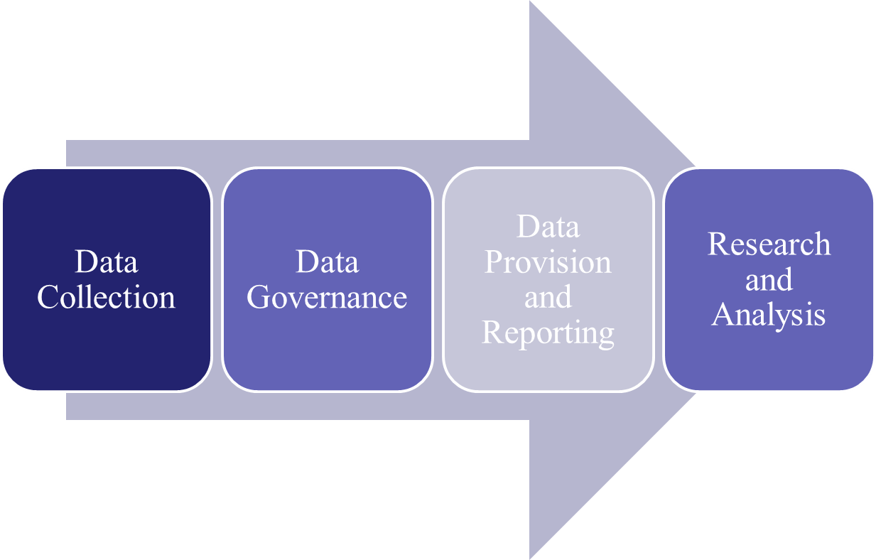
RPA Functions

Slide 4
Data Collection and Governance

Slide 5
ADC Recent Changes
ADC Spring 2018 Mid-term
Dual Enrollment changes from rebranding of MOWR
GPA Precision
Campus Housing charges**
Email Address logic change to exclude inactive addresses

Slide 6
ADC Recent Changes
ADC Spring 2018 Mid-term
ACT Sub-Scores required—note, edit not implemented, will have to be changed
Required High School Curriculum code modifications
Accuplacer WritePlacer Score (change minimum valid score 1 to 0)

Slide 7
ADC Upcoming Changes
Summer 2018 Mid-term
Low & No Cost Course Section Attribute (required Fall)
Fix Test Score extraction problem (will require recollection of most critical scores)
Shoring up dual enrollment and learning support data quality

Slide 8
ADC Upcoming Changes
Spring 2019
Course section “Campus Code”-thank you for responses
  Purpose is tracking course section enrollment on institution different instructional sites
  Further information is forthcoming

Slide 9
ADC Upcoming Changes
Timing not designated
High Impact Practices-for course sections
Degrees and Majors:
  Minors and Concentrations
  New “Nexus” credential
Other Momentum Year needs being assessed

Slide 10
ADC General
First, thank you!
Work to ensure ADC Points of Contact (POCs) understand changes and responsibilities
More regular meetings, better communication
Enhanced turnaround reports
We welcome feedback!!!

Slide 11
Outside Requests for USG Data
New more rigorous process:
  New application
  Template of available variables
  Vetting by subcommittee of system FDGC
  Same FERPA-compliant data sharing agreement; requires review of publications
  Presentation to full FDGC and notice to campuses

Slide 12
Reporting and Other Projects

Slide 13
RPA Reporting so you don’t have to
IPEDS
Gateway to Completion
Complete College America
Gates Grant
Consortium for Student Retention Data Exchange

Slide 14
USG/Carl Vinson Data Project
New Qlik resources:
  Semester Enrollment Report-already there
  Transfer and Completion Flow-soon
  Adult Learner Outreach-soon
Trainings will be offered
Contact your IR director for access

Slide 15
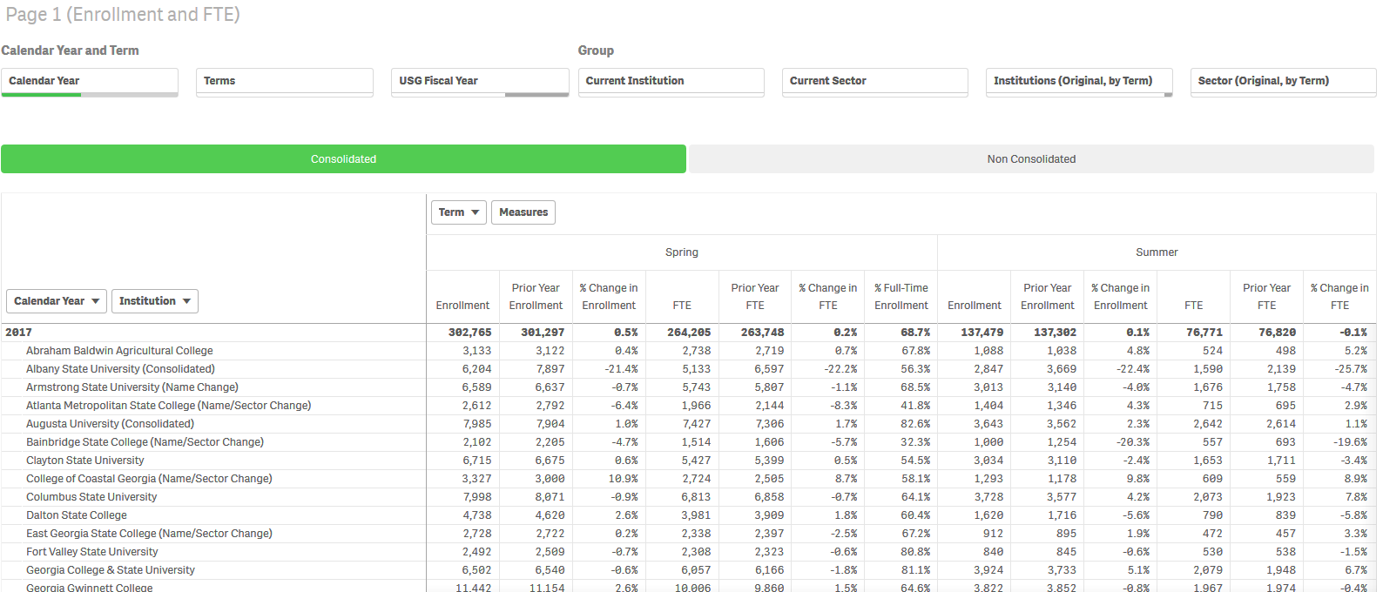
Semester Enrollment Report App

Slide 16
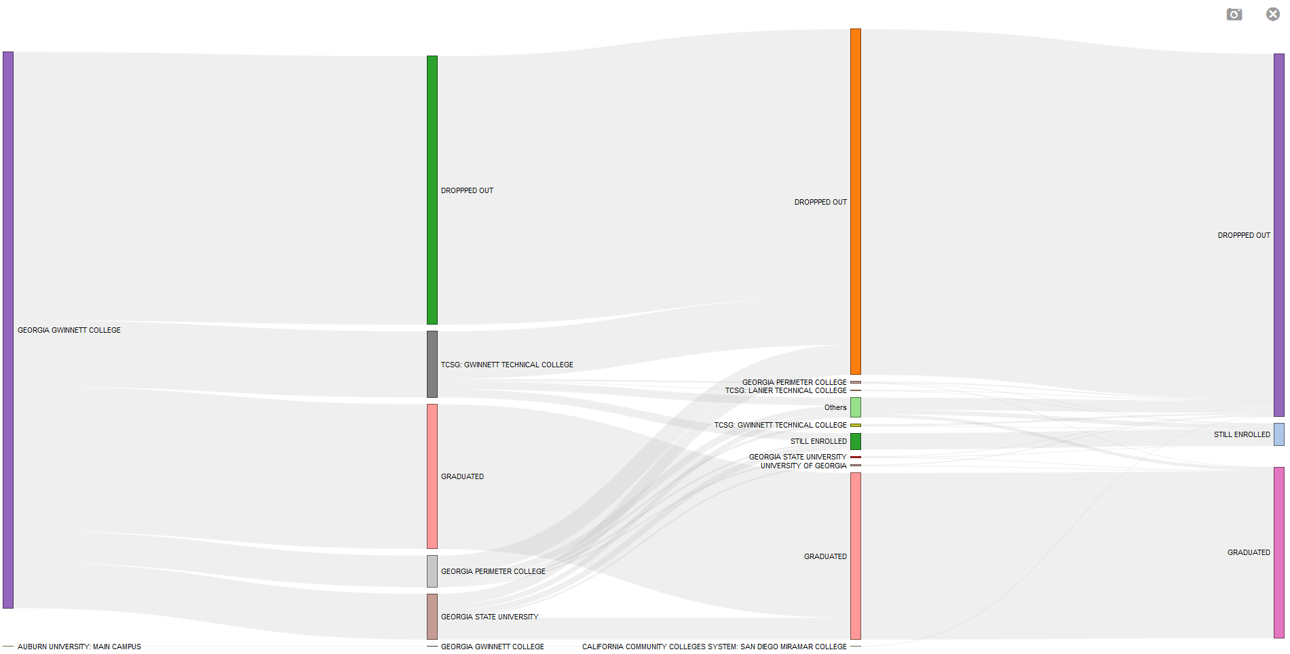
Student Transfer and Completion Flow App
NO LONGER ENROLLED
NO LONGER ENROLLED
NO LONGER ENROLLED
State College
INSTITUTION A
STILL ENROLLED
GRADUATED
INSTITUTION B
GRADUATED
GRADUATED
INSTITUTION C

Slide 17
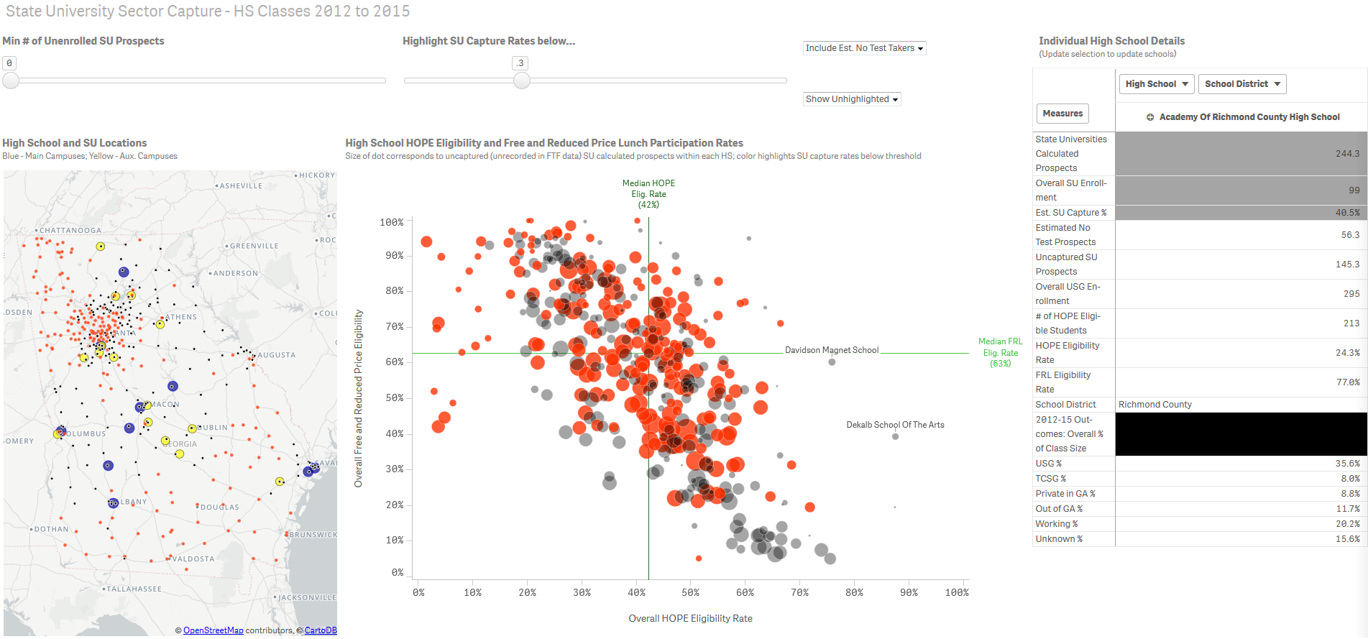
High School Graduate Market Share Tool
Sliders and Toggles to Change Viewing Settings
4
3
2
1
17

Slide 18
Adult Learner Outreach
Where are adults with some college or high school diploma but no bachelors’ degree?
What types of jobs are in my region?
What jobs are projected to grow?
What level of education is required for these jobs?
Which neighborhoods should we target for marketing our education programs?

Slide 19
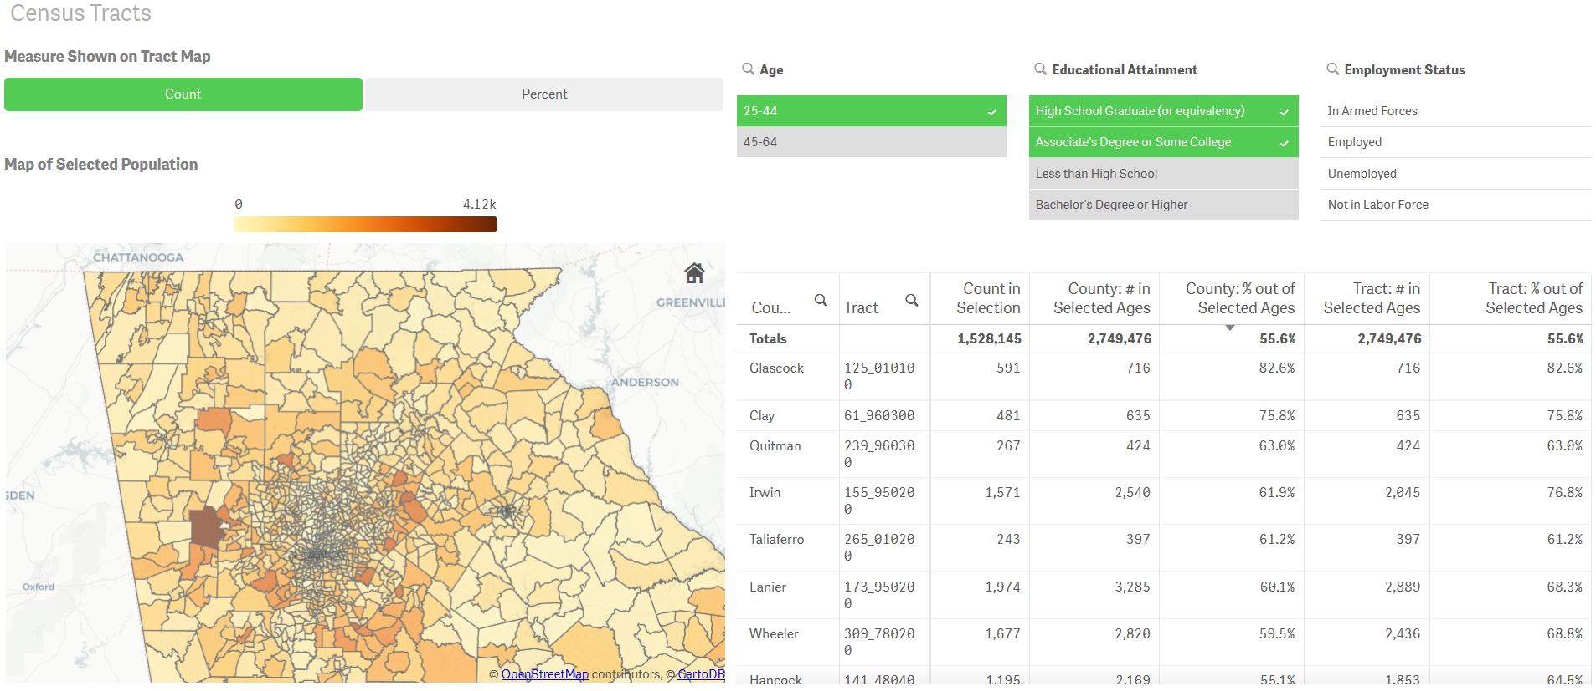
Where are Adult Learners?

Slide 20
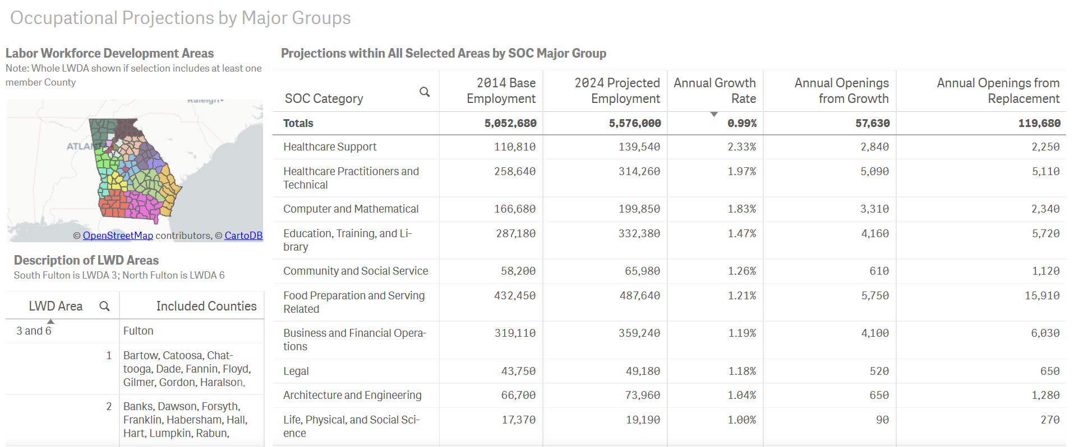
What jobs are growing?

Slide 21
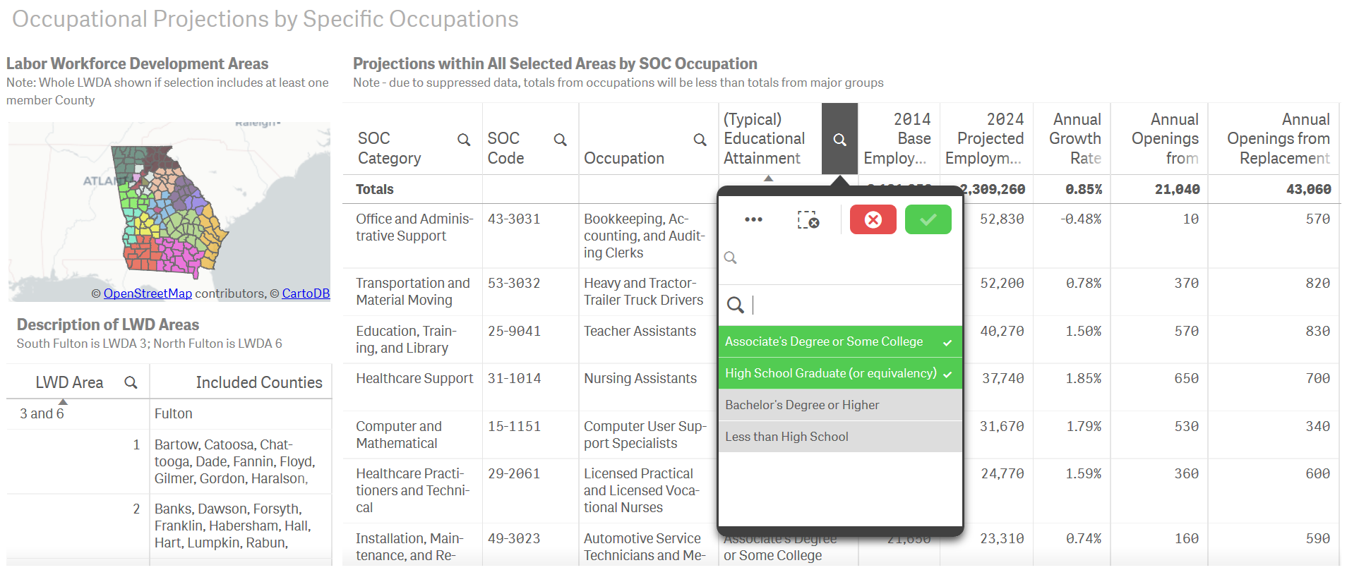
What are the educational requirements for jobs in my region?

Slide 22
Contact
RPA website: www.usg.edu/research
Lori Hagood, Research Associate
Lori.Hagood@usg.edu
404.962.3089

