Slide 1

Changes to Remediation . November 5, 2014 for the Regents Advisory Committee on Registration and Admissions
Barbara Brown
Office of Educational Access & Success
Barbara.Brown@usg.edu

Slide 2
Paving the Way
Task Forces
Ad Hoc Committees
Regional Meetings
Committee on Remediation Policy and Procedure
BOR Approval at August 20 Meeting.

Slide 3

Key Change 1
There are now two Learning Support areas, rather than three.
Reading, English, & Mathematics
English (reading/writing) & Mathematics

Slide 4
Key Change 2
USG institutions must provide Learning Support for students as corequisites to college level courses.
ENGL 1101
MATH 1001, 1101, or 1111
Institutions may offer corequisite remediation only or corequisite remediation and year-long remedial pathways that begin with stand alone Foundation-level courses.
The majority of students requiring remediation must be placed into corequisite courses.

Slide 5

Learning Support English and mathematics programs must be structured so that students can complete all requirements in a maximum of two semesters, one of Foundations-level and one of corequisite-level Learning Support.

Slide 6
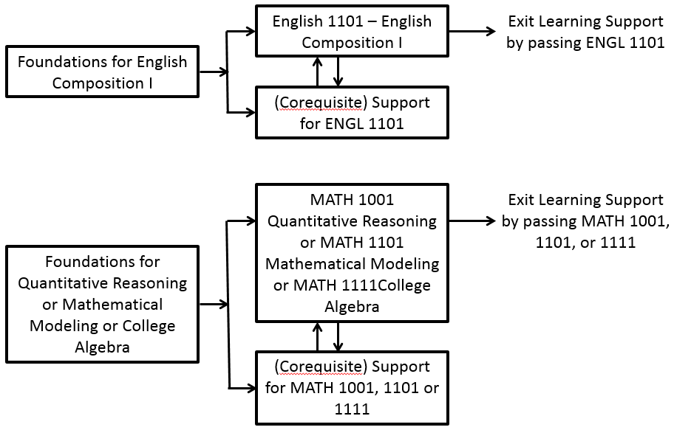


Slide 7

Corequisite Course Numbers
Key Change 3: Numbering of Learning Support Courses
These will be 1 – 2 credit courses.
ENGL 0999 – Support for English Composition (ENGL 1101)
MATH 0997 – Support for Quantitative Reasoning (MATH 1001)
MATH 0998 – Support for Mathematical Modeling (MATH 1101)
MATH 0999 – Support for College Algebra (MATH 1111)

Slide 8
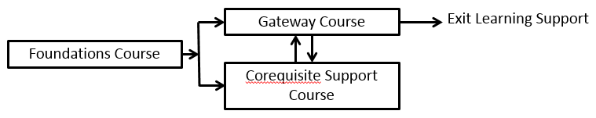
Foundations Course Numbers: Year-Long Pathways
These will be 3 – 4 credit courses.
ENGL 0989 – Foundations for English Composition (ENGL 1101)
MATH 0987 – Foundations for Quantitative Reasoning (MATH 1001)
MATH 0988 – Foundations for Mathematical Modeling (MATH 1101)
MATH 0989 – Foundations for College Algebra (MATH 1111)

Slide 9

Key Change 4: Math Pathways
MATH 1111 (College Algebra) prepares students for calculus. Should not be the default math pathway.
MATH 1001 (Quantitative Reasoning) or MATH 1101 (Mathematical Modeling) should become the default math pathway.

Slide 10
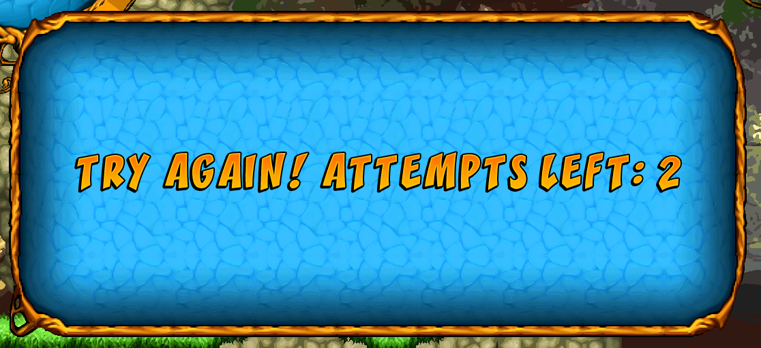
Key Change 5: Learning Support Attempts and Exit
Attempts are defined as institutional credit courses in which students receive any grades (or symbols) other than “W” or “WM.”
If students do not complete requirements for Foundations-level English or mathematics in two attempts, they will be suspended for a calendar year.
Can go to TCSG during that year.
There are no limits on attempts in corequisite Learning Support courses.

Slide 11

Learning Support Exit
Students will exit Learning Support by successfully passing (as defined by the institution) the corresponding Area A collegiate-level course.

Slide 12
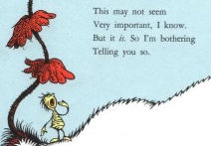
Key Change 6: Withdrawals
Students who withdraw from Learning Support courses will no longer be required to withdraw from unrelated collegiate courses.

Slide 13

Key Change 7: Learning Support Prerequisites or Corequisites
Institutions shall inform students of those courses that have LS courses as prerequisites or co-requisites. The following Core Curriculum areas require students to exit or exempt certain Learning Support requirements.
Reading Completion or exemption from Foundations-level English is a prerequisite for Social, Natural, and Physical Science courses . . .

Slide 14
Completion or exemption from Foundations-level Learning Support English or placement into corequisite English is required for placement into LS English and Reading are prerequisites for college-level English.
Completion or exemption from Foundations-level Learning Support mathematics or placement into corequisite mathematics is required for placement into college level mathematics courses.
Completion or exemption from Foundations-level Learning Support LS Mathematics is a prerequisite for Mathematics, Physics, and Chemistry courses. . .

Slide 15
Key Change 8: Learning Support Evaluation
A Mathematics Placement Index (MPI) and an English Placement Index (EPI) will be calculated based on High School Grade Point Average (HSGPA),
SAT or ACT and, when indicated, the COMPASS placement test or other approved placement test.
Indices will be composed of:
1. HSGPA and SAT/ACT - when both are available
2. HSGPA and COMPASS - when SAT/ACT are not available
3. COMPASS - when neither HSGPA nor SAT/ACT is available

Slide 16
Evaluation for Learning Support Placement
When COMPASS testing is required, the COMPASS Math (Algebra) test will be used for math placement. The Compass Reading and COMPASS e-Write 2-12 tests will be used for English placement.

Slide 17

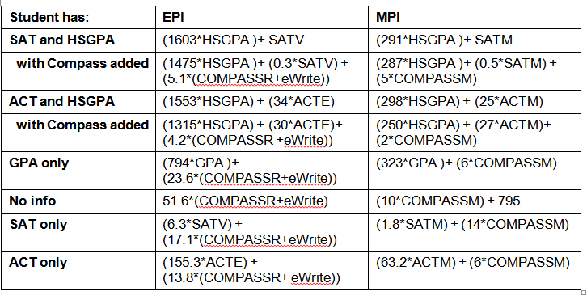
Calculating Placement Indices

Slide 18
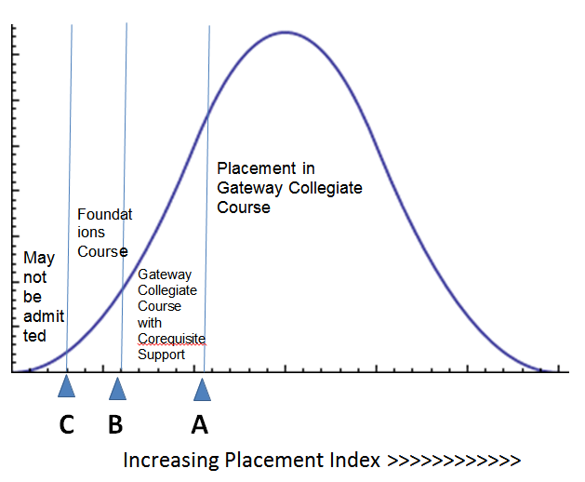

Slide 19
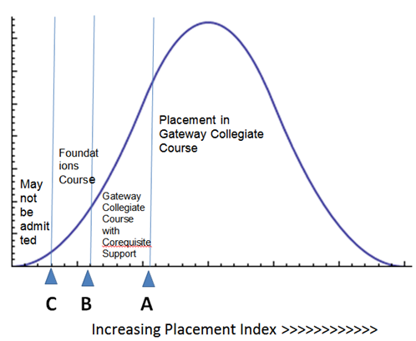
Students who place into both (Math and English/Reading) LS areas will not be denied admission unless
They score below the “floor score” in both areas or they score below the “floor score” in one area and below the offsetting placement index in the other.

Slide 20
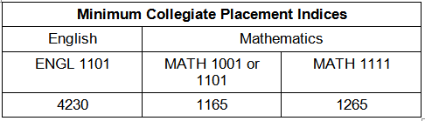

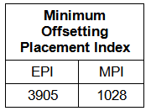

Slide 21
Question: How do institutions set cut scores between placement in corequisite and Foundations-level remediation?
Cut score should be chosen so that the majority of students are placed in corequisite remediation.
Suggest cut score that would place 2/3 of students in corequisite remediation.

Slide 22
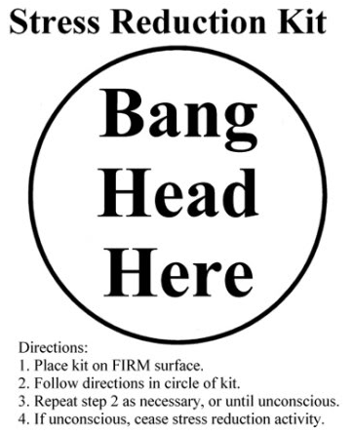

Slide 23
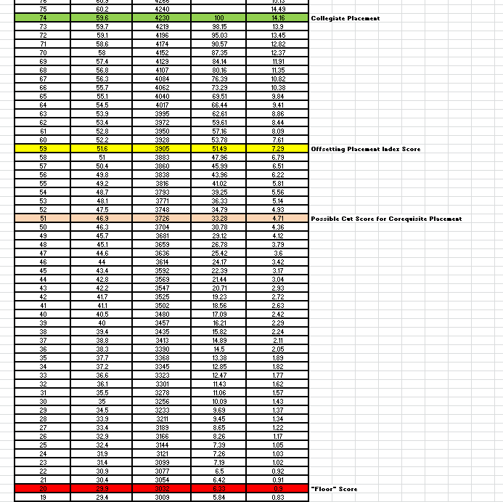
English

Slide 24
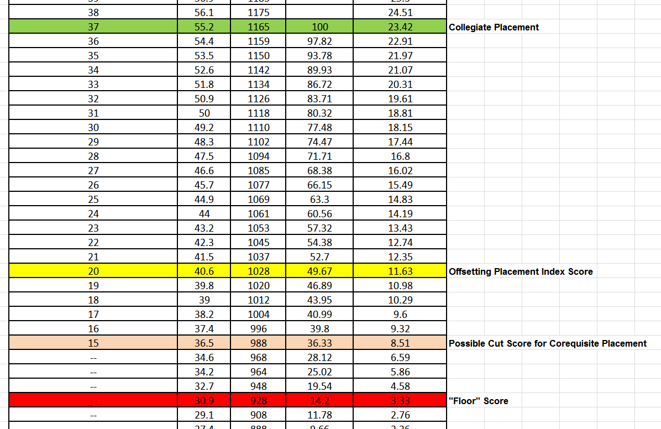
Mathematics

