Slide 1
Complete College Georgia
Web Resource
inventing beyond
Notes:
1. CCG goals are a team effort; everyone present is crucial, as well as
all institute stakeholders
2. USG is always prepared to assist everyone to reach goals through
typical and current means
3. But we want to provide, as much as possible a 24/7, just-in-time, one-stop shop of
information to all working toward CCG goals
4. One important way to do this is a new, greatly enriched web resource

Slide 2


What’s the Need
CCG resources at USG OEAS
CCG activities at 31 USG Institutions
Research and Information from Philanthropic & Academic Partners
Disconnected resources
CCG elements among USG System Office Partners
Notes:
We currently have multiple resources to assist CCG goals, including electronic news updates and a website, but to answer the total needs of CCG, these resources are somewhat disparate.

Slide 3
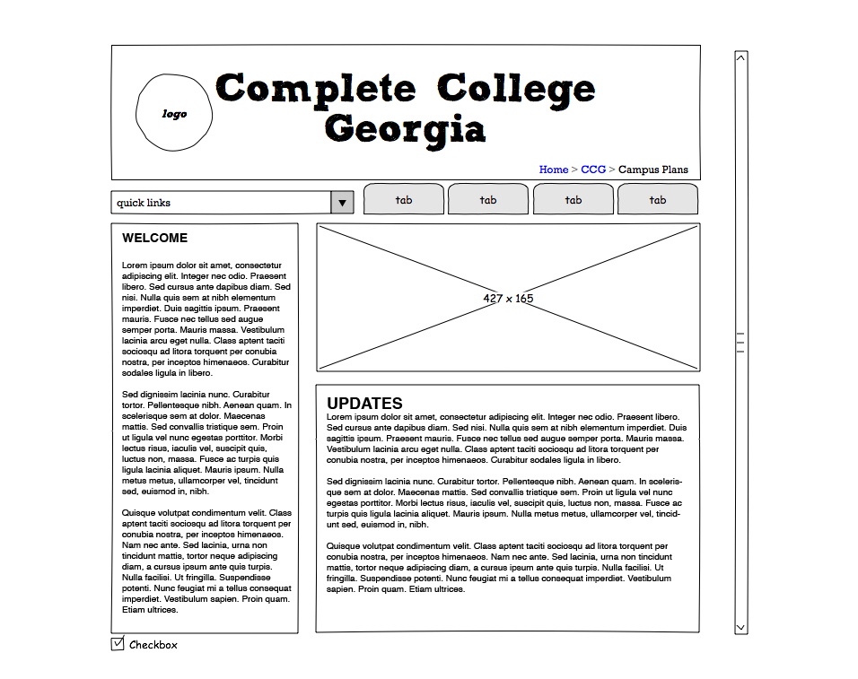
A Completion Website
USG OEAS
Philanthropic & Academic Partners
31 USG Institutions
USG System Office Partners
Notes:
Answer: A consolidated resource that provides a variety of answers to need.
It is critical for us to provide resources to a wide audience, most importantly, YOU!

Slide 4
Flexible Framework
One-Stop Shop
Complete Georgia College Plan Updates
Performance Funding
Grant Opportunities
Policy Changes
Implementation toolkits
Research and Reports
Tools for dealing with data
Forum for partners
Meeting and webinar information and archives
Clearinghouse of activities and best practices
Regional information hub
Notes:
We are creating a flexible, expandable information resource that can grow with all our needs.
Our initial survey results indicate that the listed tools/resources are of strong importance.

Slide 5
We Need Your Input …
        Thank you for Survey Input
        Focus Groups in Future
ccg@usg.edu
Notes:
Please contact us at the listed address to nominate potential focus group participants, or simply to provide your input.

