Slide 1
SAVE
Systematic Alien Verification for Entitlements
Nancy Sanders
Kennesaw State University

Slide 2
SAVE at KSU
KSU was approved to use SAVE in December 2010
To date we have verified 143 students in SAVE
Unexpected SAVE verification delays

Slide 3
How Does SAVE Verify Immigration Status?
SAVE electronically verifies immigration status using a three step process.
The initial verification electronically compares information the agency enters against DHS databases and returns a response within seconds. If a match is not possible, the agency is prompted to institute additional verification (also referred to as “second step”) and provide any additional information that may assist with verification. The agency must click the “institute additional verification” button to begin additional verification. It does not occur automatically.

Slide 4
Sign–On Screen

Slide 5
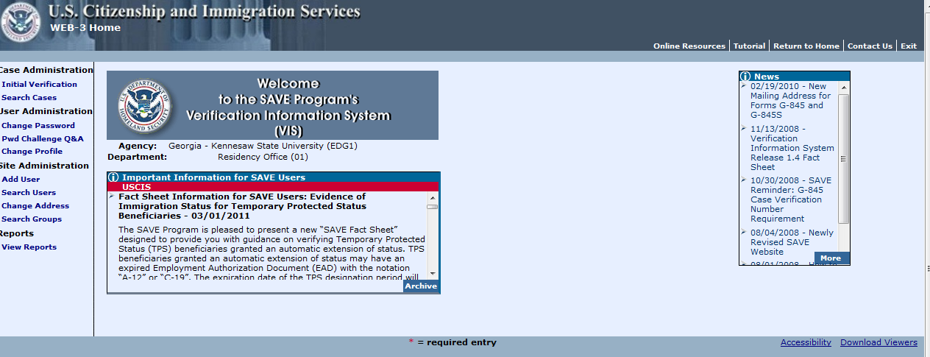
Initial Verification Screen # 1

Slide 6
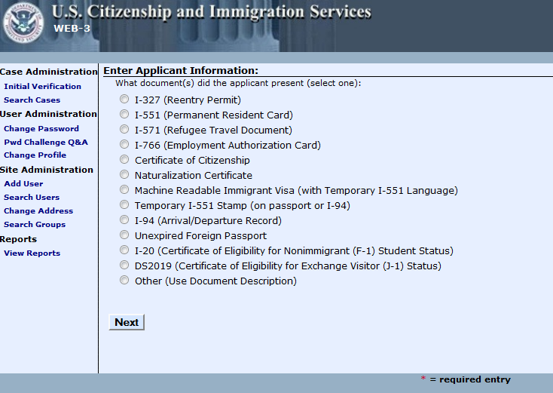
Initial Verification Screen # 2
Notes:
I have chosen EAC

Slide 7
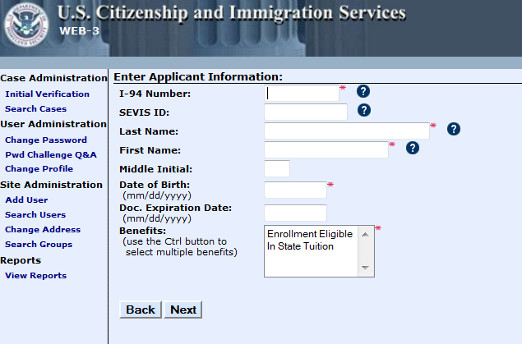

Slide 8
COMPLEX SURNAMES
Enter the entire surname, including prefixes or name stems (without periods). Hyphenated names and names with apostrophes are allowed.
Example name: Alexandra De La Cruz Enter as follows: Alexandra De La Cruz
Example name: Peter O'Donoghue Enter as follows: Peter O'Donoghue
Example name: Maria Lopez-Garcia Enter as follows: Maria Lopez-Garcia
Ignore all suffixes such as Jr., Sr., III, etc.
Example name: Roberto Garcia, Sr. Enter as follows: Roberto Garcia
Do not use periods
Example name: Rachel St. John Enter as follows: Rachel St John
Individuals from some cultures may use their surname first and their given name last.
Example name: Nguyen Mai Enter as follows: Mai Nguyen
If you encounter a name that you think may fall into this category, ask the student for clarification or check the original document (if available).

Slide 9
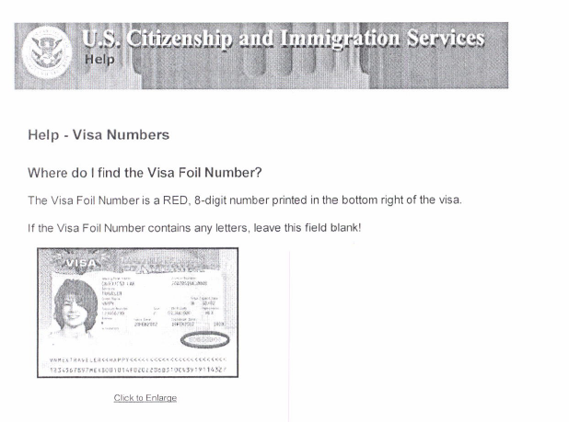
Visa Numbers

Slide 10
ALIEN IDENTIFICATION NUMBERS
The space provided for the alien identification number, consists of a nine-digit field. Omit the preceding "A" . If the number provided by the alien is less than nine digits, add leading zeros.
Example: A72 735 827 should be input as 072735827
I-94 IDENTIFICATION NUMBERS
The space provided for the l-94 number, also known as the admission number, consists of an eleven-digit field. If the l-94 number provided by the alien is less than eleven digits, you must provide leading zeros.
Example: 7273582701 should be input as 07273582701

Slide 11
Accuracy of Data
After you have entered the information needed to perform a primary query, but before you send the query to the database, you should review the data for accuracy. By taking the extra step to ensure that the information submitted is correct, you may eliminate the need to perform additional steps necessary to complete the verification process.
SAVE only knows what you tell it – it does not know that a status has been extended or changed.
Use current documentation – save 50

Slide 12
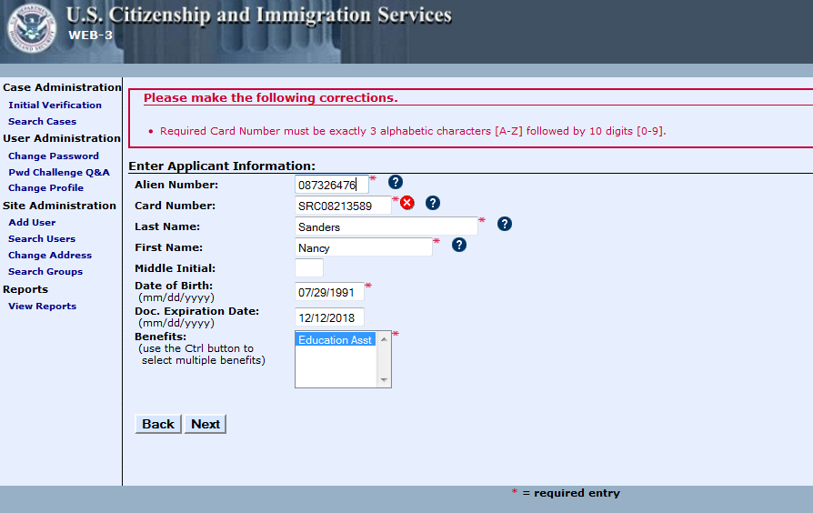
Error Message
Notes:
Required Card Number must be exactly 3 Alphabetic characters A-Z followed by 10 digits (0-9) . Resubmission of initial query will count as a new query (.50)

Slide 13
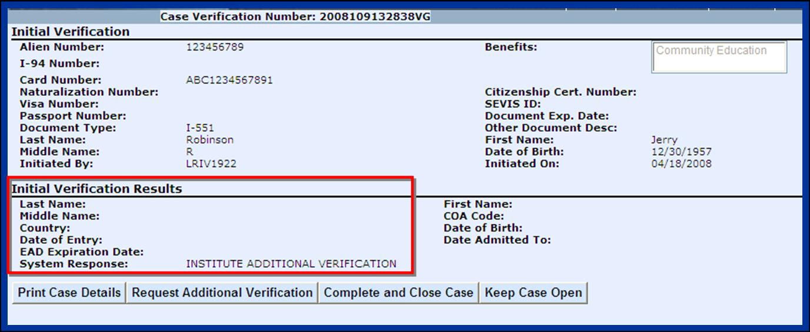
Initial Verification Results

Slide 14
The verification number is the system-generated number that appears in the message area when a verification request is submitted.
The first thirteen digits contain the year, day, and time the case was submitted, encoded as follows: First four digits are the year, next three digits the Julian date, next two digits the hour, next two digits the minute, and the next two digits are the seconds. The last two characters in the verification number are part of an alphanumeric sequence number that helps to uniquely identify this case.

Slide 15
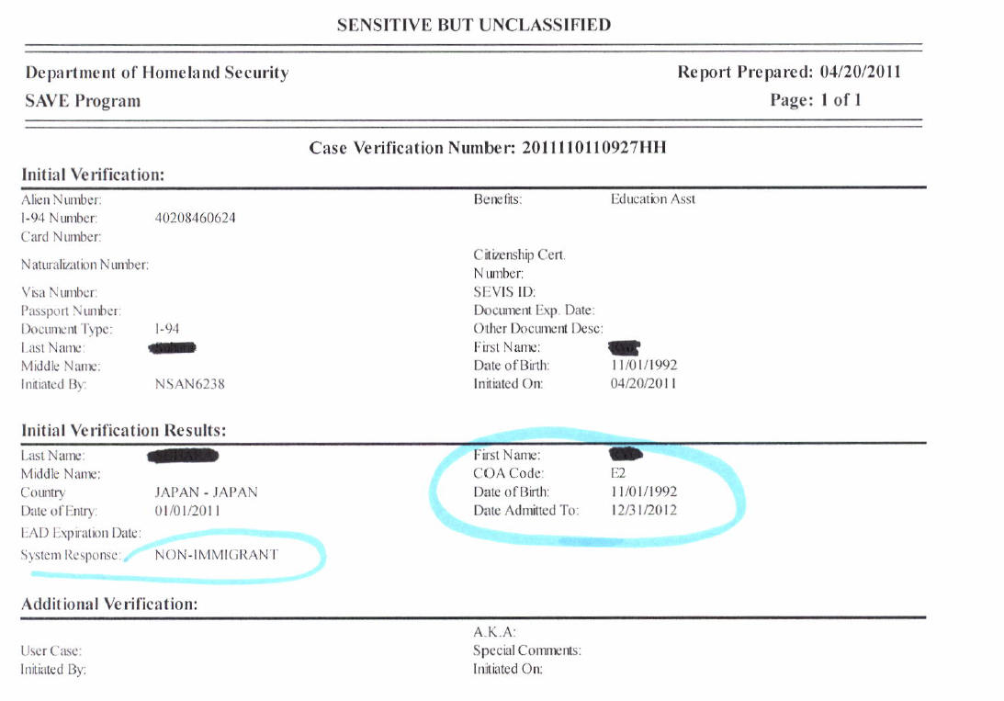

Slide 16
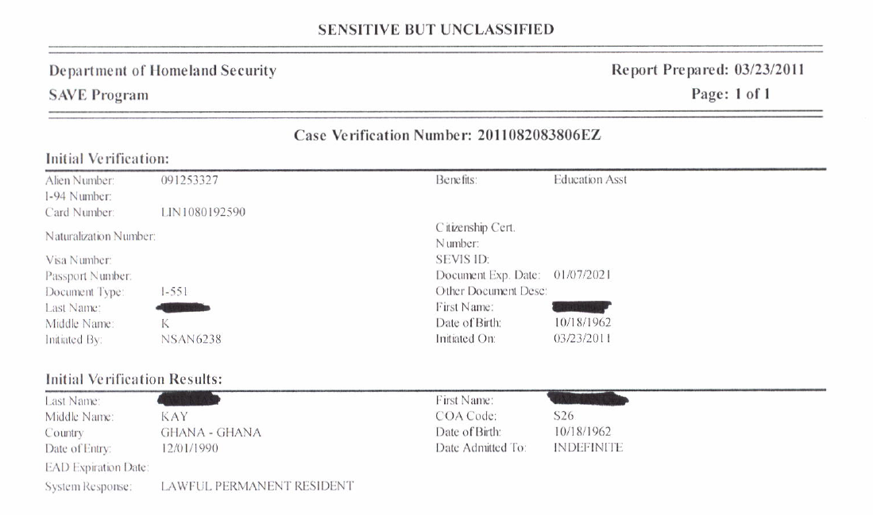

Slide 17
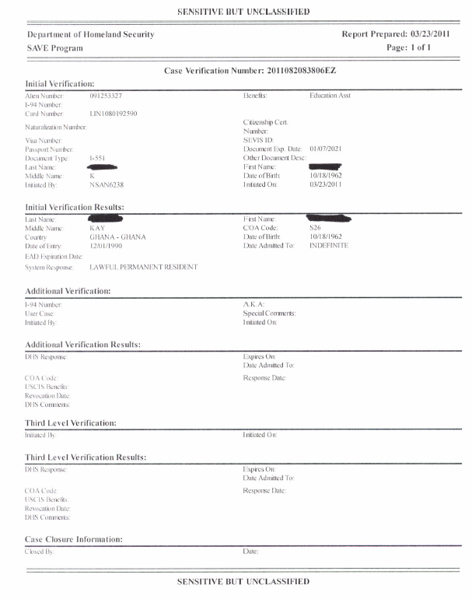
KSU places
this page in
the student’s
NOLIJ file
titled SAVE

Slide 18
Additional Verification?
During additional verification, a status verifier conducts a manual search of DHS databases, including databases not automatically searchable during the initial step. This step takes between 3–5 federal working days.
If after this step verification is still not possible, the system prompts the agency to submit a Form G-845 and copies of the immigration documents the applicant presented (Third Level Verification).

Slide 19
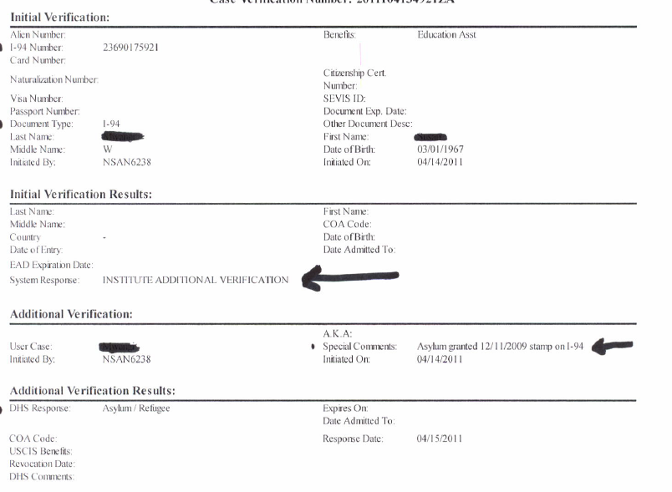

Slide 20
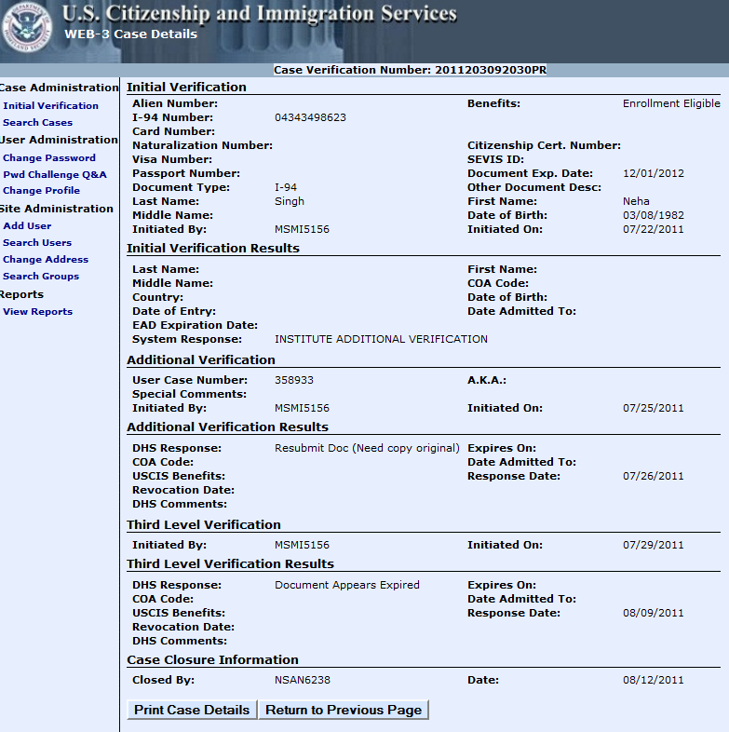

Slide 21
Third Level Verification
The third step of the SAVE process requires the agency to mail a Form G-845 and photocopies of the document to USCIS. Agencies should receive a response within 10–20 federal working days.

Slide 22
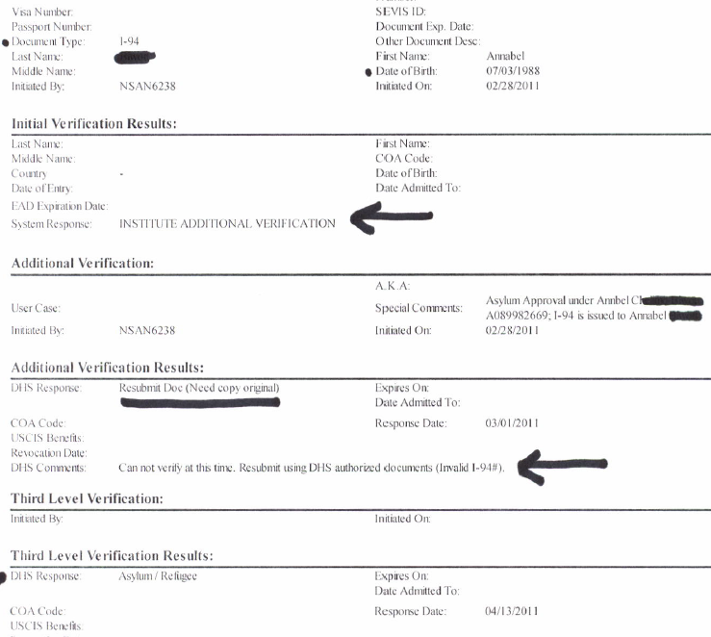

Slide 23
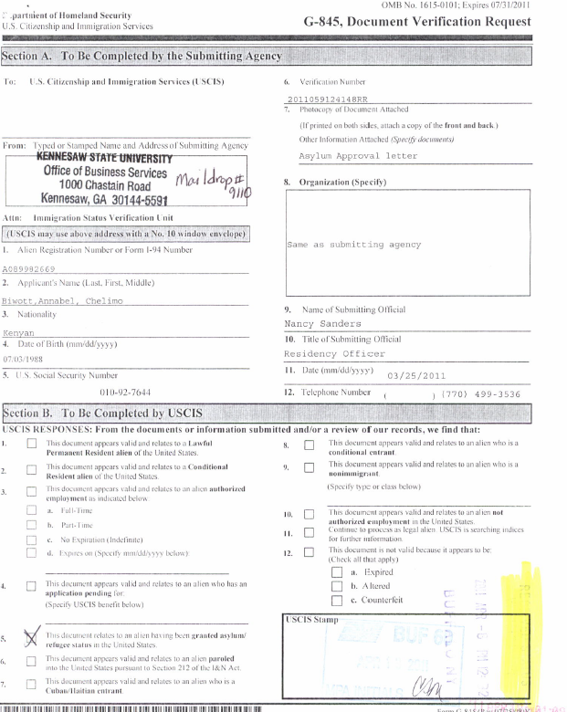
G-845

Slide 24
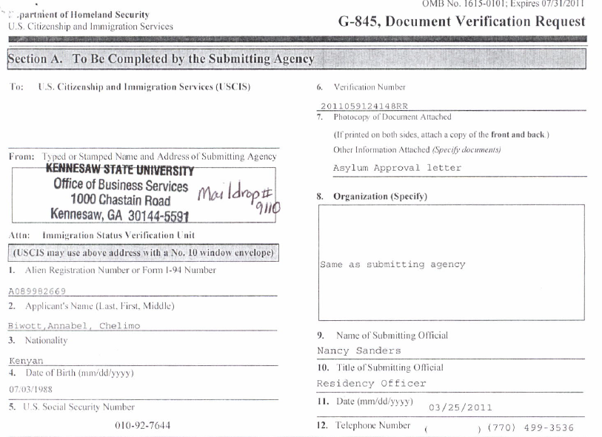
Section A

Slide 25
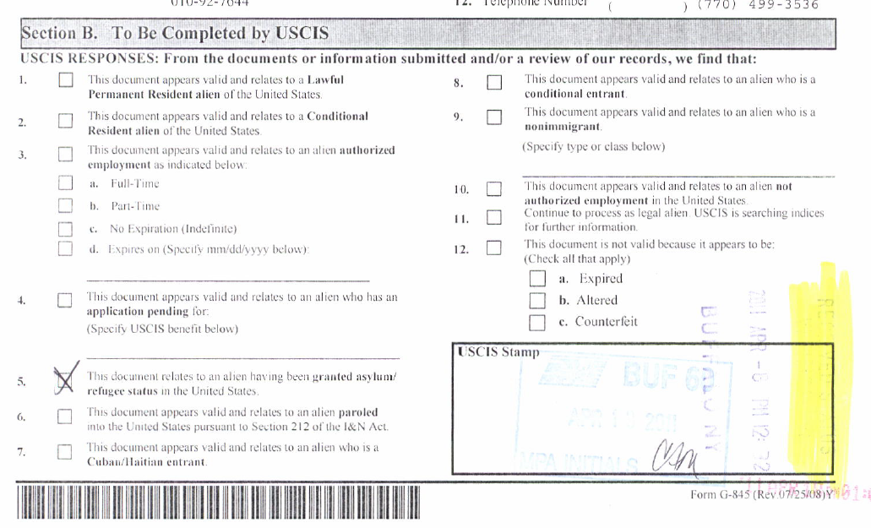
Section B

Slide 26
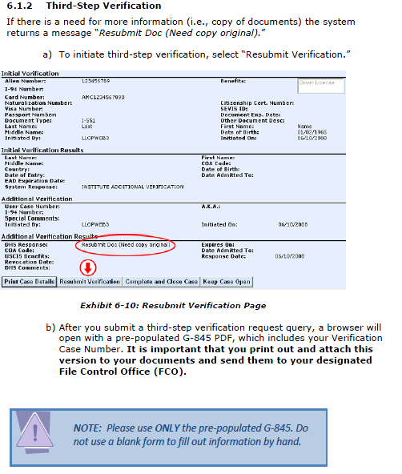
Verify information included in
pre-printed G-845, it is not
complete. Some fields will need
to be populated by the sender.

Slide 27
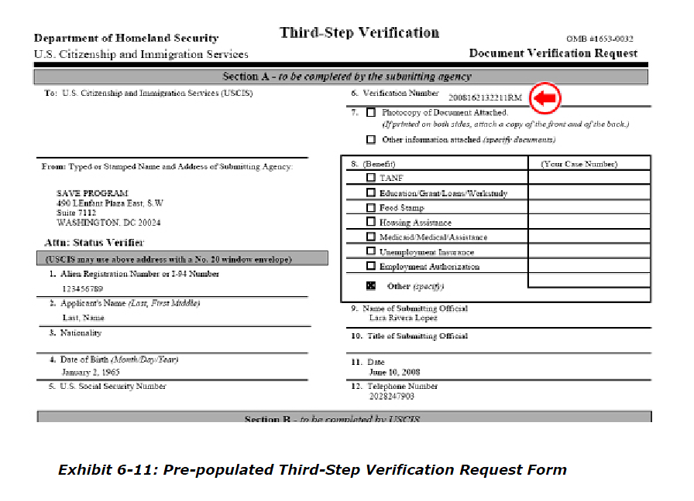

Slide 28
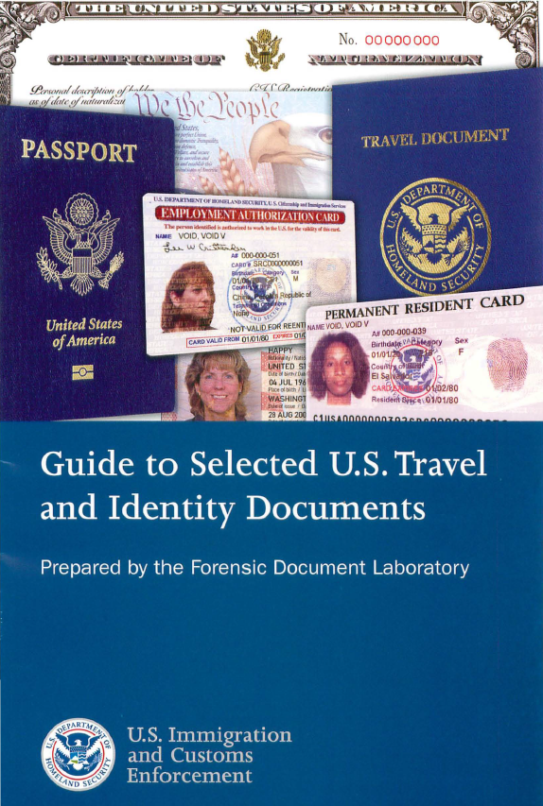
M-396
Current version is 4/2008. Ordered June 2010, received March 2011. Green card updated May 2010.

Slide 29
M-396 – ordering
http://forms.cbp.gov/pdf/CBP_Form_262.pdf
http://www.cbp.gov/xp/cgov/toolbox/forms/ordering_forms.xml

Slide 30
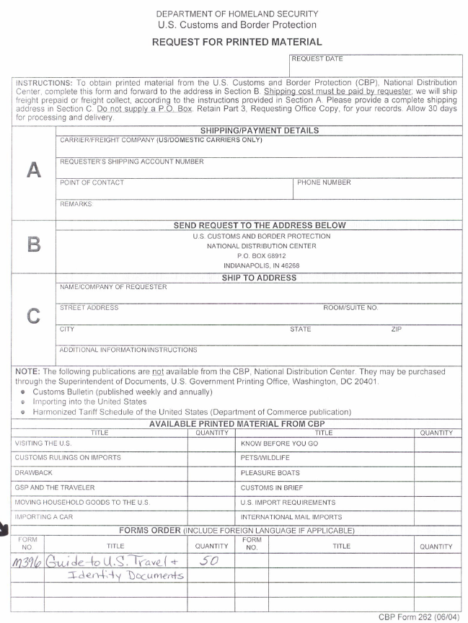
Order form for M-396

Slide 31
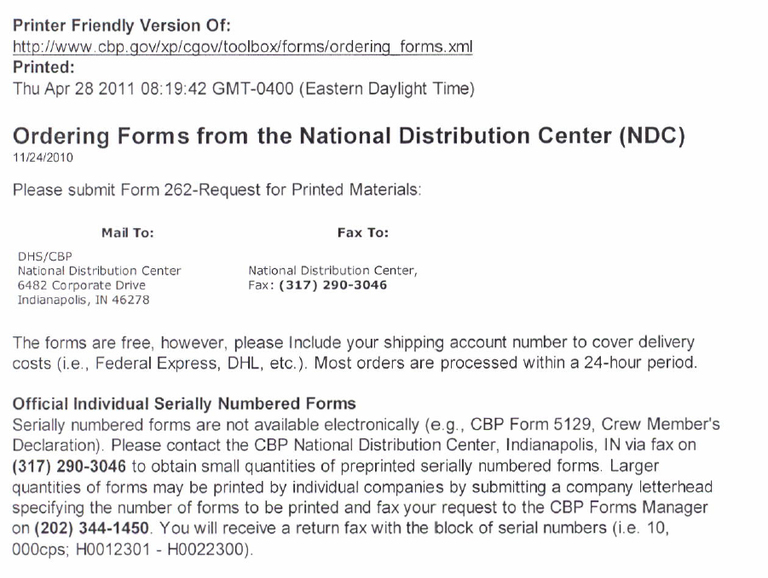

Slide 32
QUESTIONS?
Nancy Sanders
nsanders@kennesaw.edu
770-499-3536

