Slide 1
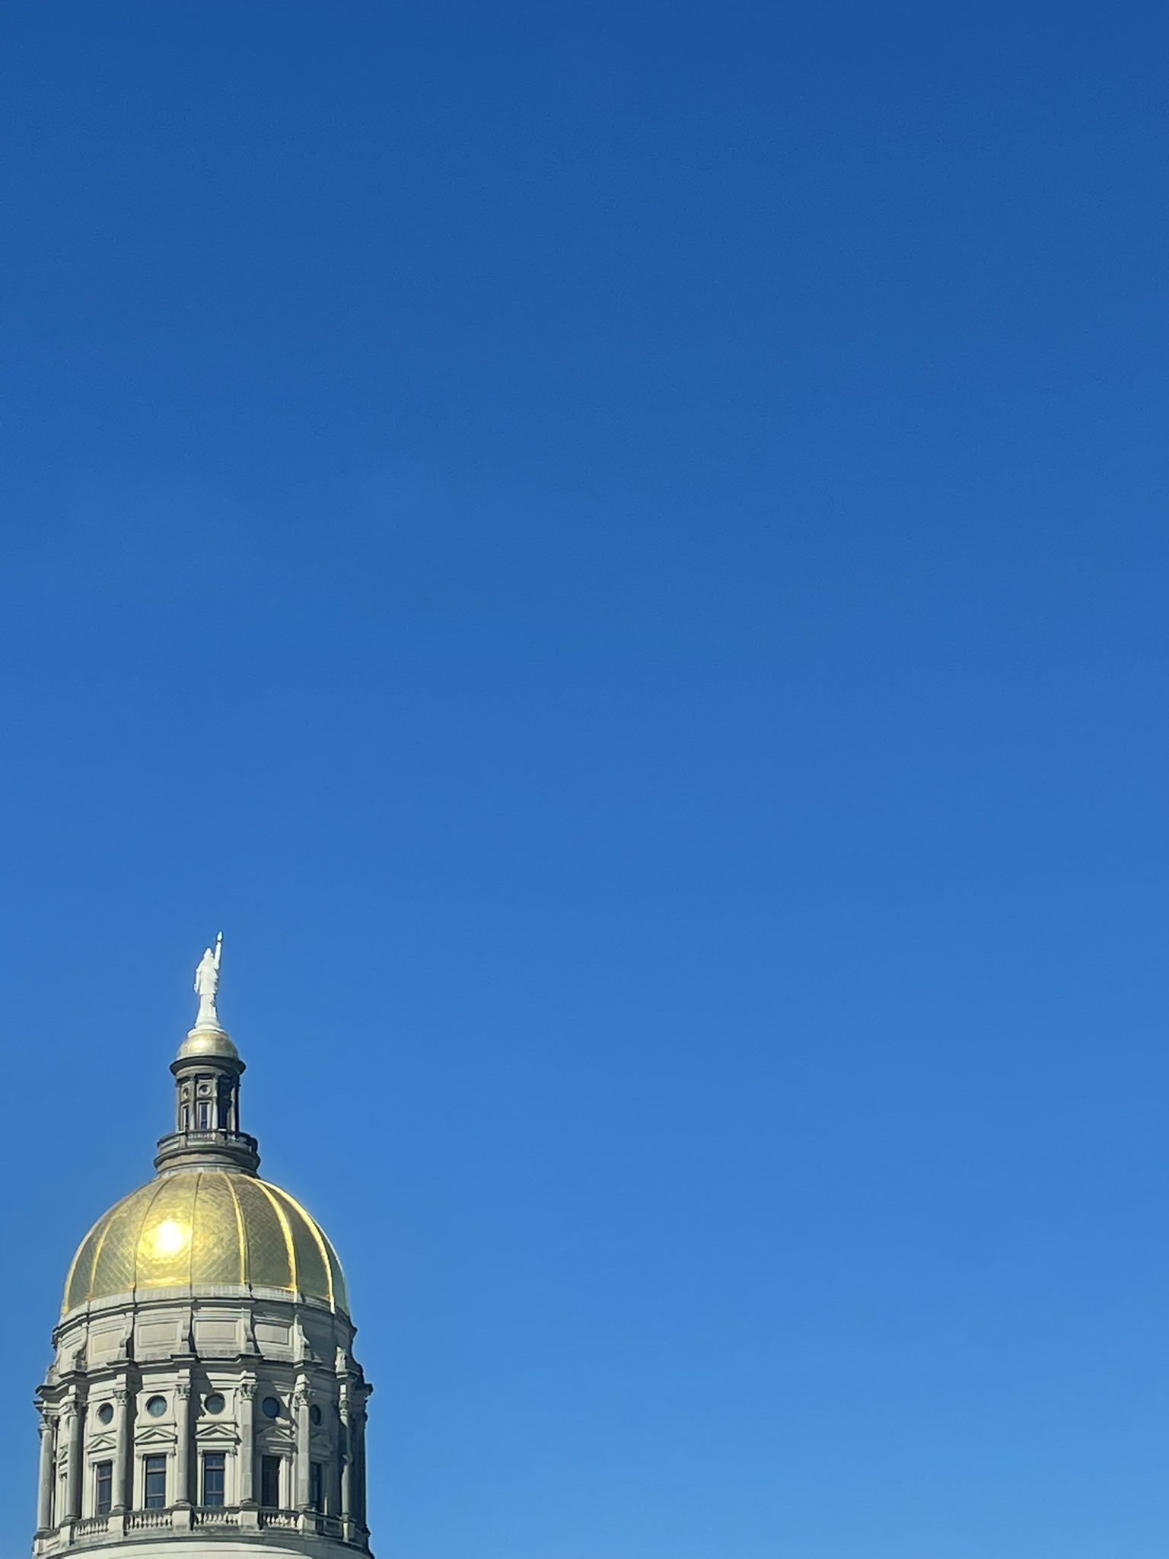
USG Legislative Update
Ashley May, Chris Kidd, & Val Pratt
Office of External Affairs
April 2023

Slide 2
Legislative Landscape
1st year of biennium
Large freshman class of legislators
53 new legislators
New Leadership in Both Chambers
LG Burt Jones
Speaker Jon Burns
Increased state revenues, but concerns about economic future

Slide 3
FY23 Amended Budget
Additional $131.9M for USG, up from the Governor’s initial recommendation of $99.6M
$105M for Augusta University/ Medical College of Georgia Digital Record System
Cooperative Extension - Increase funds for one-time funding for the replacement of cabins at Rock Eagle 4-H Center - $3M
Cash funding for a several projects we initially had in our FY24 Capital request
• Georgia Gwinnett College - Gateway Building and Infrastructure - $3.7M
• University of Georgia - Science and Ag Hill Modernization, Phase I - $6.2M
• University of North Georgia - Design for the Military Leadership Center Expansion - $1.3M
• Georgia Research Alliance - Equipment and R&D Infrastructure - $5M

Slide 4

Budget Presentation

Slide 5
FY24 Budget
$66 million funding cut to the Teaching Formula
Impact on all institutions
In addition to $71.6 million decrease due to enrollment decline
$83 million for cost-of-living increases to full-time faculty and staff
$18 million for increased costs to institutions for health insurance
Special initiatives:
Aviation, Archway Partnership Expansion, STEM Teacher Academy, Center for Rural Prosperity & Innovation, GA Tech’s Next-Gen Battery Lab
Capital Outlay Projects Funded
Fort Valley State University, University of North Georgia, Georgia State University, Kennesaw State University, Columbus State University, Dalton State University, Georgia Southern University, East Georgia State College, Georgia Southwestern, Georgia College and State University, University of West Georgia, Albany State University, University of Georgia, and the College of Coastal Georgia.
HOPE funding at 100% for students attending both public and private institutions

Slide 6
Legislation – passed
HB 319 (amended to include any tuition increase over 3% requiring legislative approval) – PASSED but VETOED by Governor Kemp
HB 538 & SB 211 (Literacy) – PASSED
HB 249 (completion grant program eligibility increase) – PASSED
SB 3 (reduce state jobs requiring 4-year degree) – PASSED
SB 246 (repayment of student loans for nursing faculty, includes IPSE) – PASSED
SB 93 (Tik-Tok) – PASSED

Slide 7
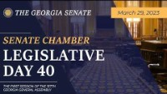
HB 319 Amendment

Slide 8
Legislation – did not pass
HB 261 (political litmus test) – DID NOT PASS
HB 39 (transcript release) – DID NOT PASS
SB 264 (in-state tuition for refugees) – DID NOT PASS
Hb 427 (Ban the Box) – DID NOT PASS
HB 131(in-state tuition for undocumented students) – DID NOT PASS
HB 30 (antisemitism) – DID NOT PASS
HB 237(sports betting) – DID NOT PASS
Key example of bill stripping

Slide 9
Looking ahead
Non-election year
Campus visits and annual reporting
Study Committees:
Education Funding Mechanisms
Dual Enrollment Expansion
Rural Medical Personnel Recruitment
Expanding Early Childhood Education
Expanding Georgia’s Workforce
Certificate of Need
Additional topics:
Literacy
Sports betting

Slide 10
Questions?
ashley.may@usg.edu
vallarie.pratt@usg.edu
chris.kidd@usg.edu

