Slide 1
Teacher Preparation Program
Accountability Report
RACAA
February 26, 2014
Lynne Weisenbach
Vice Chancellor
Educational Access and Success

Slide 2
Why Change?
  Need to hold programs accountable for student learning – both pre-service teachers and the K-12 students they will teach
  Need to align with national/state expectations for evaluating quality of educator preparation programs
  Need to include new high quality assessments for pre-service teachers and in-service teachers
Notes:
Many changes in play at state and within USG – question – why?
Keep in mind that this is aligned with USG’s focus on program outcome accountability, but teacher prep is the first one out with this level of rigor

Slide 3
Stakeholders Involved in the Change Process
  USG Universities
  Department of Education
  Governor’s Office
  Governor’s Office of Student Achievement
  Private Universities
  Professional Standards Commission
  RESA
  School Systems
REFINING EVALUATION
Notes:
This has been a five year process with major stakeholder involvement

Slide 4
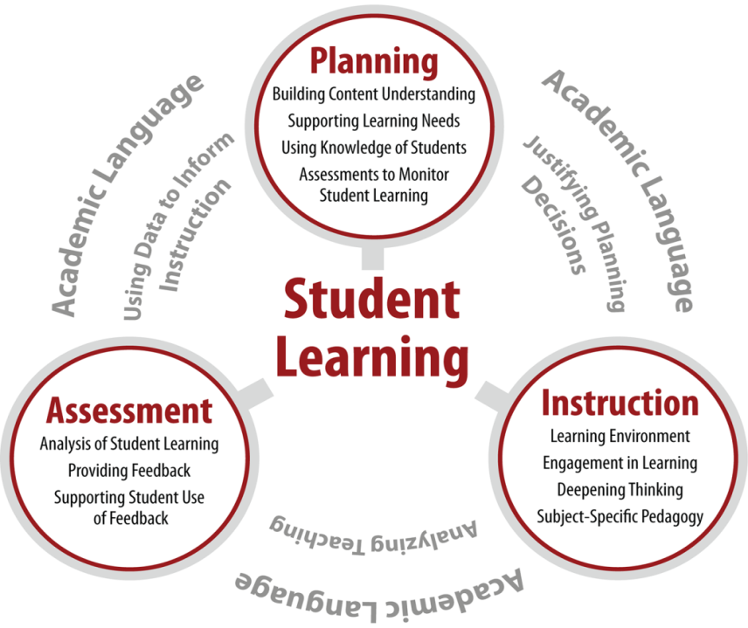
GACE (ETS) and edTPA
REFINING EVALUATION
Notes:
It involves a range of assessments. Of importance – the Georgia Assessment for Certification of Educators - now handled by ETS – is heavily content. Preliminary data indicates our students did not fare well in first administration. There are a range of tools available on PSC site. It is critical that students prepare and that you monitor results. This is NOT education school – its’ content.
EdTPA has been piloted and going live – nationally scored. $300 per student. Campuses like it.

Slide 5
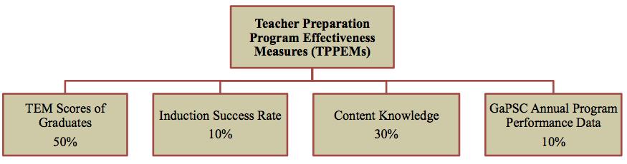
REFINING EVALUATION
Teacher Preparation Program Effectiveness Measures (TPPEMs)
Notes:
The PSC is holding programs accountable for outcomes. This rolls out in 2015. This is PROGRAM specifc. You could have an English program that is high performing and a math program that isn’t.

Slide 6
TPPEM Performance Levels
Exemplary
Effective
At-risk of low performing, and
Low performing
Note: These are specific to individual programs not institutions
REFINING EVALUATION

Slide 7
TPPEM Performance Levels Consequences
After the first year a program is rated as At-risk of Low Performing or Low Performing, the GaPSC will:
  Require the EPP to submit an action plan describing how the problem will be addressed, and/or
  Facilitate the formation of a peer assistance team to serve as consultants to the EPP, and
  Monitor the implementation of the action plan
  Depending upon the severity of the problem, a forensic audit or focused review may be planned
REFINING EVALUATION

Slide 8
TPPEM Performance Levels Consequences
After the second year the GaPSC will:
Monitor the implementation of the action plan (assess the impact of changes)
Conduct a forensic audit or focused review
If adequate progress is not made, the program will likely be placed on probation and given one year to improve
REFINING EVALUATION

Slide 9
Intended Impact of Accountability Reporting
  Provide USG institutions and the System Office with meaningful indicators to guide decision making and/or flag potential problems
  Emphasize the principle that educator preparation is a university-wide responsibility requiring collaboration across all academic units and with K-12 schools and districts
  Improve external communication with a standard, concise, accessible reporting tool across all institutions that prepare educators
INTENDED IMPACT
Notes:
At the system level we will be monitoring this and are looking at ways that the system ought to be involved. Keep in mind that we currently have only one staff member for the entire enterprise, so our capacity is limited. That said, and under the Chancellor’s direction, we are rolling our a “bridge” accountability system between now and the full state implementation. HANDOUTS

Slide 10
Teacher Preparation Accountability Reporting
  Just as with Complete College Georgia, less reliance on input measures and more focus on student outcomes
  System-wide standardization of measures and metrics
  Aligned with expectations for accountability in other State educational agencies
RESULTS OF USG EFFORTS

Slide 11
QUESTIONS/DISCUSSION

