Slide 1



First-Year Experience Redux
Getting it Right the Second Time Around with the REAL First-Year Experience
AKA Gateway Courses
John N. Gardner
President
Regents’ Advisory Council for Academic Affairs | University System of Georgia
Macon, Georgia | February 18, 2015

Slide 2

This morning’s objectives
Putting everything in context of why CAO’s matter
Connect problem of high DWFI rates in gateway courses
to larger objectives/activities of Complete College Georgia
Get you CAO's thinking about your own investment in efforts to improve gateway courses
Connect this issue to your legacy
Try to increase your interest in taking a more concerted approach to improving gateway course performance
jngi.org

Slide 3
This morning’s objectives
See if any of you would be willing to participate in a
multi-campus improvement initiative to reduce gateway course failure rates
Consider our Gateways to Completion® process as a possible way to do this
Ascertain your interest in System office hosting a USG system-wide convening on gateway courses.
jngi.org

Slide 4
This morning’s objectives
Invite you CAO's to encourage your faculty/department chairs to participate in our forthcoming national conference on the Gateway Course Experience,
Charlotte NC, April 12-14
jngi.org

Slide 5


I am the senior officer and founder of the Gardner Institute, a 15 year old, non-profit organization based in Brevard, NC that assists higher education institutions in improving student success outcomes.
jngi.org

Slide 6
I am a recovering former CAO!
(1983-96)
Why Do CAO’s matter?
What do you want your legacy to be?
I have a legacy request for you!
jngi.org

Slide 7

My story is in two phases
USC/USG phase (1977-1999)
JNGI/USG phase (1999-present)
jngi.org

Slide 8
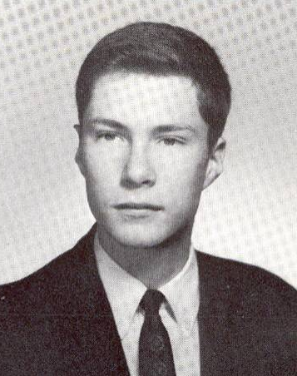
An opening confessional!
I was not a successful beginning college student.
jngi.org

Slide 9
USC/USG phase
1977: There was a retreat at Lake Laurel Lodge at what was then Georgia College - to launch the first replication in USG of USC’s University 101.
1982-1999: Hundreds of USG personnel visited Columbia SC in February, annually, for the Conferences on The First-Year Experience. I visited at least half the USG campuses to spread the FYE gospel and met twice with the annual USG Academic Affairs/Student Affairs retreat at Sea Island.
jngi.org

Slide 10
USG/JNGI phase
1977 - 1999: Visited19 System institutions
Albany State University
Armstrong State University
Clayton State University
Columbus State University
Dalton State College
Darton State College
Dekalb College/Georgia Perimeter College
Fort Valley State University
Gainesville State College
Georgia Gwinnett College
Georgia State College and University
Georgia State University
Kennesaw State University
Macon State University
Savanna State University
Southern Polytechnic University
University of Georgia
University of West Georgia
Valdosta State University
jngi.org

Slide 11
USC/USG phase
1990: USC and Kennesaw State co-hosted the first National Conference on The Senior Year Experience in Atlanta (which The Chronicle covered prominently)
jngi.org

Slide 12
JNGI/USG phase
1999: The non-profit organization, John N. Gardner
Institute for Excellence in Undergraduate Education,
is established in Brevard, NC.
October 1999: I address the USG BOR
2000: I deliver the inaugural address for David Bell at Macon State and Steve Portch nearly runs me
off the stage!
jngi.org

Slide 13
USG/JNGI phase
2003-2004: USG plays leadership role in Foundations of Excellence® through contributions of Georgia Southwestern and Kennesaw State as “Founding Institutions”
2003-Present: Total of 8 USG institutions have participated in Foundations of Excellence:
  College of Coastal Georgia Kennesaw State University
  Gainesville State College University of West Georgia
  Georgia Gwinnett College Waycross College
  Georgia Southern University
  Georgia Southwestern University
jngi.org

Slide 14

Let’s fast forward to the present!
jngi.org

Slide 15
One of the most important findings from our work
Campuses that develop a strategic action plan to improve student success and retention AND then implement that plan to a high degree
get big gains in retention.
jngi.org

Slide 16
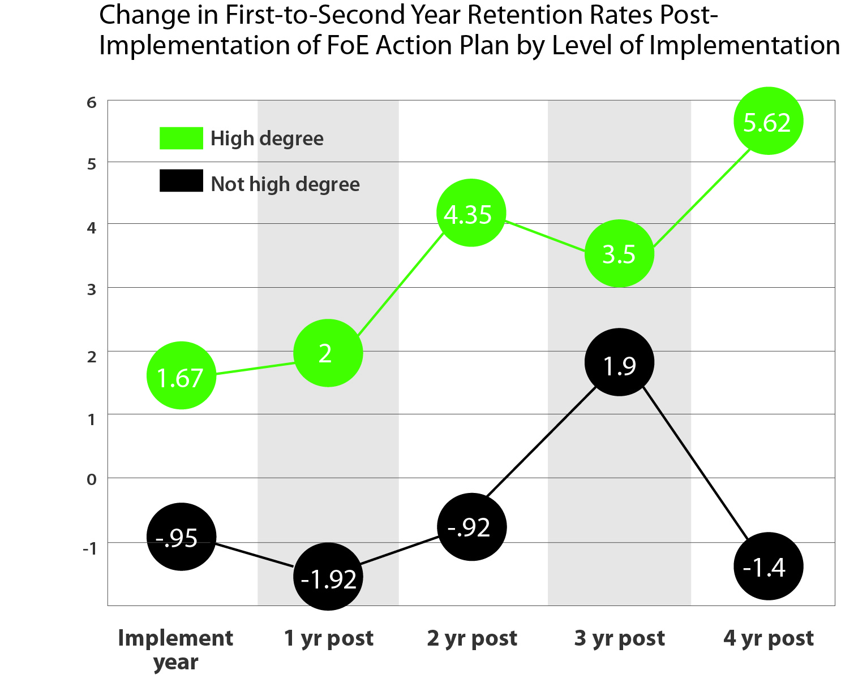
jngi.org

Slide 17
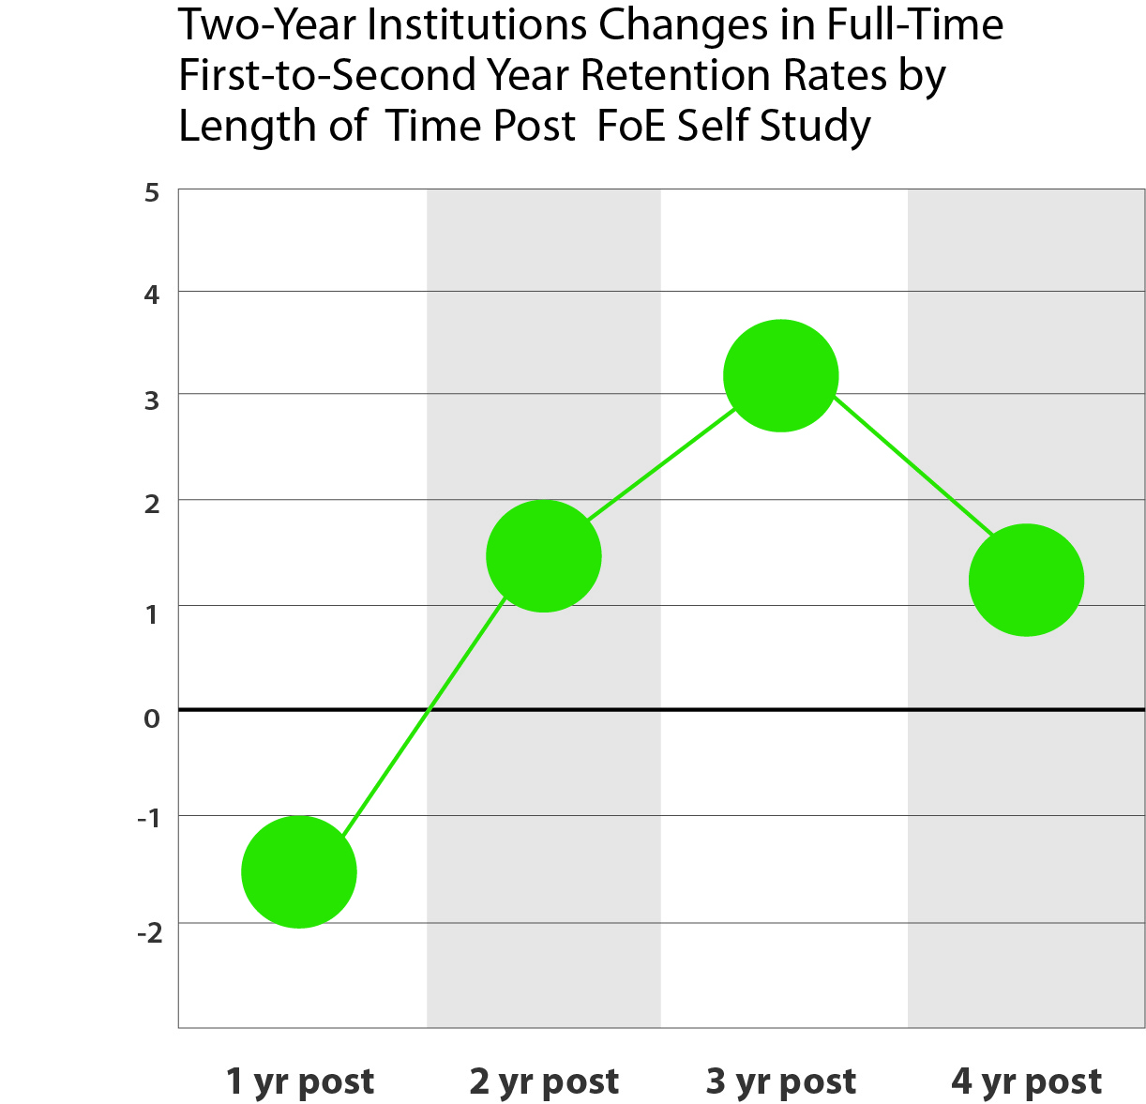
jngi.org

Slide 18
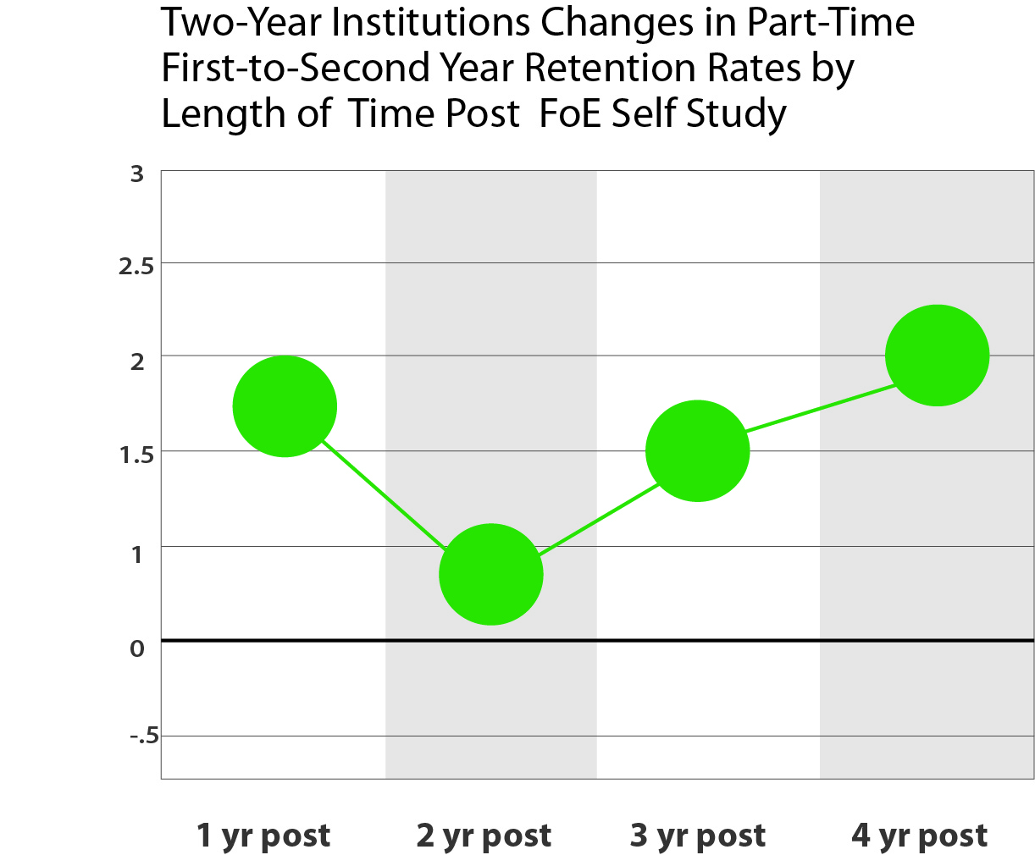
jngi.org

Slide 19
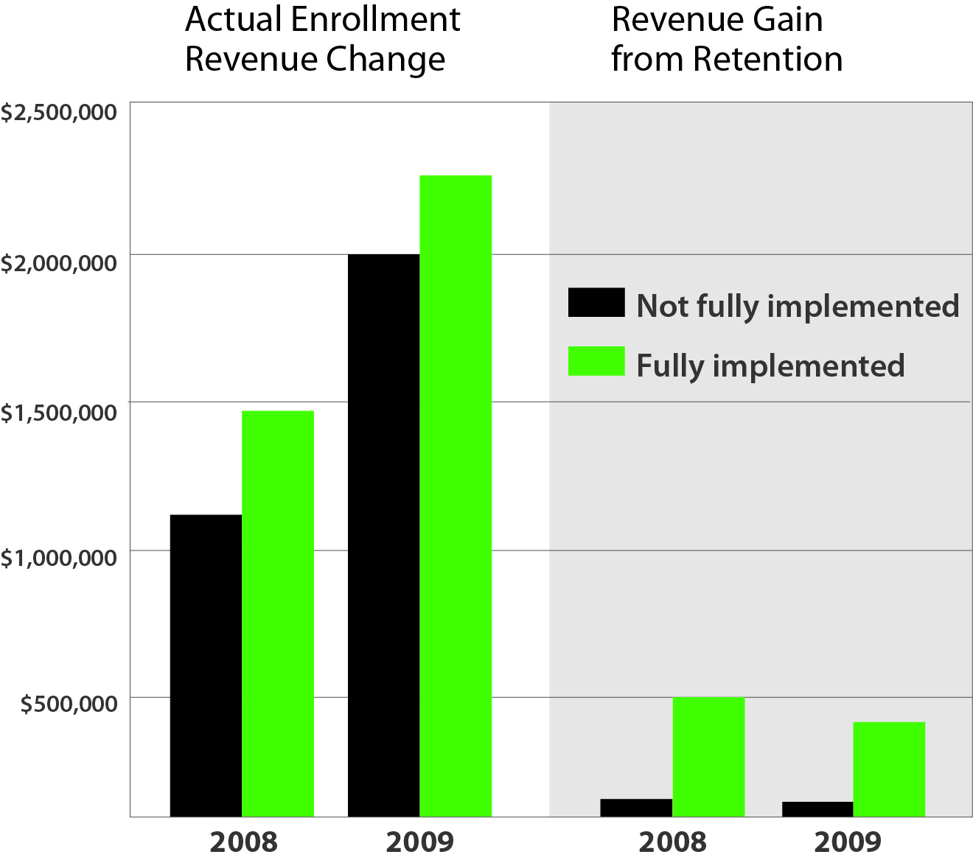
jngi.org

Slide 20
Over four decades
of a multiplicity of
student success efforts…
we have managed to largely avoid the faculty role and the component of the college experience where the students experience the highest failure rates: GATEWAY courses.
jngi.org

Slide 21
Over four decades
of a multiplicity of
student success efforts…
Our work at the Gardner Institute is taking what I did in the 1970’s-90’s - create a new movement to focus on one component of the college experience: the REAL First-Year Experience:
the Gateway Course Experience
jngi.org

Slide 22
Through its work with Foundations of Excellence, the Gardner Institute
has learned…
about the value of conducting a voluntary
self study to create an action plan - and then
to implement the action plan.
jngi.org

Slide 23
Gateways to Completion® (G2C®)
This time around (déjà vu) the self study
focuses on:
conducting a self-study of gateway courses
developing an action plan to improve performance in gateway courses
executing and refining that plan with the help of predictive analytics
jngi.org

Slide 24
Gateways to Completion (G2C)
Gateway Courses: Definition & Impact
jngi.org

Slide 25
Why Addressing Killer Courses Matters
Its About
  Teaching
  Learning
  Student Performance
  Institutional Performance & Funding
jngi.org

Slide 26
Gateways to Completion (G2C)
Gateway Courses: Data from Foundations
of Excellence
jngi.org

Slide 27
Average DFWI Rates for First Year Courses
Four-Year Institutions
Academic Year | Institutions | Number of Courses | DFWI Average Rate
2004-2005 | 20 | 100 | 25%
2005-2006 | 18 | 90 | 25%
2006-2007 | 10 | 50 | 28%
2007-2008 | 17 | 85 | 22%
2008-2009 | 9 | 45 | 31%
2009-2010 | 11 | 55 | 21%
2010-2011 | 6 | 30 | 23%
2011-2012 | 9 | 45 | 22%
2012-2013 | 9 | 45 | 22%
overall | 109 | 545 | 25%

Slide 28
DFWI Rates by Course
for Four-Year Institutions
Field | Number of Courses | DFWI Rate
Economics | 6 | 40
Math developmental | 27 | 38
Math college level | 63 | 37
History | 24 | 31
Biology | 21 | 28
Chemistry | 11 | 26
Psychology | 69 | 25
Philosophy | 7 | 24
Political Science | 11 | 24
Sociology | 24 | 22
Computer | 8 | 20
English college level | 134 | 20
Fine Arts | 6 | 20
Health/PE | 13 | 19
FYS/ success | 37 | 16
Speech | 33 | 16
Religion | 6 | 9

Slide 29
Average DFWI Rates for First Year Courses
Two-Year Institutions
Academic Year | Institutions | Number of Courses | DFWI Average Rate
2004-2005 | 10 | 50 | 36%
2005-2006 | 13 | 65 | 36%
2006-2007 | 13 | 65 | 38%
2007-2008 | 10 | 50 | 35%
2008-2009 | 7 | 35 | 33%
2009-2010 | 19 | 91 | 38%
2010-2011 | 15 | 74 | 31%
2011-2012 & 2012-2013 | 5 | 24 | 35%
overall | 92 | 454 | 35%

Slide 30
DFWI Rates by Course
for Two-Year Institutions
Field | Number of Courses | DFWI Rate
Math developmental | 100 | 44
English developmental | 27 | 43
Math college level | 16 | 42
Sociology | 14 | 37
History | 15 | 36
Computer | 34 | 35
Biology | 9 | 33
English college level | 105 | 33
Political science | 7 | 32
Psychology | 57 | 31
FYS/ Success | 27 | 28
Health/ PE | 6 | 26
Speech | 23 | 24

Slide 31
Percentage of High Enrollment Courses that Are High Risk
Percent of Courses with DFWI Rate of 30% or More
Academic Year | 2-Year Institutions | 4-Year Institutions
2004-2005 | 70% | 32%
2005-2006 | 69% | 30%
2006-2007 | 80% | 36%
2007-2008 | 62% | 25%
2008-2009 | 63% | 51%
2009-2010 | 71% | 27%
2010-2011 | 57% | 37%
2011-2012 & 2012-2013 | 67% | 21%
Overall | 68% | 30%

Slide 32
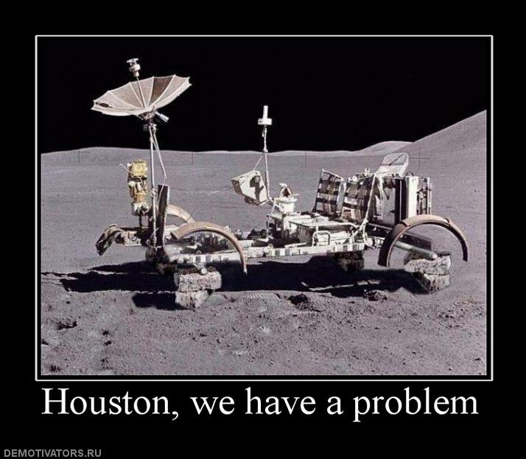

Admitting There Is An Issue
jngi.org

Slide 33
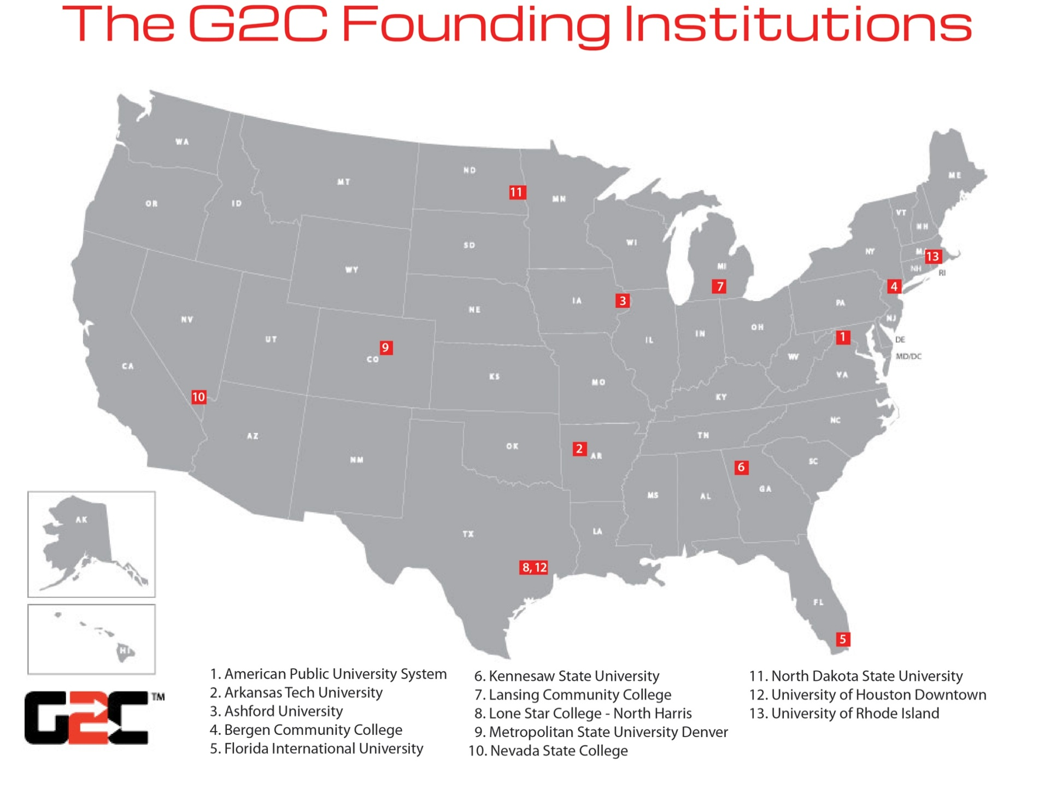
G2C Founding Institutions
jngi.org

Slide 34
The G2C National Advisory Committee
Lou Albert – Pima Community College
Linda Baer – Minnesota State U – Mankato
Trudy Bers – Oakton Community College
Hunter Boylan – National Center for Developmental Education
Linda Braddy – Mathematical Association of America
John Campbell – West Virginia University
Elizabeth Cox Brand – Oregon Department of Community Colleges & Workforce Development
Jeff Cornett – Ivy Tech Community College
Brent Drake – Purdue University
Johanna Dvorak – University of Wisconsin Milwaukee & NCLCA
Maribeth Ehasz – University of Central Florida
Scott Evenbeck – CUNY Stella and Charles Guttman Community College
Trinidad Gonzales – South Texas College / American Historical Association Learning Division
Casey Green – The Campus Computing Project
Bob Guell – Indiana State University
Jeanne Higbee – University of Minnesota
Amber Holloway – Higher Learning Commission
Christine Keller – APLU
Jillian Kinzie – Indiana Univ. Center for Postsecondary Research & NSSE Institute
Robert Kubat – Pennsylvania State University
Tricia Leggett, Zane State College
Julie Little – EDUCAUSE
Jean MacGregor – Washington Center
Jodi Koslow Martin – North Park University
George Mehaffy – AASCU
Jerry Odom – University of South Carolina
Karan Powell – American Public University System
Lynn Priddy – National American University
Elaine Seymour – University of Colorado at Boulder
Marion Stone – International Center for Supplemental Instruction
Emily Swafford – American Historical Association
Uri Treisman – University of Texas at Austin
Ross Peterson-Veatch – Goshen College
Kaye Walter – Bergen Community College
Cynthia Wilson – League for Innovation in the Community College
jngi.org

Slide 35

Gateway Courses Defined
Foundation-Level
High-Risk
High Enrollment
“Killer Courses”
jngi.org

Slide 36
Broad Charge
Create and subsequently implement
an evidence-based plan for improving
student learning and success in
high-enrollment courses that have
historically resulted in high rates of failure and/or unsatisfactory progress.
jngi.org

Slide 37

G2C Goals
The institution will strive to:
Improve student learning as measured by survey responses and content outcome measures
Increase knowledge and application of engaging / research-based pedagogies as measured by faculty pre-/post-tests
Increase student success as measured by:
  Grades
  Retention rates
  Graduation / program completion rates
jngi.org

Slide 38
G2C Goals
The institution will strive to:
Study, learn and apply promising practices for improving gateway courses applied in local context;
Engage in and promote a culture of continuous improvement by linking G2C to efforts such as:
  reaffirmation of accreditation
  strategic planning
  other comparable efforts
jngi.org

Slide 39
G2C Goals
The institution will strive to:
Reflect on and shape the body of scholarship on gateway course success; and,
Provide feedback to the Gardner Institute.
jngi.org

Slide 40
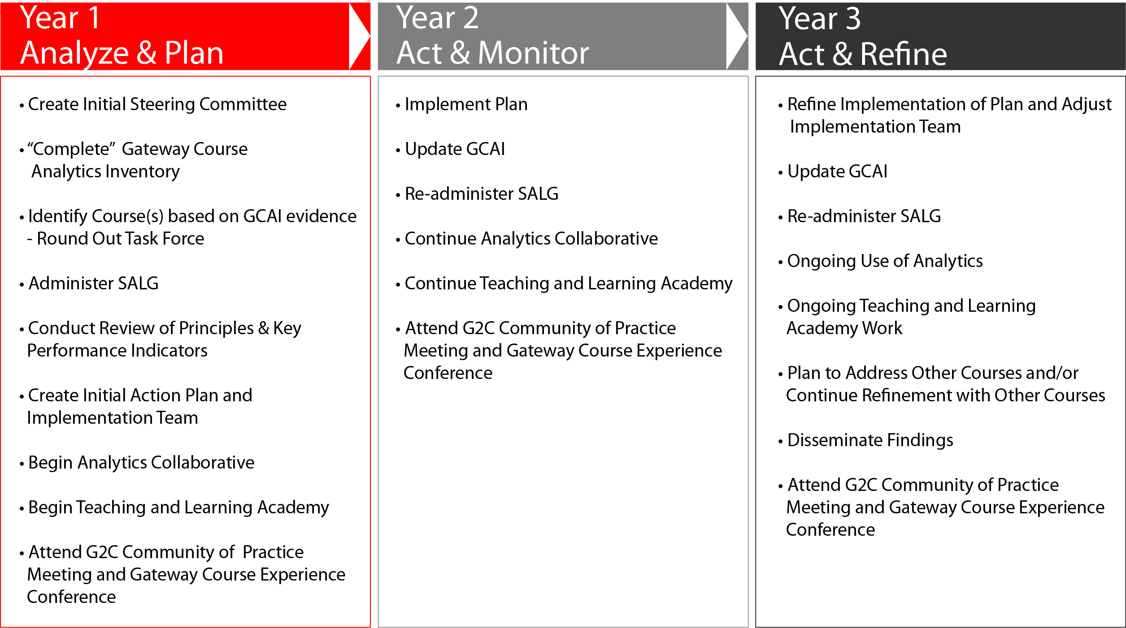
G2C Comprehensive Model
Three-Year Timeline
jngi.org

Slide 41
Roles
Liaisons
(At Least 2)
Serve as overall project leaders/
managers
jngi.org

Slide 42
Roles
Liaisons
(At Least 2)
Course-Specific Committees
One committee
for each course.
Each committee led by one chair
or two co-chairs.
jngi.org

Slide 43
Roles
Liaisons
(At Least 2)
Steering
Committee
Course-Specific Committees
Comprised of Liaisons, Course-Specific Committee chairs, and other key stakeholders
jngi.org

Slide 44
DFWI Rates by Course/Area
Column A. Course | Column B. Number of Institutions Working on Course | Column C. Average DFWI Rate for All Students
Accounting | 2 | 43.4%
Biology | 8 | 30.8%
Chemistry | 4 | 31.9%
English – College Level | 6 | 30.3%
History | 6 | 30.3%
Math – College Level | 10 | 35.3%
Math – Developmental | 3 | 49.4%
Psychology | 5 | 30.0%
jngi.org

Slide 45

  Race Matters
  And So Do Income and First-Generation Status
jngi.org

Slide 46
Early Lessons – Demographics
Column A. Course | Column B. Subpopulation | Column C. Average DFWI Rate for Subpopulation
Accounting | African American | 62.0%
 | Hispanic / Latino | 69.5%
 | First Generation | 48.2%
jngi.org

Slide 47
Gateway Course Success
is a DIRECT predictor
of retention . . .
jngi.org

Slide 48
Early Lessons – Correlation with Retention
Column A. Course Examples from Individual G2C Institutions | Column B. Average DFWI Rate | Column C. DFWI Rate for Non-Retained Eligible-to-Return Students* | Column D. DFWI Rate for Academic Dismissal Students
Principles of Accounting I | 54.0% | 81.6% | 100%
Foundation for Physiology / Biology | 18.9% | 55.0% | 92.9%
General Chemistry | 36.3% | 73.9% | 82.4%
Writing and Rhetoric I | 10.6% | 25.8% | 61.4%
Survey of American History | 26.8% | 67.2% | 100%
College Algebra | 59.7% | 73.5% | 89.6%
Beginning Algebra | 24.4% | 65.1% | 100%
(Introduction to Psychology | 28.1% | 46.1% | 83.7%
Mean of Average DFWI Rates for Examples | 32.4% | 61.0% | 88.8%
* These students left voluntarily. In other words, their lack of retention was not due to formal academic dismissal.

Slide 49

G2C:Outcomes to Date – Retention
 | G2C Students | Non-G2C Students
Retention | 83% | 72%
Good Academic Standing (GPA > 2.0) | 74% | 65%
jngi.org

Slide 50

G2C: Outcomes to Date – Grades
Grade Differences in introduction to Accounting
Year (2012 Baseline) | Success Rate ABC | Below Average Rate D | Fail Rate F | Withdraw Rate W
2012 N=432 | 41% | 14% | 15% | 29%
2013 N=425 | 49% | 18% | 15% | 18%
2014 N=379 | 58% | 13% | 7% | 22%
jngi.org

Slide 51
G2C: Outcomes to Date – Grades
Grade Differences in College Algebra
Year (2012 Baseline) | Success Rate ABC | Below Average Rate D | Fail Rate F | Withdraw Rate W
2012 N= 2009 | 69% | 9% | 6% | 16%
2013 N= 1900 | 70% | 6% | 8% | 16%
2014 N= 2129 | 76% | 6% | 5% | 13%
jngi.org

Slide 52
Want to Dig Deeper / Do More?
2015 Gateway Course Experience Conference
Gateways to Completion
jngi.org

Slide 53

April 12-14, 2015
Annual Gateway Course Experience Conference
Register Now!
Charlotte, North Carolina

Slide 54
Gateways to Completion: Choices
Analytics Collaborative
Teaching & Learning Academy
Comprehensive
jngi.org
Notes:
G2C is the solution. We have three ways for you and your institute to take this step to student success.

Slide 55
Gateways to Completion
Application Process
Application due date: June 30, 2015
www.jngi.org/g2c-application/
jngi.org

Slide 56
CONTACT
John N. Gardner gardner@jngi.org
828-885-6014
jngi.org

