Slide 1

RACCA & RACSA
June 22-24, 2014
Pearson -the world’s leading learning company
Notes:
I work for Pearson, but I don’t sell textbooks. I represent a segment of our organization that crafts institutional and system wide solutions that solve Access, Affordability and Achievement.

Slide 2
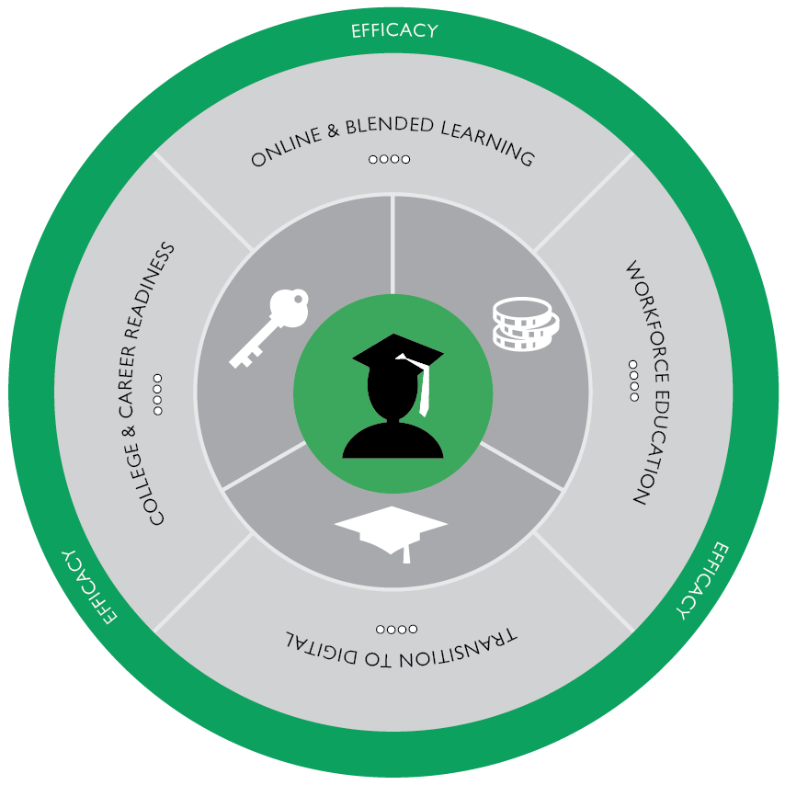
Efficacy – A focus for everything we do
Improve someone’s life through learning
Help people make progress in their lives through learning
Align business activities around efficacy
Notes:
We know about the pressure on Higher Ed on value cost and therefore, we are adjusting our posture our focus to outputs and not inputs. We are embracing an efficacy culture to focus our relationship with our clients around performance and outcomes because we recognize and accept that performance and outcomes are important to you.
And what that means is that by 2018 we will report our effect on student performance measured in student outcomes as part of our financial results. We will not only report on our profits but also the results that we’ve made on improving someone’s life through learning.
Not only do we see your issues, but we’re also committed to measuring our success through the efficacy of our solutions.
“So what? What does it mean to me? Why is it important to me?”
our engagements are mission driven and that our solutions are aligned to your initiative.

Slide 3
Partnership provided in 4 Key Areas
College & Career Readiness
Transition to Digital
Online & Blended Learning
Workforce Education
Notes:
Here is what efficacy looks like through the lens of an institutional relationship and
we see the 4 key initiatives that you are addressing around performance as:
College & Career Readiness,
A shift to Digital
Online learning
and Workforce Education.

Slide 4
College Readiness & Access
Direct Access Model
The Kentucky Community and Technical College System (KCTCS)
South Dakota Board of Regents (SDBOR)
Tennessee Board of Regents (TBR)
Ivy Tech Community College System
Notes:
Here are a few examples of how we have worked with institutions on one of these initiatives.
These partnerships are never a cookie cutter relationship,
we adapt, build and deploy resources based on the consulting with a client on a need based solution. (We consult, we discover opts to improve learning, we create models, we build acceptable solutions and then deployed these solutions to address these issues in partnership with the institution).
In KY, Chancellor Box launched its “learn on demand” in partnership with PLS to address College & Career Readiness. We had fairly significant market share, but students weren’t accessing the materials through the traditional bookstore model, we changed that to a Direct Access model and now every student has access to materials on the first day of class.
At SBDOR, CAO Dr. Gingrich introduced a price per term business model to accomplish 3 goals: reduce cost of materials, improve equal access and streamline distribution of content.
TBOR – The Regents Online Campus Collaborative supported under the TBOR, consisting of 13 CC’s, partnered with us to increase use of technology to support learning support courses
At Ivy Tech, President Snyder was committed to moving from print to digital by 2015 and we implemented the Direct Access model

Slide 5
Cost Comparison: Three Systems – Three Direct Access Models
Notes:
Not only did students gain access on the 1st day of class, which resulted in increased student performance, but the Direct Access model also provides students with lower cost access – showing a significant cost savings in each case

Slide 6
Powering Online Learning
Northern Arizona University
Indiana Wesleyan University
Southern New Hampshire University
George Washington University
Notes:
In the case of powering online learning… the following examples will showcase our scope and scale:
NAU– As we all know CBE is a hot topic, but also a complicated one as everyone has a different interpretation and we have the experience and expertise the different flavors of CBE. NAU needed deliberated resources and we provided the expertise in helping them launch one of the most granular CBE model.
Indiana Wesleyan –is a college with a well established online program. They already had great success in the online space, but they realized that they could not maintain their program and build new programs without outside help to keep their content current and to scale their program to remain competitive and to continue their shift to digital.
A similar case at SNHU – COCE – Center for Online and Cont. Ed. – 1. There is on the ground traditional students 2. COCE serving 90,000 students or 30,000 FTE and 3. College for America serving now 1000 students (CBE program)- COCE is the Non-for Profit / Degree completion /Adult Education program- where we also helped build up their program by providing content curriculum services and the capacity to help them meet their explosive growth,
At George Washington – They had an online presence and they wanted to rebrand that presence with a more sophisticated online experience for their students, They came to use to elevate that user experience ..and we provide them with high production video hyperlinked with instructional resources, case studies and other resource materials - we moved their graduate programs online in a more sophisticated way

Slide 7
Workforce Education
Ivy Tech Corporate College
Richard Stockton College of New Jersey
The College Prep Academy, Washington DC
Notes:
And finally Workforce Education….
In our partnership with Ivy Tech Corp College -, Ivy Tech was interested in ways to create new revenues by taking the college out to corporations and businesses through a corporate college. Their goal is to build this program to 50K enrolments over 3 yrs. We are providing them with online, self-paced and customizable courses, that then Ivy Tech business development team sells then to corporations for corporate training and corporate development.
At Richard Stockton –Another funding source was utilized through the Workforce Investment Board where each student is required to take a Workforce Readiness course. Interesting here is the different contracts that Richard Stockton has with different associations and industry, where Stockton is building courses to support different certifications within those industries. One ex. EMS Fire
The College Prep Academy, was a another successful model that tied workforce into academic readiness - if we make you academic ready –why not also workforce ready?
We are successful because of the combination of things: 1. Our size, our scale our experience
2. Our posture – we’re not focused to sell but to solve issues and those issues tend to be around scale, capacity and speed – Our posture is inquisitive, collaborative, it’s partnership

Slide 8
Petra Kohlmann Sanchez
Executive Director,
Strategic Partnerships
Pearson North America
Phone: 305-792-6962
Email: petra.kohlmann.sanchez@pearson.com
Notes:
We’re not trying to sell you these things, but letting you know the things that we’ve done because of who we are and how we approach our customer and open the door for them to ask us what we can do for them.
I’m happy to answer any questions.
Questions: Where else in GA doing this?
We have some early stages adoption of Direct Access
We have some early (part of the Redesign efforts)
We already have a pretty successful footprint in GA. A lot of schools are using us in GA. What I do, take that market share and penetration and work with institutions to convert that to address larger issues. We have all sorts of things going on, we are all over the place, but those things are typically centered around adoption level decision and departmental initiatives, we focus on the bigger issues.

Slide 9
Petra Kohlmann Sanchez
Executive Director,
Strategic Partnerships
Pearson North America
Phone: 305-792-6962
Email: petra.kohlmann.sanchez@pearson.com
Notes:
What does this cost? We don’t charge you as an institutions for services that you have to pay for out of your operating budget. Our transition to an efficacy company move students away from buying books and codes, towards buying access to digital materials, assessment items and other resources that we build for you. It doesn’t cost the institution anything to work with Pearson., What Pearson will do is look at the value of what a student pays for a book and is that valuable to a student and is a students getting a return on that expense and we change the value preposition. So instead of buying something they don’t see a value in, we work with you on a deliverable that does have value, that in many cases is lower cost than the physical print product and aligns with educational experience that you want to provide
NAU did not spend any money out of their operational budget,,, we took a share of the tuition.
At Ivy Tech , they pay us a flat fee for every course.
Competition?
There really is no-one that does all these things
IN a direct Access model we don’t establish and we don’t require an exclusive relationship, it’s still an adoption driven model, what we do is, we create the transactional value, so that students can buy materials at the lowest possible price.

