Slide 1
CISS Best Practices Workshop
June 29, 2023

Slide 2
Welcome & Agenda
Orientation Best Practices 9:00 Welcome 9:05 Presentations: 1) Orientation Best Practices - Sheila Schulte, UNG 2) Virtual Orientations - Katie Patton, GaTech 3) New Orientation Technology 9:50 Breakout Rooms Per Topic 10:30 Closing Remarks 10:40 Break
Employment Best Practices 1:00 Welcome 1:05 Presentations: 1) CPT Best Practices - Kristina Guinn, KSU 2) OPT Best Practices - Robin Catmur, UGA 3) H-1B & Post-OPT Employment Options - Drew Webster, GSU 1:50 Breakout Rooms Per Topic 2:30 Closing Remarks
Committee for International Students and Scholars (CISS),
SCIE Sub-committee
Planning Committee
Kathryn Gaylord-Miles, CISS Chair, KSU
Allie Seay, CISS Vice-Chair, GSU
Kate Kirk, CISS At-Large Rep, Tech

Slide 3

Best Practices for ISSS Orientation
Sheila Schulte
Associate Vice President, International Programs
University of North Georgia
Sheila.Schulte@ung.edu
www.ung.edu/cge

Slide 4

Sense of Belonging
One of the main purposes of international student orientation is to create a sense of belonging for the new student.
Please take a minute to choose a word or two to put into the chat on how you would define a sense of belonging.

Slide 5

Soft Belonging
“The soft aspects of belonging are relational and include feeling at home or feeling socially connected. Belonging, in this sense, is often defined simply as “a sense of ease with oneself and one’s surroundings” (May 2011, 368). At the heart of belonging is connectivity and the extent to which international students can establish ties—to a variety of constituents, within and beyond the institution. These ties provide an essential sense of community, attachment, and affiliation.”
American Council on Education’s Publication: Towards Greater Inclusion and Success: A New Compact for International Students written by Chris. R. Glass, Kara A Godwin, and Robin Matross Helms in 2021

Slide 6

Hard Belonging
“Belonging is not merely international students feeling welcomed or connected to an institution (Wang et al. 2014). It is more than being tolerated or feeling accepted. It requires international students’ voice and participation in campus life (Straker 2016). It necessitates full participation in—and recognition of—the vital role of international students in shaping the university’s living tradition (May 2011; Page and Chahboun 2019).”
Notes:
Notes: I encourage you to read the full article and we will share the link for download with you.
I think it is important to understand that a new student will not feel a sense of belonging over the course of a day, week or even semester but this is an on-going process for them. Orientation is a good first step in creating this sense of belonging so let’s talk about the practical elements needed for orientation. My colleagues will be talking about different modalties and ways to reach the students, but what are those basic elements that all students will need to know?

Slide 7

Pre-Arrival Information
What to bring with you in order to enter the US as an F-1, what to expect at the Port of Entry (POE)
Emphasize the need to check-in with the ISSS office upon arrival—need to provide information for SEVIS plus can answer any questions and provide guidance on next steps.
When, where to arrive: how to get from airport to campus? Are there buddies or a pick up plan? Or a map?
Housing information, on and off-campus options, expectations.
Information on orientation—school, international student orientation, and any specific departmental orientation for graduate students.
Transportation: buying a car and getting a US driver’s license, using the mass transit, bike share programs, etc.
Managing Money: university payments, banking, etc.
Food: Restaurants and residence hall cafeterias
Shopping: where to go to get essentials to set up room/apartment. How will they get that sofa home? What services are available for this?
Health insurance and medical forms/policies: are there any specific immunizations they will need before registration? Is health insurance required? Is it billed automatically or does the student need to find a policy?

Slide 8

Orientation Modules
Health and Safety: counseling services, medical services, what to do in an emergency, campus police vs. city police, understanding the health insurance policy
F-1 Status, travel, and work options and how to find out more details when you need them
Code of Conduct: includes plagiarism, classroom expectations, relationships with professors
Academic deadlines, understanding the registration system, next steps before classes begin
Student engagement opportunities including religious info, cultural and nationality groups, art events, etc.
Social aspect/Adjusting to US culture

Slide 9

Context Matters
WHAT to cover in orientation is Step One and equally important is thinking through the HOW and the WHEN.
What Happens at Your University?
Are your students integrated into domestic student orientation? What is covered in that orientation?
What is essential and how do you convey the essential vs. the non-essential?
Is orientation mandatory?
What is the timing? Over one day, one week, the course of a semester?
Are student peers involved? How?
Notes:
Notes: Orientation often reflects the values and culture of the institution and sets the student’s expectations. This is directly related to the context. The IS orientation at a large school with a large pop of IS will look very different than the one at UNG. Same type of information is relayed to the student but the how will be different.
Example, UNG has a small population of IS so academic advising can take the time to walk them through each student’s academic schedules during orientation, talk about drop/add, discuss with the academic advisor what are the expectations for the classroom, core curriculum, and how to access registration and tutoring assistance when needed. Highly personalized.
This is not to say that the large school can’t create personalized programming or personal touches, but it is likely not going to be as high touch as a smaller place. I would argue that students choose a small place bc they have expectations that they will not be a number and they very much need the personalized assistance.

Slide 10
Continuous Improvement is the Key
How does the international student orientation reflect your institution’s values and culture?
What kind of student expectations are you setting during orientation programming?
How do you evaluate or assess the program?
Notes:
Notes: One last thing: Do not be afraid to try new things and keep improving over time. Need to make sure to get feedback from participants immediately as well as over time to see what is the long-term effect of your orientation on the student’s sense of belonging.
HOW and WHEN will also be discussed by my colleagues in the next sessions of this workshop. I would welcome your questions and also remember that we will have break out rooms, so if you are looking to talk more with you at that time.

Slide 11
Virtual Orientations
Katie Patton, Georgia Tech

Slide 12
COVID-19: Restructuring the Delivery
Expanding access
Increase in attendance and engagement
Recordings and slides available for viewing later
Use of questions to develop an FAQ
Benefits of continuing virtual/hybrid

Slide 13
Considerations When Offering Virtual Programming
Communicating access information
Testing in advance
Staffing to moderate the Q&A
Balancing regulatory volume with welcoming students
Leveraging student leaders for a virtual help desk for general non-immigration questions
Engaging students

Slide 14
Georgia Tech’s Orientation Series
Nine virtual sessions:
Three in-person sessions:
Info session (related to I-20 issues and other general questions)
Pre-arrival and check-in information
Exchange pre-arrival webinar
Health, safety, and wellness
GT Traditions
Maintenance of status (2 sessions)
GT Undergraduate Orientation for Exchange Students
Student panel
Welcome Party
Campus Scavenger Hunt
Exchange Welcome Reception
For reference, visit: https://isss.oie.gatech.edu/welcome-series

Slide 15
New Orientation Technology
Charlotte Roulet, GSU
CANCELED

Slide 16
Breakout Rooms

Slide 17
Afternoon Presentations Welcome Back!

Slide 18
CPT Best Practices
Kristina Guinn, KSU

Slide 19
What is Curricular Practical Training (CPT)
•What does it look like in practice?
• Internships
• Practicums
• Thesis research
• Co-ops
• Guided study
•Any “work” that is performed in executing the requirements of a class.

Slide 20
Why does this matter?
•Institutional accreditation and reputation
•Student’s current and future immigration statuses
•Practical Training eligibility

Slide 21
Recommendations
•Time, location and eligibility
•Fall + Spring semesters= one year
•Not immediately available for Change of Level students
•FT for official breaks only
•PT during required fall and spring; final semesters
•Maintain full course of study
•Be aware of out-of-town job offers
•Granted per semester

Slide 22
Recommendations (cont)
•Ensuring it is “curricular”
•Academic program input
•Developing policy with academic program
•Regular reviews
•Maintaining a list of courses commonly eligible for CPT
•Course descriptions clearly indicate practical training component
•May not be suitable for courses within “minor”
•Consistency

Slide 23
Recommendations (cont)
•Procedure within DSO’s Office
•Consistent process for every international student
•Same procedure for everyone
•Use of immigration software programs
•Publish instructions clearly
•Publish policy clearly
•Job offer letter
•Academic department recommendation
•Course enrollment

Slide 24
Recommendations (cont)
•Legal Review
•Legal consultant
•Review CPT interpretations from the lens of it’s curricular-ness, not a student’s need for employment.
COMMON PROCEDURE:
Student submits: job offer letter + proof of course enrollment + Dept rec=
Evaluated in DSO’s Office.

Slide 25
Thank you and remember:
Focus on the curricular aspect of training for creation and eligibility.
CPT Policy Formation is important!

Slide 26
Optional Practical training – OPT Best Practices
Robin Catmur-Smith
University of Georgia

Slide 27
OPT Regulations
8 CFR 214.2(f)(10)
Practical training. Practical training may be authorized to an F-1 student who has been lawfully enrolled on a full time basis, in a Service-approved college, university, conservatory, or seminary for one full academic year. This provision also includes students who, during their course of study, were enrolled in a study abroad program, if the student had spent at least one full academic term enrolled in a full course of study in the United States prior to studying abroad. A student may be authorized 12 months of practical training, and becomes eligible for another 12 months of practical training when he or she changes to a higher educational level. Students in English language training programs are ineligible for practical training. An eligible student may request employment authorization for practical training in a position that is directly related to his or her major area of study.

Slide 28
STEM OPT
8 CFR 214.2(f)(10)(ii)(C)
24-month extension of post-completion OPT for a science, technology, engineering, or mathematics (STEM) degree. Consistent with paragraph (f)(11)(i)(C) of this section, a qualified student may apply for an extension of OPT while in a valid period of post-completion OPT authorized under 8 CFR 274a.12(c)(3)(i)(B). An extension will be for 24 months for the first qualifying degree for which the student has completed all course requirements (excluding thesis or equivalent), including any qualifying degree as part of a dual degree program, subject to the requirement in paragraph (f)(10)(ii)(C)(3) of this section that previously obtained degrees must have been conferred. If a student completes all such course requirements for another qualifying degree at a higher degree level than the first, the student may apply for a second 24- month extension of OPT while in a valid period of post-completion OPT authorized under 8 CFR 274a.12(c)(3)(i)(B). In no event may a student be authorized for more than two lifetime STEM OPT extensions. A student who was granted a 17-month OPT extension under the rule issued at 73 FR 18944, whether or not such student requests an additional 7-month period of STEM OPT under 8 CFR 214.16, is considered to have been authorized for one STEM OPT extension, and may be eligible for only one more STEM OPT extension. Any subsequent application for an additional 24-month OPT extension under this paragraph (f)(10)(ii)(C) must be based on a degree at a higher degree level than the degree that was the basis for the student’s first OPT extension. In order to qualify for an extension of post-completion OPT based upon a STEM degree, all of the following requirements must be met.

Slide 29
OPT – filing of I-765 application
Filing fee: https://www.uscis.gov/sites/default/files/document/forms/g-1055.pdf (Currently $410.)
Online: https://www.uscis.gov/i-765
Paper : https://www.uscis.gov/sites/default/files/document/forms/i-765.pdf; ( current edition 10/31/2022)
Filing Addresses: https://www.uscis.gov/i-765-addresses
Wet signature on the I-765, or scanned copy of a wet signature
Premium Processing now available since April 2023: https://www.uscis.gov/i-907 (additional $1500. fee)

Slide 30
OPT Best Practices
Educating students about OPT and the application process
Policy development:
Recommendation and filing dates
Failure to complete the academic program
Unemployment time and SEVIS record terminations
Self-employment under OPT
Addresses: mailing and email - updates by student
STEM extensions
CIP code changes
Use of prior degree (Provide institutional accreditation) (Degree earned within 10 years of recommendation)
I-983 training Plan
Corrections to PSC: psc.studentead@uscis.djs.gov (do not share address with students!)
Cap gap extensions

Slide 31
OPT Resources
Nafsa: https://www.nafsa.org/system/files/resource-pdf/OPTresource2023.pdf
USCIS Ombuds office: https://www.dhs.gov/case-assistance
Study in the States:
STEM OPT hub: https://studyinthestates.dhs.gov/stem-opt-hub
Eligible STEM CIP codes: https://studyinthestates.dhs.gov/stem-opt-hub/additional-resources/eligible-cip-codes-for-the-stem-opt-extension
OPT Planning Tool: https://studyinthestates.dhs.gov/sevis-help-hub/student-records/fm-student-employment/planning-tool-for-post-completion-opt
OPT Resource (2010): https://www.ice.gov/doclib/sevis/pdf/opt_policy_guidance_042010.pdf

Slide 32
H-1B & Post-OPT Employment Options
Drew Webster, GSU

Slide 33
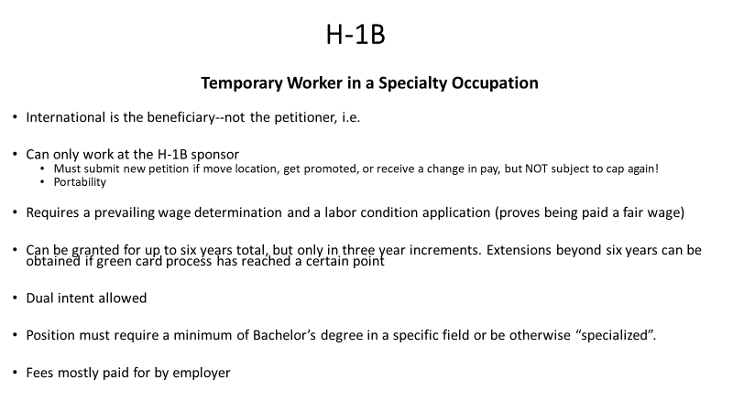

Slide 34
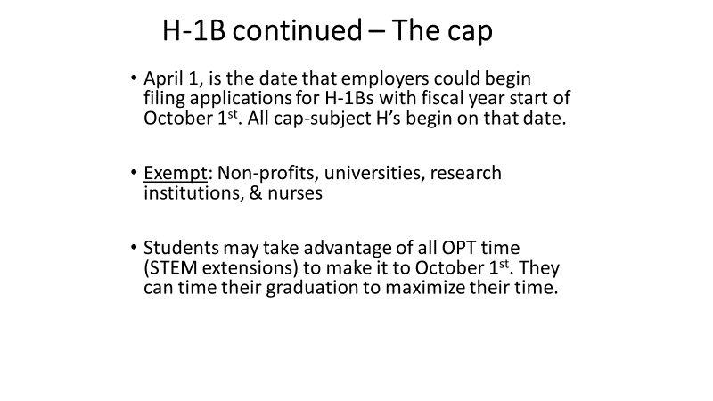

Slide 35
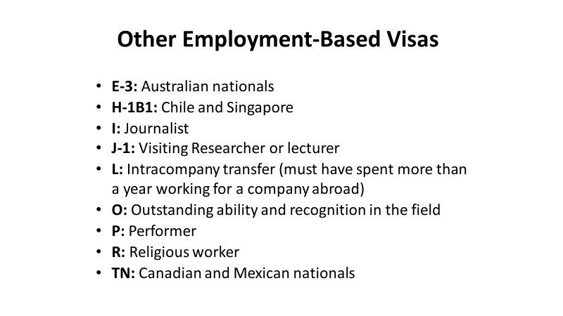

Slide 36
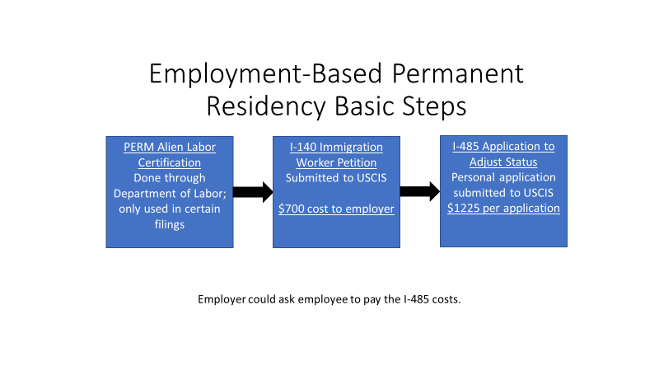

Slide 37
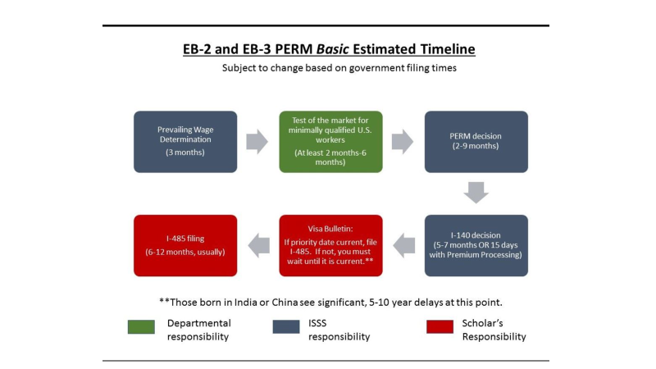

Slide 38
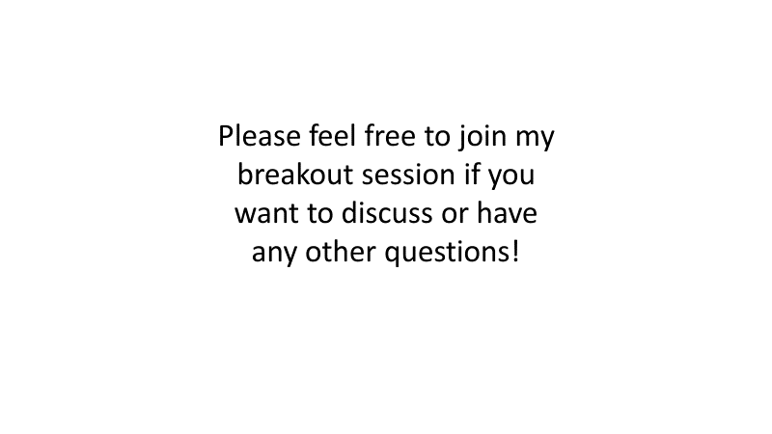

Slide 39
Breakout Rooms

