Slide 1

The Clery Act & Study Abroad Trips
Lacey E. Kondracki
Police Inspector / USG Clery Coordinator
Safety and Security

Slide 2
Overview
The Clery Act – The Basics
Study Abroad Trips According to The Clery Act
What To Report and To Who?

Slide 3
The Clery Act
20 U.S.C. § 1092 (f) Signed into law in 1990
Full Name “The Jeanne Clery Disclosure of Campus Security Policy and Campus Crime Statistics Act”
Monitored by the Department of Education
Mandatory Requirements to include an Annual Report (Oct 1) , Crime Log, Timely Warnings/Emergency Notifications and Crime Statistics

Slide 4
The Clery Act
Clery Crimes
When specific crimes occur within the specific Clery geography:
Murder & Non-Negligent Manslaughter/ Murder by Negligence
Sex Offenses (Rape, Fondling, Incest, Statutory Rape)
Robbery
Aggravated Assault
Burglary
Motor Vehicle Theft
Arson
Hate Crimes
Liquor/ Weapons/ Drug Law Violations & Referrals
VAWA Crimes: Dating Violence, Domestic Violence and Stalking

Slide 5
The Clery Act
Clery Geography
On Campus (including Student Residence Halls)
Public Property
Non-Campus Property
“Any building or property owned or controlled by an institution that is used in direct support of, or in relation to, the institution’s educational purposes, is frequently used by students, and is not within the same reasonably contiguous geographic area of the institution”

Slide 6
The Clery Act
Considerations To Make
Repeated Use – Every Year & Same Location (Hotel, Houses, etc)
Location matters not the students going
Short Stay Away Trips
“Traditional” Study Abroad Programs

Slide 7
The Clery Act
Non Campus Property – Off Campus Trips
Off-campus trips have been clarified as follows “Repeated use of a location for school-sponsored trip- institution sponsors students on overnight trip every year and student in same hotel each year, then statistics for common areas and rooms used by students should be included as non-campus geography.” The key is the use of the location by the institution not the number of days or if used by the same people.

Slide 8
The Clery Act
Non Campus Property – Short Stay Trips
Short stay away trips have been clarified as follows “Institution sponsored short stay away trips of more than one night for its students, all locations used by students during the trip, controlled by the institution during the trip and used in support of educational purposes should be treated as non-campus property. Any classroom or housing space specified in the agreement between the institution and the third party providing the space would also be non-campus property. If a third party contractor entered into an agreement with institution to provide housing or classroom space then assumed that institution under control of space.” (An example of third party no control would be a host institution making arrangements for your institution to stay somewhere during a trip)

Slide 9
The Clery Act
Owning vs. Controlling Space
Owning – disclose crime statistics that occur within that space at ANY time.
Controlling – Informal or Formal Agreement – disclose crime statistics for the dates, times, space contracted for in the agreement.
Space Vs. Program Agreements – Is your contract for the physical location or use of the program?
Third Party Leasing Agreements

Slide 10
The Clery Act
Study Abroad: Homestay vs. Staying at Hotel / Campus
Contracts
“Significant Control”
Host Institutions Responsibilities

Slide 11
The Clery Act
Know Your Role
Study Abroad Program Coordinator
Study Abroad Administrator / “Trip Facilitator or Chaperone”
Title IX vs. Clery
Foreign Public Safety Departments vs. Your Campus

Slide 12
The Clery Act
Know Your Role- Campus Security Authority
The Clery Act defines a Campus Security Authority as any employee:
To whom crimes should be reported
OR
Who has "significant responsibility” for student and campus activities.

Slide 13
The Clery Act
Know Your Role- Campus Security Authority
Campus Security Authorities are required to report crime statistics to Campus Police. Crimes reported to a Campus Security made "in good faith" need to be reported. "In good faith” means there is a reasonable basis for believing that the information is not simply rumor or hearsay. That is, there is little or no reason to doubt the validity of the information.
A crime can be reported by a victim, witness, third party, or even the offender.

Slide 14
The Clery Act
Know Your Role- Campus Security Authority
Get the facts - When, what, where, who, etc.
Report all Clery Act related crimes immediately to the Campus Police Department so the campus can comply with timely warning policies and have accurate crime statistics for the annual security report
Inform victims of their options, including confidential reporting options and offer referrals to resources (e.g., campus assistance programs or counseling service, if appropriate)

Slide 15
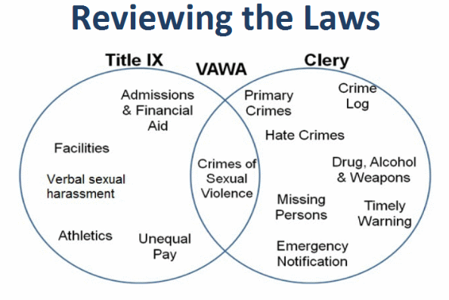
The Clery Act
Title IX vs. Clery

Slide 16

The Clery Act
Where To Find Me ☺
Lacey E. Kondracki
404 – 962 – 3177
Lacey.Kondracki@usg.edu

