Slide 1


Emergency plan table exercise
USG International Education
Summer Workshops
Michael Sweazey
Director of Global Operations
International Risk Mitigation Officer
Ariel Wiley
Implementation and
Utilization Manager
Notes:
Speaking points:
Thank you for joining us!
Introductions/Welcome

Slide 2




DUTY OF CARE AND
TRAVEL RISK MANAGEMENT
PROTECT YOUR PEOPLE
Organizations that fail to protect their people risk significant legal, financial and reputational damage.
PROTECT YOUR INVESTMENT
Developing a travel risk management plan helps fulfill the University’s duty of care responsibility.
PROTECT YOUR UNIVERSITY

Slide 3



REACTIVE
Assistance and Insurance
PROACTIVE
Preparation and Education
Notes:
A Travel Risk Management Plan needs to consider both in equal measure
Reactive – you need the resources to respond to emergencies and ensure your travelers are safe.
Proactive – proactive planning and education is just as important, providing information and tools to help prepare administrators and travelers for the specific risk they will face during international travel.

Slide 4

Components of a HOLISTIC Travel Risk Management Plan
ASSESSMENT
OF YOUR SCHOOL’S UNIQUE RISK PROFILE?
REPETITION KEEPING YOUR PLAN UP TO DATE
PLANNING HOW YOU
WILL RESPOND TO THAT RISK
ENFORCEMENT
OF POLICIES
PUT IN PLACE TO PROTECT TRAVELERS
TESTING
TO ENSURE NO GAPS IN YOUR RESPONSE PLAN
EDUCATION
ABOUT DESTINATION AND RESOURCES AVAILABLE TO ASSIST
Notes:
Assessment - assessing global risk exposure specific to your institutions unique demographics
Preparation - preparing for those risks by developing emergency response plans and procedures
Testing - running through those emergency response plans to ensure there are no gaps in your response
Education - taking steps to ensure administrators and travelers understand the risks of traveling and know about the resources you've provided them to both avoid additional risk and respond to a crisis
Compliance - making sure employees follow those processes and protocols you put in place to protect them
Repetition - Completing the cycle frequently, review of TRM to ensure it is up to day.

Slide 5
Communication and Education
Internal Communication Plan
- Should define departments / individuals that need to be informed, broken down by type of incident
- Should ensure all involved have access to the plan / contact info 24/7
- Should clearly identify roles and responsibilities
Education Plan
- Students, Faculty, and Staff should know what resources are available and how to access them.
- Students, Faculty, and Staff should be educated on what the University expects of them in an emergency

Slide 6
The PACE Model
Process Owner / Leader, drives the decision process in a timely and efficient manner.
Approver, makes the final decisions.
Contributor(s), provides content and input to frame the options, they may include:
Public Relations
Student Affairs
Human Resources
Legal
Risk Management
Study Abroad / International Programs
Executor, owns the delivery and takes the necessary actions, roles may include:
Family Representative, designated liaison
Traveler Communication, outreach, check-in manager and manifest owner
Coordinate internal communication

Slide 7
Incident Response exercise: one day in rome
Notes:
Incident Response Exercises are meant to help you further develop your response plans in a low-stress environment. They should provide an opportunity for open discussion, planning and problem solving. The scenario we are going to run through today is an extreme example that allows us to talk about different aspects of emergency response. The challenges that we’ll talk about can easily occur in a non-emergent case, the kind that occur every day.

Slide 8
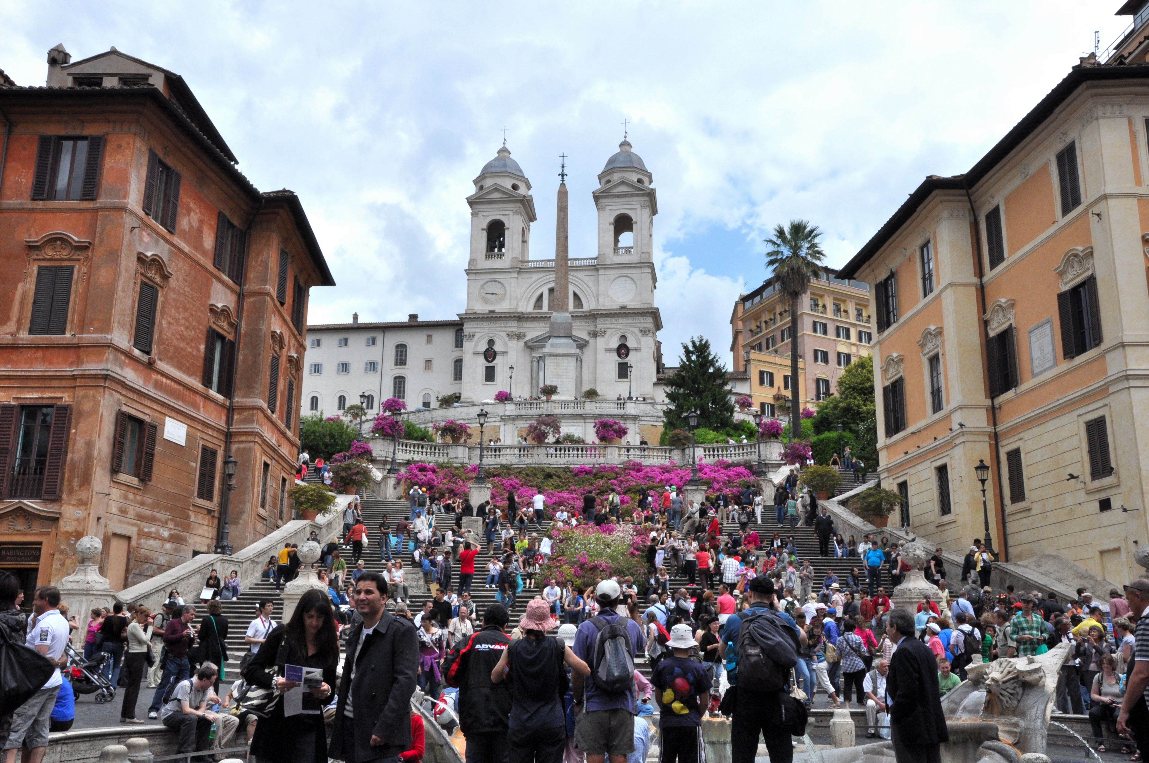
Sunday, 16 April 2017 Around 10:00 AM, CEST
It’s a beautiful spring day in Rome!
The tourist sites are brimming with people and the area around the Vatican is packed with people
Like many Romans, your travelers are out and about. Today is Easter, it is Holy Week in Vatican City.

Slide 9
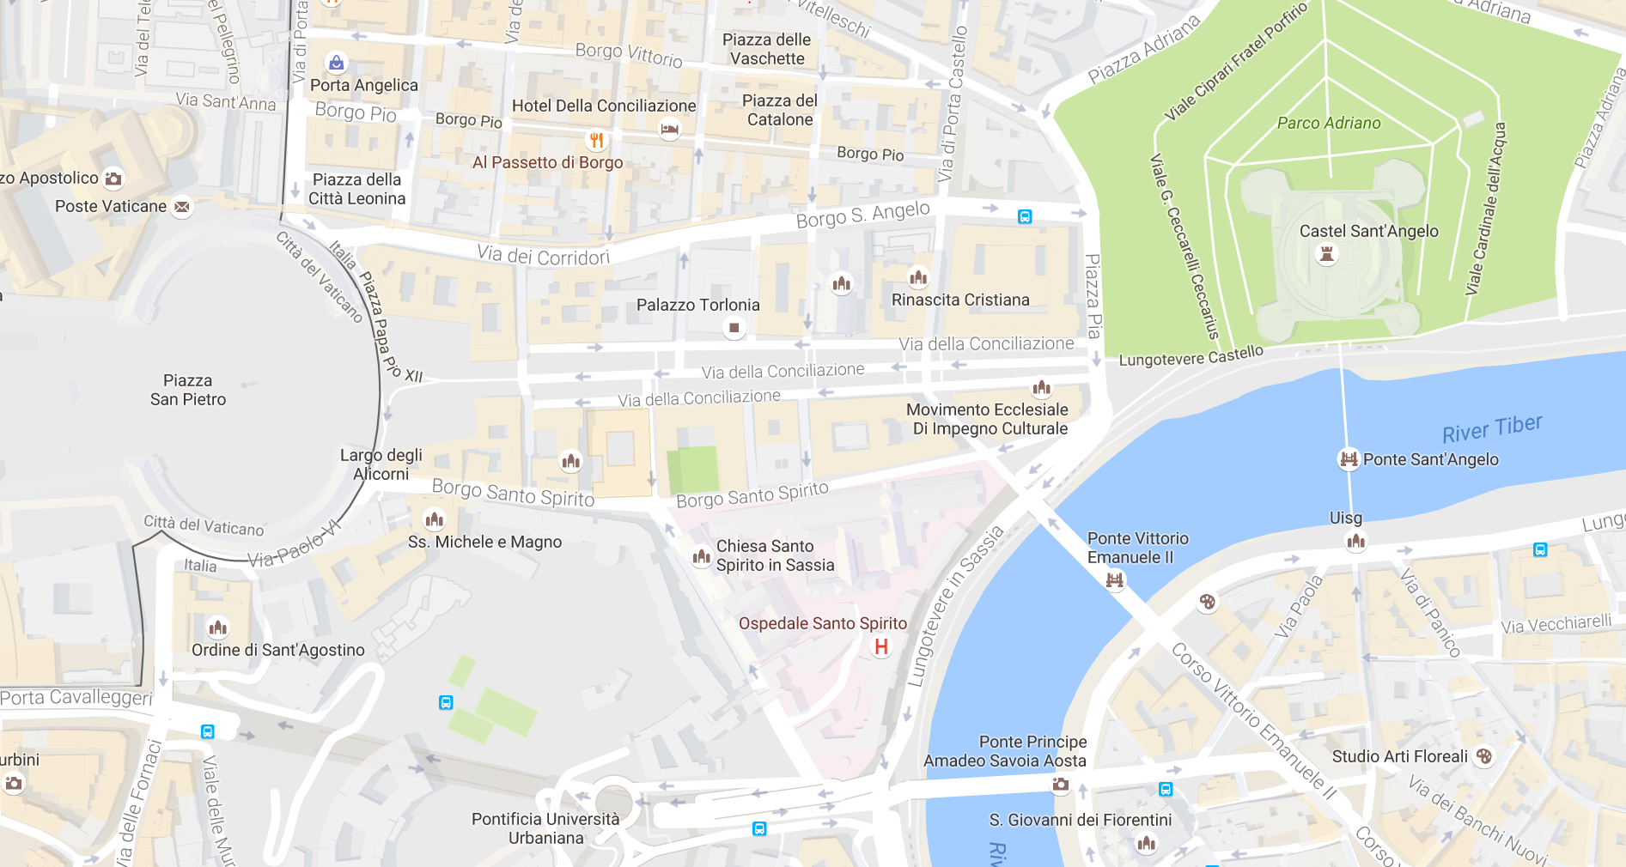
The event....
A massive explosion has occurred near St. Peter’s Square in Vatican City.
According to initial media reports, the site of the attack was the intersection of Via Della Conciliazione and Via S. Pio
Notes:
Questions that should be answered:

Slide 10
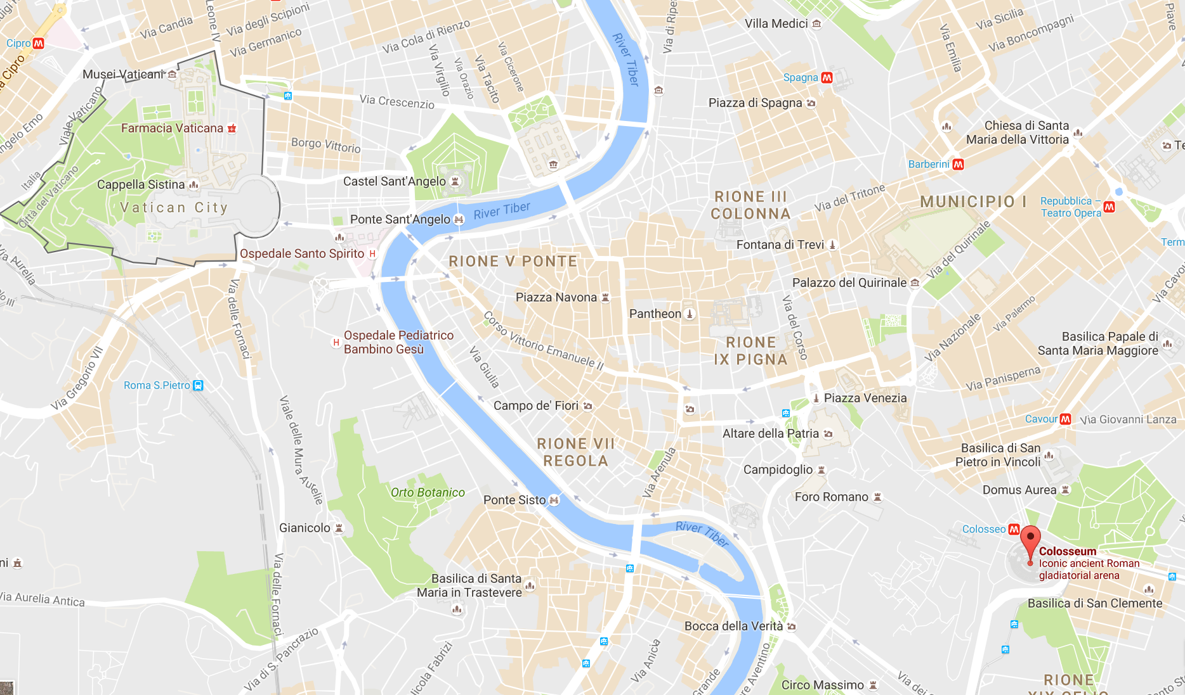
Report of another attack
A shooting has been reported at a restaurant across from the Colosseum.
Nearby, police are
engaged in a shootout with the
attackers. People are now fleeing this area.

Slide 11

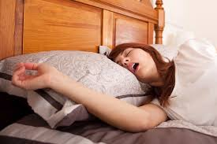
a short time later, back in Georgia 4:36 AM EDT

Slide 12
Notification
A student has contacted the school and relays the following:
A small group of 3 or 4 students were heading to St. Peter’s that morning.
The student is friends with one of them and he has tried to contact her repeatedly but has not reached her.
He provides you his contact number and address and the name and contact number for the friend that may be in the St. Peter’s area with a group

Slide 13
Challenge 1
Total # potentially affected travelers
Establish contact
Verify welfare
Verify exact location
Establish plan for check-ins
What methods or tools do you have to report expected location of students, faculty, staff and any other constituents?
Does this include their, contact info, housing arrangements, emergency contact, passport info?
What intelligence resources do you have for credible analysis and advice?

Slide 14
Result 1 – Without a Response Plan
Which departments have travelers?
Who is the right contact?
Can info be accessed remotely?
Delay in Response
Incomplete Information
Question from Administration:
What is our total exposure?
Response team answer:
We are not sure yet....

Slide 15
Result 2 – With a Response Plan
Initiate internal communication plan
Review roles and responsibility of Response Team
Access the travel registry or travel monitoring system
Obtain credible incident briefing and advice
Activate documented contacts in other departments to request info
Activate your assistance company
Question from Administration:
What is our total exposure?
Response team answer:
We have 11 known travelers
Organized, Efficient & Timely Response

Slide 16
Traveler Update + 5 hours
You have confirmed a group of FIVE students were at the scene of the first attack in St. Peters:
TWO are injured, they were taken to the nearby Casa Di Cura Santa Famiglia Hospital
TWO escaped unharmed and made their way to a nearby Italian friend’s house, they are ok but shaken
ONE student remains unaccounted for

Slide 17
Traveler Update + 5 hours
You have confirmed TWO faculty may be in the region:
ONE has made contact and is safe
ONE was at a conference that ended the previous week but wasn’t due to return home until Tuesday. You have been unable to make contact.

Slide 18
Traveler Update + 5 hours
You have confirmed FOUR other students are reported in Rome:
ONE is the student who made first contact, sheltering in place
THREE have yet to make contact

Slide 19
Situation Update + 5.5 hours
Internet and phone lines are being inundated resulting in communication in the hours following the attack being unreliable
It is early morning hours in the US....family and loved ones are waking up to the news and unable to reach the travelers...

Slide 20

Challenge 2 - Family
Mom: “My son is studying in Rome and I haven’t been able to get in contact with him since the bombing.”
University Employee: "The information I have is that we have not had any contact with your son yet, we have a team responding to this incident. There are multiple attempts being made to find out where he is.”

Slide 21


Result 1 – Without a Response Plan
Mom: "What does multiple attempts mean? He’s on your program, why doesn't anyone know where he is?"
University Employee: "I am not sure ma'am, this is all the information I've been given. We can't keep tabs on students 24/7."
[insert university name here] has no clue how to handle the attack in Rome and has no idea where my child is, if anyone has advice on how I can escalate this, send it my way. please help #dontsendyourkidto[___]

Slide 22
Result 2 – Result with a Response Plan
Mom: "What does multiple attempts mean? He’s on your program, why doesn't anyone know where he is?"
University Employee: “We’ve assigned a family liaison to keep you up to date with the most current information available. I will have them call you back within 15 minutes."
HAVING A PLAN MITIGATES RISK TO THE
UNIVERSITY’S REPUTATION
Notes:
A clear and efficient plan to communicate internally ensures stakeholders are informed quickly
Planning ahead to identify the routes of communication coming into the University and ensuring they have a consistent message to provide
Consider providing training / coaching on how to respond to family or loved ones in distress - Perception can often be the difference between getting sued or not.

Slide 23
Situation Update + 7 hours
Reports of casualties from the attack near the Vatican vary, but reliable sources put it about 40 dead and hundreds wounded.
Police have confirmed that eleven were killed at the restaurant attack near the Colosseum, and fifteen more wounded. T
niversity
The University has received a call from the Faculty member that was at a conference the previous week, he extended the trip for personal travel. His wife was killed in the restaurant attack and he is at the hospital where she was taken.

Slide 24
Challenge 3 - Authorizations
Are accompanying spouse, partners and dependents addressed in your travel policy?
Is personal travel that is before or after university related travel addressed in your travel policy?
Has your Response Team discussed level of responsibility and authorization process for circumstances for which there is no insured coverage?
The Faculty member is requesting help from the University to return her remains to the US; she did not purchase her own coverage.

Slide 25
Result 1- Without a Response Plan
You are unsure how to respond to the faculty initially
Following a lengthy discussion, it is decided that the University should offer assistance at its own expense, given that this is a high profile event.
You do not know who is allowed to authorize this expense so you go about trying to find out
As significant time passes without a clear answer, the Faculty member gives up, makes his own arrangements and blames the University.
Authorization is received but when the bill arrives, there is no budget for this type of expense and it is unclear which department is responsible.
OR

Slide 26
Result 2- With a Response Plan
You let the Faculty member know that the University wants to offer support and as much assistance as possible. You tell him that this is not covered through the policy so you need to confirm next steps.
You follow the documented approval process and get back to him within the hour.
HAVING A PLAN MITIGATES RISK TO THE
UNIVERSITY’S REPUTATION (again!)
Authorization is received but when the bill arrives, there is no budget for this type of expense and it is unclear which department is responsible.

Slide 27
Situation Update + 9 hours
In a speech to the nation following the attack, the Prime Minister notes the following:
A state of emergency has been put in place.
Additional police and military assets will be deployed to airports, tourist sites, and important public places.
Temporary border controls have been put in place.
No more attacks have occurred and there is a heavy police and military presence on the ground in Rome.
Current recommendation is to shelter in place.

Slide 28
Traveler Update + 9 Hours
ONE student in critical condition, currently hospitalized, your assistance company is monitoring and coordinating as needed
ONE student, minor injuries, treated and released
ONE student, killed in the initial attack
FOUR students are sheltering in place (group of 2, 1 and 1)
TWO students reported in Rome are actually on a personal excursion in France
ONE Faculty is sheltering in place
ONE Faculty has a deceased spouse, your assistance company is coordinating return of remains
Notes:
A response plan needs to provide clear instructions for day to day minor issues as well as critical medical and security emergencies and death.

Slide 29
The Days Ahead
Resources for emotional support – victims, family, other students and staff
Gather information needed for executive review of the program and whether it will continue or be cancelled
Continue monitoring the situation and access credible intelligence
Prepare to discuss the decision to shelter in place versus evacuate, to travelers and family members
Review travel registry for any future travelers to the affected region and make contact with instructions
Notes:
Your plan should include not only immediate incident response, but also what needs to be prepared for in the days ahead

Slide 30

ASSESS
PLAN
TEST
EDUCATE
ENFORCE
REPEAT
TRM
Protect Your People
Protect Your University
Protect Your Investment

Slide 31
Thank you!
Michael Sweazey
Director of Global Operations
International Risk Mitigation Officer
Kennesaw State University
Desk: 470/578-3785
Cell: 404/576-7310
msweazey@kennesaw.edu
Ariel Wiley
Implementation and Utilization Manager
On Call International
603-328-1303
ariel.wiley@oncallinternational.com

