Slide 1
Policy Development in International Education:
Best Practices

Slide 2
Presenters
Robin Catmur, Director, Immigration Services, UGA
Heather Housley, Director, International Student and Scholar Services, GSU
Katie Tudini, Assistant Director, GA Tech

Slide 3
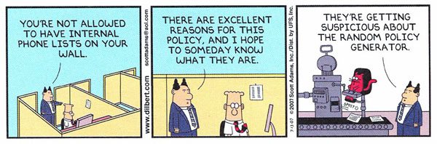
Notes:
Why care about this?

Slide 4
Why?
Minimize risk to the institution
Solve common ‘problems’ before they happen
Standardize practices across the office
Stop ‘advisor shopping’ by students/scholars
Fair application of protocols and procedures
Other?

Slide 5
Areas Conducive to Policy Development
Visa Sponsorship Categories
Payment Requirements
Timeframes to Process
Regulatory and Statutory Interpretation
Office management and expectations

Slide 6
Areas NOT conducive to Policy Development
Clear regulatory standards
Areas that allow some flexibility of processing
Areas that require creativity and innovation
Unique – one-off situations that would rarely if ever happen
Other?

Slide 7
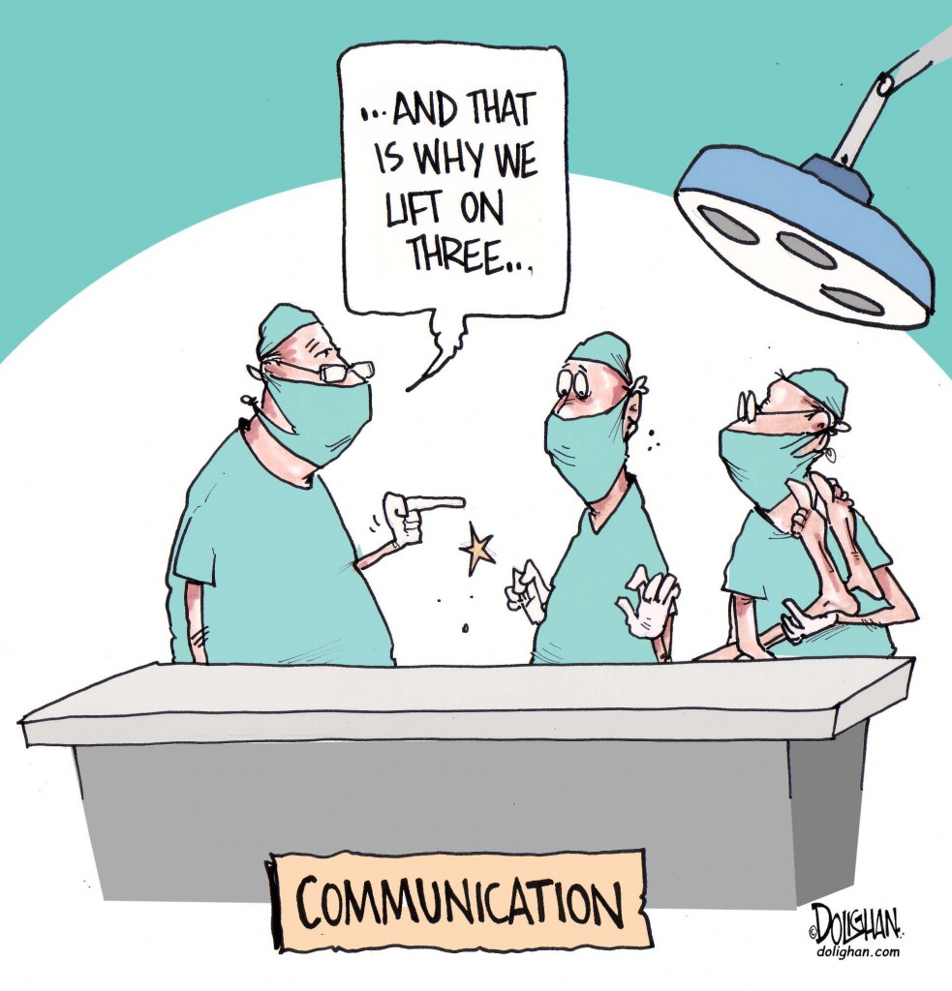
Notes:
How to do this? Policy development is about consistency, but also, communication.

Slide 8
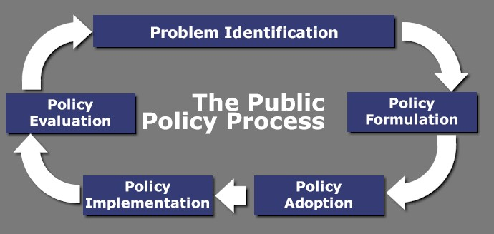
Notes:
This is sort of a standard general flow – what is implied is that communication piece. Who identifies the problem; who are the stakeholders, who helps to craft the policy; how do you go about implementation (method, timeline, etc); how to asses the impact and effectiveness.

Slide 9
Process to Develop a Specific Policy
Determine who owns the area of responsibility
Define the problem / situation
Meet with stakeholders / collaborators to get feed back and perspective
These perspectives will usually require negotiations or modifications
Plan and agree on implementation
  Timeline
  Method
  “Enforcement”?
Plan to re-visit and assess periodically (regulations and laws change; institutional priorities change....
Notes:
Third bullet – don’t just inform! You need them to have a voice and input, in order to ensure support and cooperation

Slide 10
Example #1 - UGA
Visa Sponsorship – overall policies
OIE clearly owned this area of responsibility, based on office history. Confirmed with HR and Legal Affairs, though.
We needed to have a consistently applied standard when evaluating whether a sponsorship could occur, and what category was most appropriate
Reviewed institutional mission statement; met with senior administrators to determine priorities (including HR, Academic Affairs, Faculty Affairs, OVPR, Admissions
In this case, they pretty much all happily accepted our recommendations (advantage if you are seen as the expert, in addition to the “owner”)
Enforcement was an issue – we are an advisory office, so we have little enforcement ability – with a few exceptions, dictated by State and Federal laws
Reviews happen in ongoing fashion – based on regulatory and statutory revisions
Notes:
Examples of fifth bullet –VLP and I-9 regs
Example for 6th bullet – F-2 study; H-4 employment....

Slide 11
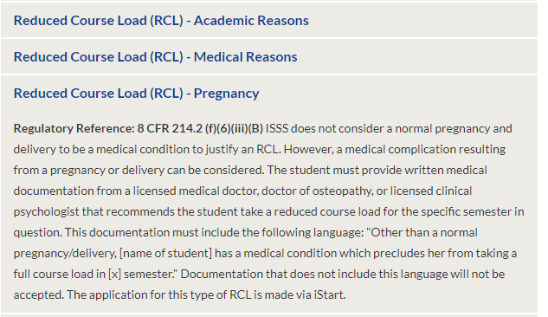
Example #2 - GSU
Reduced Course Load (RCL) – Pregnancy
Huge variance in practice across institutions on this topic!
Need for policy, and its revisions, created by individual cases
  Always want to be sympathetic, but policy enables consistency and fairness
  Students talk, and bring expectations when transfer from other institutions
Policy created and revised during weekly DSO Roundtables in ISSS
Necessary to bring into alignment with GPC post-consolidation
Policy posted online at http://isss.gsu.edu/about/policies/

Slide 12
Example # 3 - Tech
Curricular Practical Training Policies
  GT has a long-standing and respected Cooperative Education Program. We partner with them to assist students in seeking COOP’s and internships and rely on them to vet for educational alignment and quality.
  GT’s CPT policies are well developed and reviewed periodically between OIE & Center for Career Discovery & Development (C2D2)
    Transfers, COL students, COM students, start and end dates, Practical Training Fee, graduation semester, on-campus employment & GRA’s, COOP enrollment deadlines, COOP terminations, office campus considered as on-campus, etc.
  OIE & C2D2 meet every term to discuss policies, special cases, update new staff and review concerns. We set-up electronic file sharing to ensure we are in regular contact and can review documentation and/or relevant projects and research easi
  OIE drafts policy and procedure updates as needed and brings C2D2 to the table before implementation or mass communication. Ensure website alignment in regards to communication. We strive to avoid bouncing students between the two offices by having open lines of communication at all times – this is KEY.

Slide 13
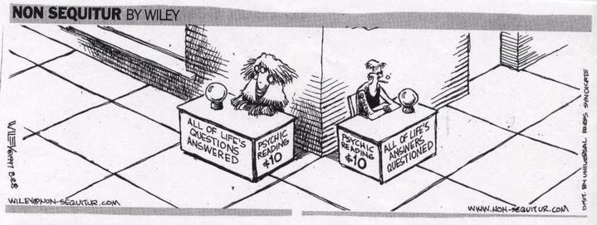
Notes:
Question and Answer

