Slide 1
International Education Resources

Slide 2
Katie Tudini
Georgia Institute of Technology
International Student and Scholar Services Resources/NAFSA

Slide 3
NAFSA’s ISS-Regulatory Practice Committee (ISS-RP)
Katie Tudini – Chair Designate of ISS-RP & Assistant Director @ Georgia Tech
Identifying regulatory practice issues that need action through government agency liaison.
ISS RP also identifies practice resources to be referred to the Knowledge Community for International Student and Scholar Services (KC ISSS) for development.
Address regulatory practice issues that are both broad and deep. ISS RP analyzes submissions to IssueNet's Report an Issue to prioritize those concerns from the ISSS field and note trends.

Slide 4

NAFSA Resources for International Educators
Free NAFSA Resources:
Create a free profile using NAFSA Passport
IssueNet: Report an Issue for ISSS & EA
Critical Updates & NAFSA Blog
All IE Resources: www.nafsa.org/Professional_Resources/
KC-ISSS Regional Liaison: Charter Morris
Regulatory Ombudsperson: Regina Georgia (student) & Marisa Atencio (Scholar)
Career Center
ISS Regulatory Updates: www.NAFSA.org/reginfo
Browse by topic type
Law Links
Protocol for contacting govt agencies
Executive Actions
Opportunities for public comment
NAFSA membership:
IssueNet: Get Liaison Help & Request Visa Help
Advisor’s Manual
Government Connection webinars
Listervs & Forums (ISSS, EA, IEM, IEP etc.)
NAFSA publications
E-learning courses & seminars

Slide 5
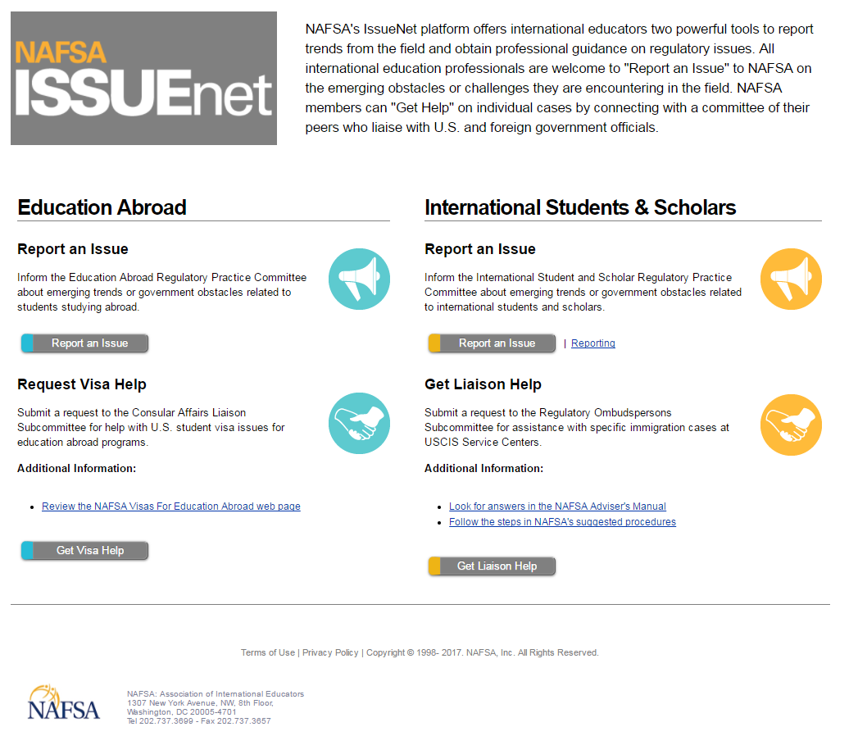
IssueNet’s Landing Page
www.nafsa.org/issuenet
Notes:
The use of the IssueNet tool is more important today than ever. The data compiled through IssueNet is critical for NAFSA’s government engagement activities. Many international educators are not aware of IssueNet, and ISS-RP would like to make IssueNet more visible.
Last year, a group within ISS-RP came up with ways to publicize IssueNet and one suggestion was to have a tagline (a catchphrase or slogan) competition. Submit your best tagline today by visiting goo.gl/forms/z3kcJLMRvMPmH1yr2
You may enter as many times as you want – multiple entries are encouraged! Entries will be judged based on appropriateness, creativity and the desired effect of publicizing IssueNet.
Besides bragging rights, the grand prize will be a NAFSA publication.
Entries are due by March 10.

Slide 6
Ronda Dowell
University of North Georgia
Georgia Association of International Educators (GAIE)

Slide 7

www.gaie.org
GAIE is a state organization that is a valuable resource to new professionals in the field of international education.
GAIE Resources
Free membership – open to all aspects and areas of international education
Reasonably priced annual conference
Listserv membership
Global Guidance Advocacy blog
Travel grants

Slide 8
Micheal Sweazey
Kennesaw State University
Overseas Security Advisory Council (OSAC)

Slide 9

OSAC
https://www.osac.gov/Pages/Home.aspx

Slide 11
Colleen Larson
University of Georgia
Study Abroad Resources/NAFSA & The Forum on Education Abroad

Slide 12

Colleen Larson
University of Georgia
Study Abroad Resources
NAFSA & The Forum on Education Abroad

Slide 13

NAFSA EDUCATION ABROAD RESOURCES
http://www.nafsa.org
Professional Development & Networking
Knowledge Communities & Interest Groups
Collegial Conversations, eLearning Courses, webinar & workshops
Conferences – Regional and National
Publications

Slide 14


NAFSA KNOWLEDGE COMMUNITIES (KC)
Teaching, Learning, and Scholarship
Intercultural Communication & Training
Internationalizing Teaching, Learning and Curriculum
Research & Scholarship
Education Abroad
Student Learning
Health and Safety
Student Support
Advocacy and Regulatory

Slide 15
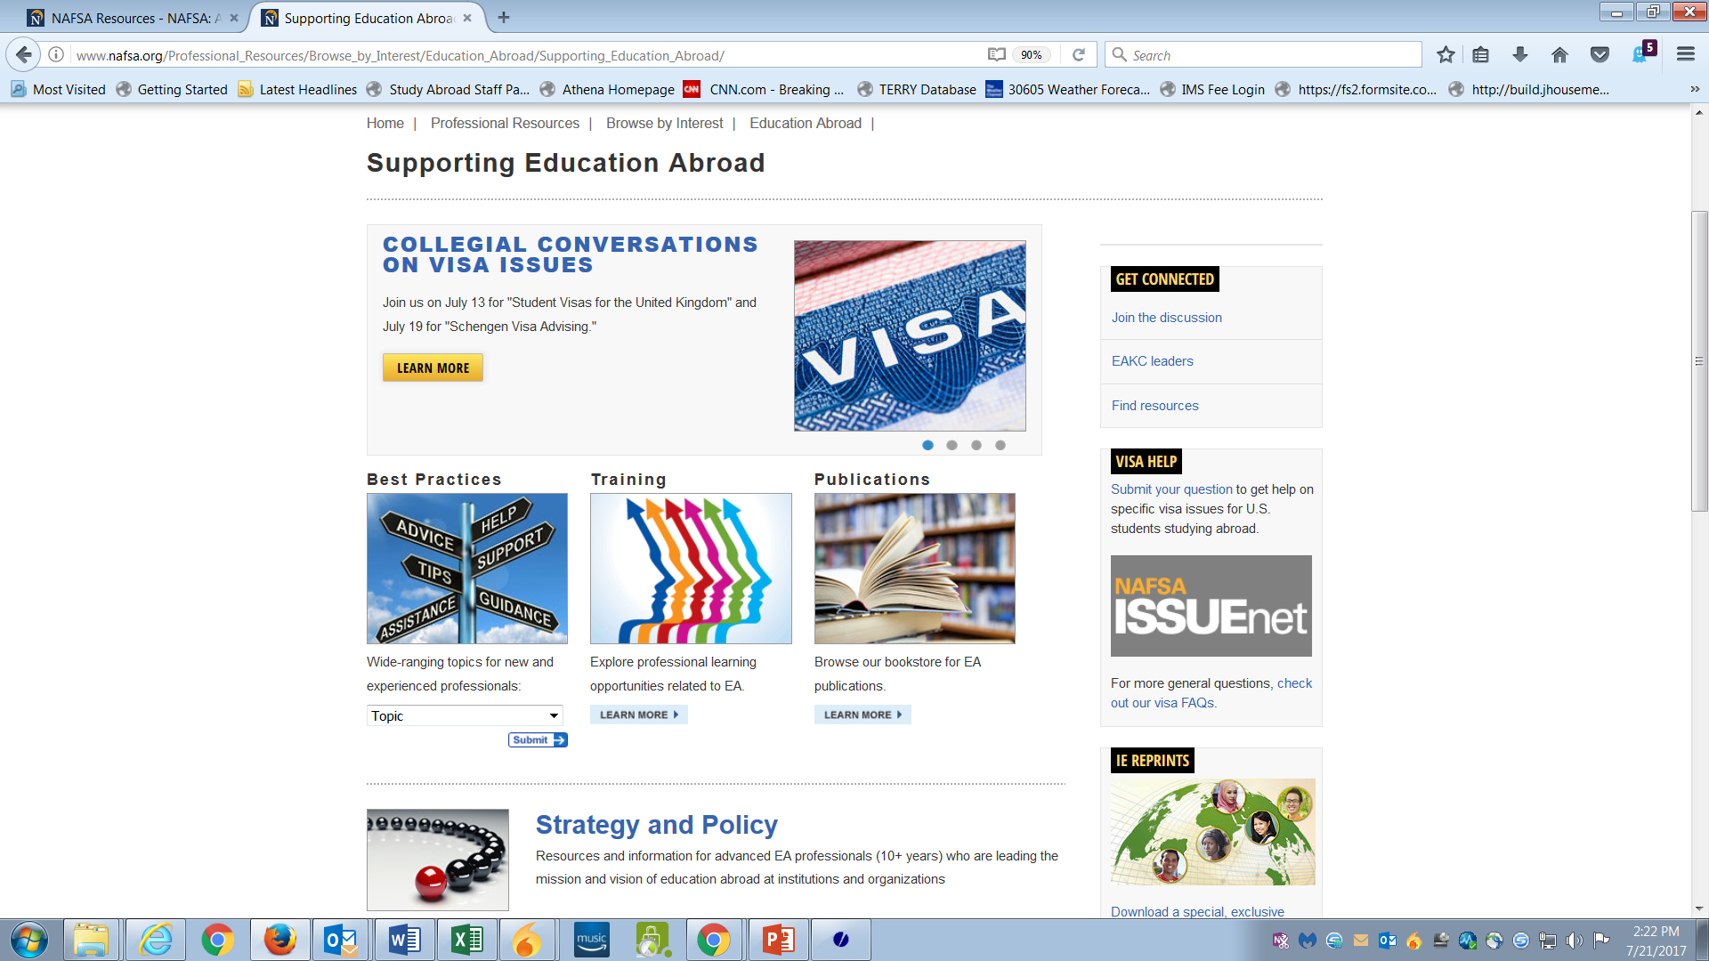
NAFSA EDUCATION ABROAD
http://www.nafsa.org/Professional_Resources/Browse_by_Interest/Education_Abroad/ Supporting_Education_Abroad/

Slide 16
TOPICS: EDUCATION ABROAD BEST PRACTICES
Advising
Directing and Managing Education Abroad
Comprehensive Internationalization
EA Visas & Regulatory Practice
Faculty-led Programs
Financing Education Abroad
Health and Safety
Marketing and Recruiting
Measuring the Impact of Study Abroad
Orientation/Re-entry Programming
Underrepresentation - Participants and Locations
Work/Intern/Volunteer Abroad

Slide 17
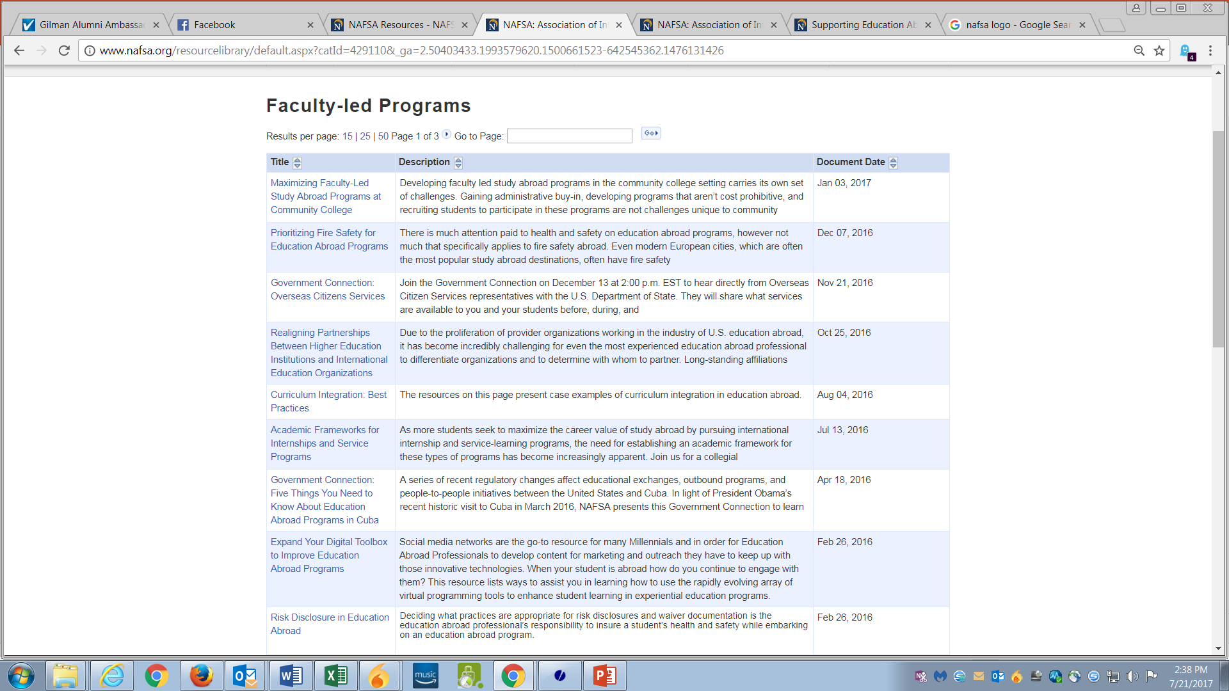
BEST PRACTICES: FACULTY-LED PROGRAMS

Slide 18
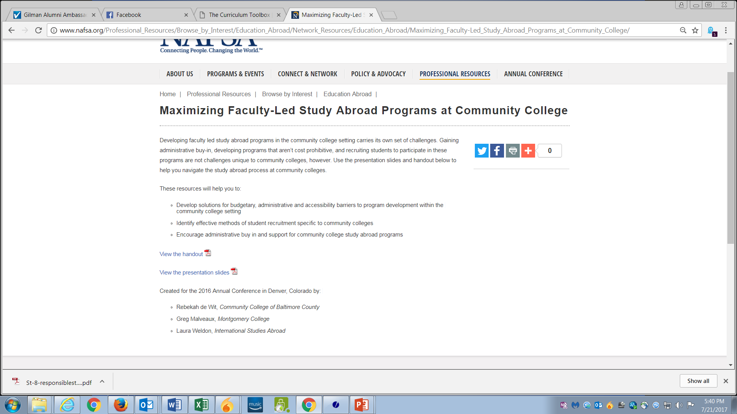
Publications
Archived Presentations
Recorded Webinars
Depending on Resource, NAFSA login might be required

Slide 19
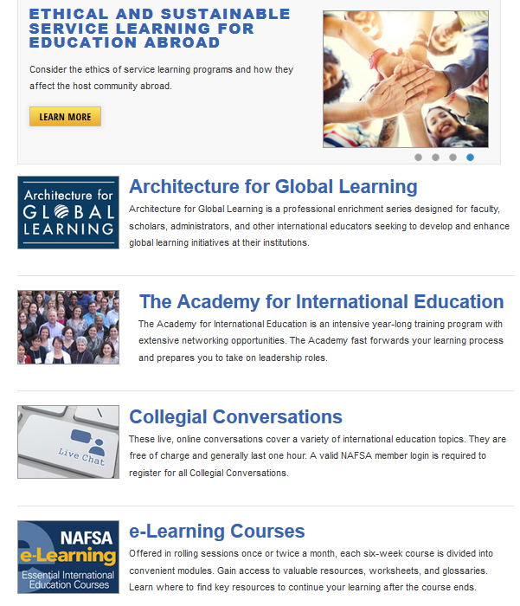
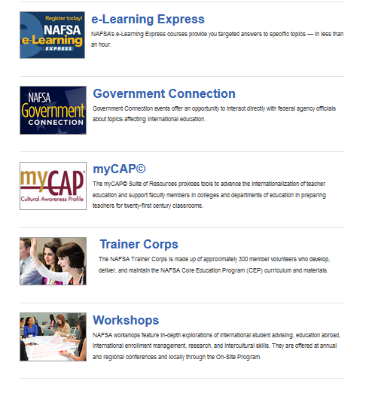
NAFSA EDUCATION ABROAD LEARNING & TRAINING

Slide 20
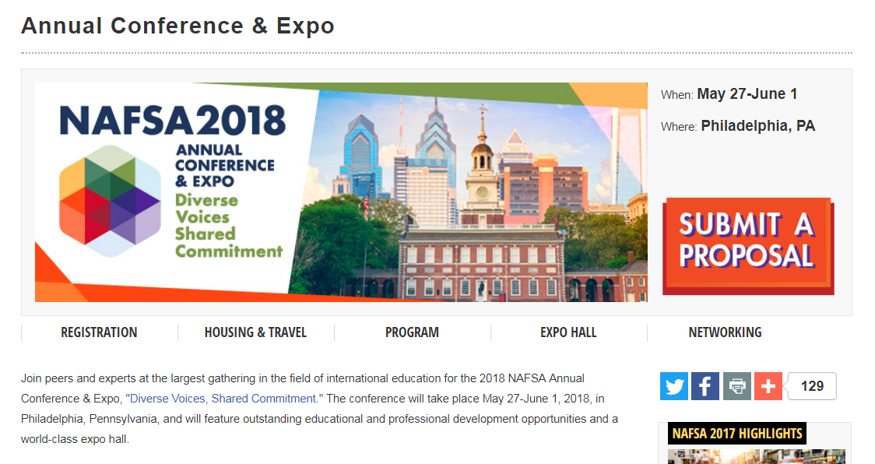
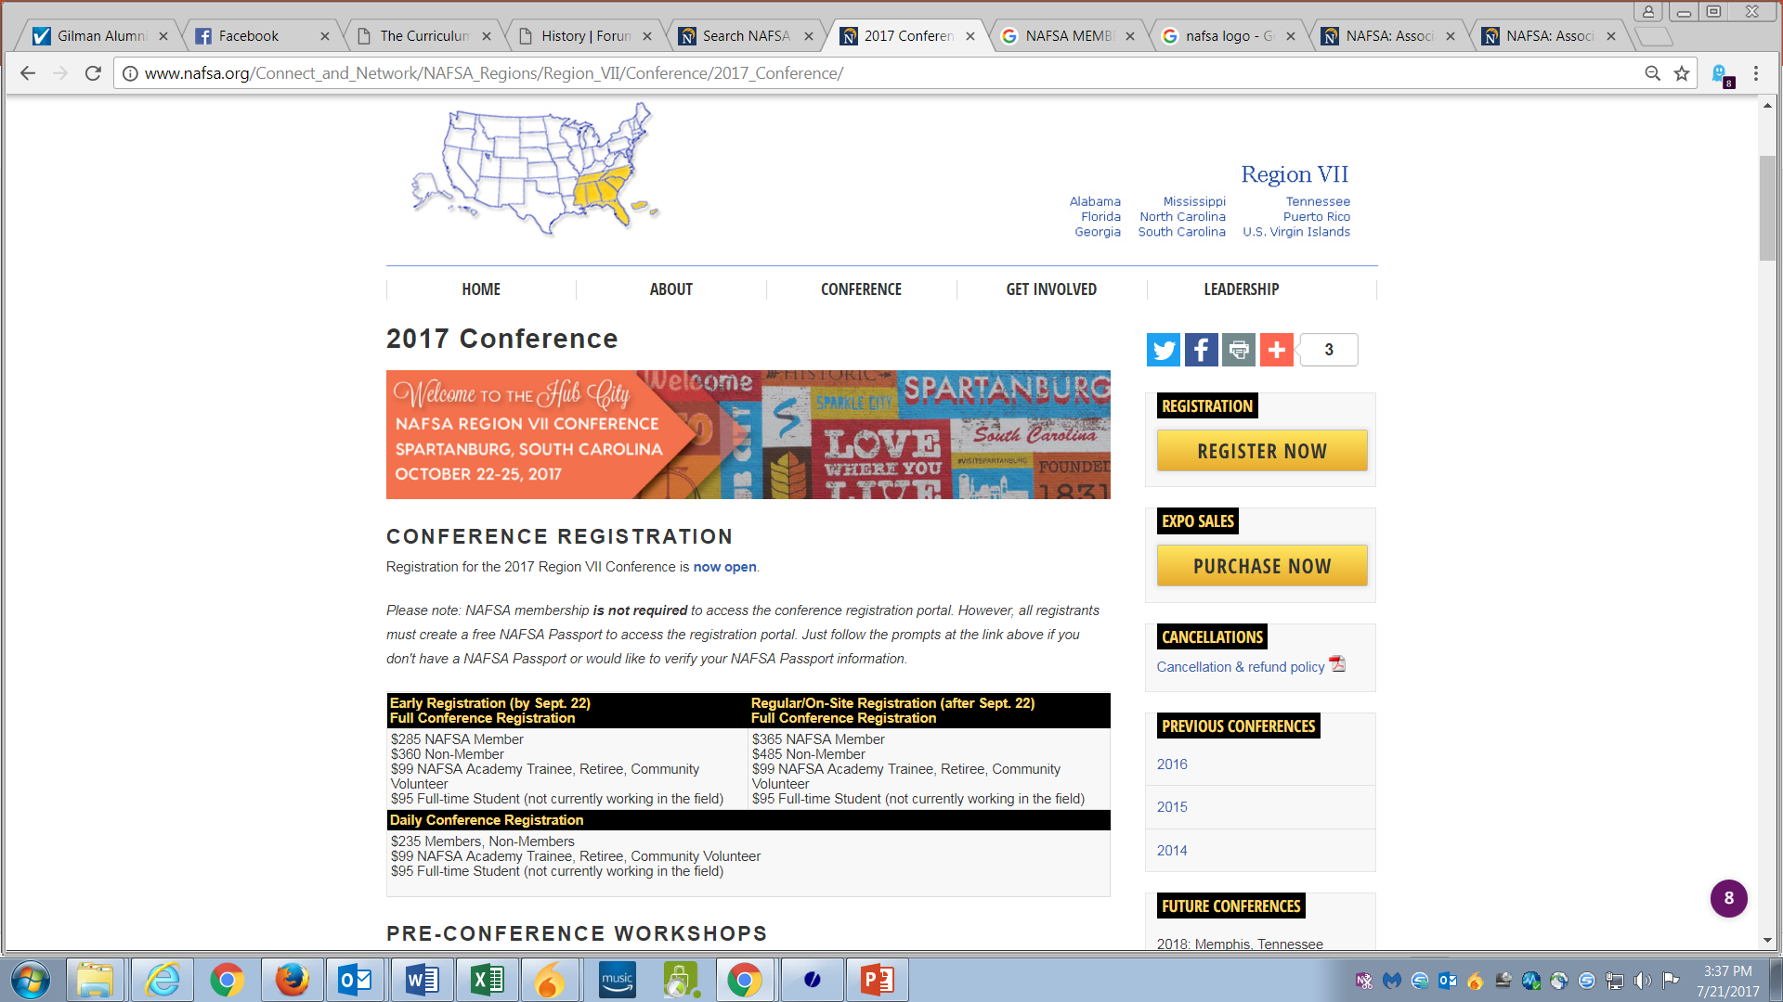
2018 ANNUAL CONFERENCE
SESSION & WORKSHOP Deadline: August 7 POSTER Deadline: Dec. 11
REGIONAL CONFERENCE
October 25-26

Slide 21
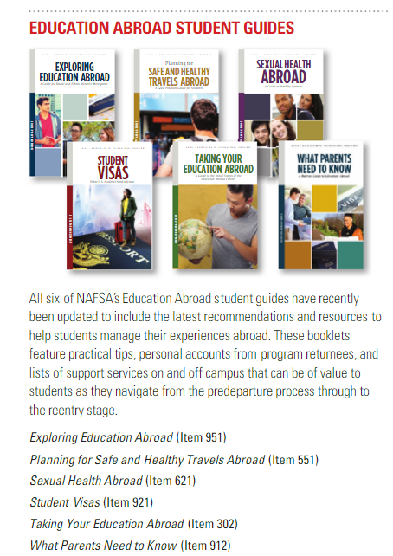
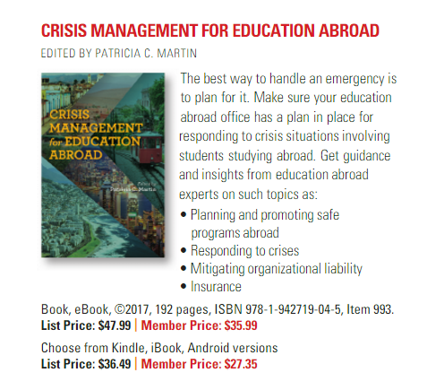
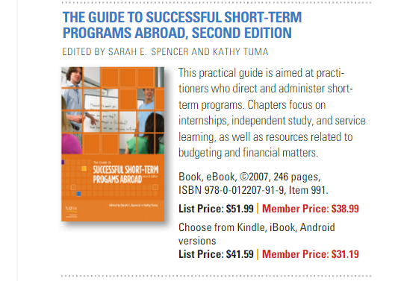
PUBLICATIONS

Slide 22
NAFSA REGION VII EDUCATION ABROAD LEADERSHIP TEAM
NAFSA Region VII
Chair: Fred von Schmelling, AIFS until Oct fvonschmeling@aifs.com
Chair-Elect: Erin Hollis, Rhodes College TN hillise@rhodes.edu
KC EA Liaison: Liz Dille, Mercer dille_em@mercer.edu
EA State Representative: Maggie Miller, GA Tech Maggie.miller@oie.gatech.edu

Slide 23

FORUM ON EDUCATION ABROAD
Standards of Good Practice
Recognized by U.S. Dept. of Justice and the Federal Trade Commission as the Standards Development Organization for EA
Outcomes, Data Collection
Curriculum Toolbox
Competency Credentials & Professional Certification
Workshops, Conferences, & Training

Slide 24
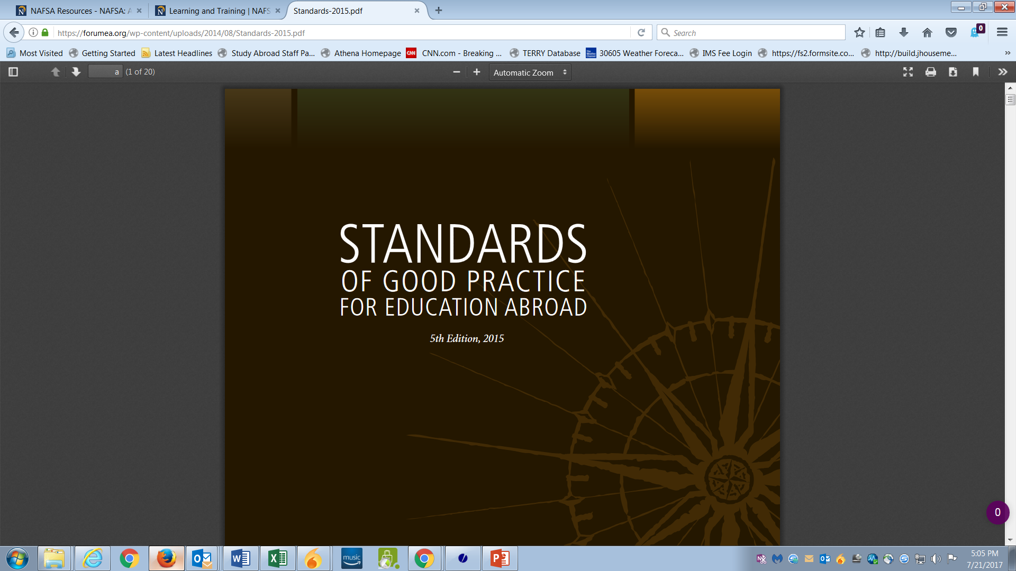
9 STANDARDS
Statements
A broad principle followed by detailed bullet points
Queries
Prompts for evaluation, designed to elicit a response
that demonstrates how the Standard is being met and encourages discussion rather than a yes or no answer.
https://forumea.org/wp-content/uploads/2014/08/Standards-2015.pdf

Slide 25
STANDARDS OF GOOD PRACTICE (1-3…)
Mission and Goals: The organization has a mission statement and articulates clear goals for its education abroad programming.
Student Learning and Development: The organization’s mission, goals, and operations prioritize student learning and development.
Academic Framework: The organization delivers academic content appropriate to its stated mission and goals, ensures adequate academic supervision and evaluation, and maintains clear and transparent academic policies.

Slide 26
STANDARDS OF GOOD PRACTICE (4-6…)
Student Selection, Preparation, and Advising: The organization maintains fair and ethical recruitment and selection processes, adequate student preparation and advising, and ongoing student support.
Student Code of Conduct and Disciplinary Measures: The organization articulates clear and accessible guidelines for student behavior and consequences resulting from violations
Policies and Procedures: The organization has well-defined and clearly-articulated policies and procedures that govern its programs and practices, ensures that they are fairly and consistently implemented, and conducts regular reviews to assess their effectiveness

Slide 27
STANDARDS OF GOOD PRACTICE (7-9)
Organizational and Program Resources: The organization ensures that its programs are adequately funded and staffed.
Health, Safety, Security, and Risk Management: The organization prioritizes the health, safety, and security of its students through policies, procedures, advising, orientation, and training.
Ethics: The organization operates its programs in accordance with ethical principles, and trains its staff and students in ethical decision-making and practices.

Slide 28
Student Learning & Development
The organization’s mission, goals, and operations prioritize student learning and development.
Educational objectives remain central to program design and management.
Regular evaluations are conducted to assess student learning and development.
Organizations seek to create and maintain continuity with student learning and development on the home campus.
In what ways do you prioritize student learning and development in the design and management of your programs?
How do you measure student learning and development outcomes?
How do you use student learning and development assessments to improve your program design and management?
How do program offerings support academic objectives of students and their home institutions?
To what extent is your program curriculum integrated with curricula of the students’ home institutions?
In what ways do your pre-program, on-site, and post-program offerings support the continuity of student learning and development?

Slide 29
Student Learning & Development
The organization’s mission, goals, and operations prioritize student learning and development.
Educational objectives remain central to program design and management.
Regular evaluations are conducted to assess student learning and development.
Organizations seek to create and maintain continuity with student learning and development on the home campus.
In what ways do you prioritize student learning and development in the design and management of your programs?
How do you measure student learning and development outcomes?
How do you use student learning and development assessments to improve your program design and management?
How do program offerings support academic objectives of students and their home institutions?
To what extent is your program curriculum integrated with curricula of the students’ home institutions?
In what ways do your pre-program, on-site, and post-program offerings support the continuity of student learning and development?

Slide 30
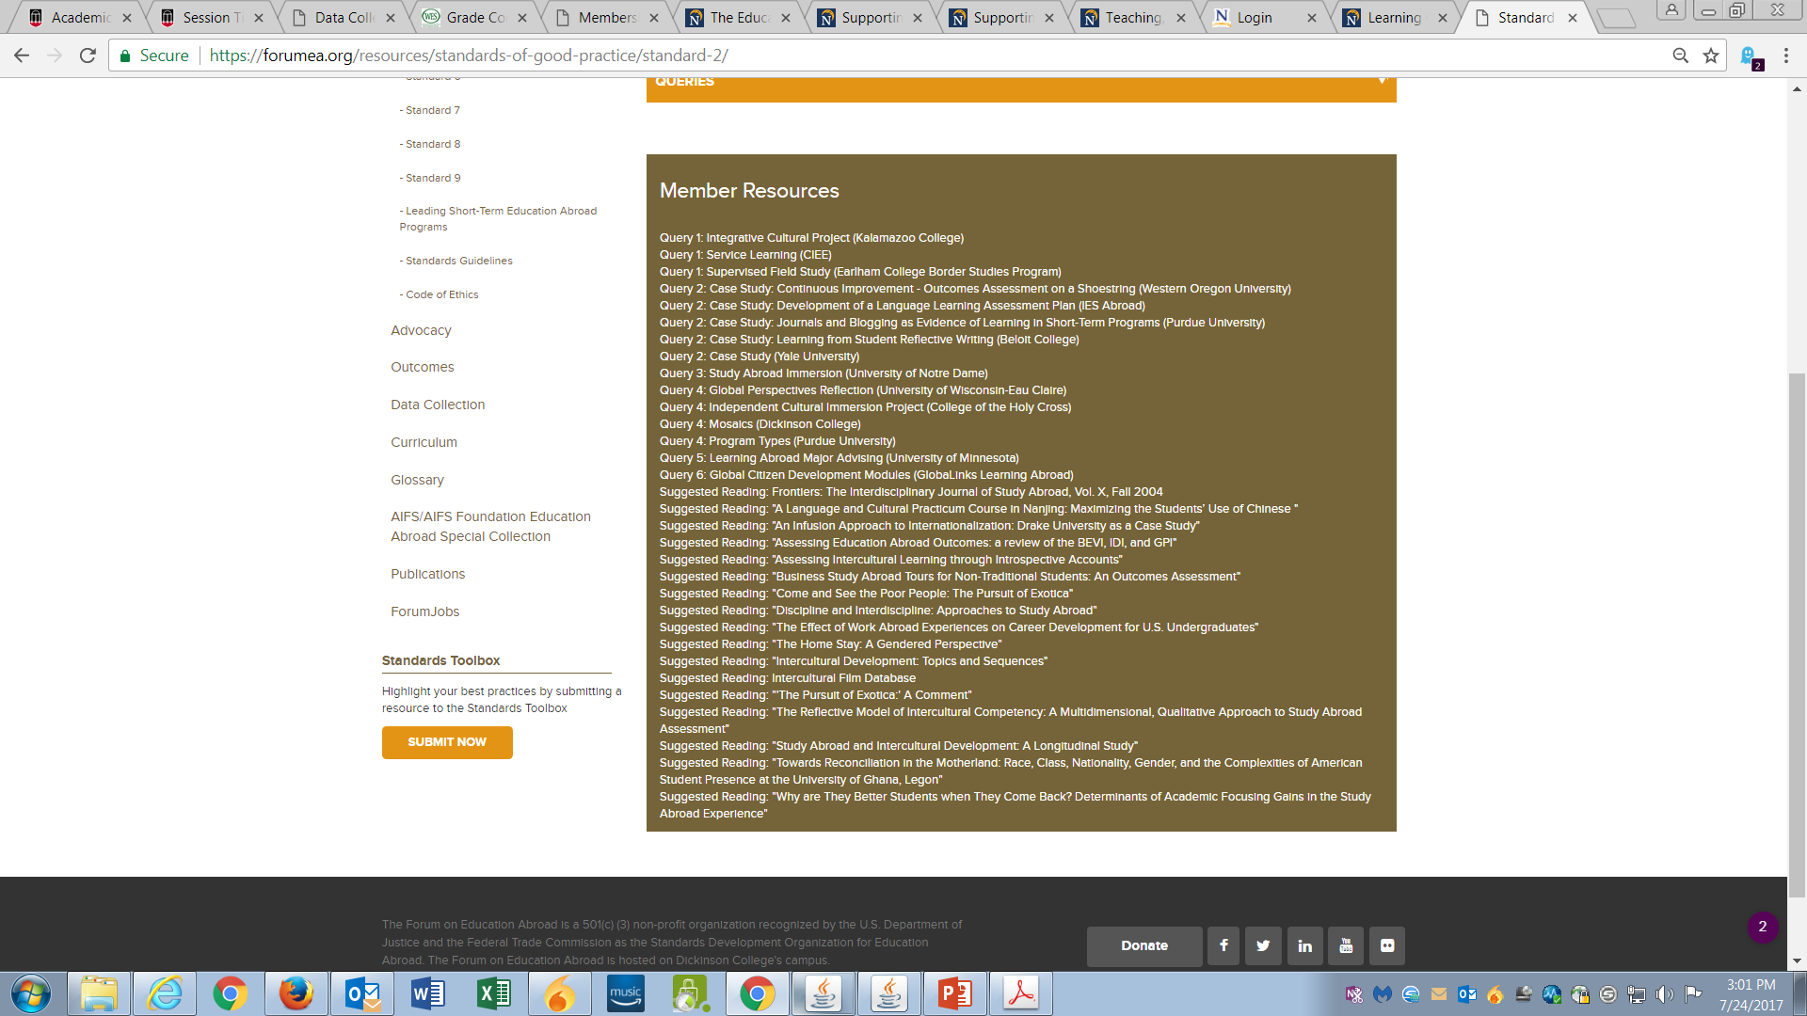
STANDARDS TOOLBOX

Slide 31
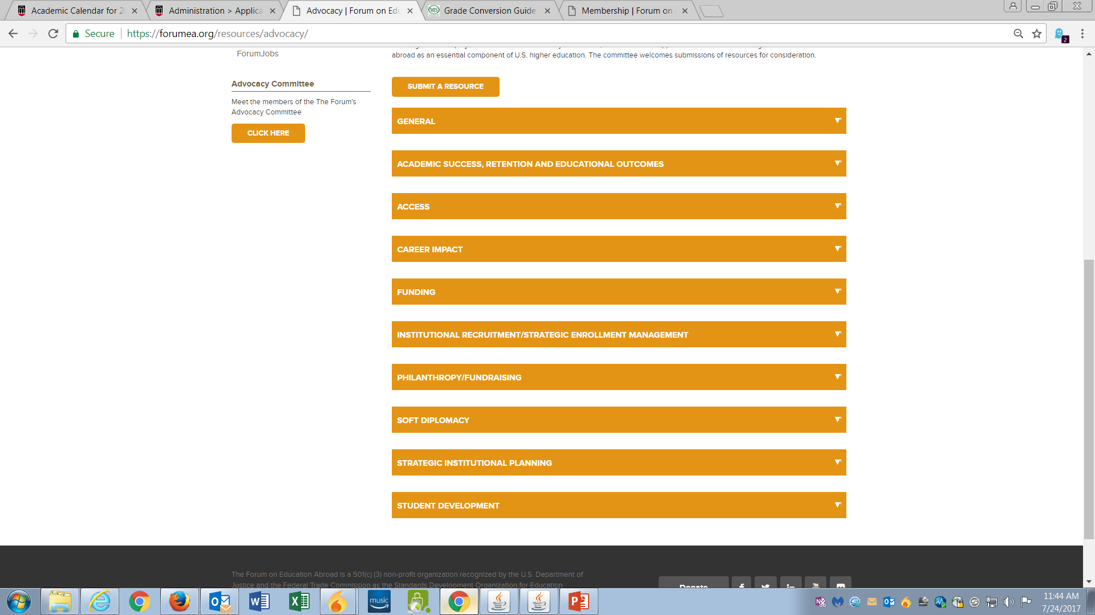
ADVOCACY CLEARINGHOUSE
DATA COLLECTION
State of the Field Survey Report
Insurance Claims Data/Mortality Rate
Critical Incident Database
2013 Institutional and Program Resources Survey
Open Doors & Snapshot Surveys

Slide 32
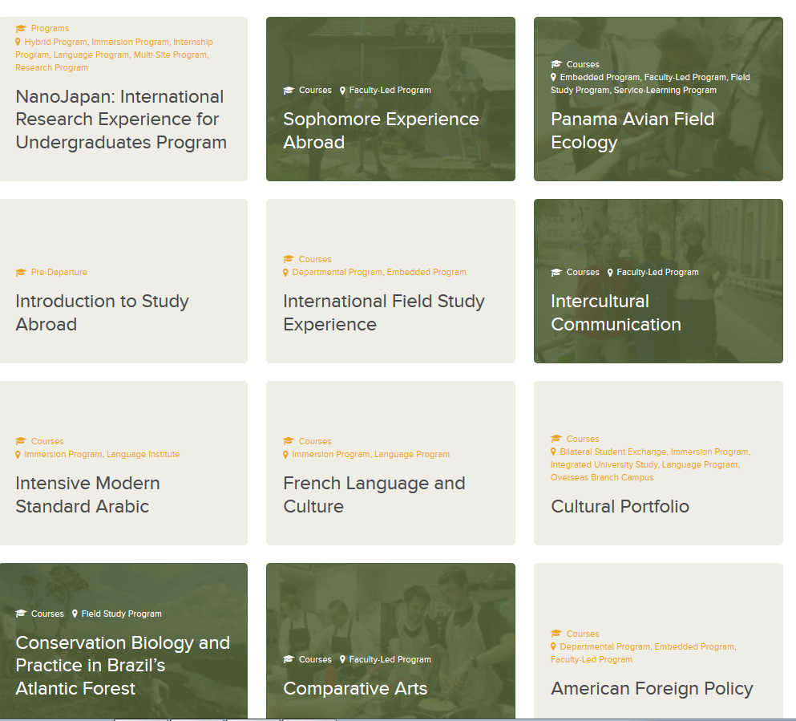
THE CURRICULUM TOOLBOX
Login required
Study Abroad Course syllabi
How course uses location to enrich instruction, learning or assessment
How course enhances curriculum at home institution

Slide 33



COMPETENCY CREDENTIALS
Attend two specific workshops associated with the credential
Successfully complete the accompanying Standards Assignments
Open to Forum members and non-members

Slide 34
PROFESSIONAL CERTIFICTAION IN EDUCATION ABROAD
Curriculum includes 6 modules and Culminating Project based on the Standards of Good Practice.
Develop ability to articulate the Standards and establish advanced skills in applying standards
Regularly scheduled Workshops led by Forum Trained Facilitator and an associated Standards Assignment
Online and accelerated (3-day) options available
Open to Forum members and non-members

Slide 35

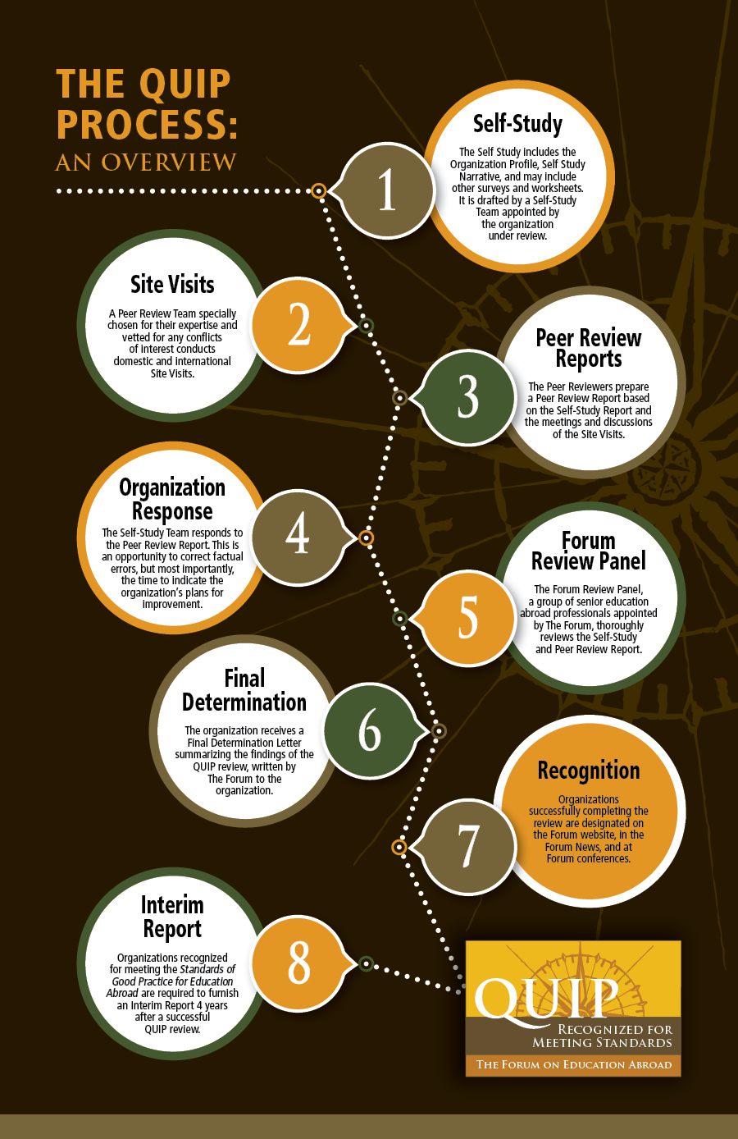
Assessment
Improvement
Recognition
Membership & Application required
QUIP Fees based on numbers of students abroad

Slide 36
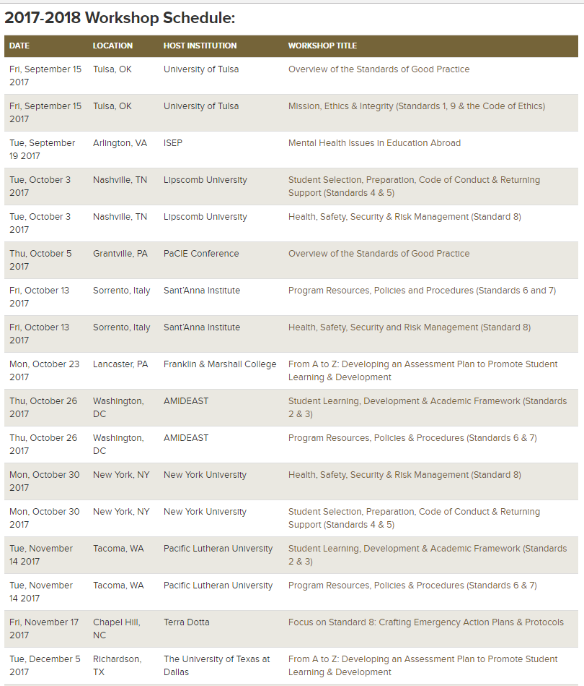
WORKSHOPS
Annual Conference
European Conference
Standards of Good Practice Institutes
Regional Workshops & other Training
Webinars

Slide 37
Tammy Rosner
University System of Georgia
Association of International Education Administrators (AIEA)

Slide 38
Association of International Education Administrators (AIEA)
Association dedicated to senior leaders in International Education
Offers all-access resources on internationalization, international organizations and surveys
Offers a yearly conference (registration open to non-members at a higher rate)
Member benefits:
Journal of Studies in International Education access
Listserv
Networking and dialogue with senior international leaders
Workshops, retreats and seminars
USG International Education is a member and can assist with resources if needed

Slide 39

http://www.aieaworld.org/

