Slide 1
International Student Recruitment Best Practices
Chenelle Goyen
Assistant Director of Admissions

Slide 3
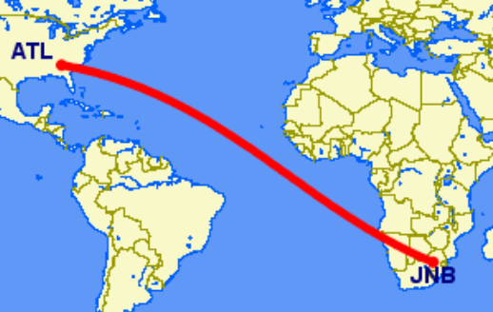
International Student Recruitment Best Practices

Slide 4
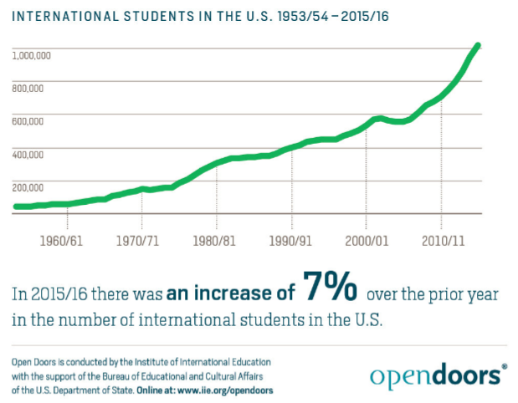
Overview of international students in the U.S.

Slide 5
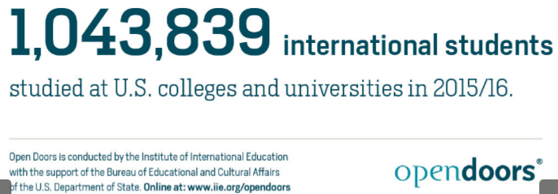

Slide 6
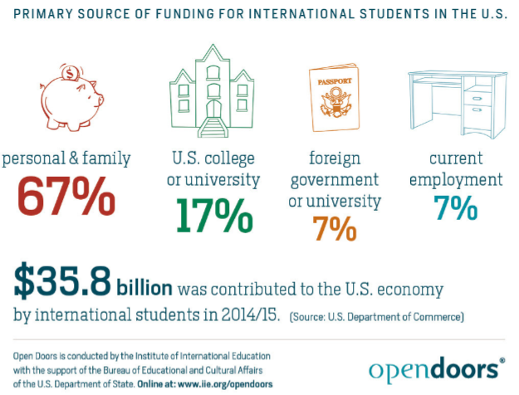

Slide 7
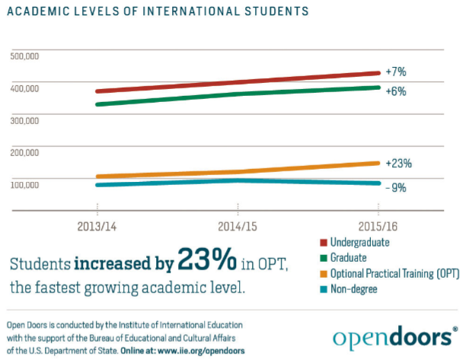

Slide 8
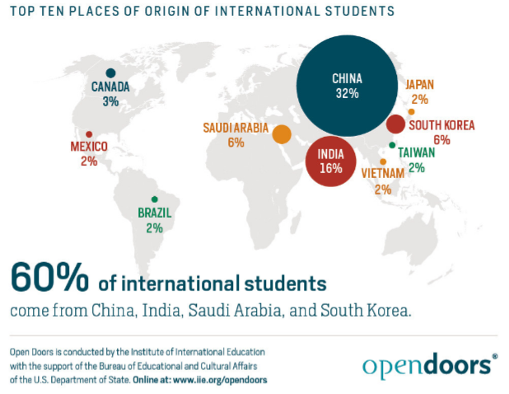

Slide 9
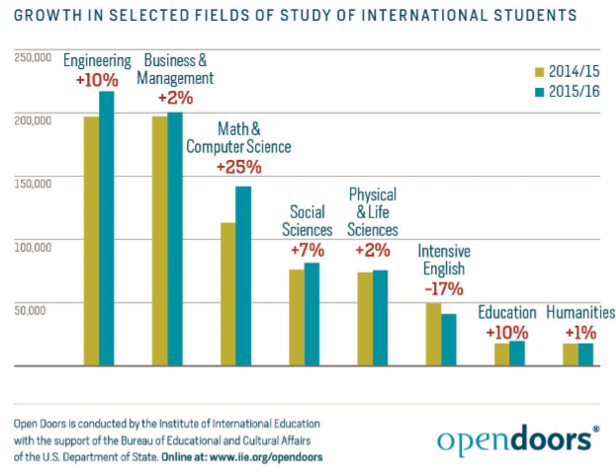

Slide 10
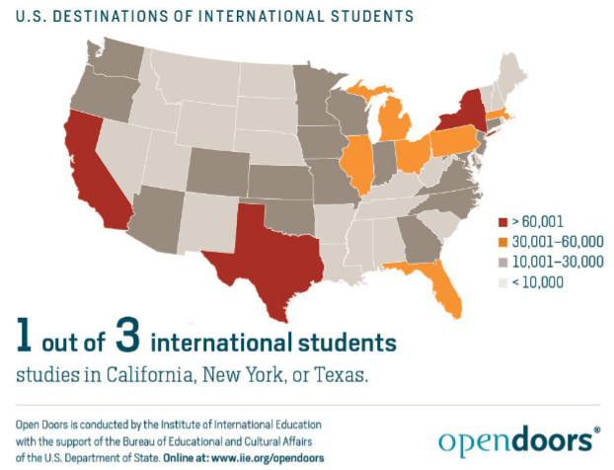

Slide 11
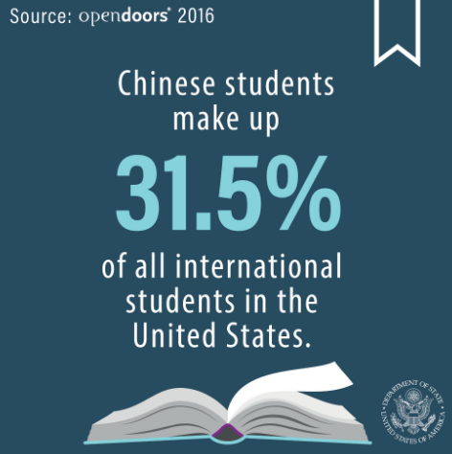

Slide 12


Slide 13
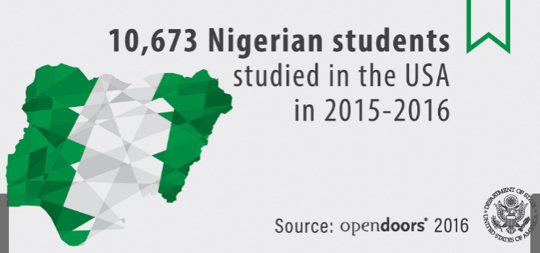

Slide 14
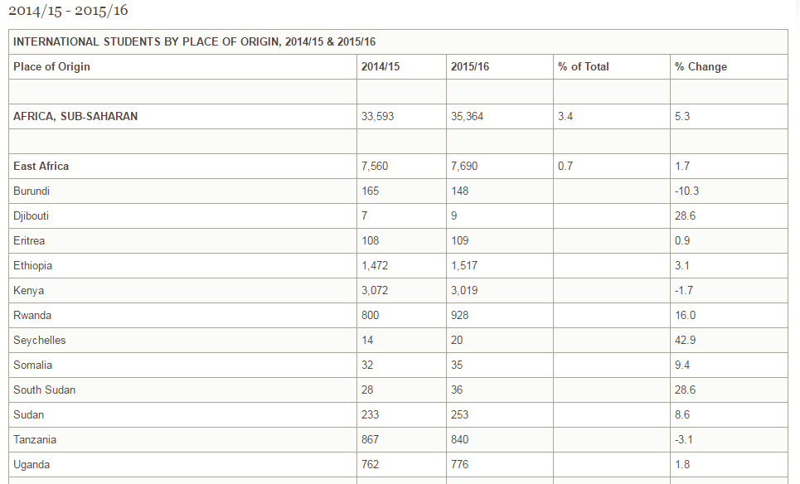

Slide 15
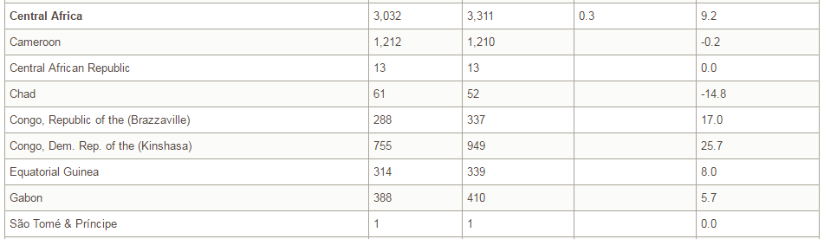

Slide 16
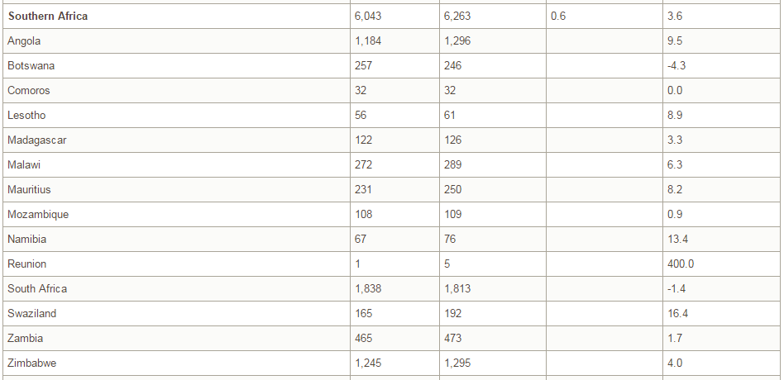

Slide 17
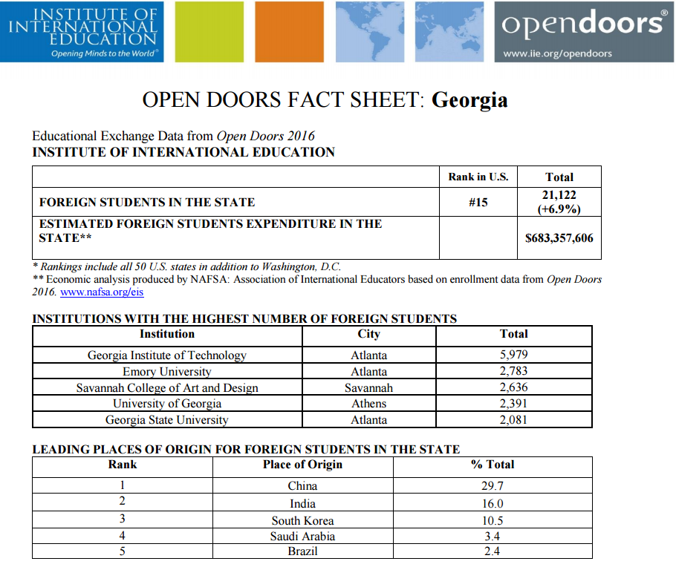

Slide 18
Recommended Recruitment Strategies
Plug into Education USA fairs abroad
USA College Day in London, UK. (Largest one in Europe – over 5000 attendees)
USA College Day Scandinavia : Nordic Tour
USA College Day Brussels Belgium, and Germany
CIS and Linden fairs for South East Asia
KIC Univ Assist tours for India
Fulbright fairs
Group travel or consortium travel
International School Counselor fly-ins
Alumni abroad
Study abroad programs

Slide 19
Recommended Recruitment Strategies
International campuses
Athletic Department – Recruitment Counsel
ELI or ELP
Different department group travel
Purchase SAT or ACT scores
Attend IACAC
Attend Education USA
Attend NAFSA

Slide 20
Recommended Recruitment Strategies
Promotional Material
Design an international brochure
Design an international scholarship/Awards brochure
Buy ads at large Education USA fairs (in handbooks)
Update the website, and application process
Cut cost on using E-Ship Global for mailing I-20’s
Develop International Student Ambassador Program
Use Skype, Facebook, Baidu, Zoom, WeChat, Weibo, and many more
Develop scholarships for international students
Talk to Scholarship Director about setting aside a specific amount of scholarships for the areas recruited
Find additional scholarships (Rugby Club, Honors, Government Waivers – Presidential Waiver)

Slide 21
International Student Recruitment at UGA
Recruitment efforts for 2016
Sweden and Norway
In March of 2016 - attended the College Day Scandinavia Fairs in Sweden and Norway.
High school visits
Presentations at Education USA in Sweden and Norway, as well as ANSA, the Fulbright Commission, and Lanekassen.
Did presentations at the Swedish Tennis Association
IACAC Conference
In July of 2016 - attended and presented several a session at IACAC on “Supporting Students through Athletic Recruitment” IACAC, at Rutgers University.
Also presented a session on “NCAA Policy and Compliance with international student athlete recruitment”.

Slide 22
International Student Recruitment at UGA
Recruitment efforts for 2016
Education USA Forum
In August of 2016 - attended and presented several sessions at Education USA Forum in Washington DC.
First presentation was on “Expand Your Global Reach: Engaging Alumni to Support Outreach and Recruitment”
Second presentation was on “Crossing the finish line 1st”
USA College Day London, UK
In September of 2016 - attended and presented at USA College Day Fulbright Fair in London UK.
In addition to attending the fairs and doing high school visits, Chenelle did presentations at Education USA UK, as well as Sutton Trust, and the Fulbright Commission.
Presented on “Finding Financial Aid for your USA College or University”
Large presentation (combined 3 high schools in UK) on “The true international student experience in the USA – a personal story”.
Organized Study Georgia Consortium travel group – hosted an even panel night and presented on “Scholarship and Financial Aid”

Slide 23
International Student Recruitment at UGA
Recruitment efforts for 2016
USA College Day Brussels, Belgium
In September of 2016 - attended and was a key speaker at USA College Day – Brussels, Belgium fair.
In addition to attending the fairs and doing high school visits, Chenelle did presentations at Education USA Belgium, as well as Sutton Trust, and the Fulbright Commission.
Chenelle did a large presentation with the Belgium Fulbright Commission on “Finding the right fit”
Kaiserslautern College Night in Germany
In September of 2016 - attended the Kaiserslautern College Night in Germany.
Met with and presented to students at the Special Events Center of the Rhine Ordnance Bks.

Slide 24
International Student Recruitment at UGA
Recruitment efforts for 2016
South Africa
In November of 2016 - attend the Education USA South African fairs.
Key speaker at 2 of the Education USA offices, and did presentations for prospective students at Coca-Cola, South Africa, and various private high schools and sports academies.
Cairo, Egypt
In November this year, Chenelle worked with Laura Kagel for a joint effort to recruit international students at the Study USA Egypt fair, by utilizing UGA alums at this Cairo fair.

Slide 25
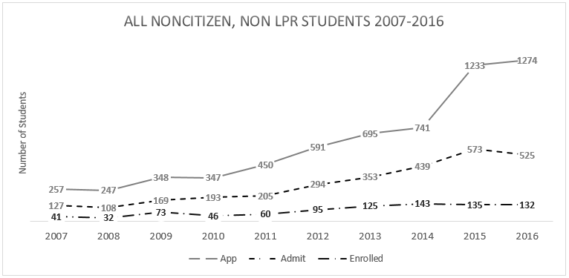
University of Georgia : International Recruitment Strategies and Results

Slide 26
International Student Athlete Recruitment
How many Student-Athletes in the USA?
More than 460,000 NCAA student-athletes – more than ever before – compete in 24 sports every year.
Member schools support their student-athletes’ academic success by providing state-of-the-art technology, tutoring and access to academic advisors.
More than eight out of 10 student-athletes will earn a bachelor’s degree, and more than 35 percent will earn a postgraduate degree

Slide 27
International Student Athlete Recruitment
How many international Student-Athletes?
With more than 17,000 international student-athletes studying and competing at NCAA member institutions, international student-athletes add much to the learning environment within intercollegiate athletics.
International student-athletes face unique challenges once they land on campus, including additional travel, language barriers, difficulties in adjusting to a new sports culture, acclimatization issues and isolation.
With such challenges, international student-athletes bring depth and cultural diversity that enhances the learning environment of every student-athlete, coach and administrator in the Association

