Slide 1
RPA and EDMA Update
Angie Bell, Cherry Zhang, Lori Hagood, Rachana Bhatt
Fall 2025 IRP Meeting

Slide 2
Data Collections and Governance

Slide 3
Financial Aid Data Collection
In October 2025 for the 2024-25 aid year (fall 24 through summer 25):
  Adjust maximum award amounts for Zell and Dual Enrollment Tuition
2425 Federal Changes
  FAFSA Housing Plans; Parental Education; Student Dependent Data; Marital Status; EFC to SAI; and Federal Benefits Received
  The complete list of changes with details is available on the RPA Academic Data Governance webpage.

Slide 4
Academic Data Collection
Summer 2025 Mid-Term
New ACT Composite Score without Science
Changes for Post Master’s Certificates
  Modifications to Degree Level codes
    Discontinue F – Advanced Certificate
    Add H – Post-Baccalaureate Certificate; L-Post-Master’s Certificate; R-Post First Professional Certificate
  New Student Level codes
    73-Post-Master’s and 81-Post-First Professional
    Post-Bacc certificate seekers should still go in 60

Slide 5
Academic Data Collection
Other Summer 2025
Ad hoc collection of introductory math and English transfer courses for undergraduates
Fall 2025 End-of-Term
Change to Existing Data Element: Regents Academic Interest – Initial Teacher Certification
New Data Element: Advanced Standing Hours - High School Career, Technical, and Agricultural Education (CTAE) Pathways
VSEC004 update: External Site Code must be a valid code for the institution

Slide 6
Academic Data Collection
Spring 2026 Mid-Term
Course Section Technology - remove as collected data and discontinue validations
Instructional Delivery Code remove T and E, update definitions of remaining (definitions on next slide)
Summer 2026 Mid-Term
New Data Element: Campus Code Description

Slide 7
Academic Data Collection
Instructional Delivery Code New Definitions
(Banner name: Instructional Method)
Code | Description
F | Fully at a distance - All instruction is delivered via technology. The course does not require students to travel to a classroom for instruction; however, it might require students to travel to a site to attend a course orientation or to take exams. (NOTE: This is generally equivalent to delivering more than 95 percent of sessions via technology.)
P | Predominately at a distance - Technology is used to deliver 51 percent or more of scheduled class sessions, but at least one visit to a classroom (or similar site) for instruction is required.
H | At most HALF at a distance - Technology is used to deliver 50 percent or less of scheduled class sessions, but at least one class session is replaced by technology.
Null | This will equate to Technology Enhanced In Person courses – Our reporting definitions already included Null values with Technology Enhanced values

Slide 8
Other Data Collections Items
External site cleanup-deleting sites no longer in use and adding address of site
Catalag of Authorized Academic Programs (CAAP)-adding accrediting agencies and program descriptions to support Credential Engine work
Admissions Collection still in the works, just delayed as other projects took priority

Slide 9
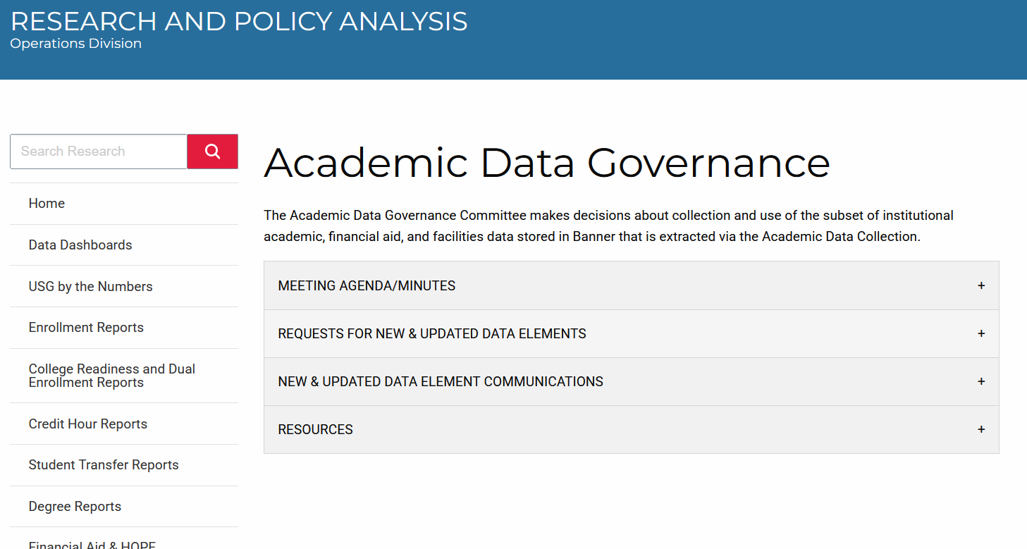
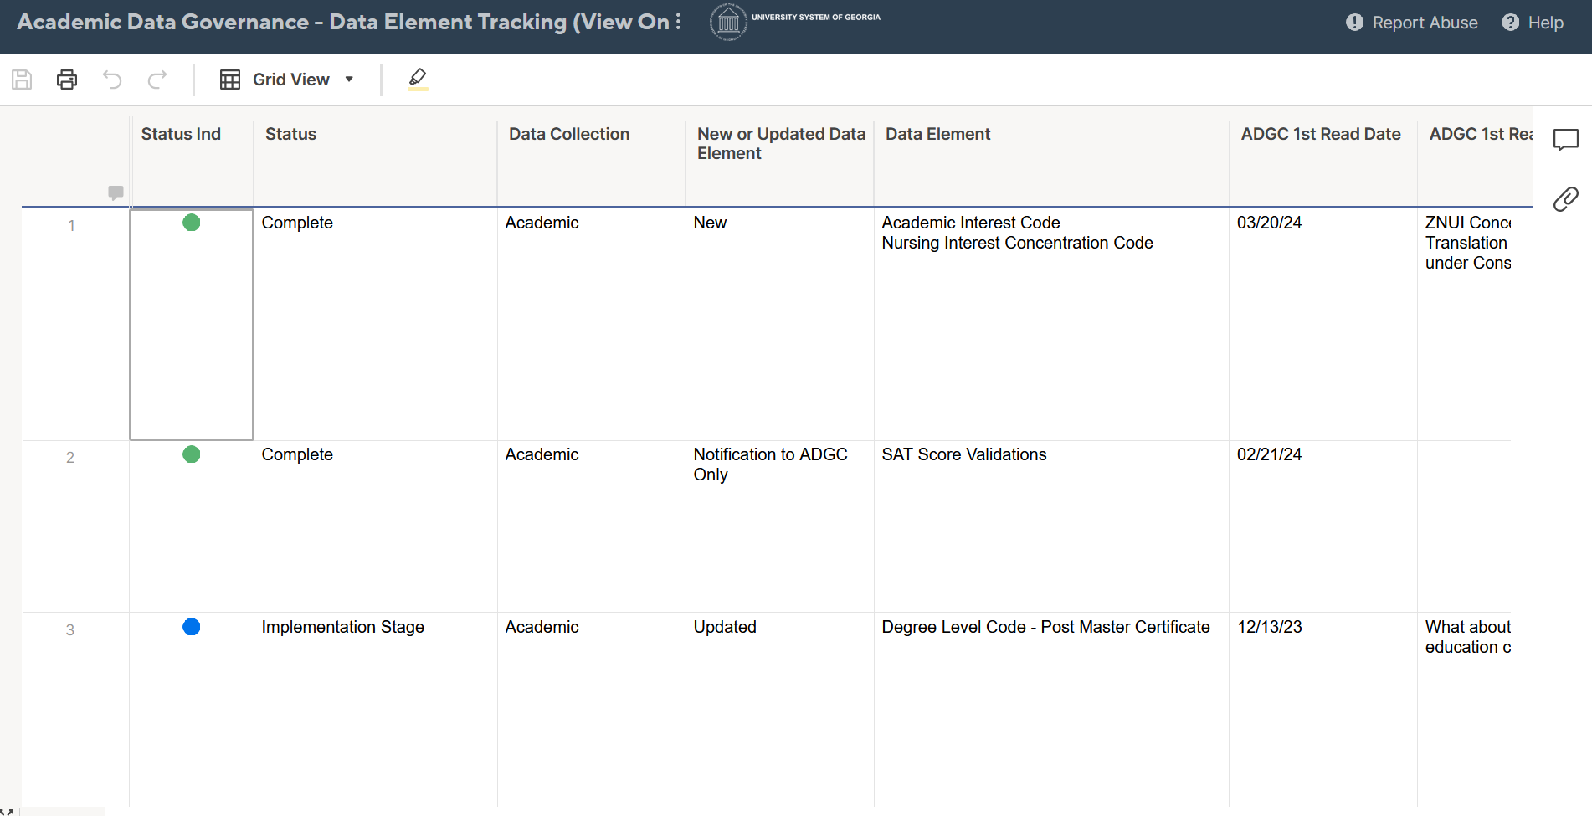
Academic Data Governance Website
Meeting documents, recent requests, tracker, communications, etc.

Slide 10
Enterprise Data Management and Analytics Update

Slide 11
EDMA Update
Dashboarding
  New GDP earnings views (earnings in bins, meeting thresholds, and by student groups)
  Migrated Qlik apps to Power BI dashboards, and integrated these dashboards into USG Power Service
    CCG dashboards
    Fall Enrollment by Academic Program (407a) - public & internal
    Degrees Conferred by Academic Program (407b) – public & internal
    Program Enrollment by Student Level – public & internal
    Graduate Student Flow - internal
    First Time Freshman – public
    Graduate Outcomes – internal
    Student Pathways – internal

Slide 12
EDMA Update
Dashboarding
  METRICS dashboard (internal)
    Transitioning in progress
    Focusing on data refresh, security management, ETL
  USG articulation agreement search tool dashboards will be posted at a different USG website
  Student disability survey dashboard (internal)

Slide 13
EDMA Current and Upcoming Work
Enrollment Monitoring Reporting – 2025 completed
External Site Application
  Added Site Street Address and Site ZIP code
  Removed EXT_SITE_CERTIFICATION
  Removed duplicates, and verified county codes
  Added a validation table in admin pages for Site Type Descriptions
  Further data cleaning in progress
  Report and dashboard in planning
Migrate Cognos to Power BI – in planning
Transfer Course Data Collection

Slide 14
RPA Projects

Slide 15
FVT/GE
Thank you!
2025 Cycle Completer List available once federal government reopens
Federal and NSC interface open until then
Feds will be fleshing out One Big Beautiful Bill earnings premium in negotiated rulemaking
Trump admin defended and won court case
NSC will be improving their interface
Will have USG debriefing to figure out what we could do better, our strategy for 2026, etc.
Notes:
Negot rulemaking Dec and Jan

Slide 16
RPA Website and Reports
Semester Enrollment Reports for Spring and Summer revised with old FTE (Chancellor’s Cup still new one emphasizing 15 hours as full time and using all hours)
Added Performance Funding Metrics
  Most metrics from strategic plan
Time to Degree (T2D) reports for all students are there to compare to Dual Enrollment T2D

Slide 17
Other RPA Work
BOR presentation on Preliminary Fall 2025 enrollment and degrees conferred
Post-Tenure Review reporting
  Presentation at November BOR meeting
Senate Higher Education Affordability Committee
Classical Learning Test analysis (upcoming)
Notes:
Basic Needs schools: Georgia State, Albany, Dalton and Georgia Southern this time next year

Slide 18
Other RPA Work
SR237 Georgia's Educator Recruitment and Retention Pipeline Plan tech/data team
SHEEO Basic Needs Data Academy
SHEEO Data Literacy Community of Practice
Notes:
Basic Needs schools: Georgia State, Albany, Dalton and Georgia Southern this time next year

Slide 19
IPEDS Reminder
Review your data
Instances recently of business rules developed previously not reflecting current state
Examples, how degrees are classified
Notes:
Basic Needs schools: Georgia State, Albany, Dalton and Georgia Southern this time next year

Slide 20
CVIOG Products
Working student full analysis
ROI pilot
New Power BI tools on Graduate Student Pipeline and Enrollment by Program and Student Level, enhanced Adult Learners, updated Market Share
Notes:
Basic Needs schools: Georgia State, Albany, Dalton and Georgia Southern this time next year

Slide 21
USG Update

Slide 22
Comparator Peer Selection
Joint effort of RPA and Academic Affairs in partnership with National Center for Higher Education Management Systems
Campuses given list of potential peers, recommended institutions and associated data in late August
Initial institution selections due Nov. 19th, meetings will campuses in early December
Final selections due January 16th.

Slide 23
Advisory Committee Changes
All Chief Academic Officer Advisory entities rather than “Regents”
Subject areas Advisory Groups in 5 tracks
IRP is a CAO Advisory Team (yes, CAT) like most administrative areas
CAO Advisory Leaders are the big ones like Academic Affairs

Slide 24
Other Academic Affairs
Core IMPACTS-catalog of courses updated, surveying students on skill acquisition
Microcredentials guidance
  Certificates will have to be standalone
  Badges, less than 9 hours, for credit or prof. ed.
  Working on data collection methods
Commission for Public Higher Education new accreditor-working steps for federal approval
BOR requirement to post syllabi by registration
Transfer enhancement: gateway, increased TCSG automatic transfer courses, course data collection, sharing student success data with TCSG

Slide 25
Governor’s Education Workforce Strategy Team
Georgia Match letters about to go out, data on pipeline will be presented at Workforce Summit
Top State for Talent legislation and website
Career Navigator
  Central resource for all Georgians to get career and postsecondary training information and guidance
  Collaboration among relevant state agencies
  Request for Information out for vendor to provide the technology infrastructure
  Credential Engine project is related

Slide 26
Institutional Consolidation
Georgia Southern University and East Georgia State College
SACS-COC approval expected December with BOR approval to follow soon thereafter
First term of students enrolling in one institution is Fall 2026.

Slide 27
Other…
System-wide Classification and Compensation project
DREAMS Scholarship-last dollar need-based awards up to $3000 per year
  Philanthropy supported but aspiring for state support

Slide 28
RPA Research and In-Depth Analyses

Slide 29
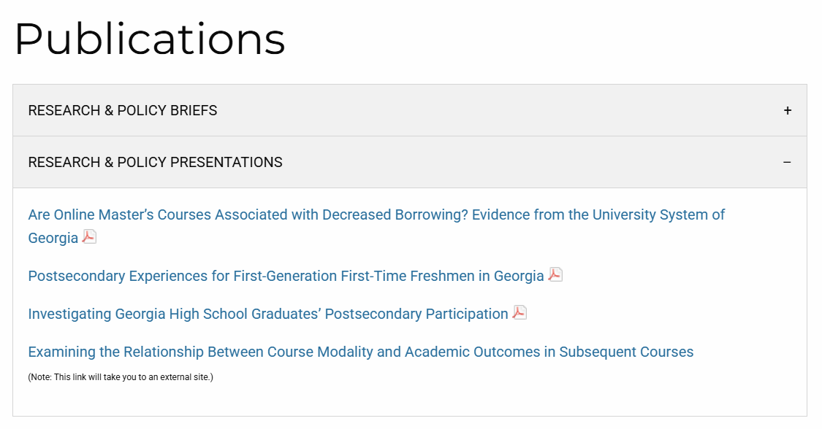
Update on Previously Presented Items
https://www.usg.edu/research/publications

Slide 30
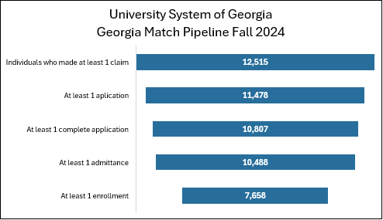
GEORGIA MATCH
Lori Prince Hagood, Kevin Lusk, Leslie Hodges, Jaden Mikoulinskii
Purpose
This work is an examination of the application to enrollment pipeline among GEORGIA MATCH participants from claiming a spot to applying to enrolling. We also investigate the overlap in engagement across USG institutions.
Type of Analysis
Descriptive. We matched student-level records across three data sources: ADC, applicant data ad hoc collection, and GEORGIA MATCH data from GSFC (students who claimed a spot, where and when). We produced system-level tables and charts that show the full pipeline from claiming a spot to enrolling. And we produced this information for each institution.
We will be presenting on this in detail at an upcoming webinar on October 15.

Slide 31
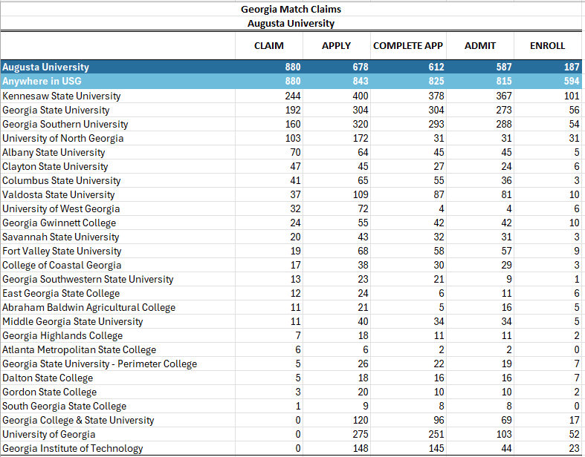
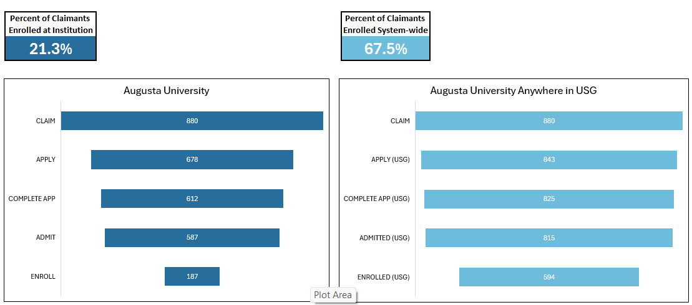
GEORGIA MATCH
Lori Prince Hagood, Kevin Lusk, Leslie Hodges, Jaden Mikoulinskii

Slide 32
College Affordability Data for Senate Subcommittee
RPA & EDMA
Purpose
  There was a Senate Subcommittee hearing on college affordability on September 18. We prepared a number of materials to answer the committee’s questions on the cost of higher education.
Overview of what was provided
  Total student loan debt
  Trends in cost of attendance
  Students who lose the HOPE scholarship and subsequent borrowing
  Borrowing peer comparison
  Unmet need for HOPE recipients and non-recipients and Pell recipients and non-recipients
  Total cost of degree completion

Slide 33
Working Students
Patrick Harris & CVIOG
Purpose
  The study aims to better understand the relationship between work, cost of attendance, and student course loads.
Type of Analysis
  Descriptive Analysis: Trend analysis by sex, race/ethnicity, and institution sector
  Predictive Modeling: Double machine learning models are in development to explore causal inference between work intensity and academic outcomes.
Overview of Findings
  Students who worked full-time or more tended to be older, female, Black, or Hispanic as compared to students who did not work or worked 20 or fewer hours per week.
  Full-time working students were 10.9% more likely to enroll part-time.
  USG undergraduates tend to increase their weekly hours worked as net cost increases; students at state colleges had the highest sensitivity to changes in cost as it relates to hours worked.
  Students working moderate hours (up to 20 hours per week) earned credits similar to non-working students, students working 21-39 hour each week earned marginally fewer credits, and those working full-time earned the fewest credits.

Slide 34
Fort Valley State Dropout Prediction
Patrick Harris & Pardha Annapareddy
Purpose
  The study examines mid-progress attrition (30–95 credit hours) at Fort Valley State University, with the goal of identifying risk factors and informing interventions to improve retention and graduation rates.
Type of Analysis
  Contextual Trends: Enrollment patterns, GPA/credit accumulation, financial aid status, and demographics.
  Predictive Modeling: Machine learning (Logistic Regression, Random Forest, XGBoost, LightGBM, CatBoost) with SHAP interpretability to identify drivers of dropout risk.
Overview of Findings
  Students with high credit hours but a stalled GPA show elevated dropout risk.
  Loan burden predicts attrition more strongly than Pell eligibility alone.
  Online, older, and financially independent students face a higher dropout likelihood.
  CatBoost achieved a recall above 90%, while LightGBM provided balanced accuracy (~75%), supporting use for early-warning interventions.

Slide 35
Return on Investment for Bachelor’s Degrees
RPA & CVIOG
Purpose
  Determine the return on investment for earning a bachelor’s degree at USG institutions and the earnings premium for UGS bachelor’s graduates compared to high school graduates.
Analytic Approach
  Calculate ROI for USG bachelor’s graduates using cost of attendance and forgone earnings and ten years of wages post-graduation.
  Determine whether and when post-graduation earnings exceeds the higher education investment (cost of attendance, forgone earnings)
  Compare cumulative wages (including the initial investment) for bachelor’s graduates to high school graduates (from US Census).
Overview of Findings
  On average, USG graduates with 10 years of annual work history post graduation and whose highest degree attained is a bachelor’s degree, reach a positive ROI within five years of graduation, some much sooner, and gain an earnings premium within 8 years of graduation.

Slide 36
GA High School Graduate Postsecondary Participation
Yanling Ma & Leslie Hodges
Purpose
  This study is a continuation of our initial descriptive exploration of postsecondary enrollment trends among Georgia public high school graduates. In this iteration, we focus on predicting the likelihood of college enrollment among Georgia public high school graduates based on student characteristics, academic preparation, and HOPE-eligibility.
Type of Analysis: Logistic regression
Overview of Preliminary Findings
  Likelihood of enrolling in college is impacted by student characteristics like race and gender
    Women are more likely to enroll compared to men
    Asian students had the greatest likelihood of enrollment; Hispanic students had the lowest compared to white students
  Likelihood of enrolling is impacted by HOPE-eligibility
    HOPE-eligible students were more likely to enroll compared to ineligible students; likelihood varies notably by race
  Likelihood of enrolling is impacted by dual enrollment and AP participation
    Students with dual enrollment or AP experience had a higher likelihood of enrolling compared to their peers who did not participate in dual enrollment or AP

Slide 37
State College Data Analytics Update

Slide 38
State College Data Analytics Update
Provide data analytics and research services to support the teaching and student success missions of colleges. Create tools and products which offer actionable insight to address business needs, challenges, and identify opportunities.
In the last six months we:
  Identified first project: Series of Power BI dashboards showcasing comprehensive data on enrollment and outcomes for Dual Enrollment students across public/private high schools and colleges (USG, TCSG, GICA, GMC).
  Engaged in requirements gathering, analyzed data sources and quality, defined and refined metrics, and finalized project plan for phase 1 of work.
  Developed project workflow, internal processes for data management and modeling, and lots of documentation.

Slide 39
April
May
June
July
August
September
October
Brainstorm & Requirements Gathering
Presidents
System Office
Campus Teams
Feedback & Questions
RAC IRP
Campus Points of Contact
Communication & External Documentation
Propose DE Project
Intake Form & Question Prompts
DE Data Tool Project Overview
(Phase 1, 2, 3)
Phase 1 Project Plan
Incorporate Feedback & Finalize
P1 PP
Data & Project Model
Identify Data Sources (GA*AWARDS + USG ADC)
Analyze Data Quality, Availability, & Limitations
Develop Phase 1
Database Objects
(EDMA)
Collaborate with Data Stewards
Process Development & Internal Documentation
Establish Project Workflow
Document data sources, standards, and definitions.
Document steps for cleaning, formatting, and linking data.

Slide 40
DE Data Tool
Phase 1
  High School Partnerships & Market Share (flows of DE students between high schools and colleges)
  Participation Intensity (retention, credit hours)
  Special Populations (enroll at multiple colleges, stop out)
Phase 2: Course Enrollments, Grades, & Schedules
Phase 3: Conversion to First Time Freshman

Slide 41
Questions and Contact
  Angela Bell
  Angela.Bell@usg.edu
  Work phone: 404-962-3069

Slide 42
Questions and Contact
  Angela Bell, Angela.Bell@usg.edu
  Phone: 404-962-3069
  Lori Hagood, Lori.Hagood@usg.edu
  Phone: 404-962-3089
  Cherry Zhang, Cherry.Zhang@usg.edu
  Phone: 706-583-2037
  Rachana Bhatt: Rachana.Bhatt@usg.edu
  Phone: 404-962-3078

