Slide 1
Unified ERP Program Update
Institutional Research & Planning
October 7, 2025

Slide 2
Agenda
Program Updates
How this affects Institutional Research
Consolidated Reports
Visualizing the Data: Workday Dashboards
Expectations as Program Progresses
Q&A

Slide 3
Unified ERP Vision
Aligns with USG Strategic Plan
Replaces legacy systems with SaaS ERP: Workday
Standardizes and streamlines processes
Improves operational efficiency
Enables data-driven decisions
Enhances student outcomes
Supports long-term excellence in higher education
This transformation will drive consistency, agility, and innovation across all USG institutions – empowering better service delivery and positioning USG as a model for modern higher education systems.

Slide 4
Unified ERP Guiding Principles
Single | Standard
We are moving toward a unified system that eliminates duplication and fragmentation. Every decision should reinforce the goal of having a single, authoritative source for data and processes. | Standardization enables efficiency, scalability, and shared best practices. While local needs matter, the default should be to adopt common processes and configurations.
Simple | Success
Complexity creates risk and confusion. Our goal is to design processes and solutions that are easy to understand, use, and maintain. | Every decision should move us closer to a successful implementation and long-term sustainability. Success is measured by adoption, usability, and value delivered – not just by going live.

Slide 5

Program Scope
Workday HCM
Workday Finance
Core HCM, Onboarding, & Academics
Grants Management
(Post-Award)
Absence Management
Compensation
FDM
Procurement
Assets & Projects
Talent Performance & Learning
Core Finance & Payroll Accounting
Time & Absence
Recruiting
Banking and Settlement
Expenses
Inventory
Non-Sponsored Revenue
Supplier Accounts and Contracts
Adaptive Planning
Payroll
Benefits
Budgets
KEY
To be determined
Notes:
Program Management
Functional Setup of HCM / FIN Modules (include the list)
Technical setup of integrations, reports, security, WD Extend
Service Delivery & Operations (Tech 2
Data Management

Slide 6
Program Scope
TECHNICAL ENABLEMENT & INFRASTRUCTURE
ORGANIZATIONAL CHANGE MANAGEMENT
SERVICE DELIVERY
Comms and Marketing
Change Preparation
Service Catalog & Knowledge Management
Service Platforms
Data Management & Reporting
Security & Access
Integrations
Training
Change Impact & Engagement
Service Center Design & User Experience
Support Model Optimization
Architecture
Data Conversion
Integrating Systems
Tenant Management
Extend & Automation
Notes:
Program Management
Functional Setup of HCM / FIN Modules (include the list)
Technical setup of integrations, reports, security, WD Extend
Service Delivery & Operations (Tech 2
Data Management

Slide 7
Program Overview: USG Collaboration
Request for Information (RFI)
Result: Workday
Request for Proposal (RFP)
Result: Deloitte
Business Suite and Workstream Leads
Requirements Gathering Workshops: Over 400 USG staff (all institutions/orgs)
Response Review: Over 100 USG staff (16 institutions/orgs)
Software Demonstrations: Over 390 USG staff (15 institutions/orgs)
16 individuals from 6 institutions and USO
43 institution and USO staff confirmed as Suite or Workstream leads (as of 10/1/25)
HCM/Payroll Business Suite
Financials Business Suite
Technical Enablement & Infrastructure Suite
Service Delivery & Operations Suite
Org Change Management Suite

Slide 8

Unified ERP Program Governance Structure
Executive Sponsor/ Sponsor Designee
Executive Sponsor Council
HR Steering Committee
CIO Advisory Committee
Program Steering Committee
CBO Advisory Committee
Org Change Mgmt Advisory Committee
Institutional PMO
Core Program Leadership Team
HCM – Payroll Business Suite
Financials Business Suite
Technical Enablement & Infrastructure Suite
Service Delivery & Operations Suite
Change Mgmt & Readiness Suite
Workstream Advisory Teams
1
Notes:
Business Suites have various workstreams with leads from USO, institutions, and Deloitte

Slide 9
Program Timeline
2025 |  |  |  | 2026 |  |  |  |  |  |  |  |  |  |  |  | 2027 |  |  |  |  |  |  |  |  |  |  |  | 2028 |  |  |  |  |  |  |  |  |  |  |  | 2029
S | O | N | D | J | F | M | A | M | J | J | A | S | O | N | D | J | F | M | A | M | J | J | A | S | O | N | D | J | F | M | A | M | J | J | A | S | O | N | D | J | F | M
Establish the foundation
Align leadership, build the team, and define the scope
Push it, break it, fix it
Validate processes, catch gaps, confirm everything works
Own it, improve it, sustain it
Support the system, drive adoption, and plan for what’s next
Program Start-up
Program Team Training
End to End Testing
Parallel Payroll Testing
Performance Testing
Production Support
New Release Management
New Projects
PLAN
ARCHITECT & CONFIGURE
TEST
DEPLOY
POST-
IMPLEMENTATION
07/03/28
Design it, build it, review it
Translate strategy into system design – iterate fast
Flip the Switch
Launch with confidence – stabilize quickly
Go-Live
Hybrid Agile Design and Configuration
Build & Test Integrations and Reporting
Transform, load, and validate data
End User Training
Gold/Pre-production Build
Go-Live

Slide 10
How does Workday affect IR?
Two of our program goals are
Real-time consistent data for decision making and
Enhanced analytics and reporting
Program intention of improving data analysis and reporting across the system
External compliance & data submissions
Trusted, centralized data
Powerful reporting & analytics
System-wide benchmarking & insights
Forecasting and strategic planning
Notes:
Two of our program goals are:
Real-time consistent data for decision making and
Enhanced analytics and reporting,
With a program intention of improving data analysis and reporting across the system

Slide 11
Creating Consolidated Reports
Composite reports
Financial Management for consolidation
Single source of truth
Multidimensional reporting
Automated consolidation tasks
Notes:
Creating Consolidated Reports for a single tenant with multiple companies
Multiple companies (institutions) can be configured within the same Workday tenant, and consolidated reporting is a standard feature built into the platform.
Key Workday features to achieve consolidated reporting:
Composite reports: This advanced report type can combine data from multiple data sources, including existing matrix reports, into a single, comprehensive view. This is useful for combining data from different time periods or different business objects across your various companies.
Financial Management for consolidation: Workday's Financial Management system includes built-in functionality to handle the financial close and consolidation process. This allows you to combine financial data from all your entities, such as subsidiaries and business units, into a unified, enterprise-wide financial view.
Automated consolidation tasks: The platform automates many of the complex tasks involved in consolidation, such as currency translation, intercompany eliminations, and non-controlling interest calculations. This streamlines the process and ensures accuracy across all companies in the tenant.
Multidimensional reporting: Workday's reporting is multidimensional, allowing you to easily drill down into consolidated data to view the underlying details for individual companies. This gives you deep insight and analysis from both a high-level and granular perspective.
Single source of truth: Having all your data within a single tenant provides a unified source for reporting and analysis. This removes the risk of data silos that can occur when moving information between different systems, which ensures accuracy and consistency for all consolidated reports.

Slide 12
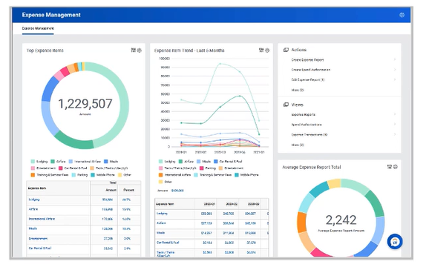
Workday Dashboards
Monitor & drive business performance
Visualize data through charts and numbers side by side
Collaborate by adding notes and sharing insights with team members
Enter data directly on dashboards and see real-time updates
Analyze historical data to improve future planning
Notes:
Dashboards are self-service, interactive visualizations of data that provide insights into business performance. They enable organizations to:
Monitor and drive business performance
Visualize data through charts and numbers side by side
Enter data directly on dashboards and see real-time updates
Analyze historical data to improve future planning
Collaborate by adding notes and sharing insights with team members

Slide 13
Driving Value
Informed Decision-Making
Portal into Workday
Greater visibility & insight
Elevate data using graphics and visualizations
Drill to details to see underlying data
Take direct action based on results
Simplified user experience based on common viewpoint
Build proficiency
Easily find available reports and tasks
Shareable and flexible
Honor user security
Notes:
Dashboards drive value by utilizing Workday’s power reporting tools

Slide 14
Types and Features of Dashboards
Shared Dashboards
Created by administrators and accessible to users at various levels. These dashboards display critical information relevant to specific roles.
Personal Dashboards
Created by individual users with report access permissions, allowing customization to display metrics important to them.
Perspectives
Can group dashboards by themes or subjects, such as business units or tasks, with filters for contextual views..
Chart Types
Various visualization options are available, each with different settings and capabilities.
Modes
Users can view dashboards in grid or presentation mode for better clarity.
Notes:
Types: Shared & Personal
Features: Perspectives, Chart Types, and Modes

Slide 15
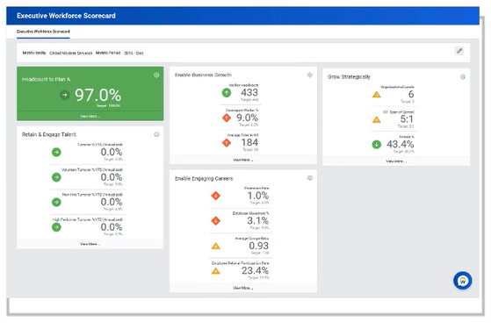
Dashboard Categories
Strategic
Audience: Executives
  Gain insights to ensure health of financials and workforce
  Holistic picture with the ability to drill into the data from a variety of dimensions

Slide 16
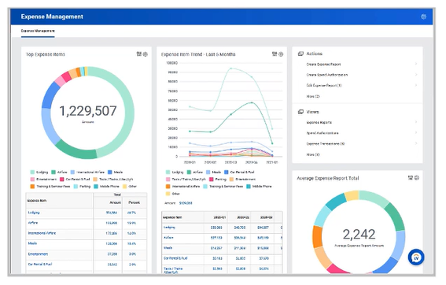
Dashboard Categories
Operational
Audience: Managers, Business Users, Compliance
  Quick insights into trends and counts
  Promote and encourage taking specific action

Slide 17
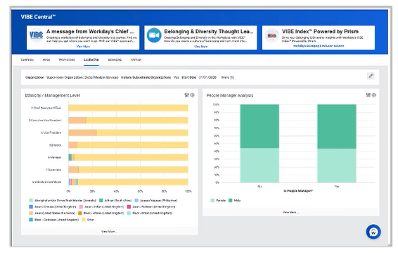
Dashboard Categories
Analytic
Audience: Analysts, Executives
  Discover trends, patterns, predict and build models to gather meaningful answers
  Drill into specific content to support deeper data analytics

Slide 18
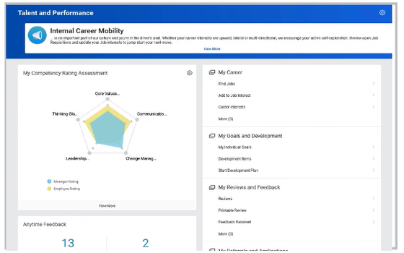
Dashboard Categories
Tactical
Audience: Individual User
  Drive user experience
  Offer quick insight

Slide 19
Standard vs. Custom Dashboards
Standard Workday-Delivered
Custom Tenanted
Developed alongside certain Workday features (over 120 dashboards)
May contain worklets only available on these delivered dashboards
Mainly shells and will require setup
Examples:
  My Team Management
  My Invoices and Payments
  Compensation and Benefits
  Procurement
  Report Administrator
  Executive Scorecard
Tenanted dashboards developed by USG or our System Implementer (SI)
Worklets can only contain reports developed in the Workday Report Writer Tool
Examples:
  Absence Administrator
  Accounts Receivable Action Items
  Finance Executive (Controller)
  Benefits Administrator
  Business Process Administrator
Notes:
Worklet = An icon or tile that provides quick access to frequently used tasks, reports, and information, acting as a customizable shortcut for specific business processes
Tenant = A dedicated instance of the Workday application for a single organization, acting as its unique secure environment for managing its own data and configurations.
Workday Company = specific type of Workday organization, typically representing a legal entity within the larger organization and serving as a primary unit for financial transactions and reporting

Slide 20
Illustrations of Workday Dashboards and Reports
Notes:
Note: Illustrative screenshots included in this file do not represent USG’s Workday configuration or design. These screenshots are simply for use in giving a glimpse into the look and feel of Workday dashboards and reports. Understanding of Workday dashboards and reporting capabilities will grow over time with the core Unified ERP project team, and down the road with Institution Change Management Leads, advisory groups and subject matter experts as the software is designed and configured, and with testers supporting the User Experience Review phase of testing. Detailed training on Workday dashboards and reports for the broader USG community is targeted to be provided aligned with the project’s “just-in-time” user training philosophy before go-live.
This series of slides show you how you can drill down into the data from the dashboard.

Slide 21
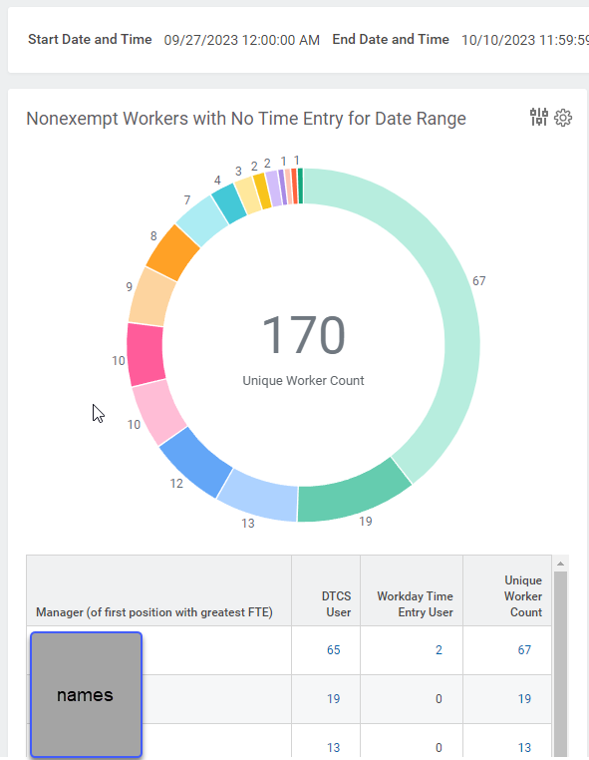
Examples of Workday Dashboards and Reports
Notes:
Click in graph to pull up underlying data (names have been scrubbed)

Slide 22
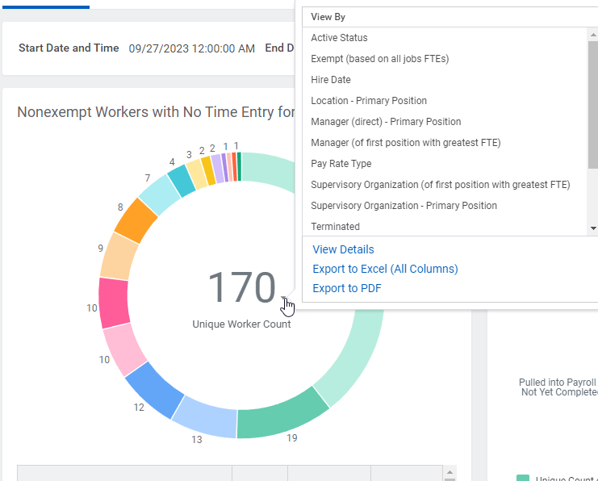
Examples of Workday Dashboards and Reports
Notes:
View information by different filters, conditions, etc.

Slide 23
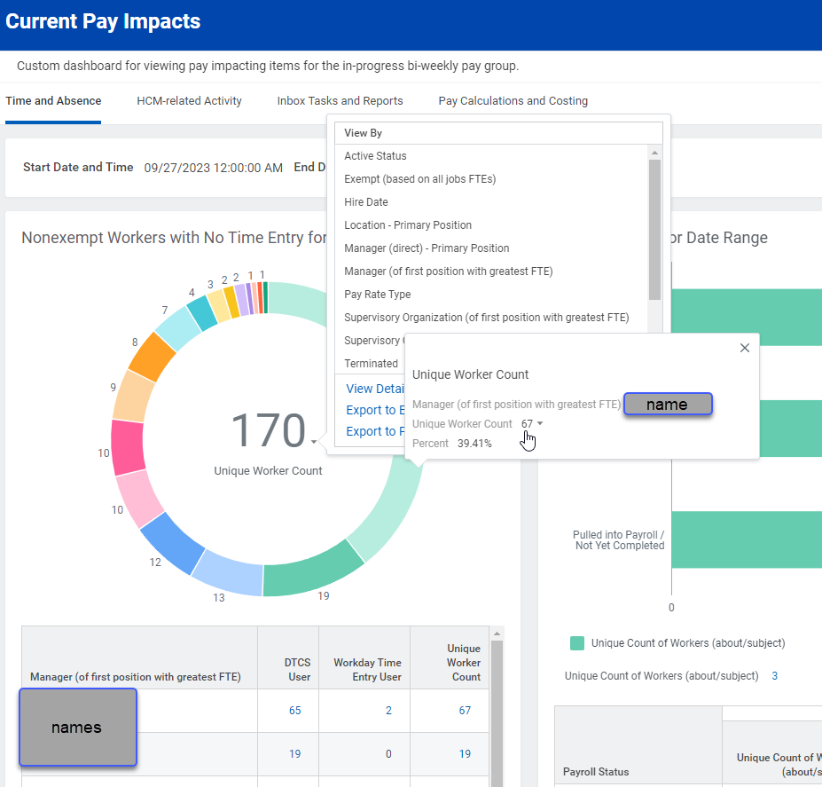
Examples of Workday Dashboards and Reports
Notes:
Example shows viewing by manager (of first position with greatest FTE), allowing viewers to drill down deep into the data

Slide 24
What to Expect as Program Progresses
Training
Training to build internal capacity for self-service analytics (early 2028)
Engagement in Design Sessions
Focus Groups
What are the key metrics for dashboards and cross-institutional comparisons?
Consider Current Dashboards
Consider how current dashboards might be affected
Notes:
As a unique stakeholder group, you may be engaged during design sessions and focus groups to gather insights.

Slide 25
Additional Information
Unified ERP Program Website
www.usg.edu/unified-erp
w

Slide 26

Questions?

Slide 27
Thank You!!

