Slide 1

Unified ERP Program
Spring 2026 CAT IRP Meeting
Rich Loftus Vice Chancellor
Strategic Implementation

Slide 2



Unified ERP – Program Overview
Where We Are (Current State) | Where We’re Going (Vision)
Legacy, disconnected systems create inefficiency, silos, and barriers to collaboration, limiting our ability to support students and adapt for the future. | A unified, modern ERP platform will seamlessly connect all institutions, streamline operations, and empower USG to drive excellence, innovation, and student success together.
Real-time data driving insights
Fragmented User Experience
Unified ERP Program
Unified, Standardized System
START
Barriers to adapt and collaborate
Seamless user experience
Outdated, disconnected systems
no single source of truth
Collaborative Continuous Improvement

Slide 3

What Changes with Workday?
Continuous improvement
Processes adapt to the system
Configuration, not customization
Standardization across institutions
Business-led ownership
Early and ongoing change management

Slide 4
Guiding Principles --“The How”
Build Together
Align cross-functionally to maximize efficiency
Single
Be Bold, Innovative, and Purposeful
Drive progress through innovation, consistency, and continuous improvement
Standard
Simplify to Amplify
Focus on clarity and sustainability to strengthen adoption and long-term value.
Simple
People First, Always
Shape every decision around user needs, adoption, and real value
Success

Slide 5
Guiding Principles As Our Compass
Guiding Principles Guide Us:
In every decision
When tradeoffs arise
When collaborating across institutions
When planning for long-term sustainability
Single
  Does this decision help unify processes and data?
Standard
  Is this solution aligned with standard Workday capabilities and shared best practices?
Simple
  Is this approach clear and user friendly?
Success
  Does this decision help our system and people succeed?

Slide 6
Program Structure Overview
Executive Sponsor/ Sponsor Designee
Executive Sponsor Council
HR Steering Committee
CIO Advisory Committee
Program Steering Committee
CBO Advisory Committee
Org Change Mgmt Advisory Committee
Institutional Leads
Core Program Leadership Team
HCM – Payroll Business Suite
Financials Business Suite
Technical Enablement & Infrastructure Suite
Service Delivery & Operations Suite
Change Mgmt & Readiness Suite

Slide 7
Workstream Structure
Business Suite Lead
Advisory Committees
Engaged for institutional awareness and feedback
Workstream Lead
Advisor
Provide insight & institutional perspective or expertise
Collaborate with Workstream Lead
Analyst
Supports/Assists the Workstream Lead
Coordinates with Institutional Leads
Specialist
Participate in Discovery and Design activities
*Plan Stage Strategists are Analysts, Advisors, and Specialists engaged to shape and develop key strategies and deliverables for the Plan Phase.

Slide 8
Program Timeline
2025 |  |  |  | 2026 |  |  |  |  |  |  |  |  |  |  |  | 2027 |  |  |  |  |  |  |  |  |  |  |  | 2028 |  |  |  |  |  |  |  |  |  |  |  | 2029
S | O | N | D | J | F | M | A | M | J | J | A | S | O | N | D | J | F | M | A | M | J | J | A | S | O | N | D | J | F | M | A | M | J | J | A | S | O | N | D | J | F | M
HR/Payroll & Finance Go Live
Jul 2028
Establish the foundation
Align leadership, build the team, and define the scope
Push it, break it, fix it
Validate processes, catch gaps, confirm everything works
Own it, improve it
Support the system & drive adoption
Plan
Architect & Configure
Test
Deploy
Post Implementation Support
Design it, build it, review it
Translate strategy into system design – iterate fast
Flip the Switch
Launch with confidence – stabilize quickly
We are Here

Slide 9
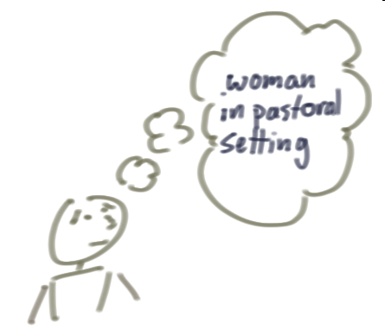
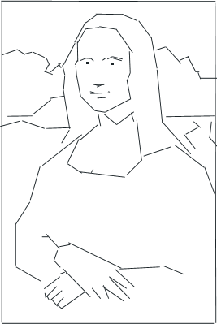
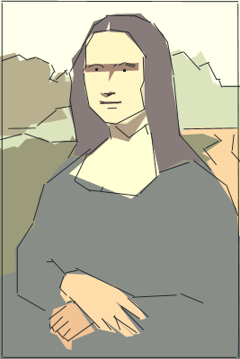

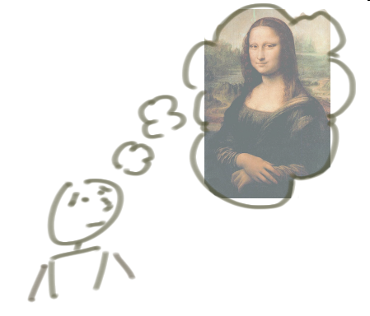



Design: Iterative Approach
An iterative approach builds incrementally as we refine the product; this means we will have a rough draft to start with and refine further with an increase in details.
A waterfall approach requires the solution to be built one piece at a time; building incrementally also calls for the need to have the full idea formulated at the very beginning.
25

Slide 10
Design Sessions Update
Unified ERP Design Sessions
291 unique USG invitees across 15 institutions
52.4% of Design Sessions Completed
Early Themes Emerging:
Shared Services Connection: Process design in WD highly interdependent on future state Shared Services approach – drawing attention from participants and program team.
Standardization of Master Data: Single unified solution means shared master lists of suppliers, customers, etc across the whole system – this is a big change for many institutions.
Systems Thinking: In a single unified ERP, decisions in one area may affect another. Teams are getting the hang of evaluating their design and how it may impact all other upstream or downstream functions in Workday.

Slide 11
Governance & Decision-Making
Executive Council
5%
Significant resource, policy, timeline, or vendor issues
Program Steering Committee (PSC)
Program Management Office (PMO)
20%
Time / Budget Tradeoffs
Business Suite Leads
75%
Process, Workflow, Configuration
Program Workstreams

Slide 12
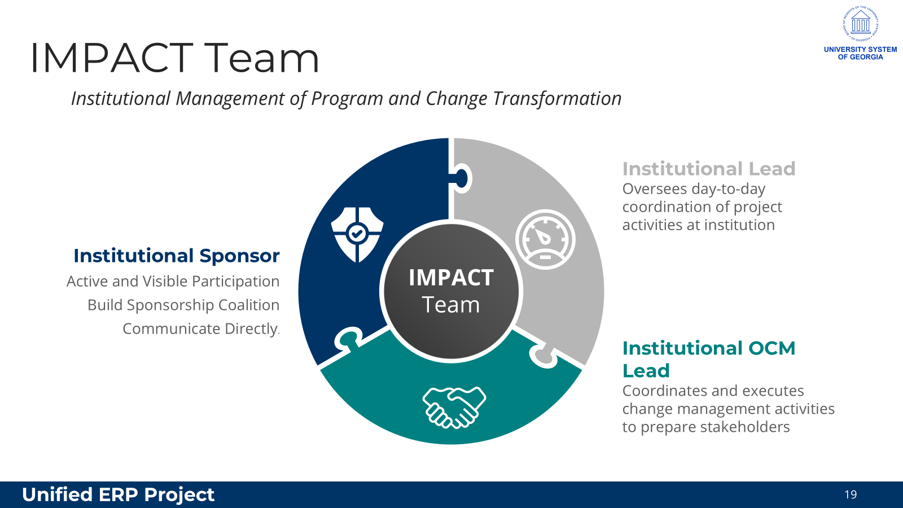
IMPACT Team – Here is what we have at the institutions

Slide 13
Program Staffing: Building Capacity Through Collaboration
Early Insight
Institutions gain early insight into the new system
Hands-on Training
Institutional staff receive hands-on training in modern ERP technology
Program Needs
Shared staffing model meets program needs and creates mutual value
Participant Growth
Participants grow as leaders and change agents for their campuses
Success
Depends on engaging resources across the USG
Ongoing Process
Staffing the program will be an ongoing and iterative process
Thank you for your continued collaboration, trust, and engagement as we work together to shape a strong, well-rounded staffing model that supports a successful and unified implementation.

Slide 14

Unified ERP: Public Program Launch
A one-hour Public Program Launch is scheduled for April 16th to engage end users across the system. All staff who work for a USG institution will be invited and watch parties will be encouraged. Invitations will be distributed the week of March 16th.
We request your support in championing this event, as it will serve as the formal introduction of the initiative to the broad end-user community.
Key Topics to be discussed:
Overview of the Unified ERP Program: What it is and why it matters?
Program Timeline and expected change impacts
Public engagement approach – how will users be informed and involved?

Slide 15
USG Future-State Data Architecture Overview
Workday as core system of record (HCM & Financials)
Enterprise Data Lake using Medallion Architecture
Standardized HR & Finance data pipeline feeding analytics

Slide 16
Architecture Diagram (Simplified)
Workday → Bronze (Raw Data)
Bronze → Silver (Cleansed & Modeled Data)
Silver → Gold (Analytics-Ready Data)
Gold → Dashboards (Power BI / Cognos)

Slide 17
Key Benefits
Single authoritative source for HR & Finance data
Cleaner, faster, more reliable reporting
Reusable curated datasets for analytics & data science
Improved data governance & consistency across institutions

Slide 18
Feedback | What Are You Hearing?
Questions?

Slide 19
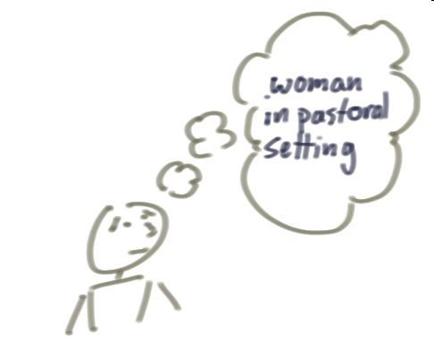
Iterative Approach to Workday
We’ll refine the design in iterations - campus feedback shapes the transformation.
Iteration means we refine the product based on feedback. Initial prototypes may be a rough draft to start with and refine further with an increase in details.
Requirements – Capture business requirements with User Stories and refine based on institution feedback.
Prototype & Design – Demonstrate configurations early to validate what works. Iterate to address gaps and confirm the standard approach.
Change Impacts – Clarify what’s changing as designs mature, then target communications, training, and readiness activities accordingly.
Iterative
3

