Slide 1

Lucy Harrison
Assistant Vice Chancellor for Academic Library Services, University System of Georgia
Executive Director of GALILEO
Lucy.Harrison@usg.edu
Judy Orton Grissett
Associate Professor of Psychology, CTL Director, and ALG Campus Champion, Georgia Southwestern State University
Judy.Grissett@gsw.edu

Slide 2
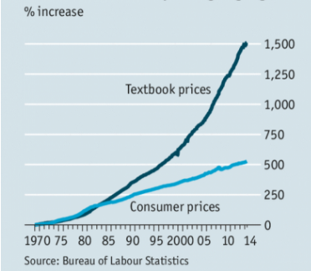
The Problem We're Addressing
In the United States:
Textbooks and course materials average $1,250 per student per year
This is a four-year cost of $5,000+
Source: The Economist, 8/16/2014
https://www.economist.com/news/united-states/21612200-its-economics-101-why-textbooks-cost-so-much
Source: The College Board:
https://trends.collegeboard.org/college-pricing/figures-tables/average-estimated-undergraduate-budgets-2017-18

Slide 3
Impact of High Textbook Costs
A survey of 22,000 students in 2016 showed:
66% had chosen not to purchase a required textbook
48% took fewer courses
26% dropped a course
Source: 2016 Student Textbook and Course Materials Survey, Florida Virtual Campus
https://florida.theorangegrove.org/og/file/3a65c507-2510-42d7-814c-ffdefd394b6c/1/2016%20Student%20Textbook%20Survey%20Draft%205.pdf

Slide 4
What are Open Educational Resources (OER)?
They’re free!
Electronic, but can be printed
Openly licensed (Creative Commons) or in the public domain
Open to Retain, Redistribute, Reuse, Revise, Remix
Anyone can use: USG, TCSG, K-12...

Slide 5
Core ALG Strategies
Redesign courses to use free and low-cost materials
Build an engaged community of educators
Partner with other leaders
Reduce the cost of textbooks to students

Slide 6
Results
To date, all ALG programs have saved students over $31 million on textbook costs
219,343 students have benefited
$19 million annual projected savings from current grants (as of April 2018)

Slide 7

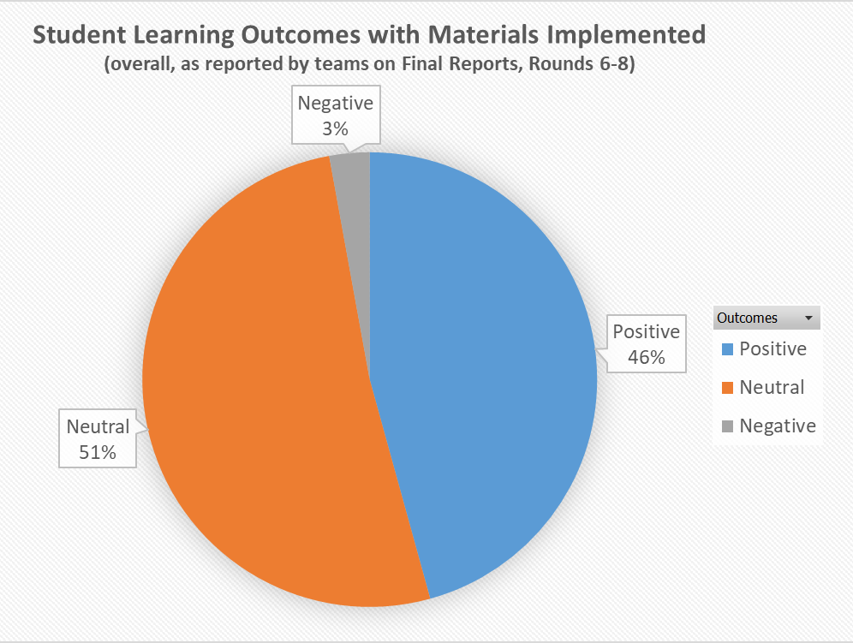
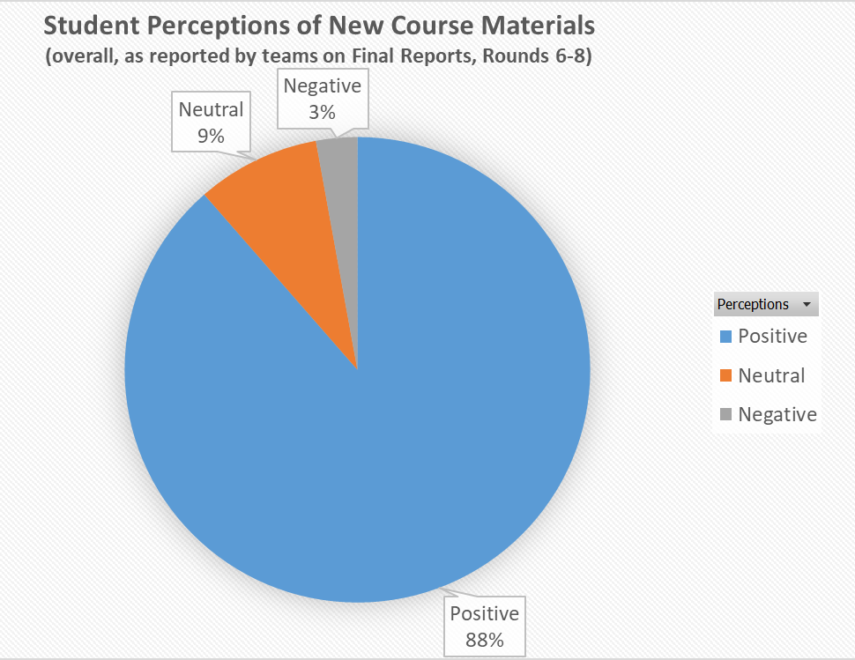
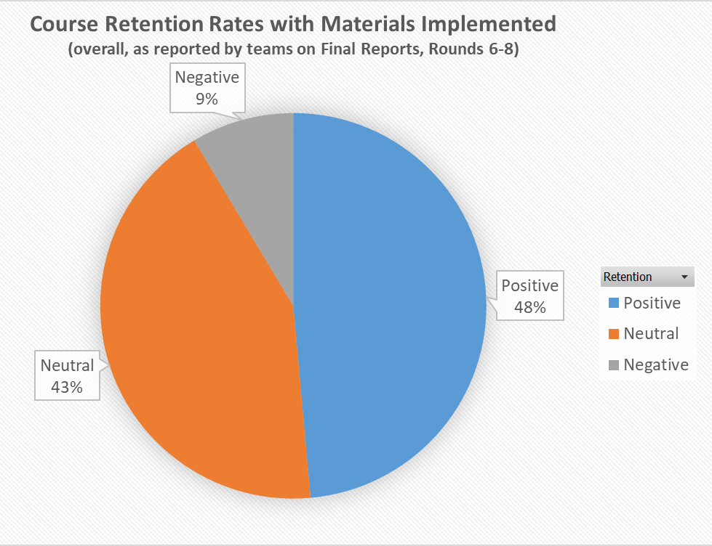
Summary Report of all Grant Projects from 2016-2017

Slide 8
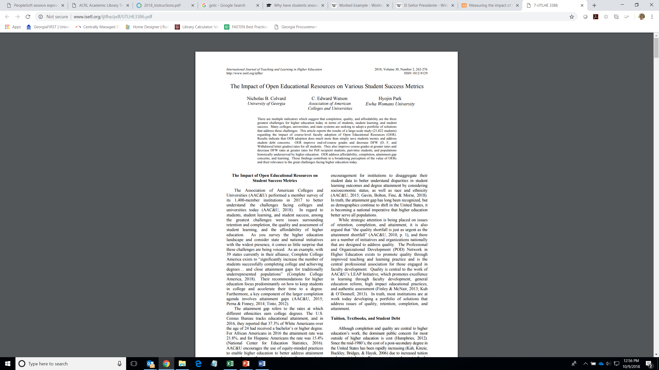
“Results indicate that OER adoption does much more than simply save students money and address student debt concerns. OER improve end-of-course grades and decrease DFW (D, F, and Withdrawal letter grades) rates for all students. They also improve course grades at greater rates and decrease DFW rates at greater rates for Pell recipient students, part-time students, and populations historically underserved by higher education.”

Slide 9
OER-Enabled Pedagogy
“The set of teaching and learning practices that are only possible or practical in the context of the 5R permissions that are characteristic of OER”
Retain the content (hard drive, bookshelf, etc.)
Redistribute the content (to students, friends, etc.)
Reuse the content (not a rental, no expiration)
Revise the content (for your course, for an update)
Remix the content (with other content)
http://www.irrodl.org/index.php/irrodl/article/view/3601/4724

Slide 10
OER-Enabled Pedagogy Rationale
Students learn by doing/making
Copyright prohibits broad categories of activity (e.g., making copies or creating derivative works) without permission from a rights holder
Therefore, copyright necessarily limits the ways in which students can learn
The 5R’s of OER lift these restrictions
Therefore, students are free to engage in a broader range of activities and, learn in a broader range of ways
http://www.irrodl.org/index.php/irrodl/article/view/3601/4724

Slide 11
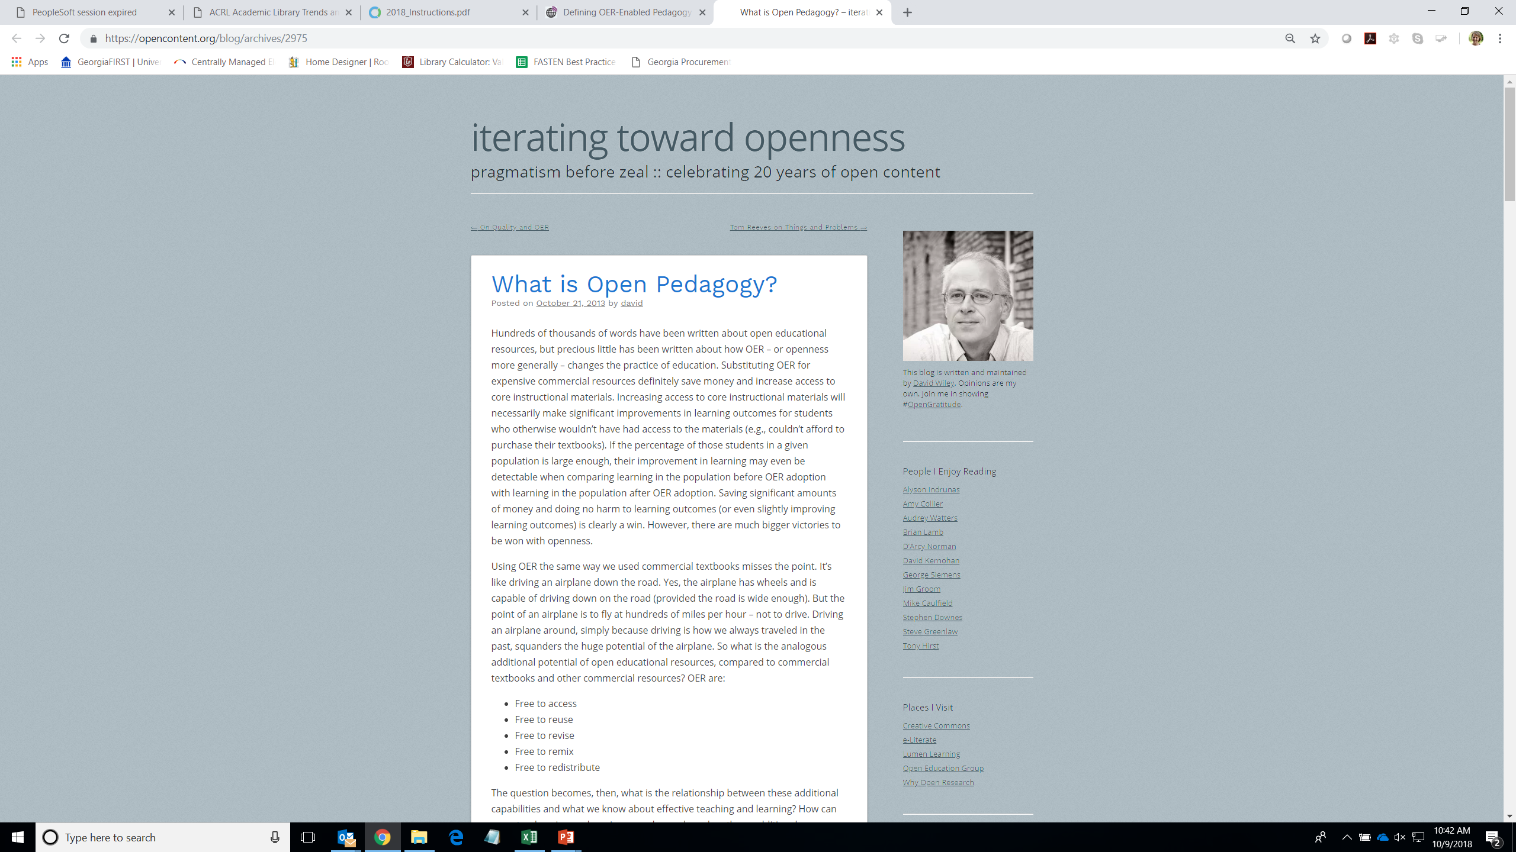

Slide 12
Disposable Assigments
“These are assignments that students complain about doing and faculty complain about grading. They’re assignments that add no value to the world – after a student spends three hours creating it, a teacher spends 30 minutes grading it, and then the student throws it away. Not only do these assignments add no value to the world, they actually suck value out of the world.”
- David Wiley
https://opencontent.org/blog/archives/2975

Slide 13
Renewable Assignments
Students create new artifacts (essays, poems, videos, songs, etc.) or revise/remix existing OER
The new artifact has value beyond supporting the learning of its author
Students are invited to publicly share their new artifacts or revised/remixed OER
Students are invited to openly license their new artifacts or revised/remixed OER

Slide 14
Examples
Open Textbooks

Slide 15
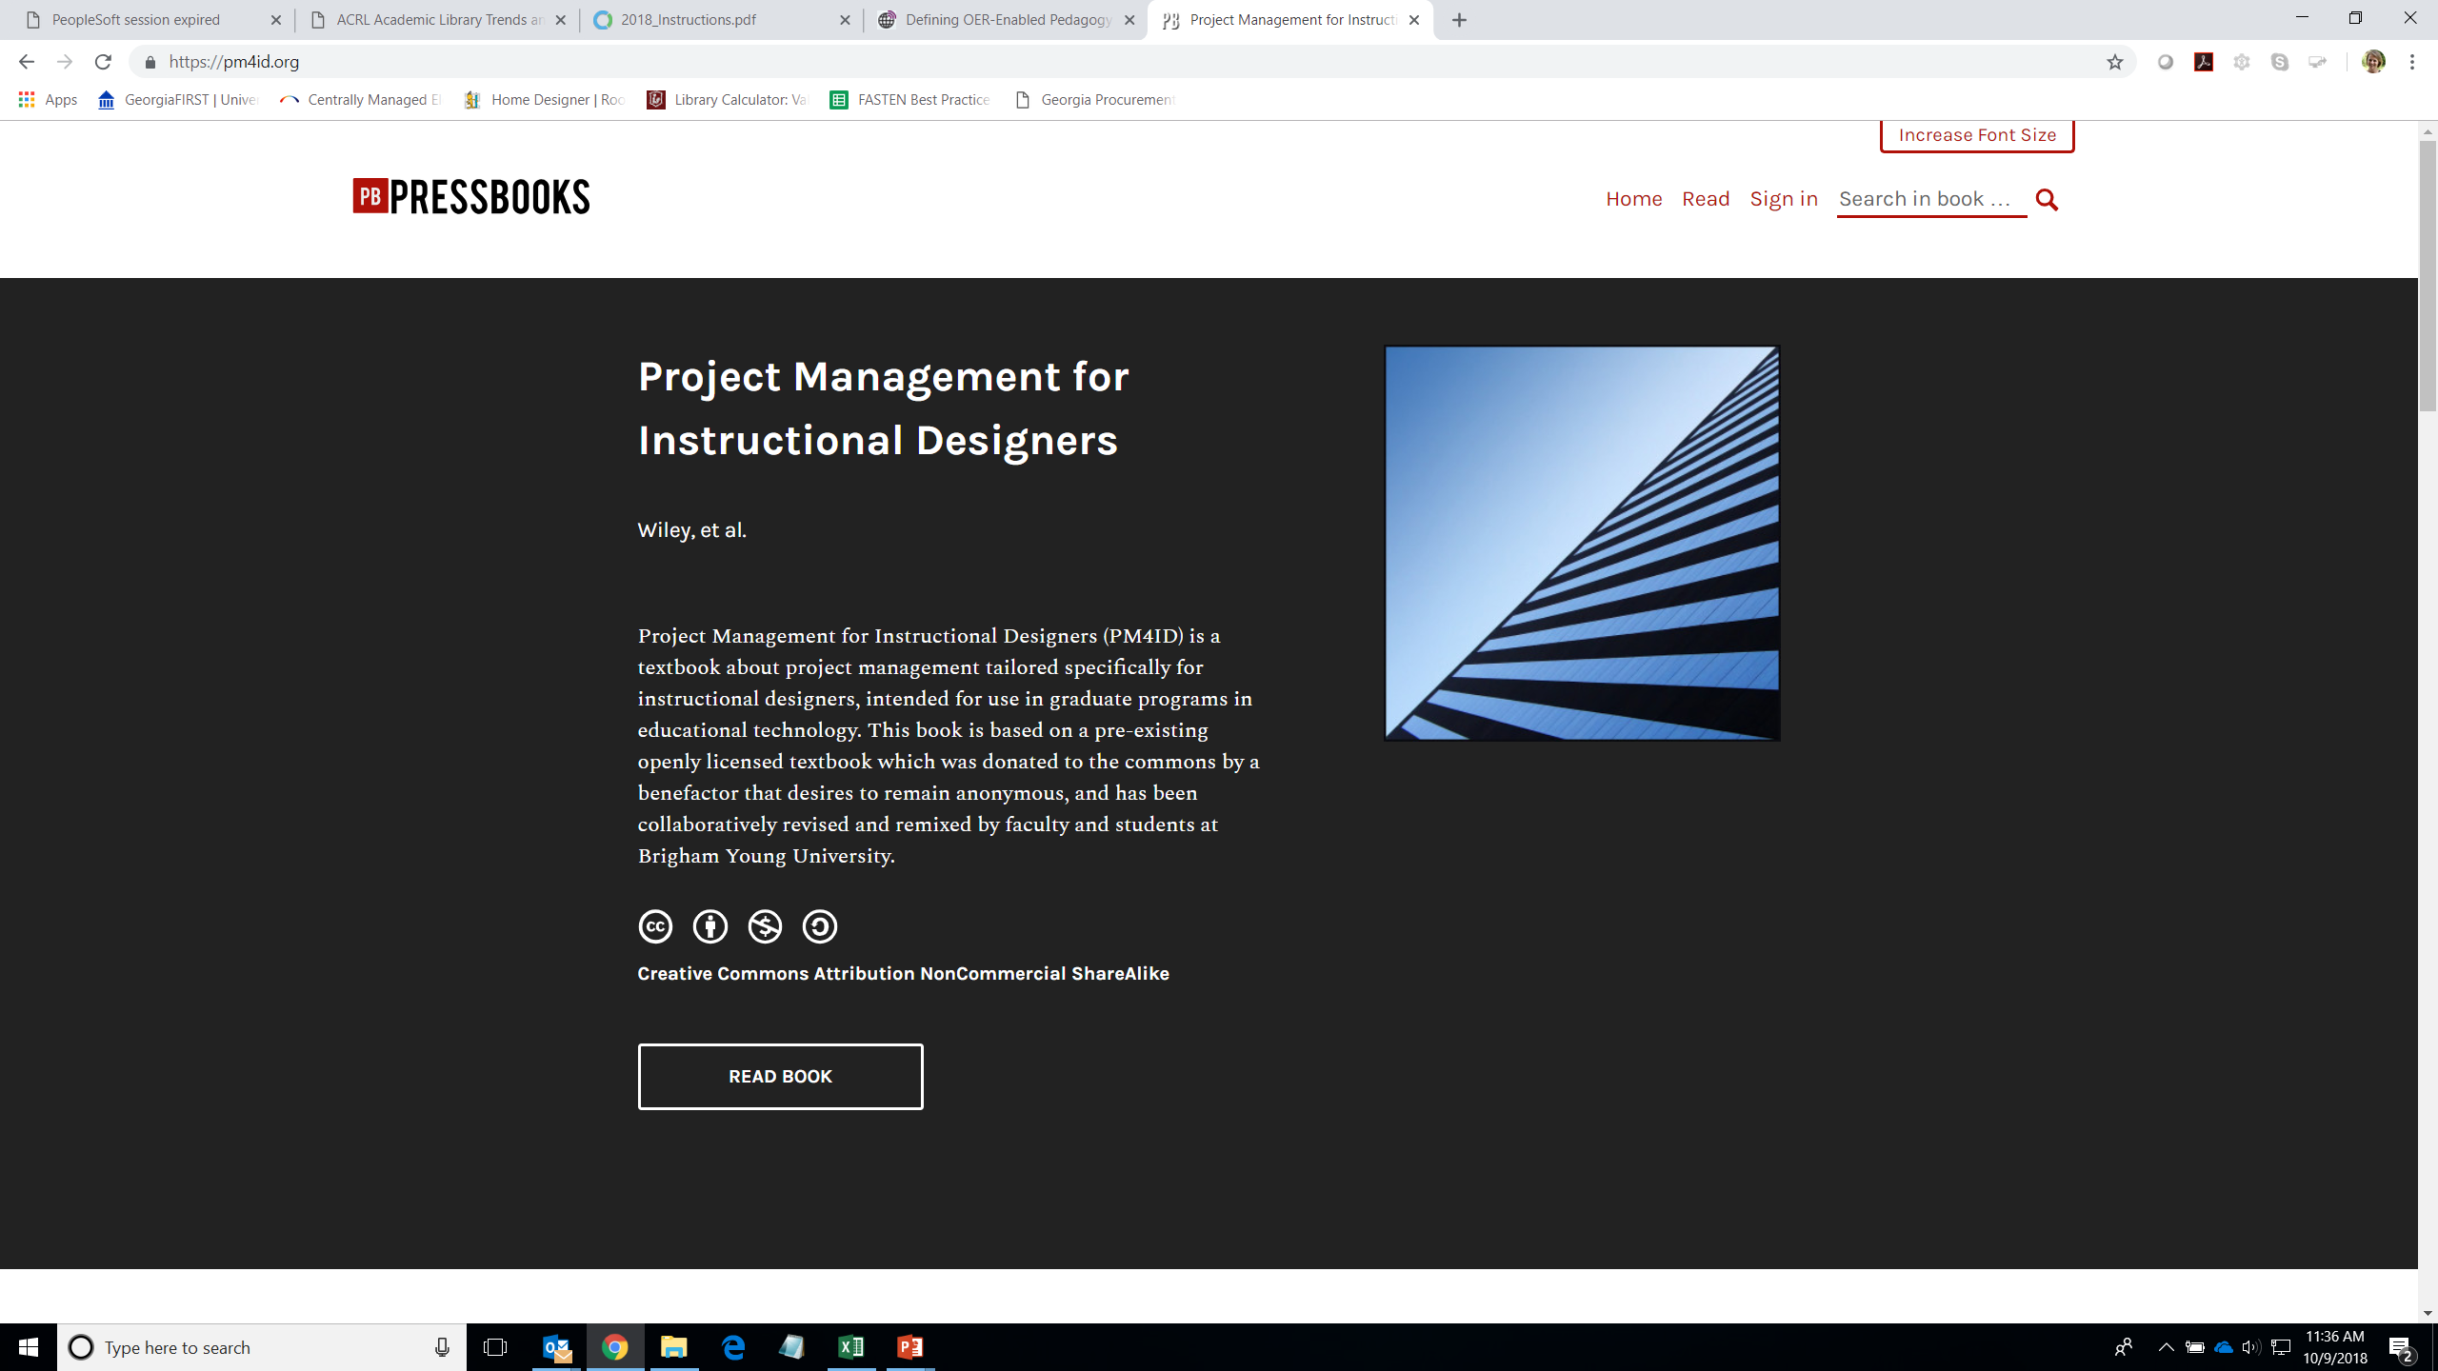

Slide 16
Examples
Open Textbooks
Wikipedia Entries

Slide 17
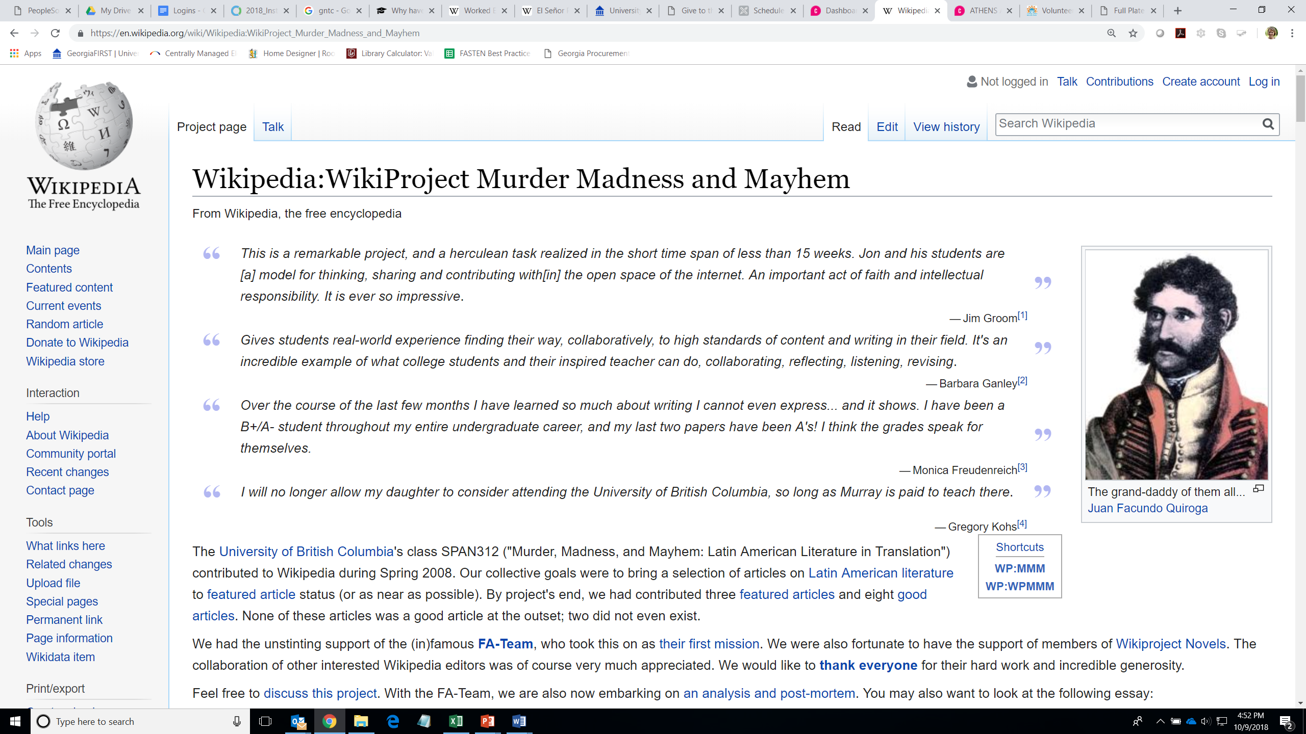

Slide 18
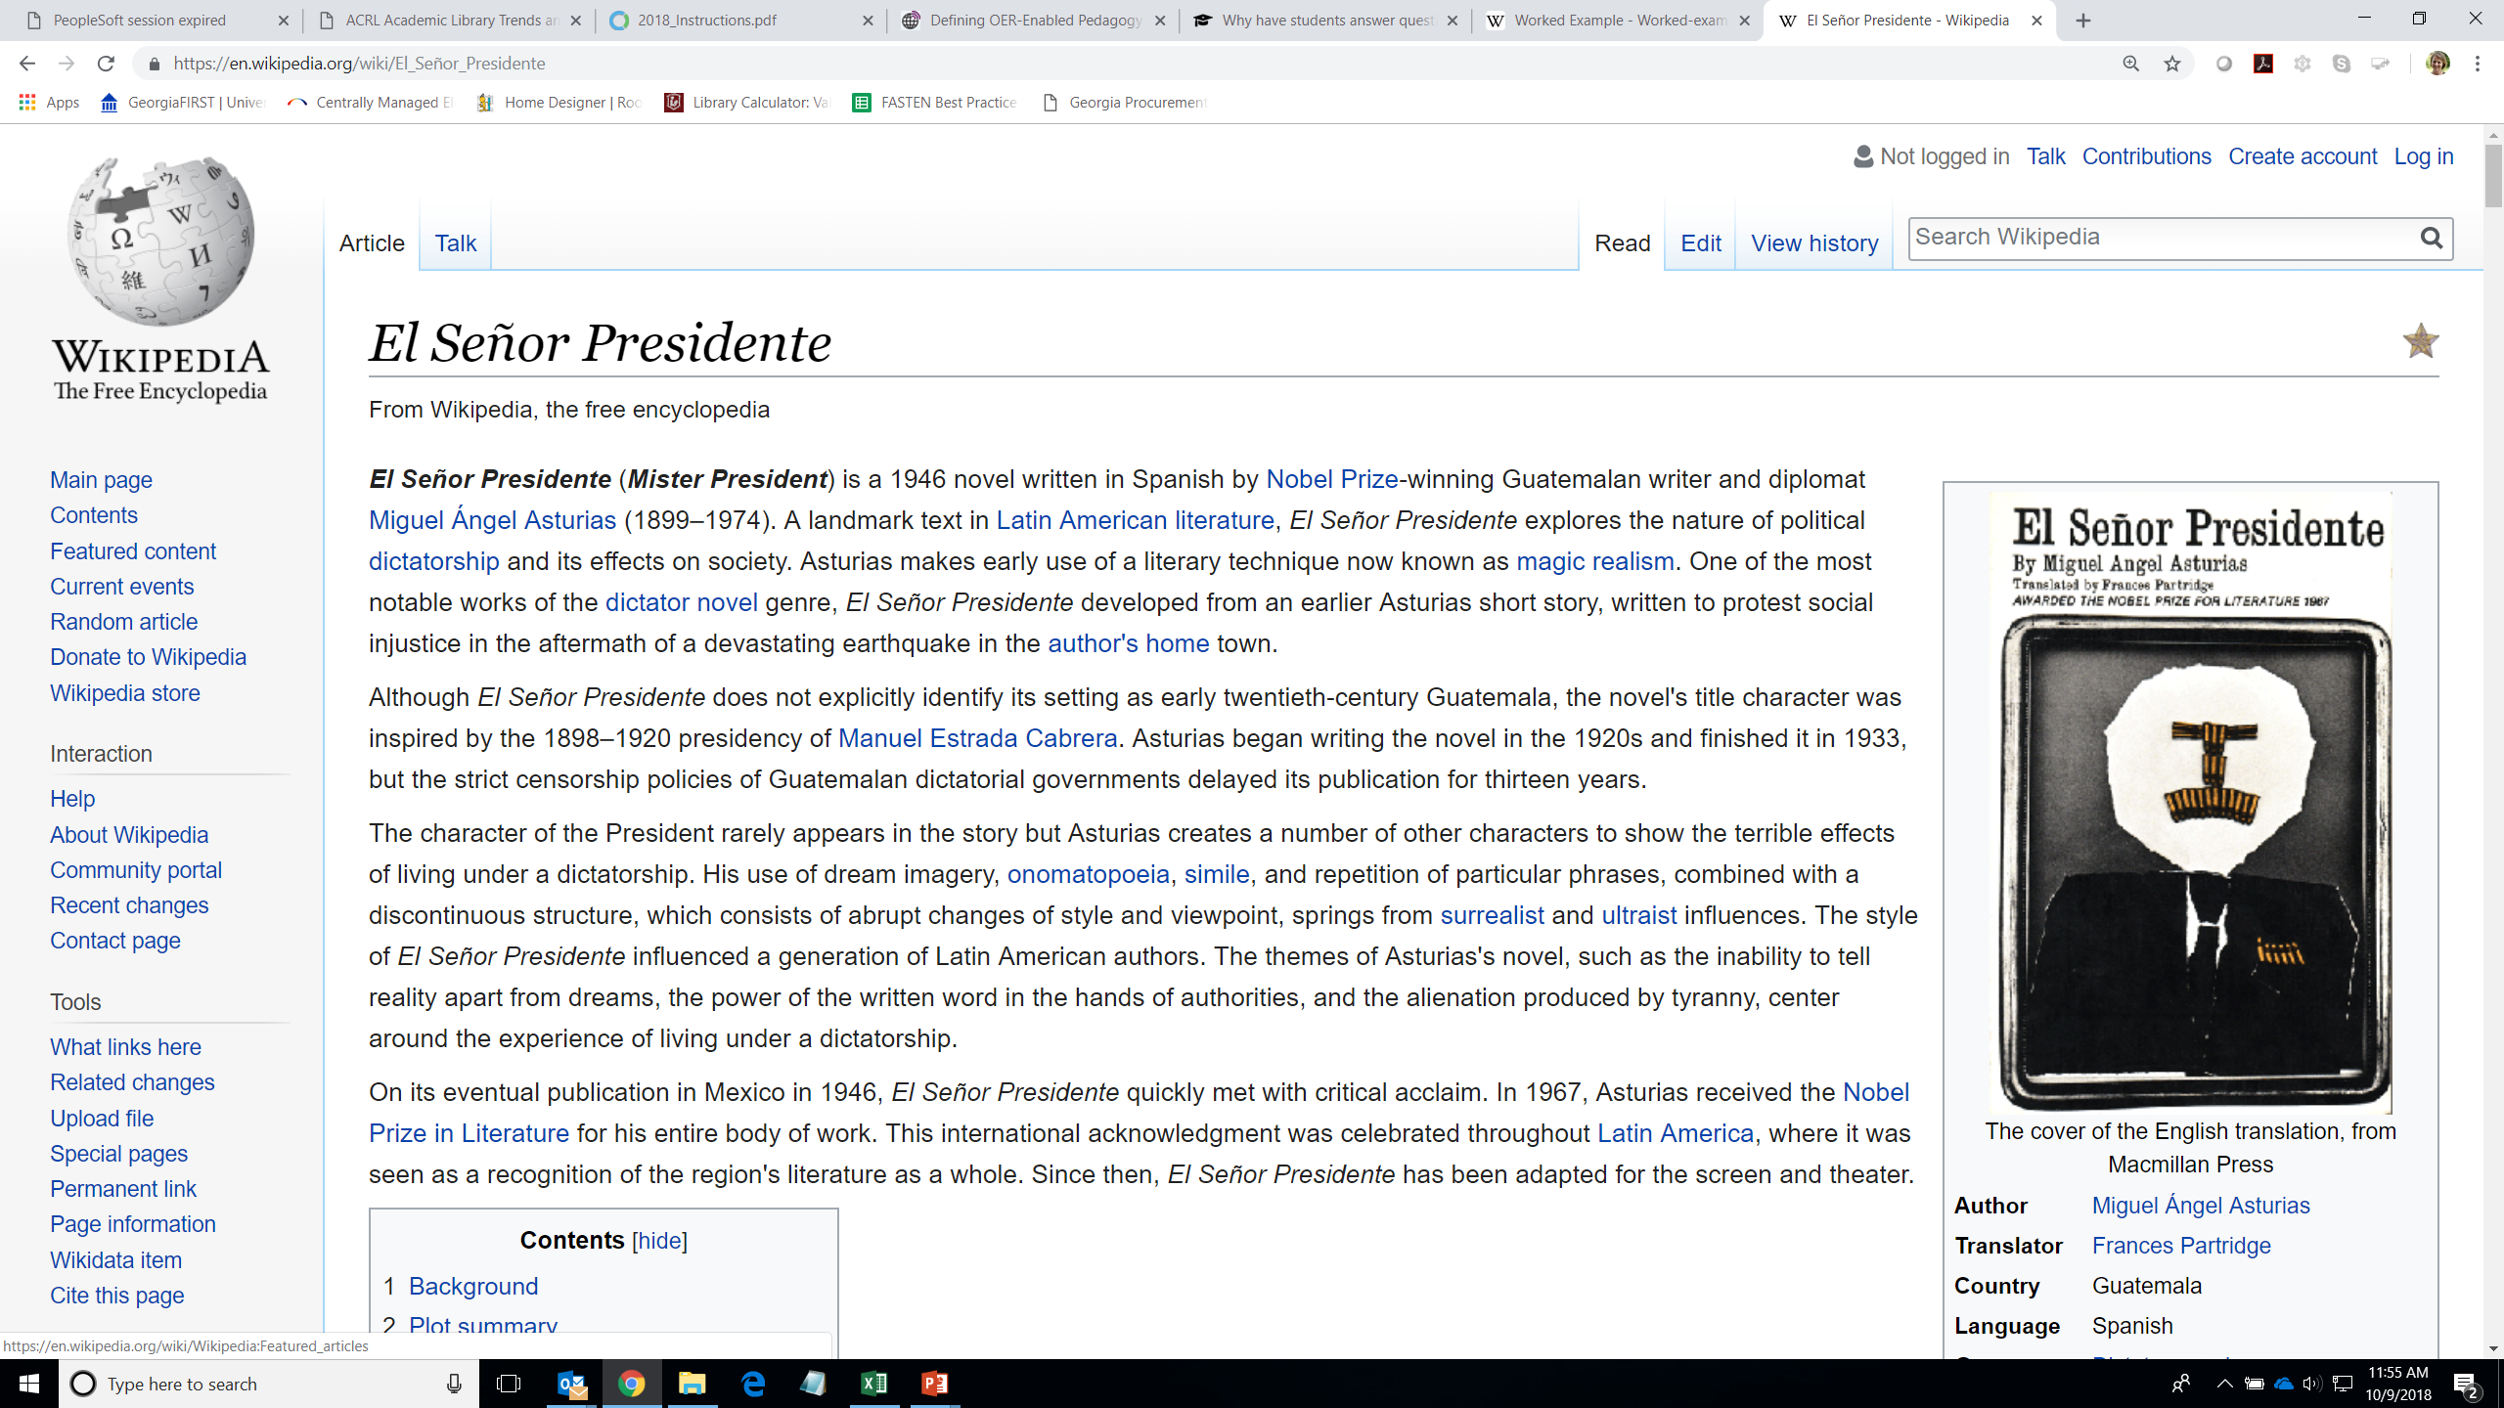

Slide 19
Examples
Open Textbooks
Wikipedia Entries
Math Problems

Slide 20
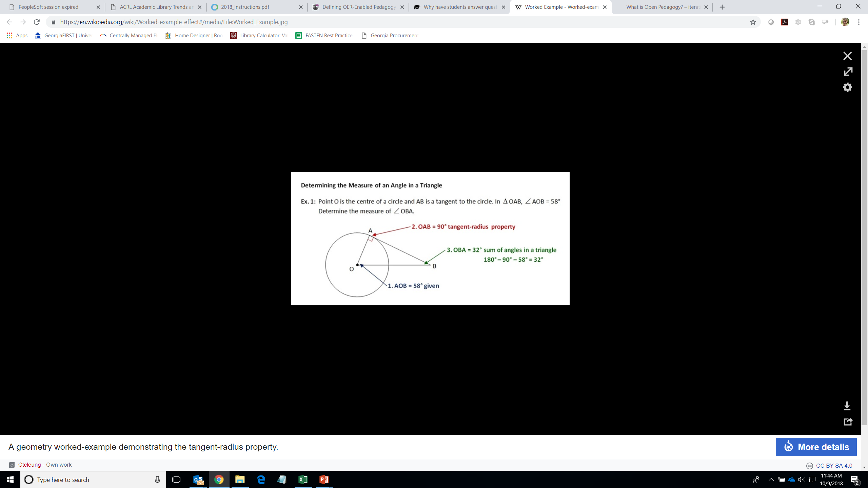
https://en.wikipedia.org/wiki/Worked-example_effect#/media/File:Worked_Example.jpg

Slide 21
Examples
Open Textbooks
Wikipedia Entries
Math Problems
Test Questions

Slide 22
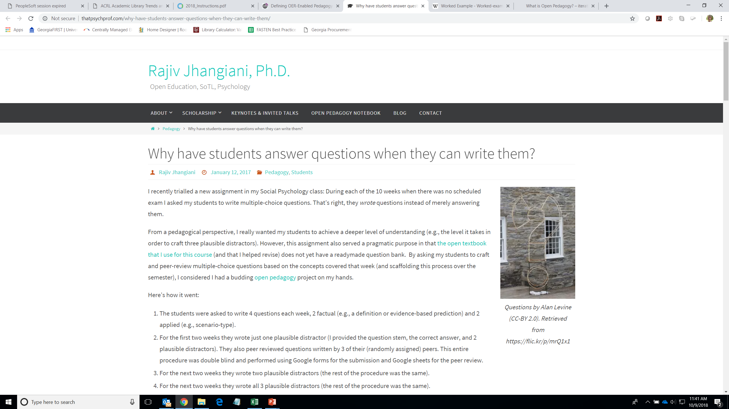

Slide 23
Integration with FLC Work?
Learn more about OER-enabled pedagogy
“Defining OER-Enabled Pedagogy,” David Wiley and John Hilton
International Review of Research in Open and Distributed Learning
Volume 19, Number 4, September 2018
http://www.irrodl.org/index.php/irrodl/article/view/3601/4724

Slide 24
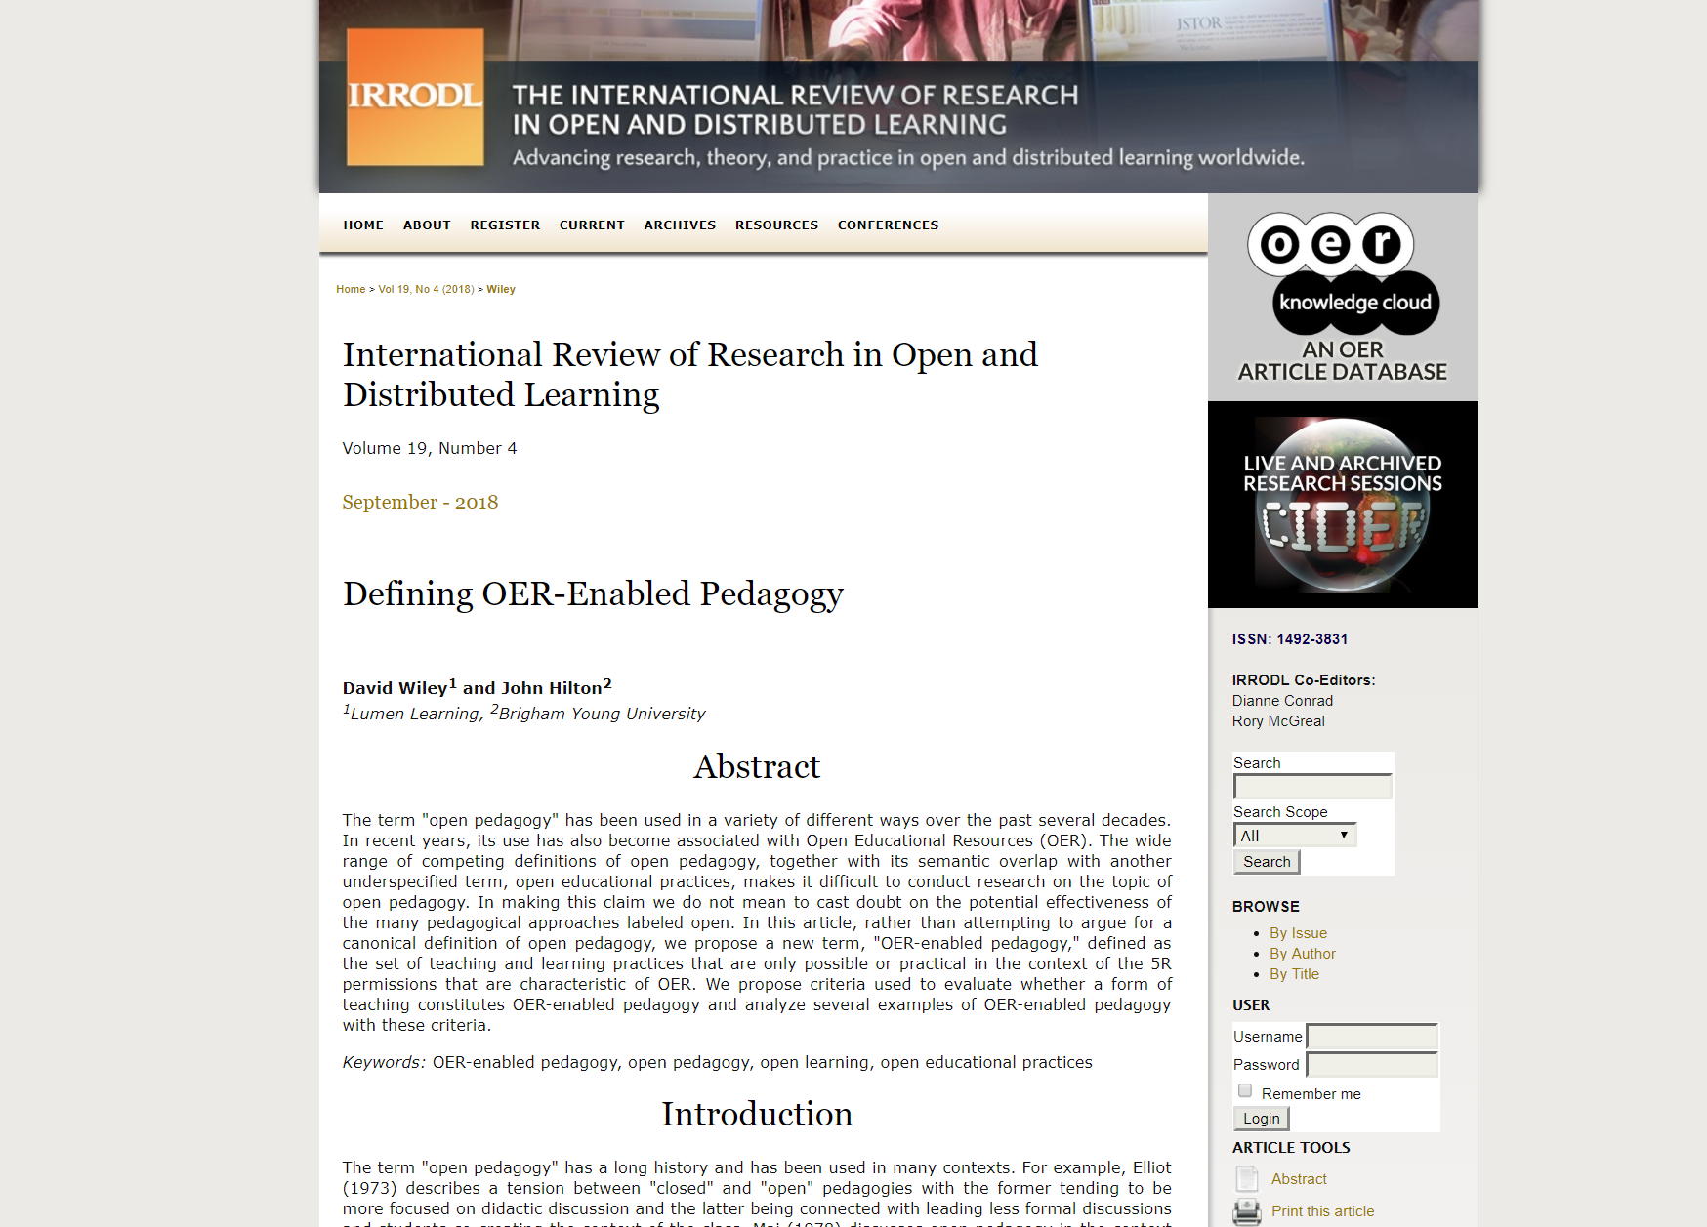

Slide 25
Integration with FLC Work?
Learn more about OER-enabled pedagogy
Consider using OER or textbook alternatives
Apply for an ALG grant!

Slide 26
Textbook Transformation Grants
Three different sizes (standard, large, mini)
Supporting faculty time, travel, materials, additional support, etc.
Proposals submitted, reviewed, awarded
Contract is with institution, not individual
All 26 USG institutions have been awarded grants

Slide 27
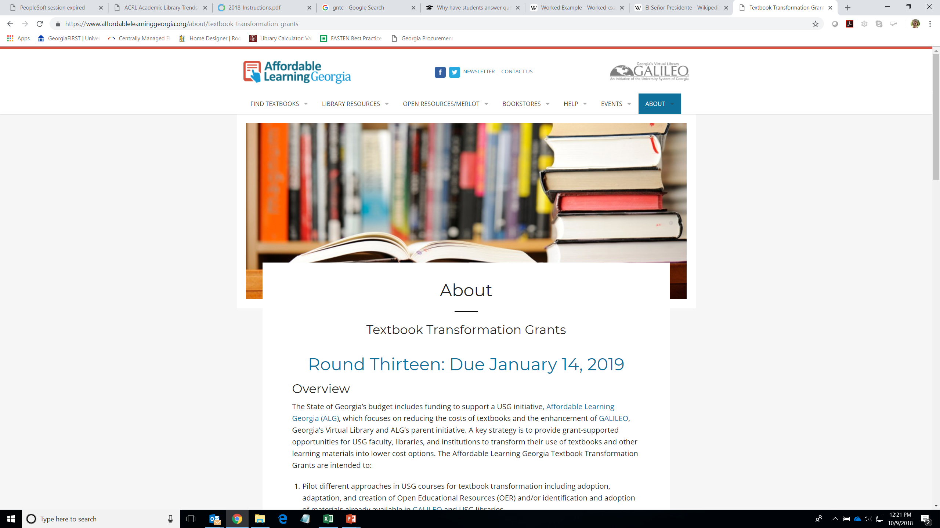

Slide 28
Integration with FLC Work?
Learn more about OER-enabled pedagogy
Consider using OER or textbook alternatives
Apply for an ALG grant!
Consider using OER-enabled pedagogy

Slide 29
Four-Part Test
Are students asked to create new artifacts (essays, poems, videos, songs, etc.) or revise/remix existing OER?
Does the new artifact have value beyond supporting the learning of its author?
Are students invited to publicly share their new artifacts or revised/remixed OER?
Are students invited to openly license their new artifacts or revised/remixed OER?

Slide 30
Integration with FLC Work?
Learn more about OER-enabled pedagogy
Consider using OER or textbook alternatives
Apply for an ALG grant!
Consider using OER-enabled pedagogy
Collect/create OER documents as part of your FLC (ALG can host!)

Slide 31
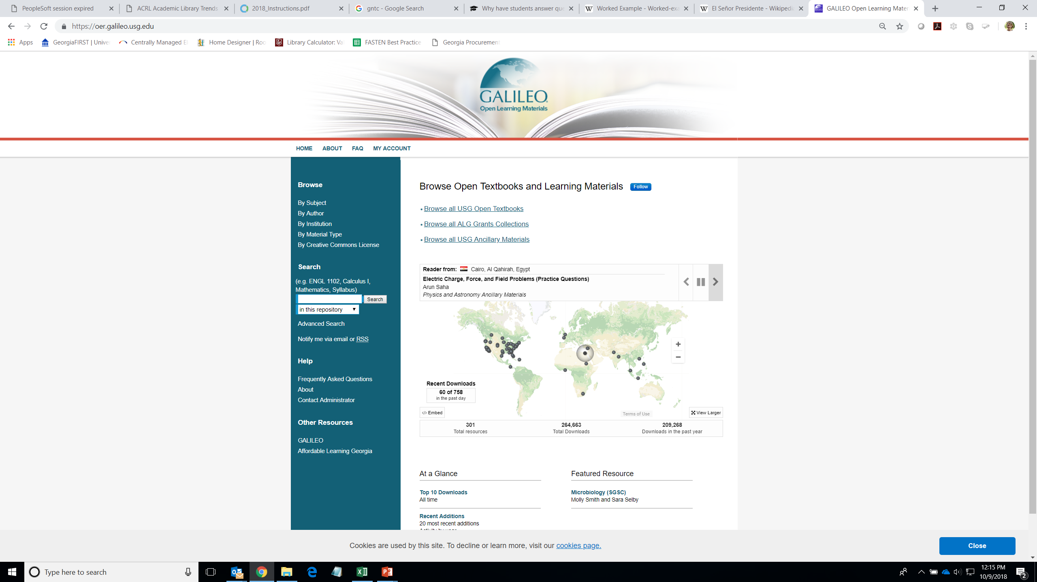

Slide 32
OER & OER-Enabled Pedagogy
OER
Allow instructors to revise/remix materials to meet their needs
Allow instructors to move beyond the constraints of a single text
Create value for the student (save money, reduce DFW rates, increase grades)
OER-Enabled Pedagogy
Allows students to learn in new and different ways
Allows students to revise/remix materials to create something new
Creates value beyond the student’s individual learning
Focus on pedagogical value

Slide 33
Resources?
Judy Orton Grissett, Georgia Southwestern State University
Director, Center for Teaching and Learning
ALG Campus Champion
Judy.Grissett@GSW.EDU
ALG Staff:
Jeff Gallant Marie Lasseter Lucy Harrison
Program Manager Director, Academic Technologies AVC for Lib Services
Jeff.Gallant@usg.edu Marie.Lasseter@usg.edu Lucy.Harrison@USG.edu
https://www.affordablelearninggeorgia.org/

