Slide 1

The Power of Small Changes
“Much of what we’ve been doing as teachers and students isn’t serving us well, but some comparatively simple changes could make a big difference.”
Brown, Roediger, McDaniel
Make it Stick (Harvard UP, 2014)
As you settle in, fill out a name tent:
Preferred name
I teach because… (≤ 3 words)
Notes:
Opening slide (visible as participants file in)

Slide 2
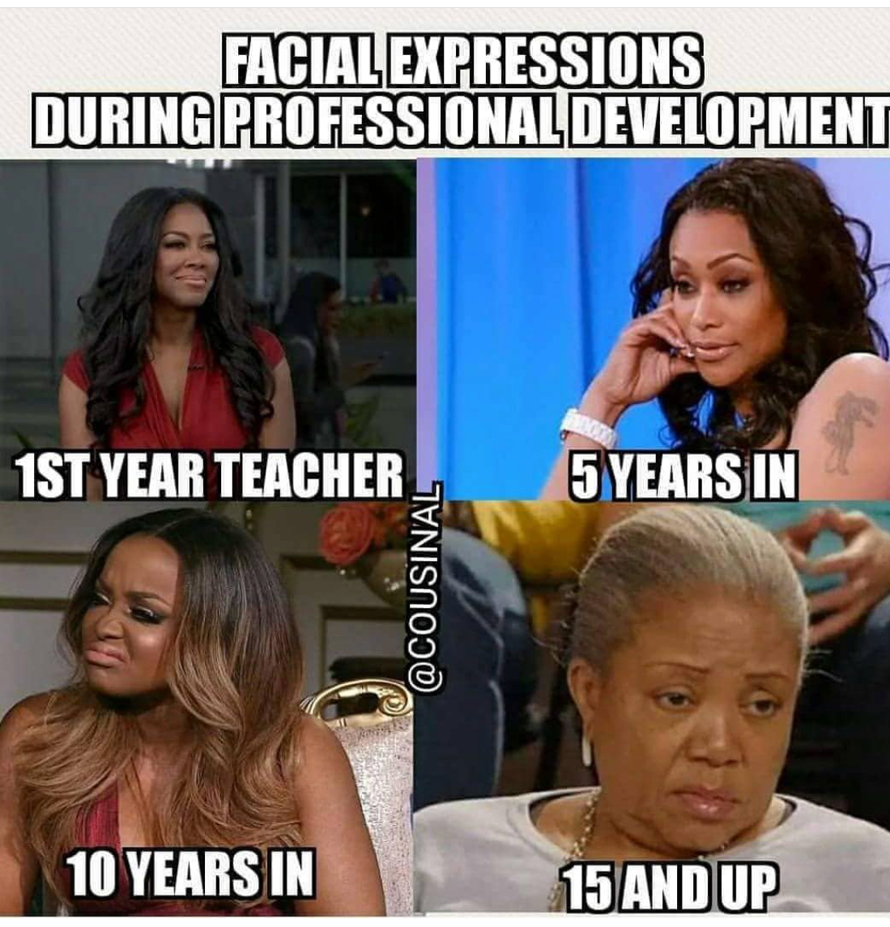

Slide 3
Small Teaching, Big Impact Integrating Lectures with Active Learning
Jordan Cofer, Abraham Baldwin Agricultural College
Justin Mays, Clayton State University
Meg Mittelstadt, University of Georgia
Pamela Moolenaar-Wirsiy, Georgia State University
Marina Smitherman, Dalton State College

Slide 4
Purpose
Goal
Introduce faculty to the idea that small teaching changes lead to major impacts on student learning.
Take-Away
Participants will develop two ideas for effective small changes that they can incorporate into their own courses.

Slide 5
Brainstorm…
In your course what does an ideal learner look like?
Notes:
If desired, bin answers into:
Students prepare for/anticipate learning
Students are attentive to learning
Students use/apply info, giving it significance
Student reflect/check their own learning

Slide 6
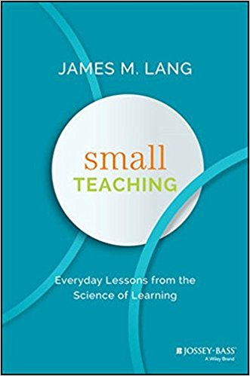
What is Small Teaching?
Brief (5 – 15 minute) interventions into individual learning session
Limited number of interventions or activities within an entire course
Minor changes to course design, assessment structure, or communication with students
Consider an example of “Small Teaching” from your own context.

Slide 7
Why Small Teaching?
Small teaching interventions which foster continuous cognitive engagement produce strong results.
IT WORKS!

Slide 8
Inventory of Small Teaching Practices
Preparation
First 5 minutes of class
Hitting pause
Last 5 minutes of class

Slide 9
Work Time
From the two inventory bins you scored the lowest on, pick two small teaching changes that you could implement in your teaching.
Write
Pair
Share
5 min
5 min
2 min

Slide 10
Post-it Parade
Summarize one of the small teaching changes you planned to make. Post your note to the legal-sized piece of paper on your table; feel free to browse others’ plans to identify ideas you may like to borrow/build upon.
Before you leave:
Exchange contact information with an accountability partner. Make plans to follow up with one another in one month about the implementation of your small teaching change.

Slide 11
Meta-Moment

Slide 12
Meta-Moment
Workshop run-of-show:
Pre-slide: quote on small changes
Introductions/goals/take-away
Brainstorm
Define “small teaching”
Why “small teaching”
Inventory
Work time
Post-it parade
Small Teaching (2016) TOC:
Knowledge
Retrieving
Predicting
Interleaving
Understanding
Connecting
Practicing
Self-explaining
Inspiration
Motivating
Growing
Expanding
Notes:
Pre-slide:
Motivating = preview quote of the workshop material
Brainstorm
Retrieving = low stakes quizzes, remind participants of prior knowledge that relates to today’s topics
Connecting = what do you already know about this
Define “Small Teaching” (“Consider an example of small teaching from their own context”)
Self-explaining = think aloud, peer instruction
Inventory
Retrieving = low stakes quizzes, remind participants of prior knowledge that relates to today’s topics
Connecting = what do you already know about this. (And, this meta-moment!)
Self-explaining = self explaining as you work
Throughout
Expanding – you’re here, engaging in self-development!

Slide 13
Questions? (& Answers)
Pamela Moolenaar-Wirsiy, Ph.D., M.P.A.
cetlpc@gsu.edu
678-891-2425

Slide 14
Resources
James, James M. (2016) Small Teaching: Everyday Lessons From the Science of Learning. Jossey-Bass Publishers.
Angelo, T. A. and Cross, K. P. (1993) Classroom Assessment Techniques: A Handbook for College Teachers. Jossey-Bass Publishers.
Barkley E. F. and Major C. H. (2018) Interactive Lecturing: A Handbook for College Faculty. Jossey-Bass Publishers.
ABLConnect: http://ablconnect.harvard.edu/
Pedagogy Unbound: http://www.pedagogyunbound.com/
Faculty Focus: http://www.facultyfocus.com/
Podcast, Teaching in Higher Ed: http://teachinginhighered.com/episodes/

